Slide 1
LEARN PYTHON

Slide 2
WHAT YOU’LL LEARN
Learn how to program in Python using the latest Python 3
Learn to preprocess data, clean data, and analyze large data.
Learn best practices when it comes to Data Science Workflow
Developer Environment setup for Data Science and Machine Learning
Explore large datasets and wrangle data using Pandas
Learn NumPy and how it is used in Machine Learning
Implement Machine Learning algorithms
Learn to use Matplotlib for Python Plotting
Supervised and Unsupervised Learning

Slide 3


WHAT IS PROGRAMMING LANGUAGE?

Slide 4
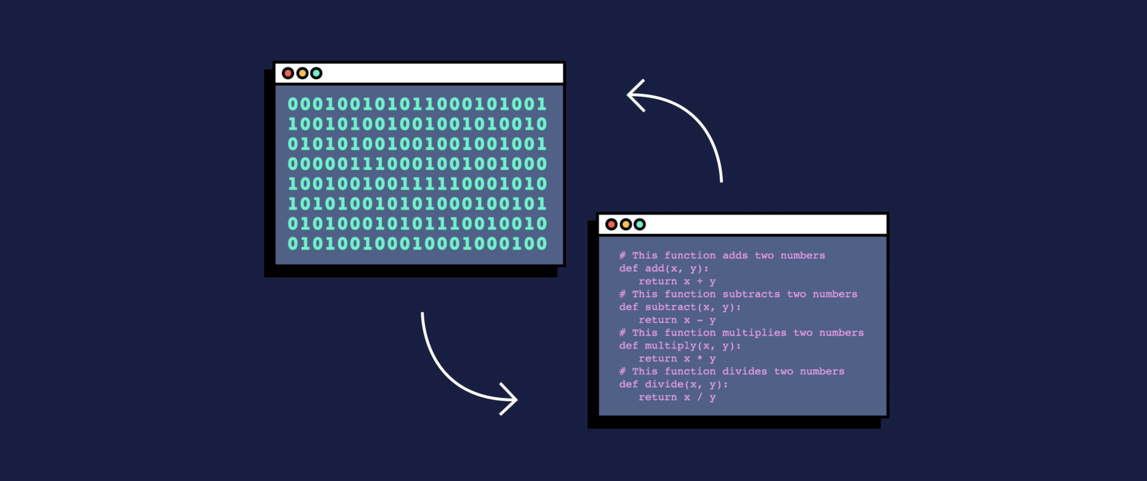
Put simply, programming is giving a set of instructions to a computer to execute. If you’ve ever cooked using a recipe before, you can think of yourself as the computer and the recipe’s author as a programmer. The recipe author provides you with a set of instructions which you read and then follow. The more complex the instructions, the more complex the result!

Slide 5
TYPES OF PROGRAMMING LANGUAGE:
Low-level programming language:
Low-level programming languages are closer to machine code, or binary. Therefore, they’re more difficult for humans to read (although they’re still easier to understand than 1s and 0s). The benefit of low-level languages is that they’re fast and offer precise control over how the computer will function.
High-level programming language:
High-level programming languages are closer to how humans communicate. High-level languages use words (like object, order, run, class, request, etc.) that are closer to the words we use in our everyday lives. This means they’re easier to program in than low-level programming languages, although they do take more time to translate into machine code for the computer.

Slide 6
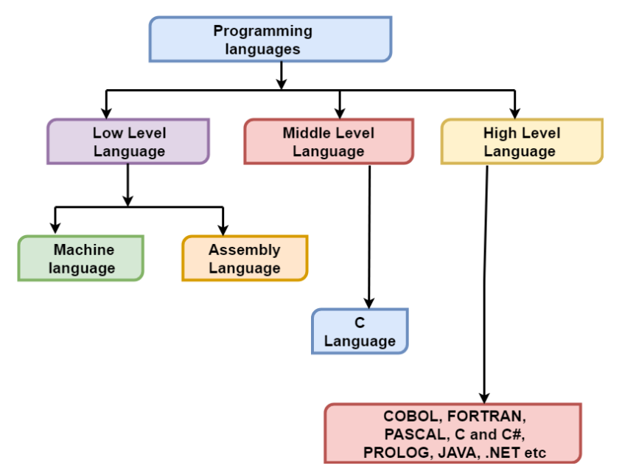

Slide 7
DIFFERENCE BETWEEN COMPILER AND INTERPRETER
Compiler | Interpreter
Compliers reads the source code, outputs executable code | The interpreter converts the source code line-by-line during RUN Time.
Translates software written in a higher-level language into instructions that computer can understand. It converts the text that a programmer writes into a format the CPU can understand. | Interpret completely translates a program written in a high-level language into machine level language. Interpreter allows evaluation and modification of the program while it is executing.
The process of compilation is relatively complicated. It spends a lot of time analyzing and processing the program. | Relatively less time spent for analyzing and processing the program
The executable result is some form of machine-specific binary code. | Program execution is relatively slow compared to compiler
C,C++,C#, Scala, Java all use complier. | PHP, Perl, Ruby, Python uses an interpreter

Slide 8
WHY PYTHON IS AN INTERPRETED LANGUAGE?
One popular advantage of interpreted languages is that they are platform-independent. As long as the Python bytecode and the Virtual Machine have the same version, Python bytecode can be executed on any platform (Windows, MacOS, etc).
Dynamic typing is another advantage. In static-typed languages like C++, you have to declare the variable type and any discrepancy like adding a string and an integer is checked during compile time. In strongly typed languages like Python, it is the job of the interpreter to check the validity of the variable types and operations performed.
DIS-ADVANTAGE:
Dynamic typing provides a lot of freedom, but simultaneously it makes your code risky and sometimes difficult to debug.
Python is often accused of being ‘slow’. Now while the term is relative and argued a lot, the reason for being slow is because the interpreter has to do extra work to have the bytecode instruction translated into a form that can be executed on the machine.

Slide 9
WHY PYTHON IS SO POPULAR?
Intuitiveness. The syntax (or "grammar" of Python, so to speak) is easy to understand.
Maturity. Python is a proven language with powerful capabilities allowing you to code just about anything you can dream up.
In-demand. Python developers are regularly hired by a host of companies throughout the world.
Remote-friendly. Coding ninjas and coding students alike merely require an internet connection to achieve their goals.
Python is the new Excel. The reason Python is being taught in business school is because Python is like Excel on steroids. With Python financial analysts, CEOs, and data-driven marketers can leverage the power of Python to crunch big data.

Slide 10
WHY PYTHON 3:
Easier user input. A common early lesson is to take a user’s typed-in data and pass it off to a simple script to create a list of information. Python 3 improves upon this process.
Improved number management. Python 3 includes some math-calculation improvements that are critical for many applications.
Popular add-ons are supported. You’ll also learn the concept of extensions called "modules" and "packages" that are not included in the default Python 3 installation. As you grow, installing and using these will become part of your daily repertoire. Nearly all of the most popular packages have been Python 3-ready for years.
Unicode support. Did you know that emojis are Unicode characters? No emojis in Python 2!

Slide 11
LEARNING PROGRAMMING LANUGAGE
Term
Data Types
Actions
Best Practices

Slide 12
INSTALL PYHTON
https://www.python.org/downloads/
https://replit.com/
https://glot.io/

Slide 13
PYTHON COMMENTS:
Comments can be used to explain Python code.
Used to make the code more readable.
Comments can be used to prevent execution when testing code.
Comments starts with a #, and Python will ignore them.
Types:
Single Line Comments
Multi Line Comments

Slide 14
PYTHON VARIABLES:
Variables are containers for storing data values.
Python has no command for declaring a variable.
A variable is created the moment you first assign a value to it.
Variables do not need to be declared with any particular type, and can even change type after they have been set.
Variable names are case-sensitive.
Example:
x = 4 # x is of type int x = "Sally" # x is now of type str print(x)

Slide 15
VARIABLE NAME PRACTICES:
A variable can have a short name (like x and y) or a more descriptive name (age, carname, total_volume). Rules for Python variables:
A variable name must start with a letter or the underscore character
A variable name cannot start with a number
A variable name can only contain alpha-numeric characters and underscores (A-z, 0-9, and _ )
Variable names are case-sensitive (age, Age and AGE are three different variables)
Example:
myvar = "John"
my_var = "John"
_my_var = "John"
myVar = "John"
MYVAR = "John"
myvar2 = "John"

Slide 16
MULTI WORDS VARIABLE NAMES:
Variable names with more than one word can be difficult to read.
There are several techniques you can use to make them more readable
Camel Case
Each word, except the first, starts with a capital letter:
Example: myVariableName = "John"
Pascal Case
Each word starts with a capital letter:
Example: MyVariableName = "John"
Snake Case
Each word is separated by an underscore character:
Example: my_variable_name = "John"

Slide 17
PYTHON VARIABLES - ASSIGN MULTIPLE VALUES:
Python allows you to assign values to multiple variables in one line:
Example:
x, y, z = "Orange", "Banana", "Cherry"
print(x)
print(y)
print(z)

Slide 18
ONE VALUE TO MULTIPLE VARIABLES
And you can assign the same value to multiple variables in one line:
Example:
x = y = z = "Orange“
print(x)
print(y)
print(z)

Slide 19
UNPACK A COLLECTION:
If you have a collection of values in a list, tuple etc. Python allows you extract the values into variables. This is called unpacking.
Example:
fruits = ["apple", "banana", "cherry"]
x, y, z = fruits
print(x)
print(y)
print(z)

Slide 20
PYTHON - OUTPUT VARIABLES
The Python print statement is often used to output variables.
To combine both text and a variable, Python uses the + character:
x = "awesome"
print("Python is " + x)
You can also use the + character to add a variable to another variable:
x = "Python is "
y = "awesome"
z = x + y
print(z)
For numbers, the + character works as a mathematical operator:
x = 5
y = 10
print(x + y)
If you try to combine a string and a number, Python will give you an error

Slide 21
PYTHON - GLOBAL VARIABLES
Variables that are created outside of a function (as in all of the examples above) are known as global variables.
Global variables can be used by everyone, both inside of functions and outside.
Example:
x = "awesome"
def myfunc():
print("Python is " + x)
myfunc()
If you create a variable with the same name inside a function, this variable will be local, and can only be used inside the function. The global variable with the same name will remain as it was, global and with the original value.

Slide 22
PYTHON - GLOBAL KEYWORD
Normally, when you create a variable inside a function, that variable is local, and can only be used inside that function.
To create a global variable inside a function, you can use the global keyword.
def myfunc():
global x
x = "fantastic"
myfunc()
print("Python is " + x)
Also, use the global keyword if you want to change a global variable inside a function.
x = "awesome"
def myfunc():
global x
x = "fantastic"
myfunc()
print("Python is " + x)

Slide 23
DATA TYPES:
Text Type: str
Numeric Types: int, float, complex
Sequence Types: list, tuple, range
Mapping Type: dict
Set Types: set, frozenset
Boolean Type: bool
Binary Types: bytes, bytearray, memoryview

Slide 24
PYTHON NUMBERS
There are three numeric types in Python:
Int
Int, or integer, is a whole number, positive or negative, without decimals, of unlimited length.
Float
Float, or "floating point number" is a number, positive or negative, containing one or more decimals.
Float can also be scientific numbers with an "e" to indicate the power of 10.
Complex
Complex numbers are written with a "j" as the imaginary part:

Slide 25
PYTHON CASTING:
If you want to specify the data type of a variable, this can be done with casting.
Example:
x = str(3) # x will be '3'
y = int(3) # y will be 3
z = float(3) # z will be 3.0

Slide 26
GET THE TYPE:
You can get the data type of a variable with the type() function.
Example:
x = 5
y = "John"
print(type(x))
print(type(y))

Slide 27
PYTHON BOOLEANS
Booleans represent one of two values: True or False.
In programming you often need to know if an expression is True or False.
You can evaluate any expression in Python, and get one of two answers, True or False.
When you compare two values, the expression is evaluated, and Python returns the Boolean answer:
print(10 > 9)
print(10 == 9)
print(10 < 9)

Slide 28
BOOL()
The bool() function allows you to evaluate any value, and give you True or False in return,
print(bool("Hello"))
print(bool(15))
Most Values are True
Some Values are False

Slide 29
MOST VALUES ARE TRUE
Almost any value is evaluated to True if it has some sort of content.
Any string is True, except empty strings.
Any number is True, except 0.
Any list, tuple, set, and dictionary are True, except empty ones.
bool("abc")
bool(123)
bool(["apple", "cherry", "banana"])

Slide 30
SOME VALUES ARE FALSE:
In fact, there are not many values that evaluate to False, except empty values, such as (), [], {}, "", the number 0, and the value None. And of course, the value False evaluates too False.
bool(False)
bool(None)
bool(0)
bool("")
bool(())
bool([])
bool({})

Slide 31
PYTHON OPERATORS
Operators are used to perform operations on variables and values.
Python divides the operators in the following groups:
Arithmetic operators
Assignment operators
Comparison operators
Logical operators
Identity operators
Membership operators
Bitwise operators

Slide 32

ARITHMETIC OPERATORS
Operator | Name | Example
+ | Addition | x + y
- | Subtraction | x - y
* | Multiplication | x * y
/ | Division | x / y
% | Modulus | x % y
** | Exponentiation | x ** y
// | Floor division | x // y

Slide 33
ASSIGNMENT OPERATORS
Operator | Example | Same As
= | x = 5 | x = 5
+= | x += 3 | x = x + 3
-= | x -= 3 | x = x - 3
*= | x *= 3 | x = x * 3
/= | x /= 3 | x = x / 3
%= | x %= 3 | x = x % 3
//= | x //= 3 | x = x // 3
**= | x **= 3 | x = x ** 3
&= | x &= 3 | x = x & 3
|= | x |= 3 | x = x | 3
^= | x ^= 3 | x = x ^ 3
>>= | x >>= 3 | x = x >> 3
<<= | x <<= 3 | x = x << 3

Slide 34
COMPARISON OPERATORS
Operator | Name | Example
== | Equal | x == y
!= | Not equal | x != y
> | Greater than | x > y
< | Less than | x < y
>= | Greater than or equal to | x >= y
<= | Less than or equal to | x <= y

Slide 35
LOGICAL OPERATORS
Operator | Description | Example
and | Returns True if both statements are true | x < 5 and x < 10
or | Returns True if one of the statements is true | x < 5 or x < 4
not | Reverse the result, returns False if the result is true | not(x < 5 and x < 10)

Slide 36
IDENTITY OPERATORS
Operator | Description | Example
is | Returns True if both variables are the same object | x is y
is not | Returns True if both variables are not the same object | x is not y

Slide 37
MEMBERSHIP OPERATORS
Operator | Description | Example
in | Returns True if a sequence with the specified value is present in the object | x in y
not in | Returns True if a sequence with the specified value is not present in the object | x not in y

Slide 38
BITWISE OPERATORS
Operator | Name | Description
& | AND | Sets each bit to 1 if both bits are 1
| | OR | Sets each bit to 1 if one of two bits is 1
^ | XOR | Sets each bit to 1 if only one of two bits is 1
~ | NOT | Inverts all the bits
<< | Zero fill left shift | Shift left by pushing zeros in from the right and let the leftmost bits fall off
>> | Signed right shift | Shift right by pushing copies of the leftmost bit in from the left, and let the rightmost bits fall off

Slide 39
PYTHON STRINGS
Strings in python are surrounded by either single quotation marks, or double quotation marks
'hello' is the same as "hello"
You can display a string literal with the print() function
You can assign a multiline string to a variable by using three quotes
Python does not have a character data type, a single character is simply a string with a length of 1
Square brackets can be used to access elements of the string
we can loop through the characters in a string, with a for loop
To check if a certain phrase or character is present in a string, we can use the keyword in
To check if a certain phrase or character is NOT present in a string, we can use the keyword not in

Slide 40
SLICING STRINGS:
You can return a range of characters by using the slice syntax
Specify the start index and the end index, separated by a colon, to return a part of the string
By leaving out the start index, the range will start at the first character
By leaving out the end index, the range will go to the end
Use negative indexes to start the slice from the end of the string

Slide 41
PYTHON COLLECTIONS (ARRAYS)
There are four collection data types in the Python programming language:
List is a collection which is ordered and changeable. Allows duplicate members.
Tuple is a collection which is ordered and unchangeable. Allows duplicate members.
Set is a collection which is unordered and unindexed. No duplicate members.
Dictionary is a collection which is unordered and changeable. No duplicate members.

Slide 42
PYTHON LISTS
Lists are used to store multiple items in a single variable.
Lists are created using square brackets.
List items are ordered, changeable, and allow duplicate values.
List items are indexed, the first item has index [0], the second item has index [1] etc.
List items can be of any data type.
A list can contain different data types.
It is also possible to use the list() constructor when creating a new list.
len() function is used to determine how many items a list.
Example: mylist = ["apple", "banana", "cherry"]

Slide 43
ACCESS LIST ITEMS
List items are indexed and you can access them by referring to the index number:
Example:
thislist = ["apple", "banana", "cherry"]
print(thislist[1])
Negative indexing means start from the end, -1 refers to the last item, -2 refers to the second last item etc.
Example:
thislist = ["apple", "banana", "cherry"]
print(thislist[-1])
You can specify a range of indexes by specifying where to start and where to end the range.
Example:
thislist = ["apple", "banana", "cherry", "orange", "kiwi", "melon", "mango"]
print(thislist[2:5])

Slide 44
CHANGE LIST ITEMS
To change the value of a specific item, refer to the index number.
thislist = ["apple", "banana", "cherry"]
thislist[1] = "blackcurrant"
print(thislist)
To change the value of items within a specific range, define a list with the new values, and refer to the range of index numbers where you want to insert the new values:
thislist = ["apple", "banana", "cherry", "orange", "kiwi", "mango"]
thislist[1:3] = ["blackcurrant", "watermelon"]
print(thislist)
To insert a new list item, without replacing any of the existing values, we can use the insert() method.
thislist = ["apple", "banana", "cherry"]
thislist.insert(2, "watermelon")
print(thislist)

Slide 45
ADD LIST ITEMS
To add an item to the end of the list, use the append() method.
thislist = ["apple", "banana", "cherry"]
thislist.append("orange")
print(thislist)
To insert a list item at a specified index, use the insert() method.
thislist = ["apple", "banana", "cherry"]
thislist.insert(1, "orange")
print(thislist)
To append elements from another list to the current list, use the extend() method.
thislist = ["apple", "banana", "cherry"]
tropical = ["mango", "pineapple", "papaya"]
thislist.extend(tropical)
print(thislist)

Slide 46
REMOVE LIST ITEMS
The remove() method removes the specified item.
thislist = ["apple", "banana", "cherry"]
thislist.remove("banana")
print(thislist)
The pop() method removes the specified index.
thislist = ["apple", "banana", "cherry"]
thislist.pop(1)
print(thislist)
The clear() method empties the list.
thislist = ["apple", "banana", "cherry"]
thislist.clear()
print(thislist)

Slide 47
LOOP LISTS
You can loop through the list items by using a for loop
thislist = ["apple", "banana", "cherry"]
for x in thislist:
print(x)
You can loop through the list items by using a while loop.
thislist = ["apple", "banana", "cherry"]
i = 0
while i < len(thislist):
print(thislist[i])
i = i + 1
List Comprehension offers the shortest syntax for looping through lists
thislist = ["apple", "banana", "cherry"]
[print(x) for x in thislist]

Slide 48
LIST COMPREHENSION
List comprehension offers a shorter syntax when you want to create a new list based on the values of an existing list.
Using for loop,
fruits = ["apple", "banana", "cherry", "kiwi", "mango"]
newlist = []
for x in fruits:
if "a" in x:
newlist.append(x)
print(newlist)
Using List comprehension,
fruits = ["apple", "banana", "cherry", "kiwi", "mango"]
newlist = [x for x in fruits if "a" in x]
print(newlist)

Slide 49
SORT LISTS
List objects have a sort() method that will sort the list alphanumerically, ascending, by default.
To sort descending, use the keyword argument reverse = True
By default the sort() method is case sensitive.
The reverse() method reverses the current sorting order of the elements

Slide 50
COPY LIST
You cannot copy a list simply by typing list2 = list1, because: list2 will only be a reference to list1, and changes made in list1 will automatically also be made in list2.
There are ways to make a copy, one way is to use the built-in List method copy().
Another way to make a copy is to use the built-in method list().

Slide 51
JOIN LIST
There are several ways to join, or concatenate, two or more lists in Python.
One of the easiest ways are by using the + operator.
Another way to join two lists are by appending all the items from list2 into list1, one by one.
Or you can use the extend() method, which purpose is to add elements from one list to another list.

Slide 52
LIST METHODS
Method | Description
append() | Adds an element at the end of the list
clear() | Removes all the elements from the list
copy() | Returns a copy of the list
count() | Returns the number of elements with the specified value
extend() | Add the elements of a list (or any iterable), to the end of the current list
index() | Returns the index of the first element with the specified value
insert() | Adds an element at the specified position
pop() | Removes the element at the specified position
remove() | Removes the item with the specified value
reverse() | Reverses the order of the list
sort() | Sorts the list

Slide 53
TUPLES
Tuples are used to store multiple items in a single variable.
A tuple is a collection which is ordered, unchangeable and allow duplicate values.
Tuples are written with round brackets.
To determine how many items a tuple has, use the len() function.
To create a tuple with only one item, you have to add a comma after the item, otherwise Python will not recognize it as a tuple.
Tuple items can be of any data type.
A tuple can contain different data types.
Tuples are defined as objects with the data type 'tuple'

Slide 54
LIST vs TUPLE
LIST | TUPLE
Lists are mutable | Tuples are immutable
Implication of iterations is Time-consuming | The implication of iterations is comparatively Faster
The list is better for performing operations, such as insertion and deletion. | Tuple data type is appropriate for accessing the elements
Lists consume more memory | Tuple consume less memory as compared to the list
Lists have several built-in methods | Tuple does not have many built-in methods.
The unexpected changes and errors are more likely to occur | In tuple, it is hard to take place.

Slide 55
SET
Sets are used to store multiple items in a single variable.
A set is a collection which is both unordered and unindexed.
Sets are written with curly brackets.
Set items are unordered, unchangeable, and do not allow duplicate values.
Set items can be of any data type.
A set can contain different data types.

Slide 56
PYTHON DICTIONARIES
Dictionaries are used to store data values in key:value pairs.
A dictionary is a collection which is ordered, changeable and does not allow duplicates.
Dictionaries are written with curly brackets, and have keys and values
As of Python version 3.7, dictionaries are ordered. In Python 3.6 and earlier, dictionaries are unordered.
When we say that dictionaries are ordered, it means that the items have a defined order, and that order will not change.
Unordered means that the items does not have a defined order, you cannot refer to an item by using an index.
To determine how many items a dictionary has, use the len() function.

Slide 57
ACCESS DICTIONARY ITEMS
You can access the items of a dictionary by referring to its key name, inside square brackets.
There is also a method called get() that will give you the same result
The keys() method will return a list of all the keys in the dictionary
The list of the keys is a view of the dictionary, meaning that any changes done to the dictionary will be reflected in the keys list
The values() method will return a list of all the values in the dictionary
The list of the values is a view of the dictionary, meaning that any changes done to the dictionary will be reflected in the values list
The items() method will return each item in a dictionary, as tuples in a list
To determine if a specified key is present in a dictionary use the in keyword

Slide 58
PYTHON IF ... ELSE
Python supports the usual logical conditions from mathematics, these conditions can be used in several ways, most commonly in "if statements" and loops.
An "if statement" is written by using the if keyword.
The elif keyword is pythons way of saying "if the previous conditions were not true, then try this condition".
The else keyword catches anything which isn't caught by the preceding conditions.
Equals: a == b
Not Equals: a != b
Less than: a < b
Less than or equal to: a <= b
Greater than: a > b
Greater than or equal to: a >= b

Slide 59
PYTHON LOOPS
WHILE LOOP
With the while loop we can execute a set of statements as long as a condition is true.
The while loop requires relevant variables to be ready, in this example we need to define an indexing variable, i, which we set to 1.
With the continue statement we can stop the current iteration, and continue with the next.
With the else statement we can run a block of code once when the condition no longer is true.
FOR LOOP
A for loop is used for iterating over a sequence (that is either a list, a tuple, a dictionary, a set, or a string).
This is less like the for keyword in other programming languages, and works more like an iterator method as found in other object-orientated programming languages.
With the for loop we can execute a set of statements, once for each item in a list, tuple, set etc.

Slide 60
PYTHON FUNCTIONS
A function is a block of code which only runs when it is called.
You can pass data, known as parameters, into a function.
A function can return data as a result.
To call a function, use the function name followed by parenthesis
Information can be passed into functions as arguments.
Arguments are specified after the function name, inside the parentheses. You can add as many arguments as you want, just separate them with a comma.

Slide 61
PYTHON LAMBDA
A lambda function can take any number of arguments, but can only have one expression.
Syntax
lambda arguments : expression
The expression is executed, and the result is returned
Lambda functions can take any number of arguments
The power of lambda is better shown when you use them as an anonymous function inside another function.
Say you have a function definition that takes one argument, and that argument will be multiplied with an unknown number

