Slide 1
Defining The Right Label
Usage Guidelines
Slide Description: Title Slide
Heading: PayPal Sans Big Thin 48pt Subheading: PayPal Sans Big Light 24pt/16pt
Usage: This is the default cover slide for all branded presentations.
Smart setting of population tag
Adi Nesher | Sep 2016
This box will not be visible in Slide Show mode or when printed.

Slide 2

Table of contents
Usage Guidelines
Slide Description: Table of Contents
Heading: PayPal Sans Big 27pt Body: PayPal Sans Big 20pt/ PayPal Sans Big Light 18pt
Usage: The TOC slide is used to describe/outline the contents of the presentation. Try keeping items short and descriptive.
The TOC slide may also be used as a summary slide. Place your summary slide at (or near) the end of the presentation.
Why do we need a Label?
Supervised and Unsupervised learning
Semi supervised learning
Manual labeling
Situations where a tag is not obvious – PayPal use case
Different approached for affective labeling
Best practices
This box will not be visible in Slide Show mode or when printed.

Slide 3

Why do we need a label?
Label is the predicted value
Sometimes it’s obvious definition your data will generate:
Job failed/succeeded
Weather temp
Conversion Rate
Patient dead or alive
Sometime it’s not obvious at all:
Good/bad client
Movie category
Picture meaning

Slide 4
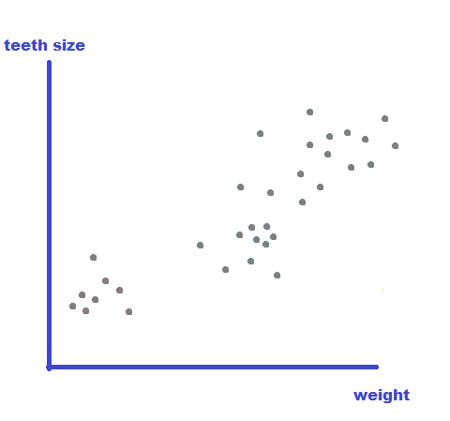
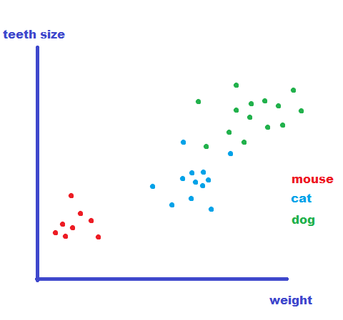
Supervised and Unsupervised learning
Supervised learning
Unsupervised learning
Different problems require different algorithms

Slide 5
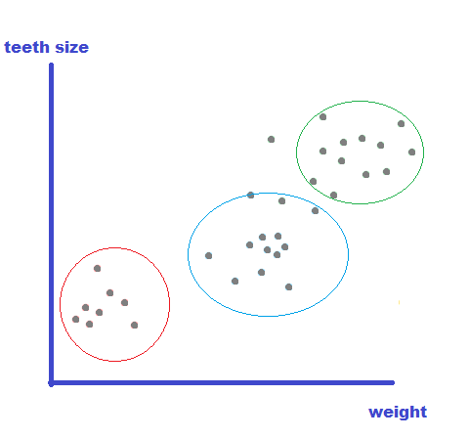
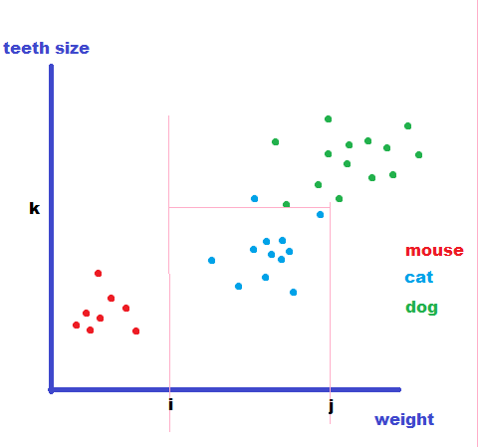
Supervised and Unsupervised learning
Supervised learning
Unsupervised learning
Different problems require different algorithms

Slide 6
Semi Supervised learning
Semi Supervised learning
Many methods of leveraging the label data to help classify the whole population:
Self training
Generative models
S3VMs
Many More…
Notes:
דורה תחתונה עדיף תיוג, זאת למידה הרבה יותר מדוייקת, לא סתם מנסים למנף את התיוג בכל השיטות האלו

Slide 7
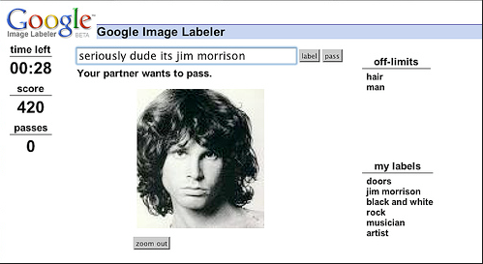
Manual Labeling
Google image labeler
Notes:
https://www.youtube.com/watch?time_continue=51&v=yWZUxnRYISs

Slide 8
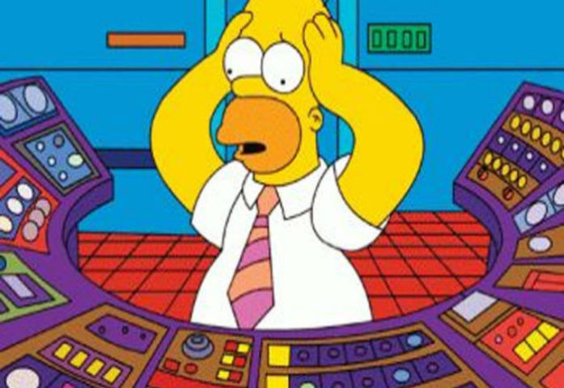
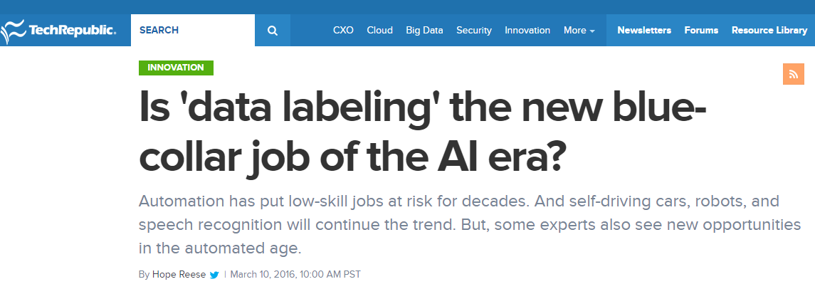


Manual Labeling
Expensive
Limited scale
Subjective?
Popular outsource platforms:
Amazon Mechanical Turk
Crowdflower
Might be the new age blue collar job
Notes:
מטלה קלה במידה

Slide 9
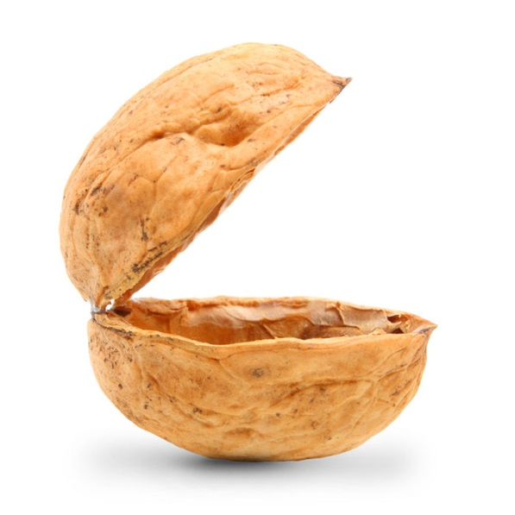

Creating a Label in situations of uncertainty
What is fraud?
PayPal’s use case:
Who is a bad client?
Notes:
בעולם של ביג דאטה – קשה לבודד ולהבין מה גורם לחשבון להיות רע.

Slide 10





PayPal Risk Product in a Nutshell
Notes:
מודל העסקי

Slide 11


Creating a Label in situations of uncertainty
PayPal’s use case: who is a bad client? What is fraud?
5 Claims
$100 net loss
1 Claims
$500 net loss
Lifetime transactions: 7
Selling iPhone
6 didn’t reach destination
Lifetime transactions: 39
Selling furniture
1 order had a broken tip
Notes:
המון דאטה
תכתובות, קישורים, היסטוריה, שיחות
התפקסנו על שלושה גורמים שמעידים על רוע – תלונות, הפסד וסגירת חשבונות

Slide 12

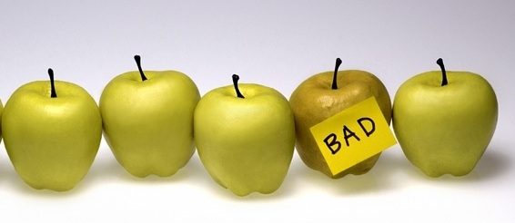
Creating a Label in situations of uncertainty
different approaches:
Logically define thresholds
Business definition that would keep us margin positive (if exist)
Create a learning model on absolute ‘bads’
Regression or classification model to apply the right thresholds for bads
Notes:
Manual review

Slide 13
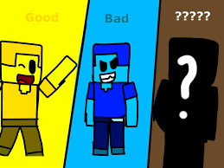
Creating a Label in situations of uncertainty
Best practice:
Explain the factor we try to optimize (loss in our case)
Avoid gray population in future training
Occam's razor : Keep it simple, even if not with perfect accuracy
Notes:
חוקים הם מסובכים?

Slide 14


