Slide 1


R and Shiny in Market Research
MIE Master Class Session 1
David Macro – Head Data Science
david@dataim.nl
Gijs van Blokland – CEO
gijs@dataim.nl

Slide 2

Outline
Who-is-who?
A very short introduction to R and Shiny
Using R in a production environment
Shiny fundamentals
Case study 1: using a template to quickly build a dashboard
Case study 2: text mining demo
What’s next?

Slide 3
1. Who-is-who?
While introducing yourselves, please give some info on:
Your research interests (e.g. topics of interest, preferred methods, etc.)
Your prior experience with R and Shiny or similar analysis stacks (e.g. Python/Pandas)
Your expectations of today’s session: what would you like to learn of this session?

Slide 4
1. Who are we?
DataIM is a research company specialized in survey research
Fieldwork via online surveys
Reporting via dashboard
Research types:
Opinion research
Market research
NPS
Churn
Organization research
Employee experience
Employee exit monitoring

Slide 5
2. An introduction to R and Shiny
R
R is a programming language targeted at users interested in statistical research, modeling, machine learning, reporting, etc.
Shiny
Shiny is a web application framework for R, enabling users to build interactive web applications without needing extensive web development knowledge.
R provides a wide range of statistical and graphical techniques, such an (non-)modeling, tests, time-series analysis, classification, clustering, etc.
R is highly extensible, allowing users to write their own software and distribute it in the form of packages.
Shiny allows data scientists to turn analyses into interactive web applications that can be shared with users.
Shiny applications are built using R code and integrate well with other R packages, making it a powerful tool for communicating data and statistical analysis results.

Slide 6
2. An introduction to R and Shiny
All code presented in this presentation is available via our repository at GitHub.
Link: https://github.com/DataIMLabs/MIE2024
Detailed instructions on how to use this package are provided there.

Slide 7
Why R and Shiny? (1)
R and Shiny are open source …
… with an active community of open-source developers …
… and backed by enterprise support of Posit (formerly RStudio)
Large R user base amoung statistically trained professionals
Statistical tools available in R can be readily integrated into Shiny
R and Shiny outperform alternatives such as Python/Dash

Slide 8
Why not something else?
R vs SPSS or Stata
Costs, flexibility
R vs Python
Traditional split of R → Statistics and Python → ML is outdated. Both are almost equally usable in practice.
Shiny vs PowerBI / Tableaux
Shiny gives more flexibility (both technically and from a business perspective)
R + Shiny vs Python + Dash
Close call. Shiny’s reactive framework ultimately leads to much simpler development cycles than Dash’ callback approach.
Note: POSIT is currently developing a version of Shiny for Python.

Slide 9
R in a production environment
Many of you know R, but R is not used the same everywhere:
In R there are many different solutions to the same problem.
The standard solution for a problem in academia, Stackoverflow or an R tutorial may be suboptimal for production
Getting a data science team to work productively with R requires solving a whole new class of problems (e.g. versioning, testing, deployment)
Warning: GPT can generate R and Shiny code that runs without errors, but this code may not be optimal and is sometimes not even correct.

Slide 10
R in Survey Research and Dashboards
Problem | Academia | Our production standard | Rationale
Code structuring | Little attention given to structured code | Code structured as R package for all projects | Not standardizing workflow leads to chaos
Raw data structure | Anything from .csv to .xlsx or SQL | Prefer SPSS/SAS/Stata data structure | SPSS/SAS/Stata encode both values and labels, which is essential for catagorical data analysis.
Data handling | Base R, tidy datahandling | All data handling happens via the data.table package (or via our own libs built on top of data.table) | Base R and Tidy lack speed that is critical to production level apps. Data.table offers superior speed and a syntax similar to SQL.
Charting | Base, ggplot, D3, highchartR, plotly | All charting happens via Plotly unless the desired chart does not exist there. | Careful feature analysis of commonly used libs
HTML | Manual; htmltools | Bslib (bootstrap5) first | Speed; ease of use

Slide 11
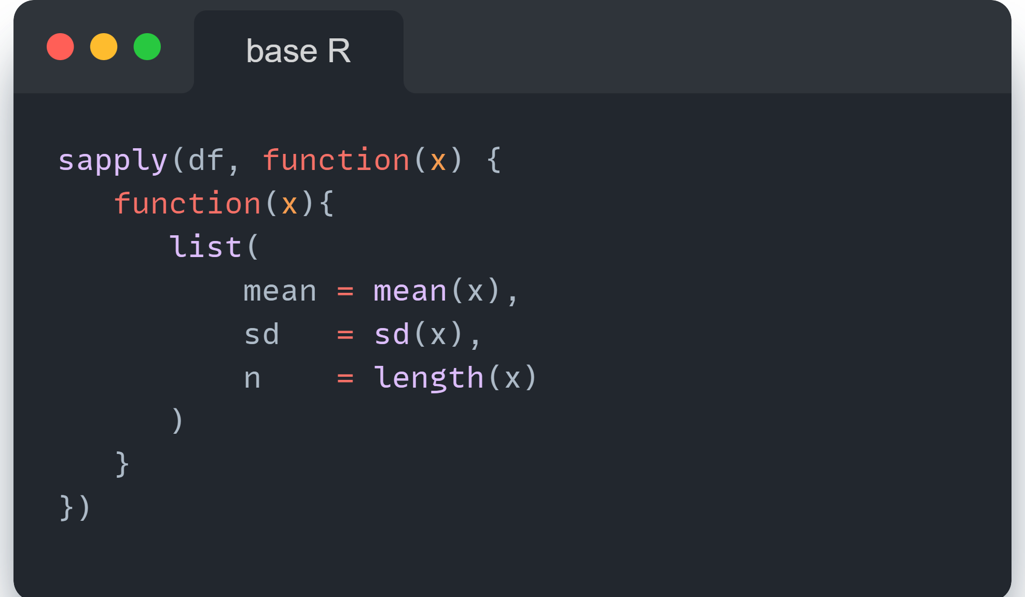
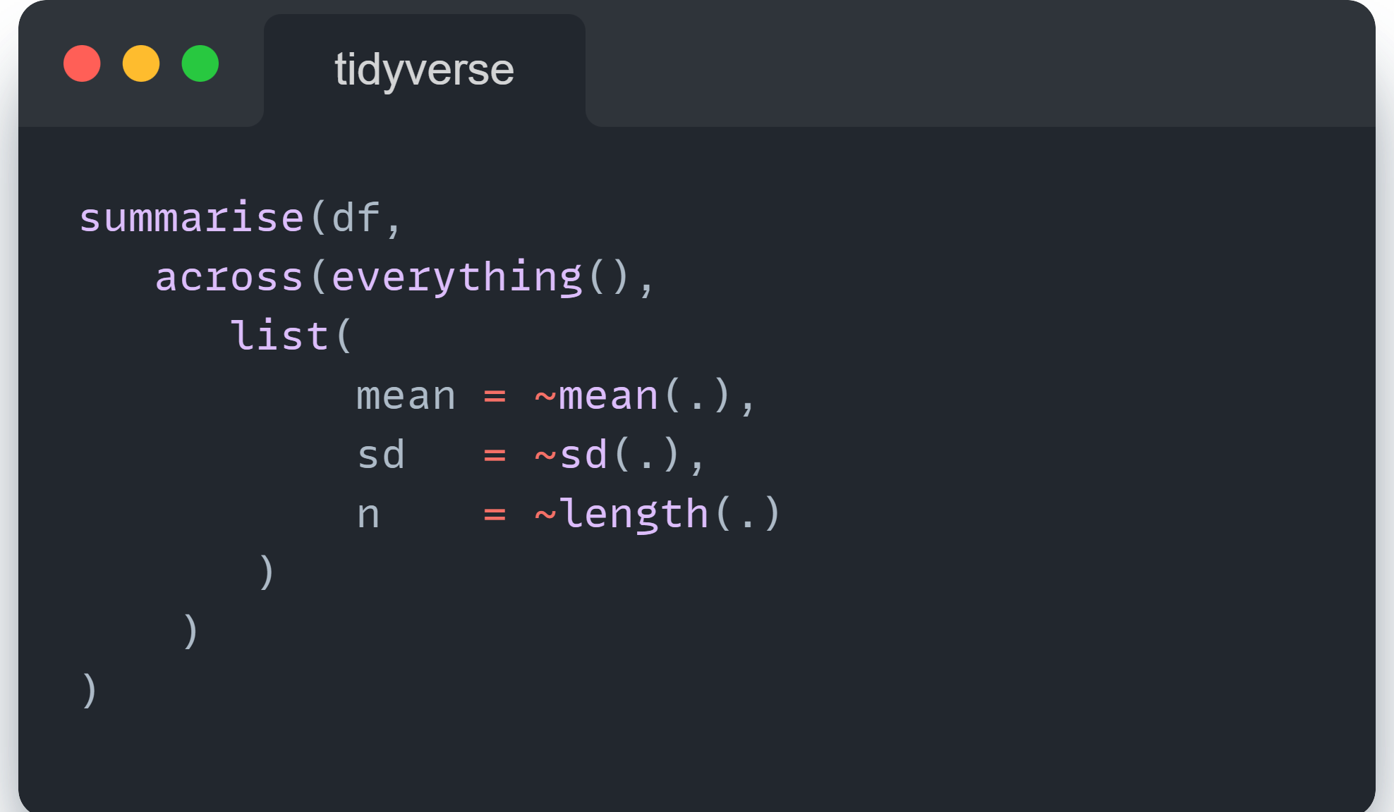
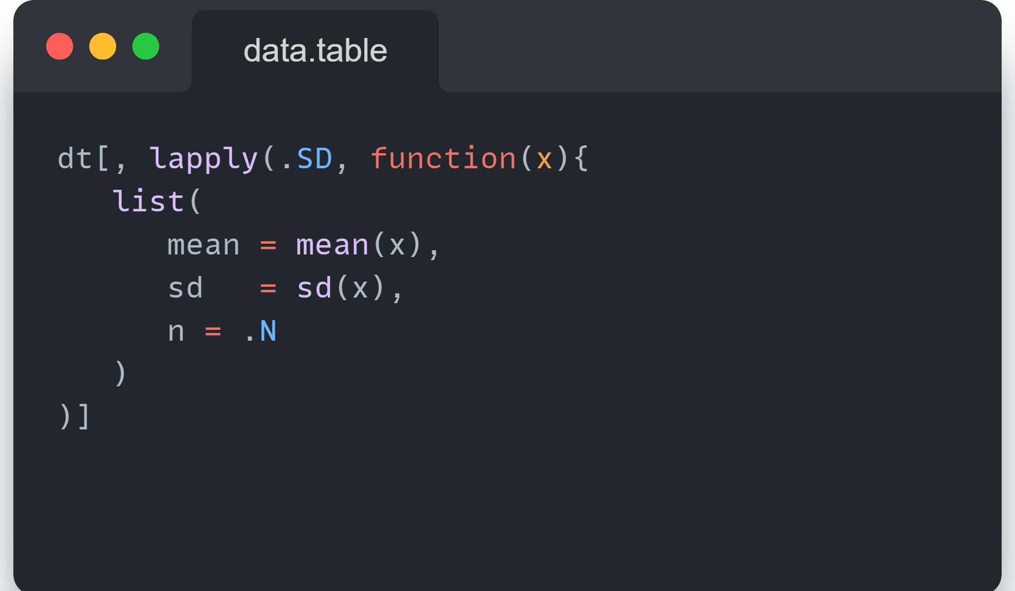
Data handling in R
Notes:
R kent verschillende systemen om data handling uit te voeren.
Met base R worden alle tools bedoeld die standaard in de programmeertaal aanwezig zijn zonder dat men daar library's voor hoeft in te laden.
Tidy data handling (m.b.v. plyr verbs) is wat men tegenwoordig doorgaans aangeleerd krijgt in opleidingen waarin R wordt onderwezen. Het tidyverse ecosysteem kenmerkt zich door een hoge mate van standaardisatie van syntax; de resulterende code is doorgaans leesbaarder dan base R of data.table.
Het data.table package heeft momenteel onze voorkeur vanwege de superieure performance, zowel qua snelheid als ram geheugen.

Slide 12
Data handling in R
Feature | Base R | Tidyverse | data.table
Philosophy | None | Readability and a consistent syntax | Performance and concise syntax; in-place modification
Syntax | Traditional R syntax | Consistent and readable | Concise; mimics SQL
Speed | Slow | Moderate | Fast
Memory Usage | Moderate | Higher | Low
Learning Curve | Low | Moderate | Steep
Use Cases | General-purpose data manipulation and exploration Scripts and packages | Data science projects emphasizing readability and ease of use Iterative data analysis | Large datasets; performance-critical applications Efficient data processing

Slide 13
Notes:
Afhankelijk van het doel van de code zijn snelheid, geheugengebruik en eenvoudige syntax meer of minder belangrijk.
Bij handmatige dataverkenningen is het minder belangrijk dat de code snel draait; bij een productie-dashboard doet snelheid er des te meer toe.
data.table wordt weliswaar minder gebruikt dan tidyverse, maar de library is superieur qua performance.

Slide 14
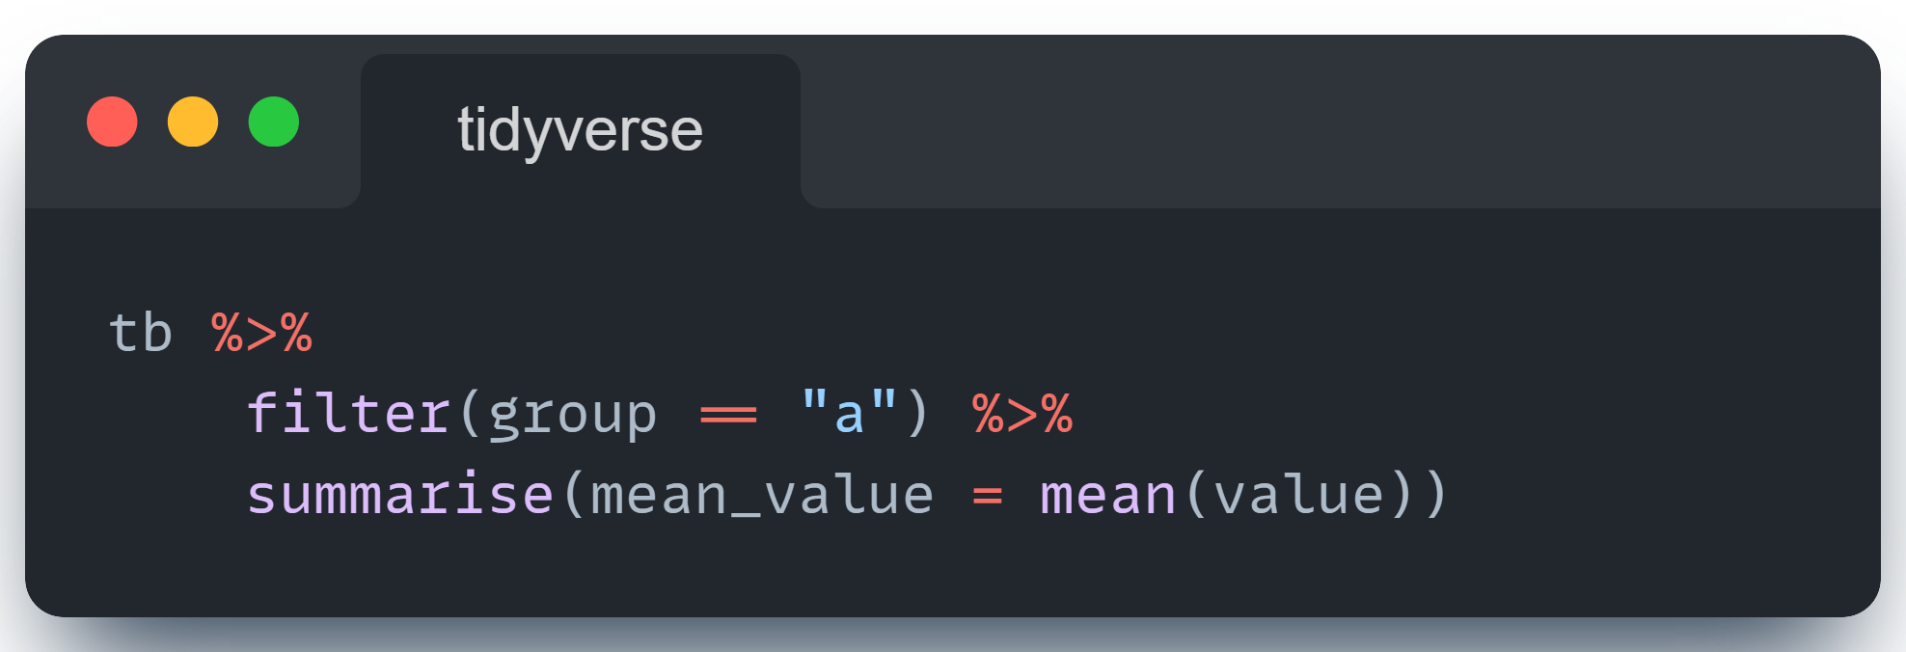
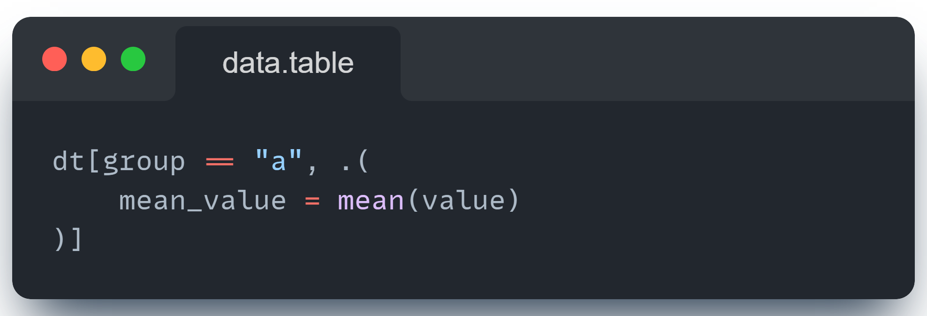
DH - Summary

Slide 15
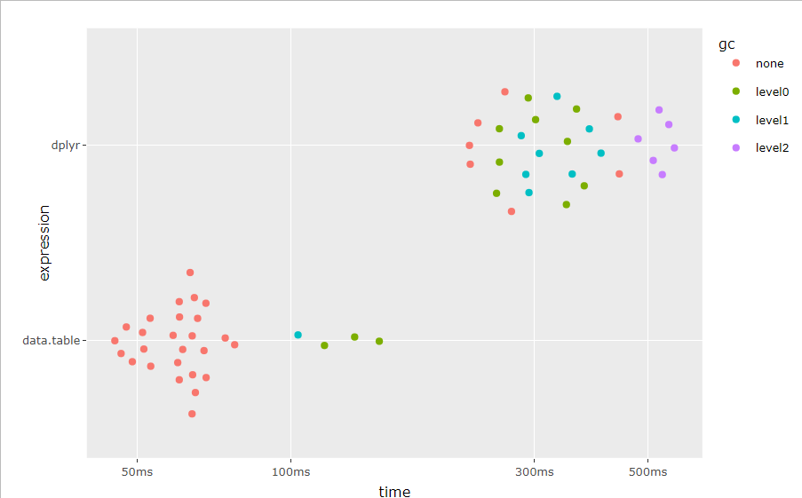
DH – Summary (benchmark)
Notes:
Deze benchmark toont het verschil tussen data.table en dplyr qua performance bij het subsetten en daarna samenvatten van een dataset.
In het MIE2024 R-package staat de code van deze benchmark:
# Eenvoudig uitvoeren van de benchmark kan via de ‘example’ functie:
devtools::load_all()
exampleBenchmarkSubsetting()
# Bekijk de broncode van de benchmark in:
examples/dh/dh.benchmark.subsetting.R

Slide 16
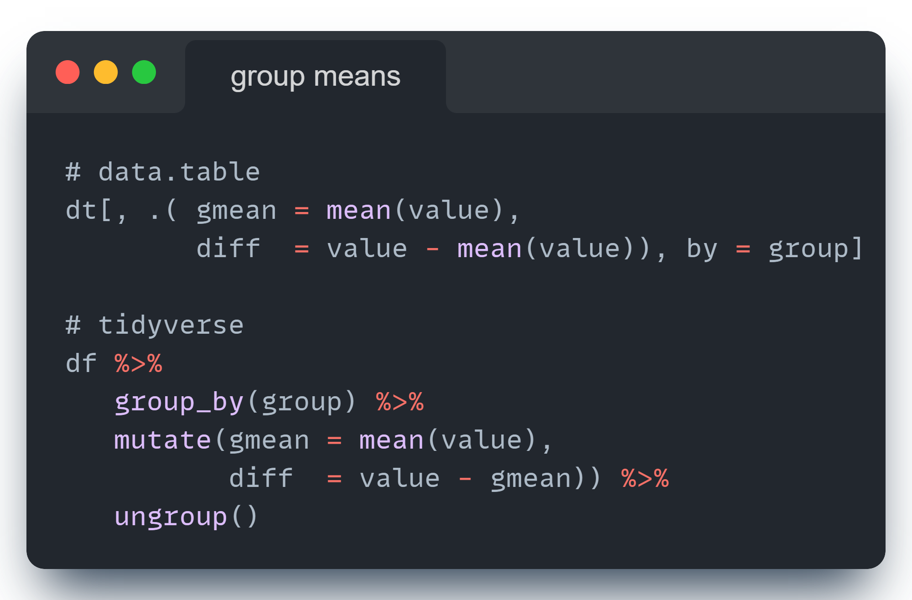
DH – Calculate group means

Slide 17
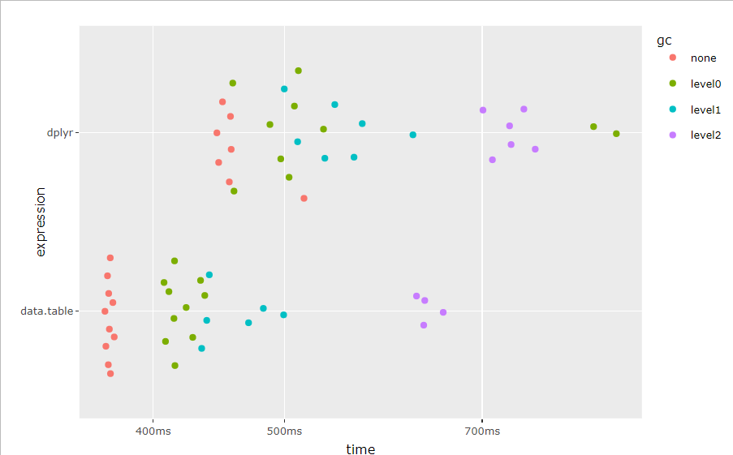
DH – Summary (benchmark)
Notes:
Deze benchmark toont het verschil tussen data.table en dplyr qua performance bij het berekenen van groepsgemiddelden (by-group)
In het MIE2024 R-package staat de code van deze benchmark:
# Eenvoudig uitvoeren van de benchmark kan via de ‘example’ functie:
devtools::load_all()
exampleBenchmarkGroupMeans()
# Bekijk de broncode van de benchmark in:
examples/dh/dh.benchmark.groupmeans.R

Slide 18
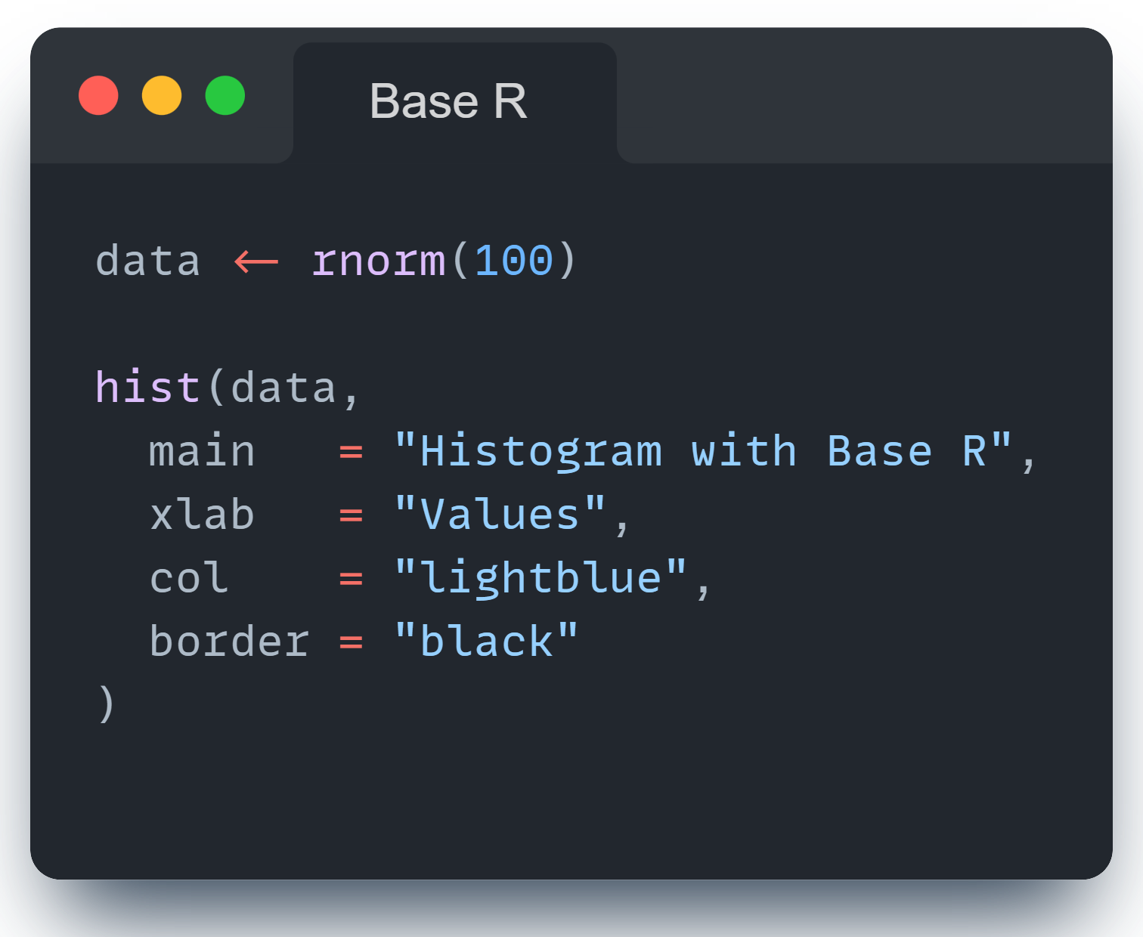
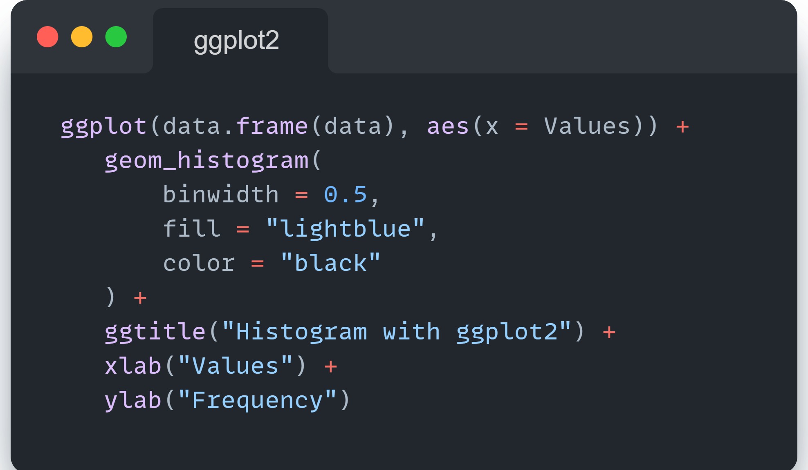
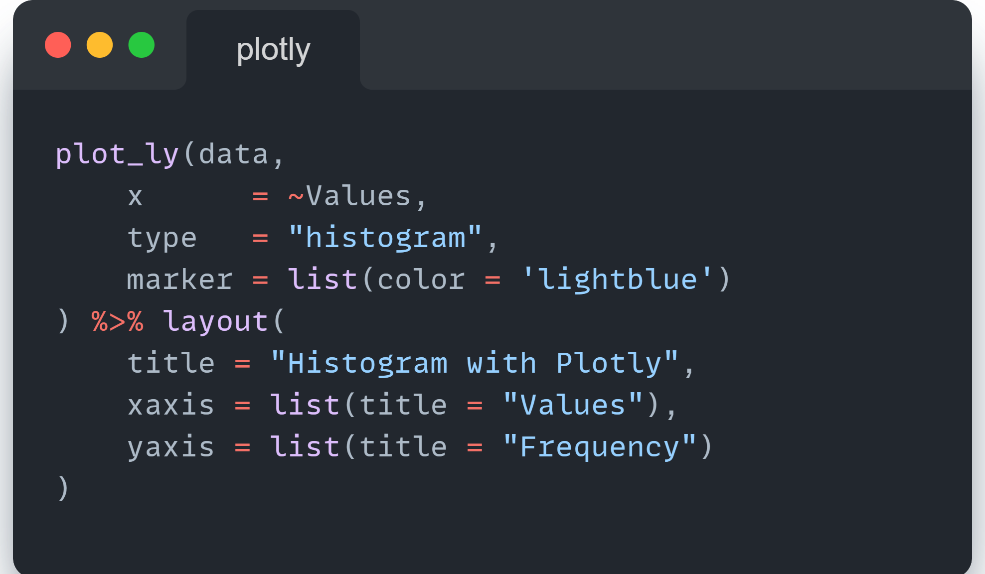
Charts in R

Slide 19
Plotly components
Name | Description
Data | The dataset from which the plot is generated, including variables for the x and y axes, color, size, etc.
Layout | Defines aspects of the chart's layout, such as titles, axis labels, legend placement, and overall chart dimension.
Traces | Individual plot elements, such as lines, bars, markers, etc., that represent the data visually on the chart.
Axes | The x-axis and y-axis of the plot, including their range, title, and tick format.
Markers | Visual markers for data points, which can vary in size, color, and shape to represent additional data dimensions.
Lines | Used to connect data points in line charts, with properties like color, width, and style.
Legend | A key that explains the symbols, colors, or line styles used in the chart to represent data categories.
Hover Information | Interactive tooltips that display more detailed information about a data point when the mouse hovers over it.
Annotations and Shapes | Text labels and geometric shapes that can be added to the chart for emphasis or additional information.
Notes:
Eén slide is natuurlijk niet genoeg om de basics van Plotly uit te leggen.
Degenen die verder willen met het bouwen van Plotly-charts verwijzen we door naar de volgende bronnen:
Onze eigen codevoorbeelden in het MIE2024 package op GIT. Zie de map: /examples/charting
GG

Slide 20
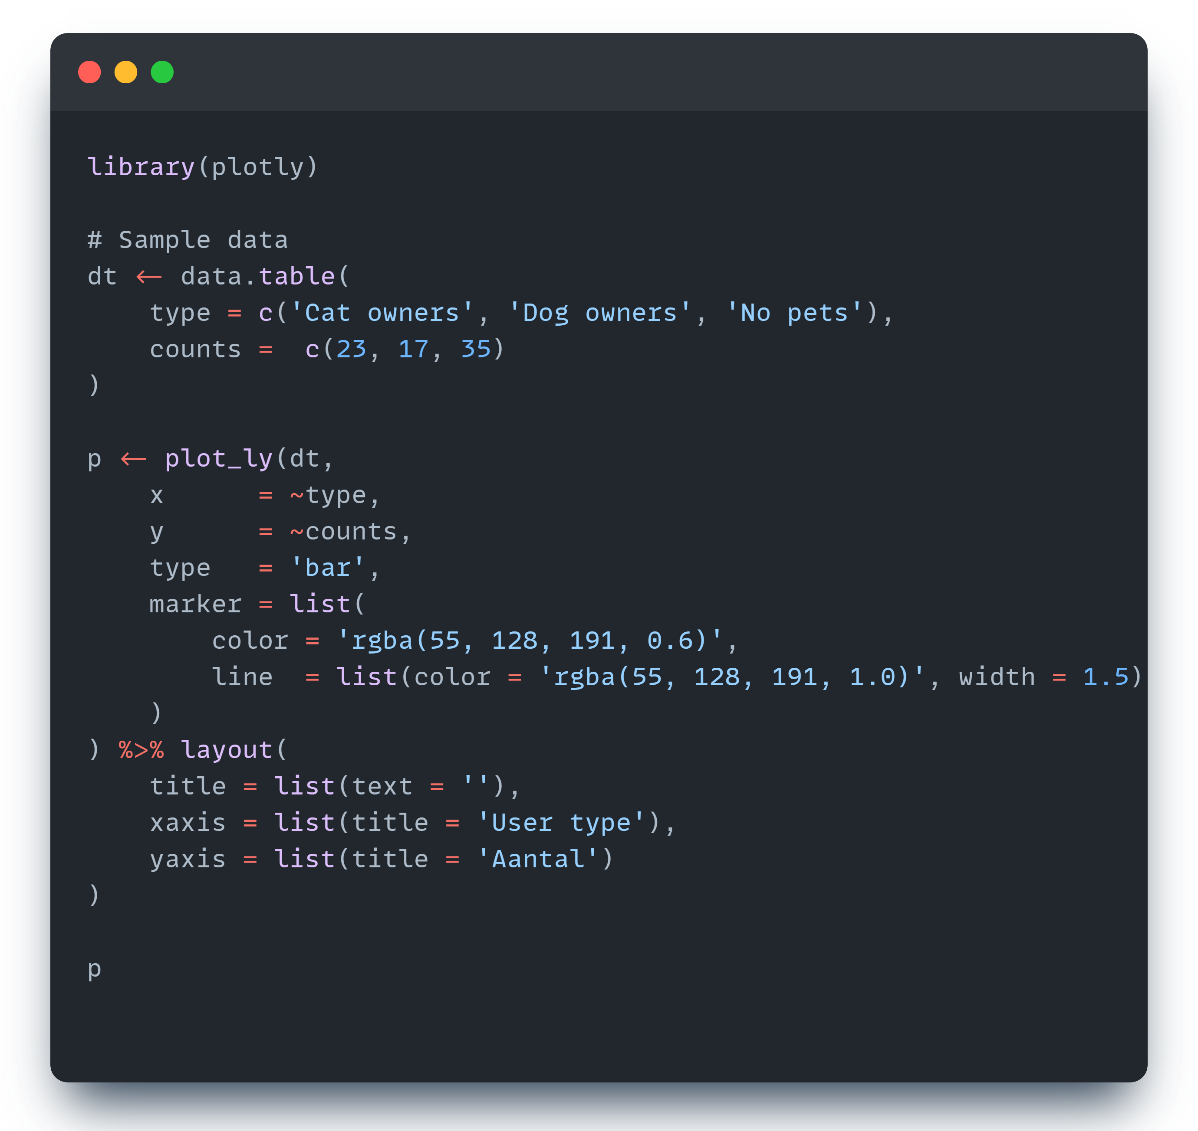
A plotly barchart

Slide 21
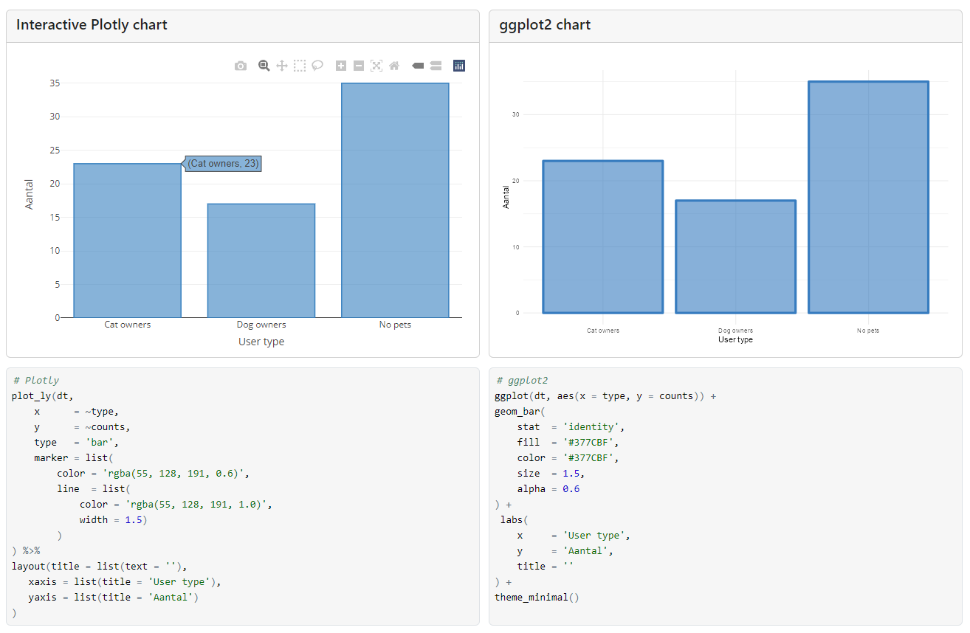
Example 1: bar chart
Notes:
Voer de volgende stappen uit vanuit het MIE2024 package om bovenstaande te repliceren:
# Uitvoeren van het voorbeeld:
devtools::load_all()
exampleBarcharts()
# Bekijken van de broncode
devtools::load_all()
exampleBarcharts(type = “view”)

Slide 22
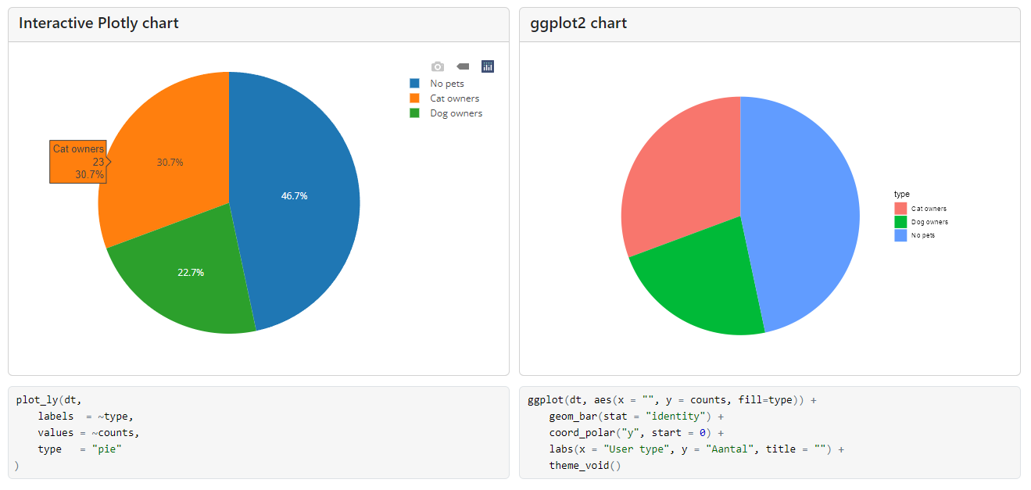
Example 2: pie chart
Notes:
Voer de volgende stappen uit vanuit het MIE2024 package om bovenstaande te repliceren:
# Uitvoeren van het voorbeeld:
devtools::load_all()
examplePiecharts()
# Bekijken van de broncode
devtools::load_all()
examplePiecharts(type = “view”)

Slide 23
Shiny Fundamentals
UI vs SERVER
ShinyAPP
input / output
Reactivity
Modules
Notes:
Disclaimer: deze sessie is veel te kort om uitgebreid in te gaan op alle details. Zie het package voor een meer uitgebreide omschrijving

Slide 24
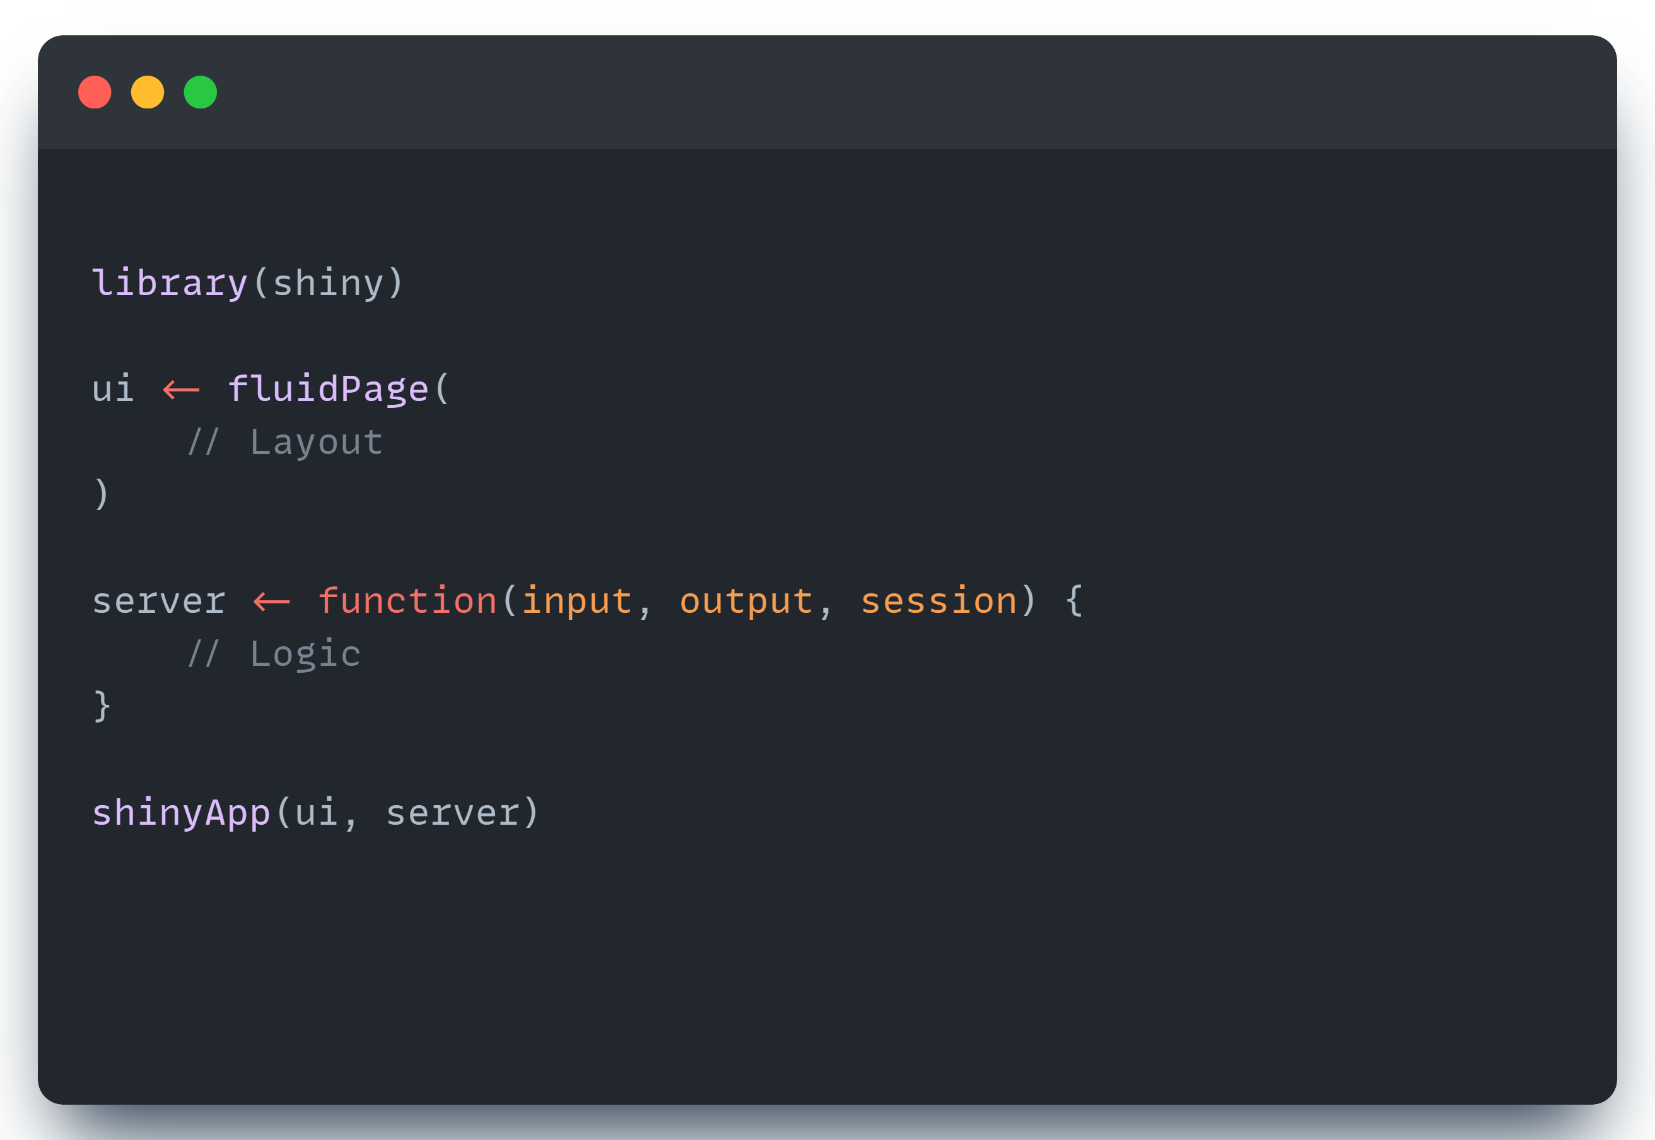
SHINYAPP = UI + SERVER

Slide 25
The User Interface (UI)
UI = R functions that generate client-side code (HTML and Javascript)
Useful packages:
Htmltools and shiny’s own html functions (R functions that generate html)
ShinyWidgets
bslib convenience functions (R functions that generate bootstrap components)
ShinyJS

Slide 26
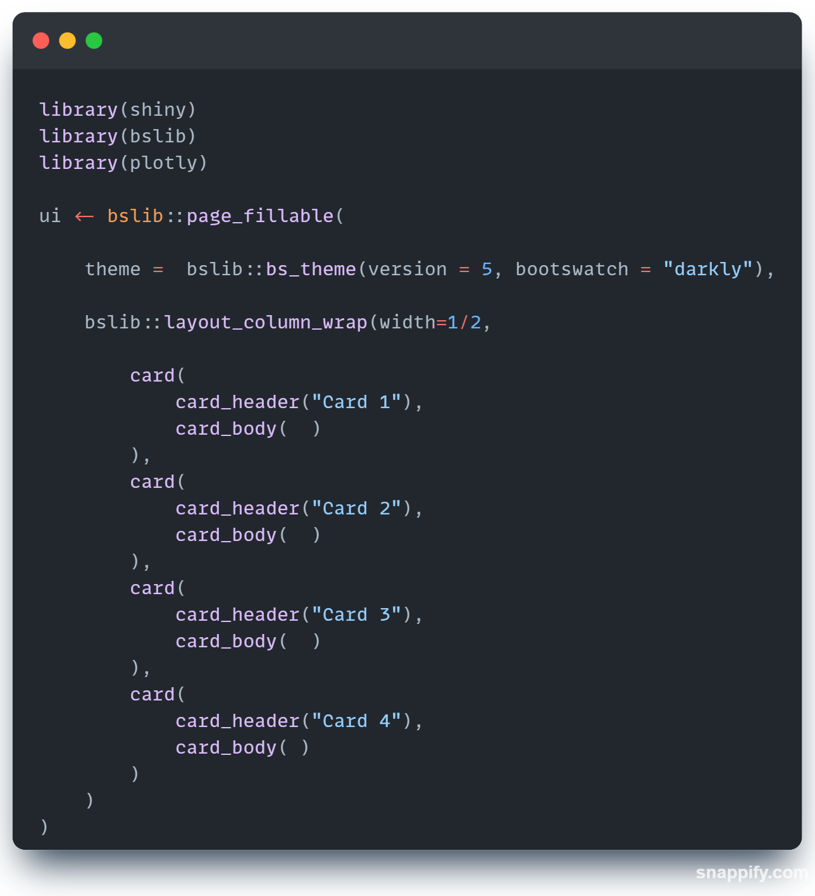
UI Example 1: BSLIB CARDS

Slide 27
UI + SERVER: a quick primer
UI displays the output of what is rendered by the SERVER
UI contains possible input elements that can be used by the SERVER
Output Element | Server function | UI function
Plotly chart | renderPlotly() | plotlyOutput()
Table | renderTable() | tableOutput()
Text | renderText() | textOutput()
HTML | renderUI() | uiOutput()
[…] | render[…]() | […]Output()

Slide 28
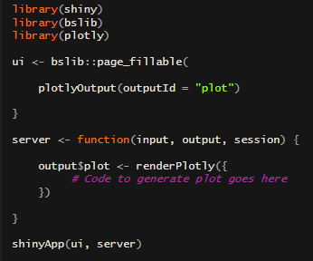
Example: rendering a plotly plot
plotlyOutput displays the plot in the UI
renderPlotly generates the plot in the server
the output variable stores the generated plot
UI and SERVER share input and output objects

Slide 29
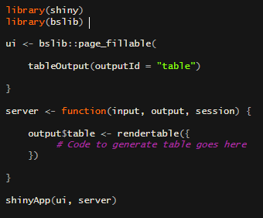
Example: rendering a table
tableOutput displays the table in the UI
renderTable generates the plot in the server
the output variable stores the generated table
UI and SERVER share input and output objects

Slide 30
Example: rendering UI elements
tableOutput displays the table in the UI
renderTable generates the plot in the server
the output variable stores the generated table
UI and SERVER share input and output objects

Slide 31
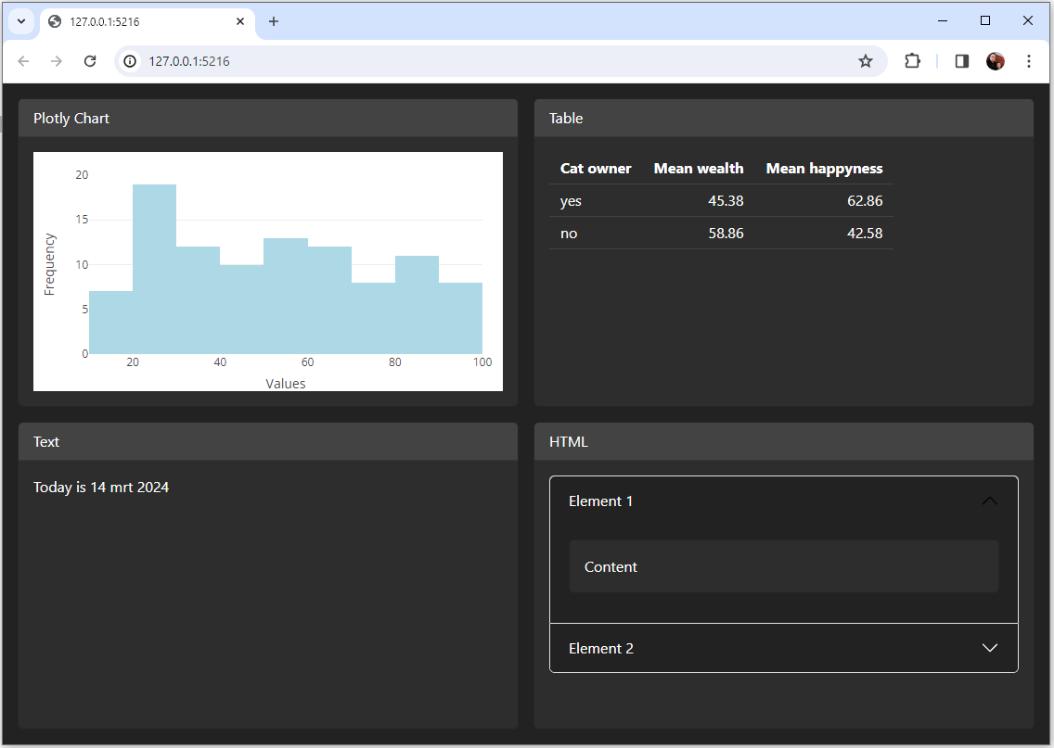
Putting it all together
Notes:
Zie voorbeeld example.ui.bootstrap.v2.content.R uit het MIE2024 package.

Slide 32
User input: some examples
Library | Function | Display type
Shiny | textInput | Text field
 | numericInput | Masked tekst field
 | dateInput | Date selector
shinyWidgets | pickerInput | Select list
 | numericRangeInput | Range selector
 | checkboxGroupButtons

Slide 33
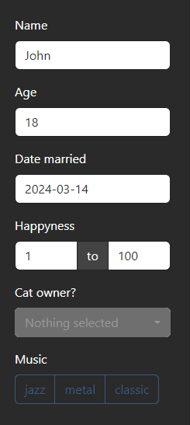
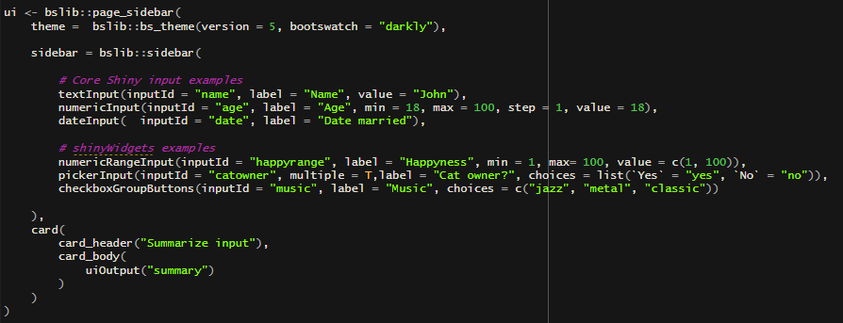
User input: some examples
Notes:
Voer de volgende stappen uit vanuit het MIE2024 package om bovenstaande te repliceren:
# Uitvoeren van het voorbeeld:
devtools::load_all()
exampleShinyCatMoneyHappy()
# Bekijken van de broncode
devtools::load_all()
exampleShinyCatMoneyHappy(type = “view”)

Slide 34
User input: some examples
Notes:
Voer de volgende stappen uit vanuit het MIE2024 package om bovenstaande te repliceren:
# Uitvoeren van het voorbeeld:
devtools::load_all()
exampleShinyCatMoneyHappy()
# Bekijken van de broncode
devtools::load_all()
exampleShinyCatMoneyHappy(type = “view”)

Slide 35

Reactivity
Implicit trigger
reactive
observe
eventReactive
observeEvent
Lazy return value
Eager side effect
Explicit trigger

Slide 36
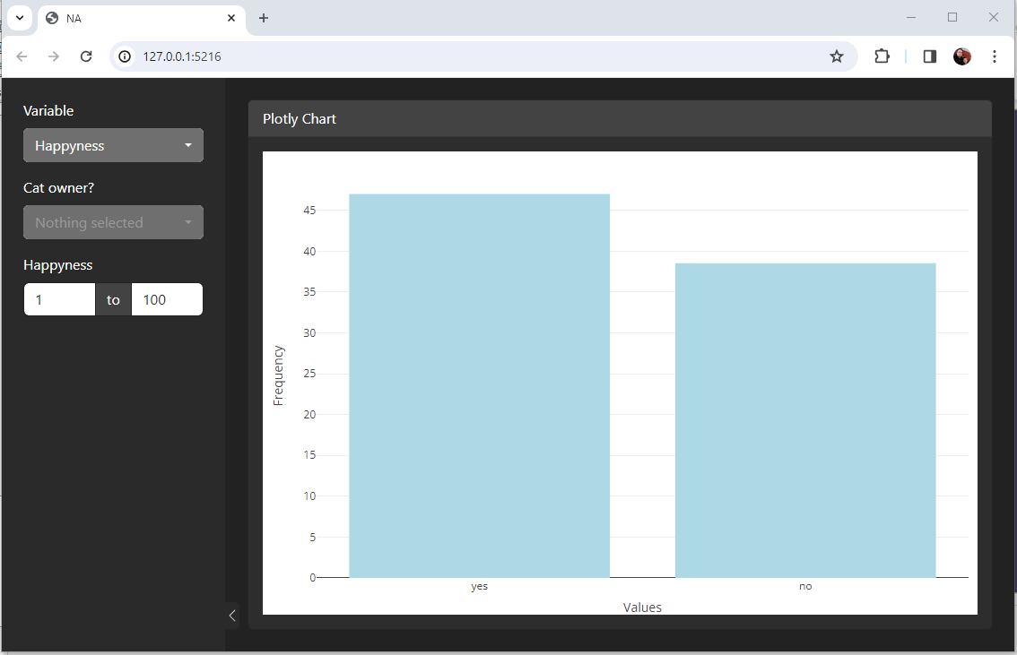
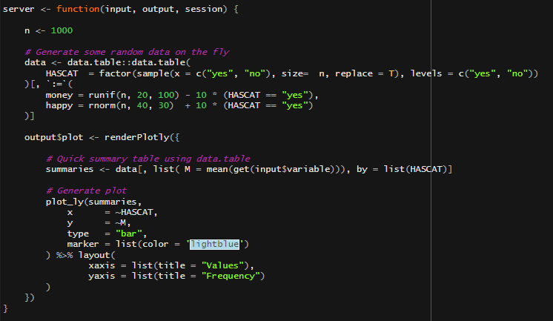
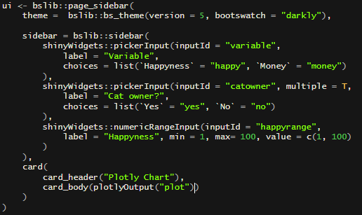
Example: how can we improve this?
Notes:
Voer de volgende stappen uit vanuit het MIE2024 package om bovenstaande te repliceren:
# Uitvoeren van het voorbeeld:
devtools::load_all()
exampleShinyCatMoneyHappy()
# Bekijken van de broncode
devtools::load_all()
exampleShinyCatMoneyHappy(type = “view”)

Slide 37
Example: how can we improve this?
Replace title with dynamic part showing the plot
Apply filters to the data using a reactive() dataset

Slide 38
Modularity

Slide 39
Case study: Text mining
Raw text
Cleaned text
Features
Multilingual
Errors
Translated into a common language
N-grams frequencies
Word counts
Notes:
DataIM heeft een pipeline om open antwoorden geautomatiseerd te classificeren. Dit kan geïntegreerd worden in een Shiny dashboard (via een module), of als losse dienst / service worden aangeboden.
Interesse? Neem contact op met David Macro (david@dataim.nl) of Gijs van Blokland (gijs@dataim.nl)

Slide 40
R + Shiny: What’s next?
Build your own dashboard
Share the dashboard with others
Need help? DataIM offers:
Training and consultancy tailored to your research project/team
A standardized template for building a Shiny dashboard on a survey dataset
Managed hosting for Shiny projects (inside EU/UU, GDPR compliant)

Slide 41
Appendix 1. Toolkit
R + RStudio + RTools (for compiled packages)
R Libraries
Shiny
ShinyWidgets
Bootstrap (bslib)
… (and many others; see repository)
DataIM Survey Research Components
Authentication
Menu structure
Data handling
Filters
Plots
Tables
Text mining and classification
….

Slide 42
Appendix 2. Project organization
Organizing R script files, standardize code, version control
Deployment and maintenance
Top-down model vs co-creation

Slide 43
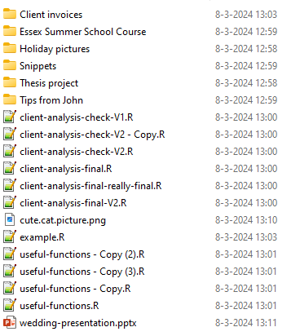
Appendix 2. Project organization
How not to organize your R files:

Slide 44
Appendix 2. Project organization
Organize R code into R Packages (see: https://r-pkgs.org/)
Standardize common elements:
Data handling
Tables and plotting
Use a distributed version control system (i.e., GIT) to manage versions and track contributions of various team members

