Slide 1


R and Shiny in Market Research
MIE Master Class Session 1
David Macro

Slide 2

INTRODUCTION
Who-is-who?
First session
Introduction to R and Shiny
Why R and Shiny?
Quick over view of Shiny
R and Shiny in production-grade projects
Case 1 - Continuous monitoring of telecom data
Case 2 - Continuous monitoring of telecom data

Slide 3
Who-is-who?
While introducing yourselves, please give some info on:
Your research interests (e.g. topics of interest, preferred methods, etc.)
Your prior experience with R and Shiny or similar analysis stacks (e.g. Python/Pandas)
Your expectations of today’s session: what would you like to learn of this session?

Slide 4
Who-is-who?
How many of you have done the following?
Used R to conduct descriptive or inferential analyses?
Used Shiny?
Organized R code for a project into an R Package (instead of using stand-alone scripts)?
Deployed a Shiny Dashboard via shiny.io or some other managed hosting provider
Deployed a Shiny Dashboard to a self managed server

Slide 5
Introduction to R and Shiny
R
R is a programming language targeted at users interested in statistical research, modeling, machine learning, reporting, etc.
Shiny
Shiny is a web application framework for R, enabling users to build interactive web applications without needing extensive web development knowledge.
R provides a wide range of statistical and graphical techniques, such an (non-)modeling, tests, time-series analysis, classification, clustering, etc.
R is highly extensible, allowing users to write their own software and distribute it in the form of packages.
Shiny allows data scientists to turn analyses into interactive web applications that can be shared with users.
Shiny applications are built using R code and integrate well with other R packages, making it a powerful tool for communicating data and statistical analysis results.

Slide 6
Why R and Shiny? (1)
R and Shiny are open source …
… with an active community of open-source developers …
… and backed by enterprise support of Posit (formerly RStudio)
Large R user base amoung statistically trained professionals
Statistical tools available in R can be readily integrated into Shiny
R and Shiny outperform alternatives such as Python/Dash

Slide 7
Why not something else?
R vs SPSS or Stata
Costs, flexibility
R vs Python
Traditional split of R → Statistics and Python → ML is outdated. Both are almost equally usable in practice.
Shiny vs PowerBI / Tableaux
Shiny gives more flexibility (both technically and from a business perspective)
R + Shiny vs Python + Dash
Close call. Shiny’s reactive framework ultimately leads to much simpler development cycles than Dash’ callback approach.
Note: POSIT is currently developing a version of Shiny for Python.

Slide 8
2. Toolkit
R + RStudio + RTools (for compiled packages)
R Libraries
Shiny
ShinyWidgets
Bootstrap (bslib)
… (and many others; see repository)
DataIM Survey Research Components
Authentication
Menu structure
Data handling
Filters
Plots
Tables
Text mining and classification
….

Slide 9
2. Toolkit
R + RStudio + RTools (for compiled packages)
R Libraries
shinyWidgets
Bootstrap Library (bslib)
Shiny
Separate UI and Server
Reactivity
Modularity

Slide 10
3. R in Survey Research and Dashboards
R has many different solutions to the same problem.
The commonly accepted solution for a given problem in academia, Stackoverflow or an R tutorial may often be suboptimal for production-grade dashboards.
Getting a data science team to work productively with R to create enterprise-level dashboards involves solving a whole new class of problems.
Warning: GPT can generate working R and Shiny code, but this code may not be ‘good’ and sometimes not even be ‘correct’.

Slide 11
3. Data handling methods in R
Base R | Tidy Verse Syntax | data.table Syntax
sapply(df, function(x) { function(x){ list( mean = mean(x), sd = sd(x), n = length(x) ) } }) | summarise(df, across(everything(), list( mean = ~mean(.), sd = ~sd(.), n = ~length(.) ) ) ) | dt[, lapply(.SD, function(x){ list( mean = mean(x), sd = sd(x), n = .N ) )]

Slide 12
3. R in Survey Research and Dashboards
Problem | Common solution | Our choice | Rationale
Code structuring | Little attention given to structured code | Code structured in R package for all projects | Not standardizing workflow leads to chaos
Raw data structure | Anything from .csv to .xlsx or SQL | Prefer SPSS data structure over all alternatives | SPSS data format is widely used, can be read and written via R (haven) and encodes both values and labels of categorical variables (!)
Data handling | Base R, tidy datahandling | All data handling happens via the data.table package (or via our own libs built on top of data.table) | Superior speed Similarity to SQL
Charting | Base, ggplot, D3, highchartR, plotly | All charting happens via Plotly unless the desired chart does not exist there. | Careful feature analysis of commonly used libs
HTML | Manual; htmltools | Bslib (bootstrap5) first | Speed; ease of use

Slide 13
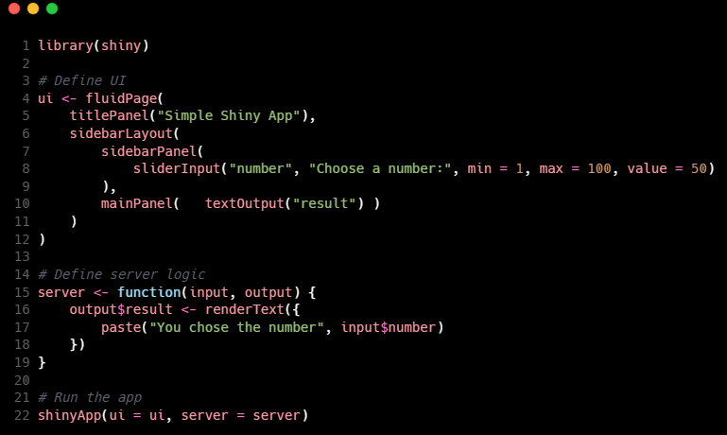
3a. Separate UI and Server
Example 1.R

Slide 14

3b. Reactive Building Blocks (1)
Implicit trigger
reactive
observe
eventReactive
observeEvent
Lazy return value
Eager side effect
Explicit trigger

Slide 15
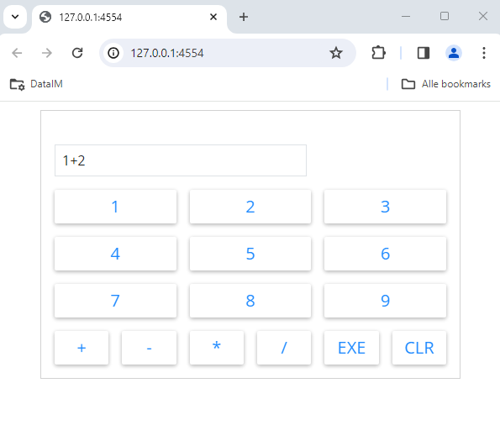
3b. Reactive Building Blocks (2)
Example 2.R

Slide 16
3b. Modularity

Slide 17
3b. Modularity

Slide 18
4. Project organization
Organizing R script files, standardize code, version control
Deployment and maintenance
Top-down model vs co-creation

Slide 19
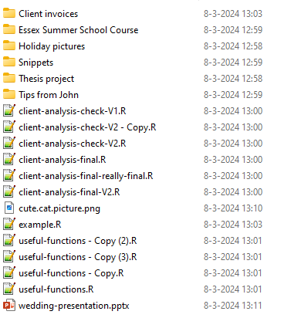
4a. Project Structure
How not to organize your R files:

Slide 20
4a. Project Structure
Organize R code into R Packages (see: https://r-pkgs.org/)
Standardize common elements:
Data handling
Tables and plotting
Use a distributed version control system (i.e., GIT) to manage versions and track contributions of various team members

Slide 21
4b. Standardize Common Elements
Menu structure
Data handling functions
Chart + Table functions
➔ DataIM Package

Slide 22
4c. Sharing dashboards
Menu structure
Data handling functions
Chart + Table functions
➔ DataIM Package

Slide 23
RATE THIS LECTURE VIA MIE’24-APP!
Please note that each lecture is rated by the attendee in the room.
Give your rating immediately after this lecture:
Look up the lecture in the Programme and
click on the VOTE button next to the lecture.
Give your grade here. The final grade for the lecture
will be announced on the screens.
Will this session become the Best of MIE 2024?
Have fun and vote!

Slide 24
Closure
This is the end of the session and are there any questions?
Thanks for your review and attendance!

