Slide 1


Patient Experience Survey Analysis
Benjamyn Wilson
Professor: Michael Dean
04/07/2026
View in Power BI
Last data refresh:
4/7/2026 4:34:28 PM UTC
Downloaded at:
4/7/2026 5:16:52 PM UTC
Notes:
Good Morning. My name is Benjamyn Wilson, and today I am presenting an analysis of patient experience survey data collected from this medical practice during June 2024. One hundred patients participated across three insurance categories and four visit types. The data reveals critical patterns in patient satisfaction that directly impact on the quality of care the practice delivers. Today I will walk you through eight visualizations, two interactive dashboards, and conclude with data-driven recommendations the practice can implement immediately. The live interactive dashboard is available by clicking the View in Power BI link on this slide.

Slide 2
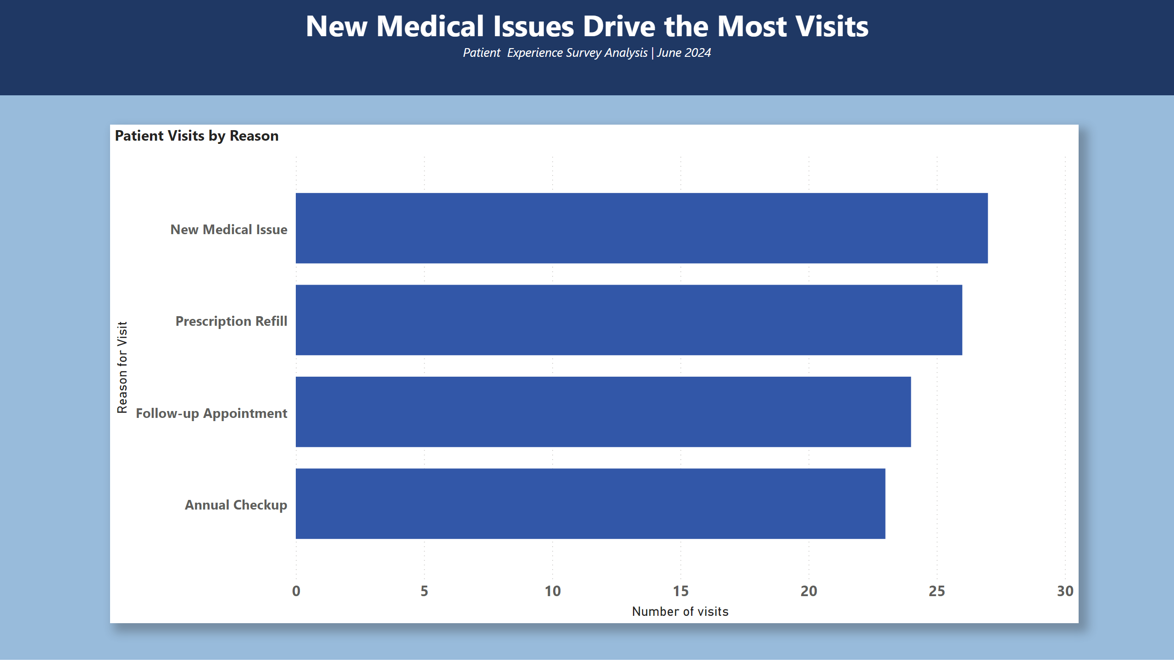
Bar chart
Notes:
This bar chart reveals that New Medical Issues represent the highest volume of patient visits at approximately 28 visits, followed closely by Prescription Refills. Follow-up Appointments and Annual Checkups generate fewer visits, respectively. This distribution has significant staffing implications — the practice should ensure adequate provider availability for new medical issues that require the most time and expertise. The high volume of prescription refills also suggests an opportunity to streamline through online or automated refill systems, which could reduce wait times and free up appointment slots for more complex cases.

Slide 3
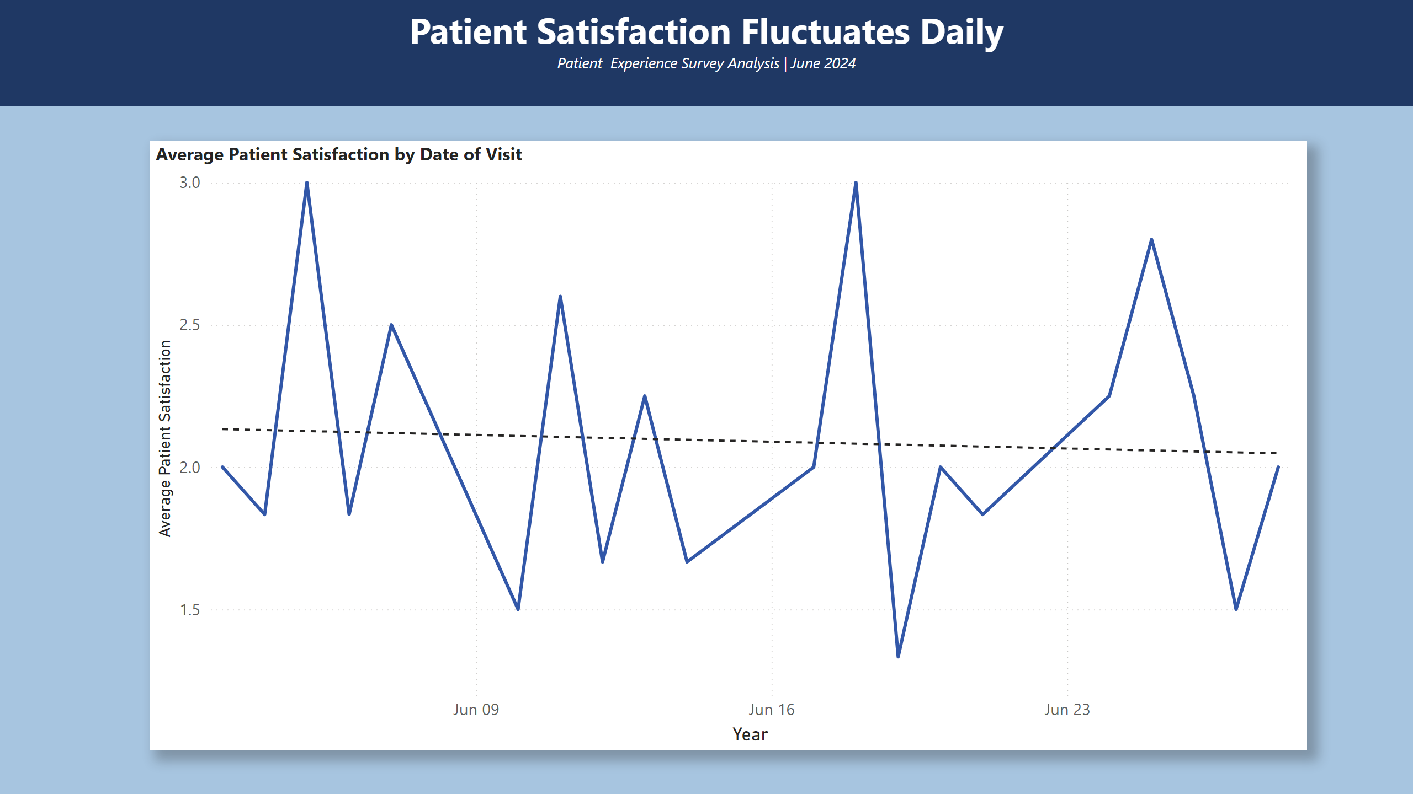
Line Graph
Notes:
Patient satisfaction scores throughout June 2024 show significant day-to-day variation, ranging from as low as 1.0 to as high as 3.0 on a 5-point scale. The average satisfaction score for the month sits at approximately 2.0, which is concerningly below the midpoint. This volatility suggests that the patient experience is inconsistent — some days patients leave highly satisfied while others leave dissatisfied. The practice should examine what differs on high-scoring versus low-scoring days. Factors such as staffing levels, provider schedules, and patient volume may be contributing to these fluctuations. Addressing the root causes of low-scoring days represents an immediate opportunity to improve overall patient satisfaction.

Slide 4
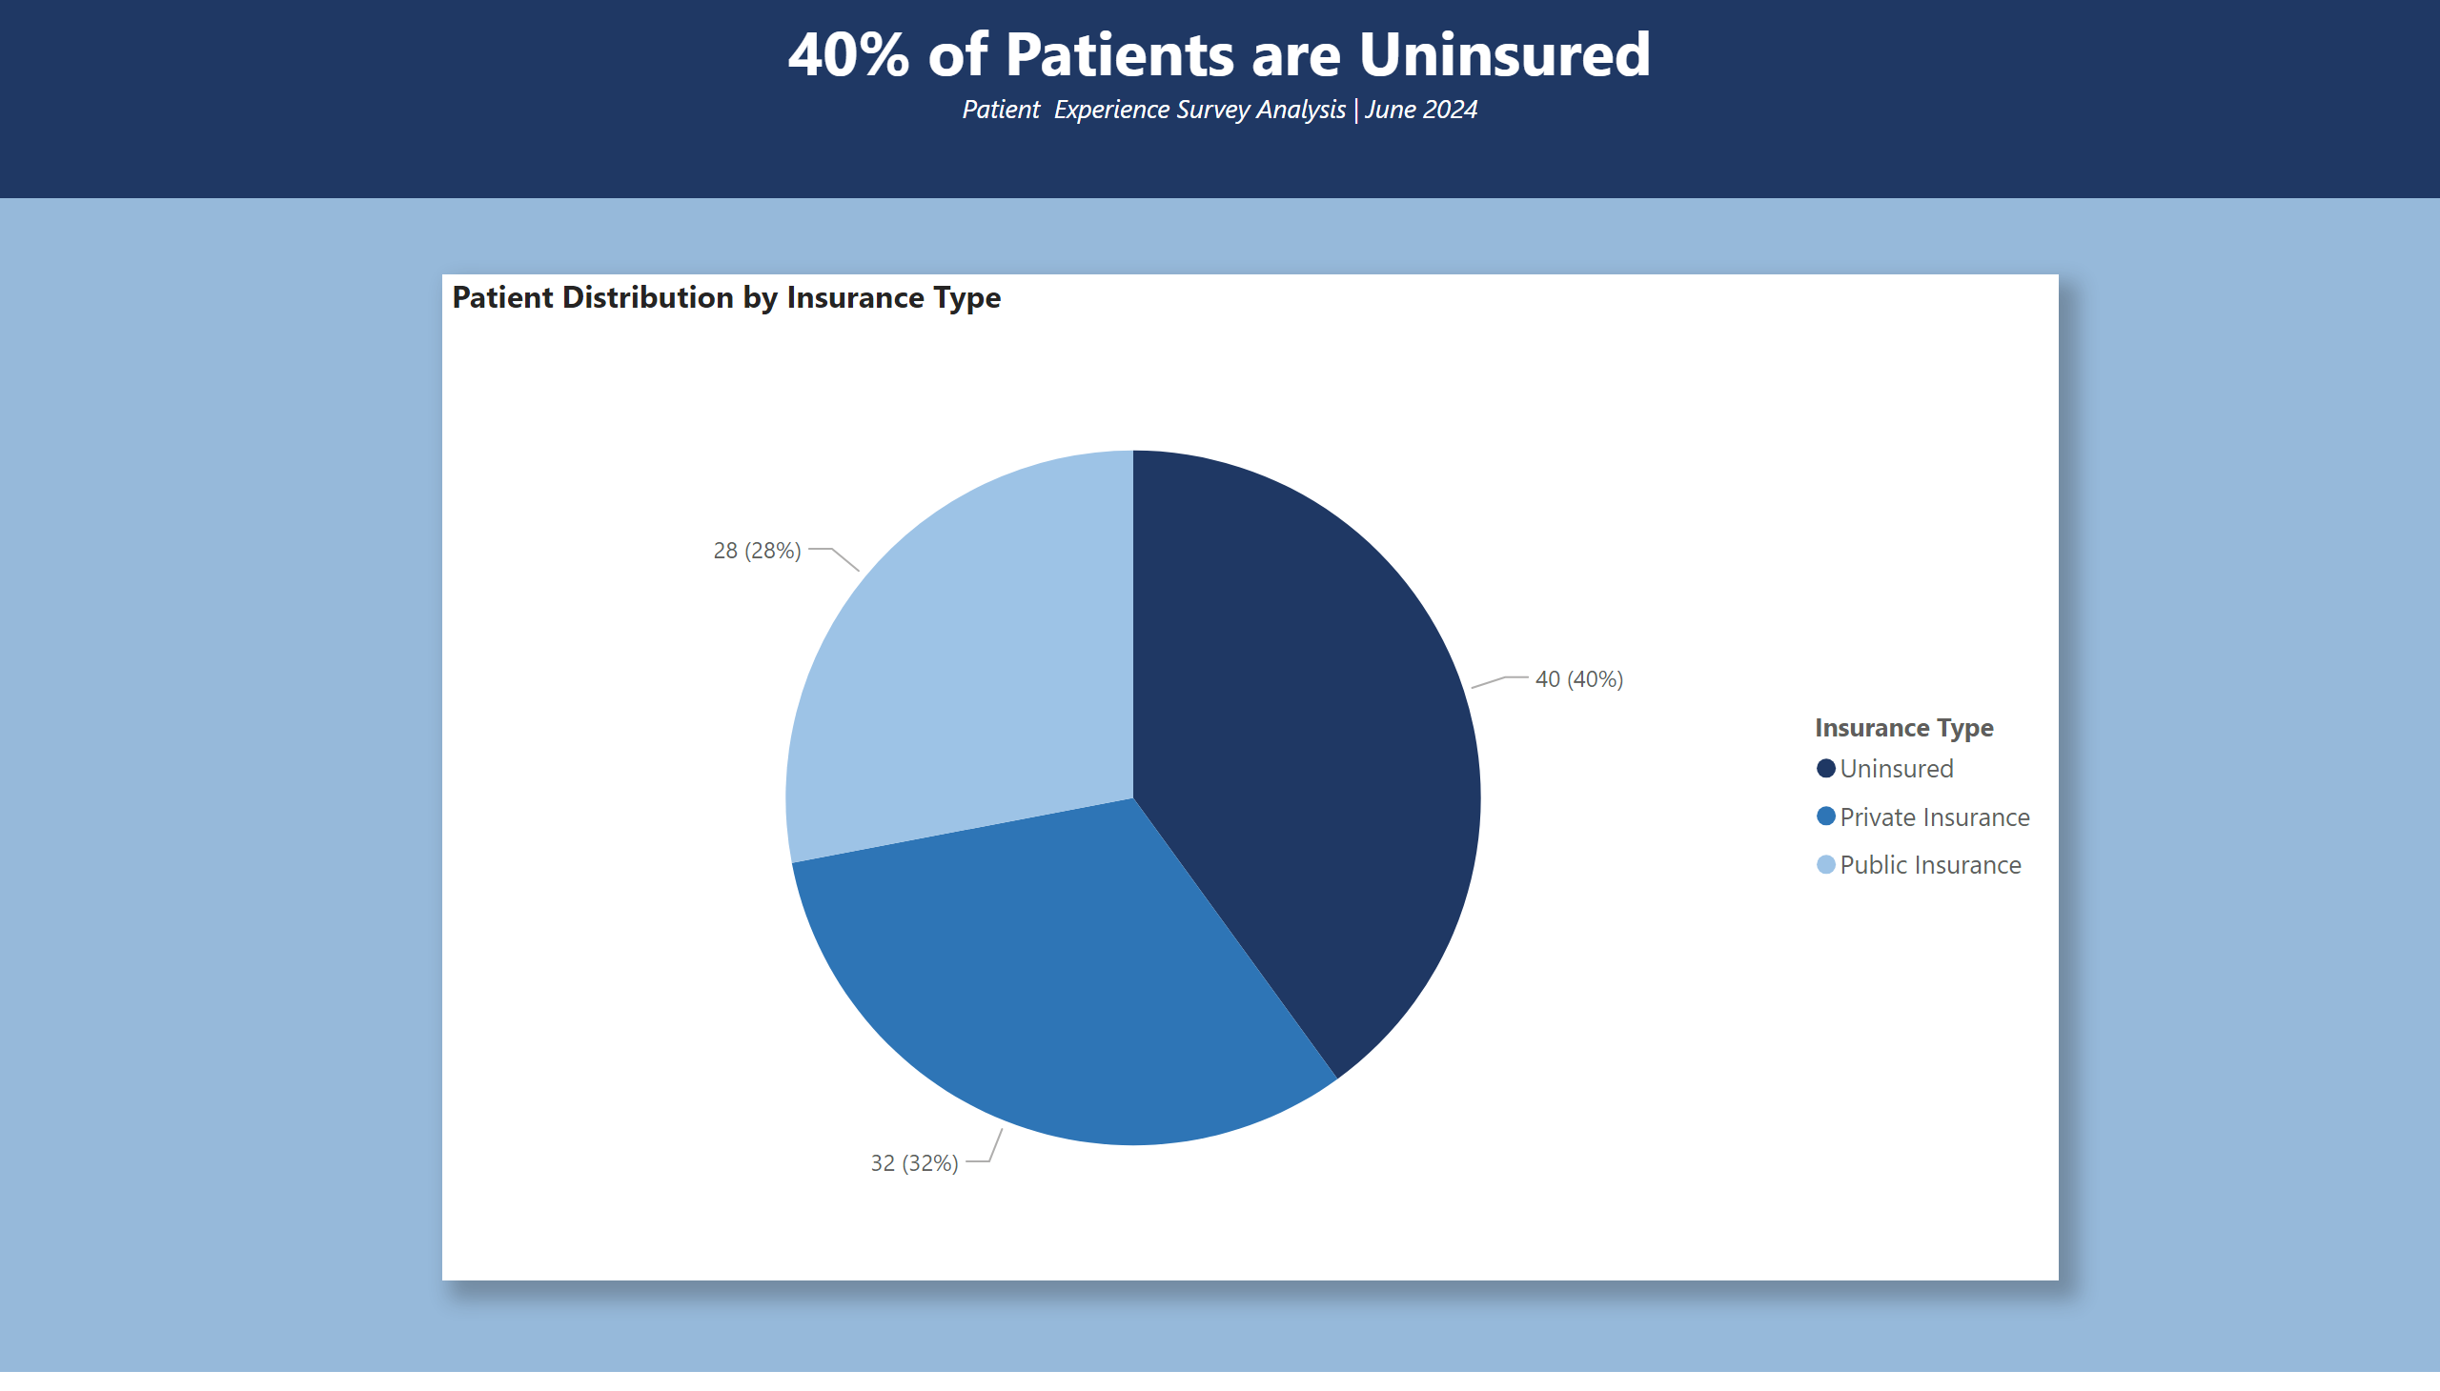
Pie Chart
Notes:
This Pie Chart reveals a striking finding—40% of patients seen at this practice are uninsured, making them the largest single patient group. Public insurance accounts for 32% of patients and private insurance represents 28%. The dominance of uninsured patients has significant financial implications for the practice, as insured patients are less likely to pay in full and more likely to delay care. This data suggests the practice should explore financial assistance programs, sliding-scale payment options, or partnerships with community health organizations to better serve this vulnerable population while maintaining financial sustainability. Understanding the insurance makeup of the patient population is essential for long-term strategic planning

Slide 5
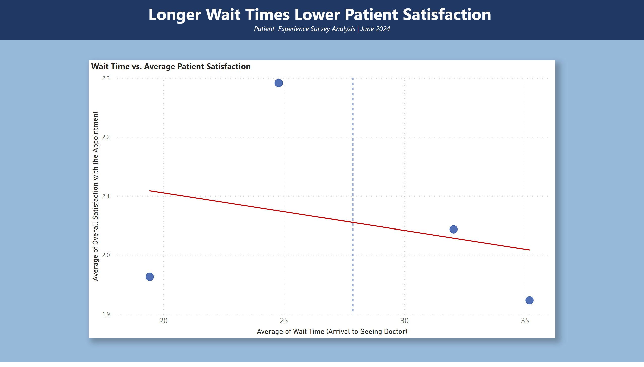
Scatterplot
Notes:
This scatter plot reveals a nuanced relationship between wait time and patient satisfaction. Patients who waited less than 20 minutes reported satisfaction scores below 2.0, suggesting that very short visits may leave patients feeling rushed or underserved. Satisfaction peaked at just under 2.3 among patients who waited approximately 25 minutes, indicating an optimal wait time range in which patients feel they received adequate attention. However, as wait times exceeded 30 minutes, satisfaction dropped to 2.0, and patients waiting beyond 35 minutes reported the lowest scores. The downward trending line after the 25 minute peak confirms that excessive wait times negatively impact satisfaction. This finding suggests the practice should target an optimal wait time of approximately 25 minutes — long enough for patients to feel heard and cared for, but short enough to respect their time. Simply minimizing wait time is not the solution — quality of interaction within that time matters equally.

Slide 6
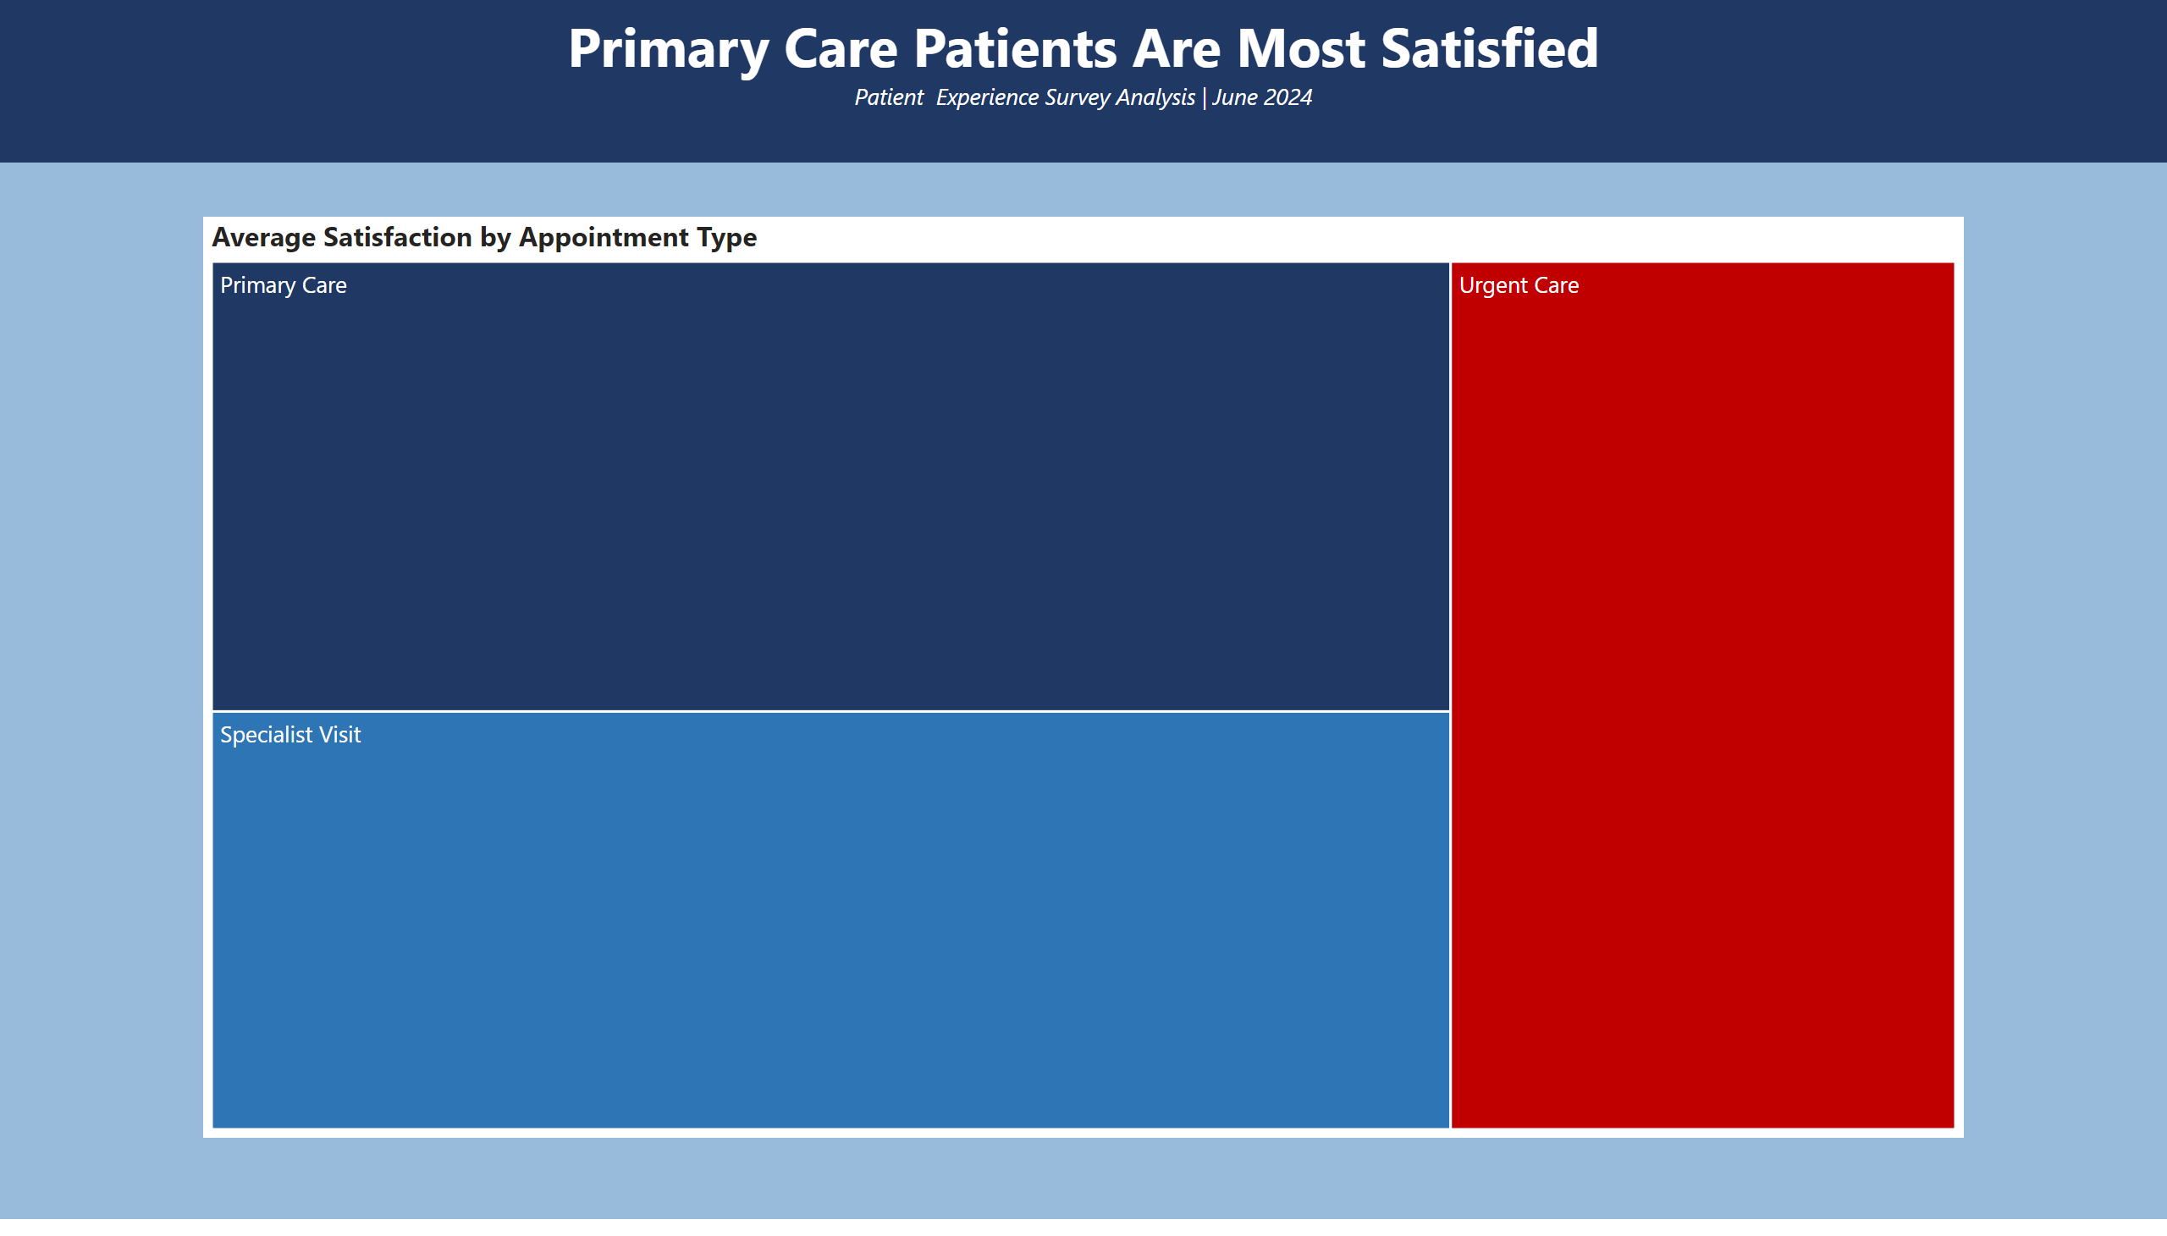
Tree Map
Patient Experience Survey Analysis | June 2024
Notes:
This tree map visualization shows the average satisfaction scores across three appointment types. Primary Care patients report the highest average satisfaction levels, represented by the largest dark navy rectangle. Specialist Visit patients report slightly lower satisfaction, shown by the medium blue rectangle. Urgent Care patients report the lowest satisfaction scores, highlighted by the red rectangle which immediately signals this as a problem area requiring attention. The size and color differences make it immediately clear that Urgent Care appointments need improvement. The practice should investigate what specific factors contribute to lower satisfaction in urgent care settings. Potential areas to explore include time constraints, complexity of issues, staffing availability, or patient expectations. Implementing targeted improvements in the Urgent Care department could significantly enhance overall practice satisfaction ratings.

Slide 7
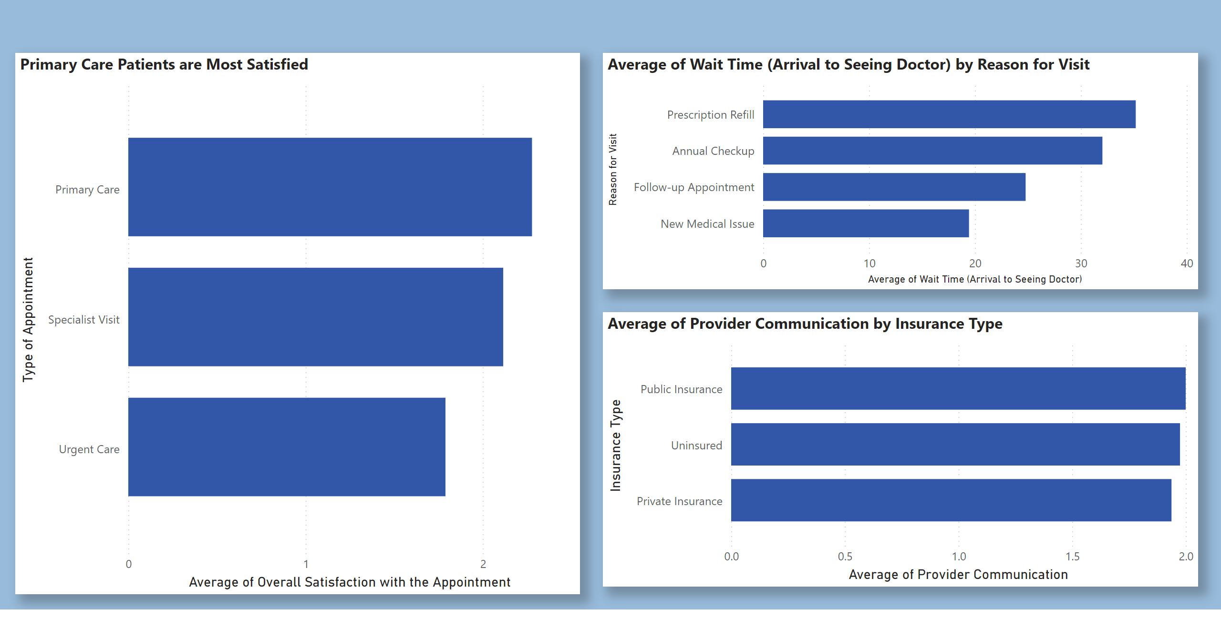
Q & A
Three Additional Patient Insights
Patient Experience Survey Analysis | June 2024
Notes:
Three additional visualizations were generated using Power BI’s Q&A artificial intelligence feature, which allows natural language queries to explore the data. First, Primary Care patients report the highest average satisfaction at approximately 2.0, while Urgent Care patients report the lowest, reinforcing findings from the Tree Map. Second, Prescription Refill visits have the longest average wait times at approximately 35 minutes, significantly higher than New Medical Issues, which average only 22 minutes. Third, provider communication scores are remarkably consistent across all insurance types, averaging approximately 1.8 to 2.0, regardless of whether patients are uninsured, publicly insured, or privately insured. This suggests that while providers communicate consistently across patient groups, there is significant room to improve communication quality overall across the practice.

Slide 8
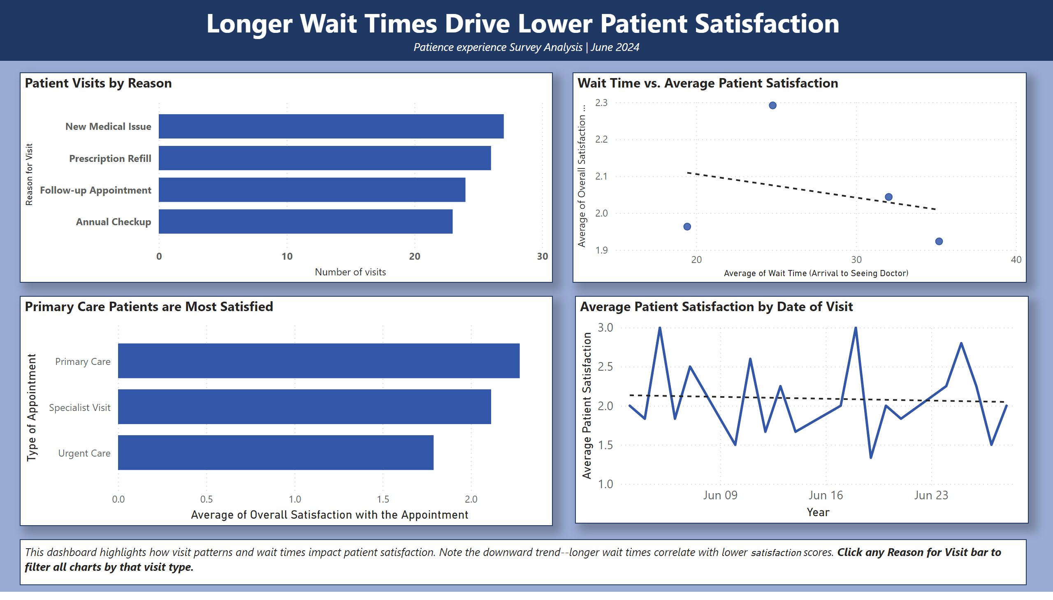
Dashboard Panel 1
Patient Experience Survey Analysis | June 2024
Notes:
This dashboard brings together four visualizations that collectively tell the story of how visit patterns and wait times impact patient satisfaction. The bar chart shows New Medical Issues drive the most visits, while the scatter plot confirms that longer wait times correlate with lower satisfaction scores. The Q&A visualization reinforces that Primary Care patients are most satisfied, and the line graph reveals daily satisfaction fluctuations throughout June. To interact with this dashboard in Power BI, click on any bar in the Patient Visits by Reason chart — this will filter all other visualizations to show data only for that visit type, allowing you to explore how a specific reason for visit affects satisfaction trends, wait times, and appointment type satisfaction simultaneously.

Slide 9
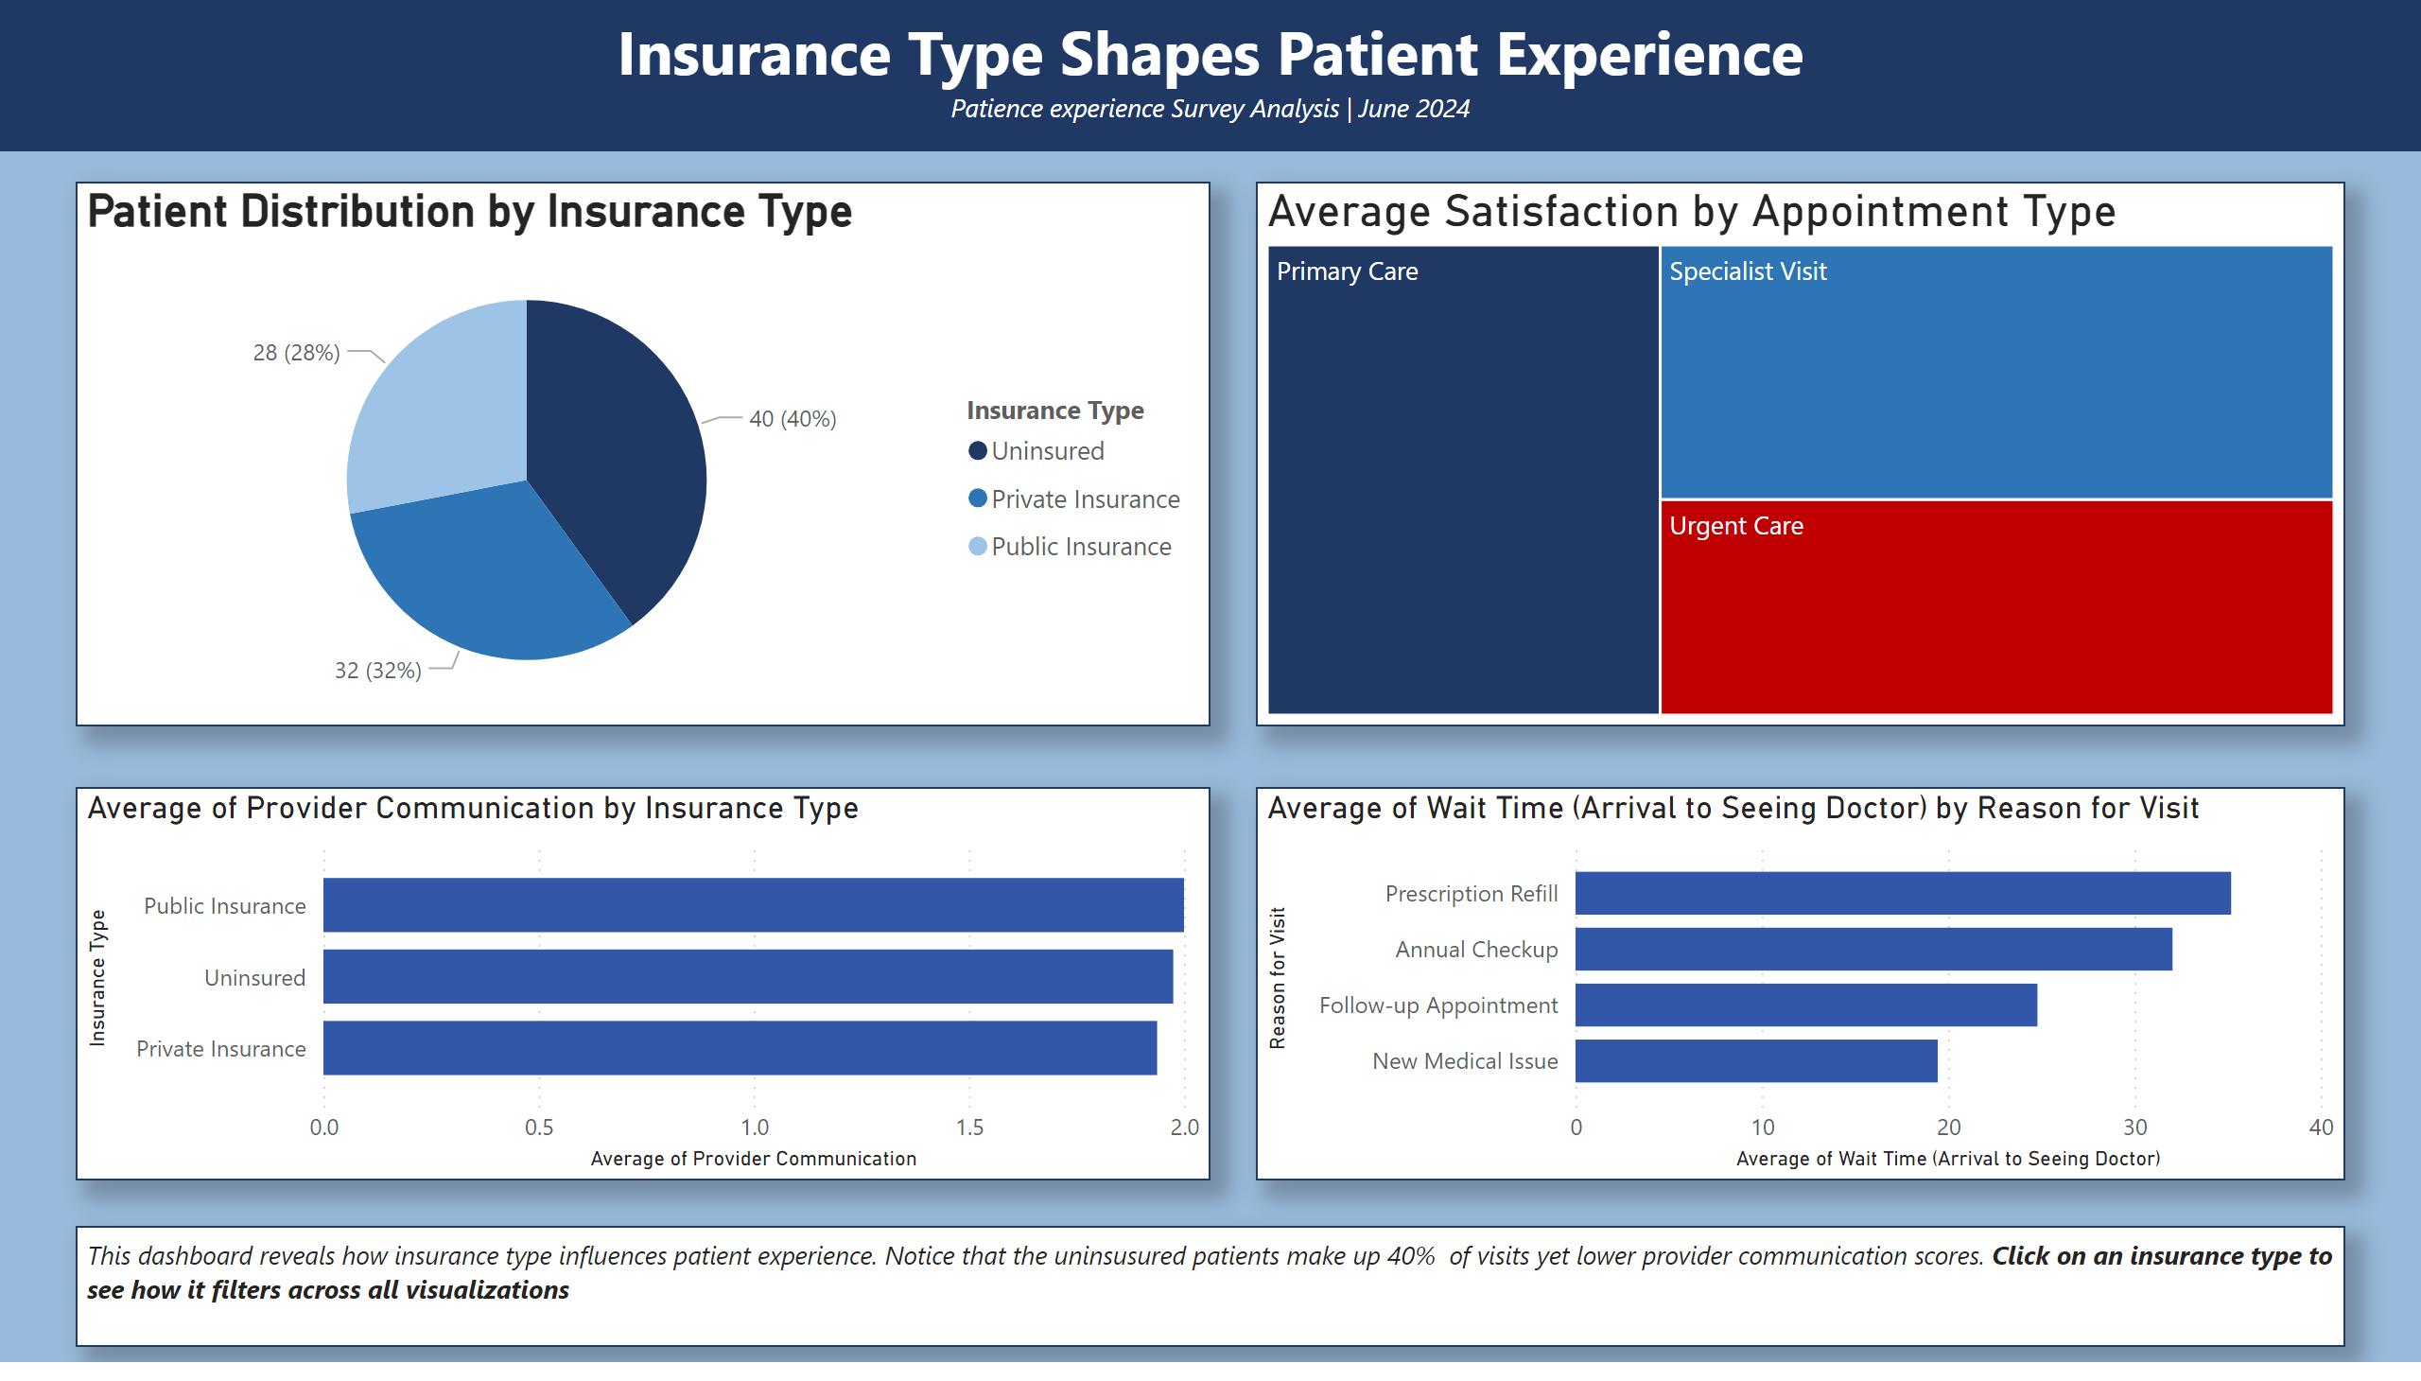
Dashboard Panel 2
Patient Experience Survey Analysis | June 2024
Notes:
This dashboard examines how insurance type and appointment category influence the patient experience. The pie chart immediately reveals that 40% of patients are uninsured — the largest single patient group. The tree map confirms that Urgent Care patients report the lowest satisfaction, highlighted in red. Provider communication scores remain consistent across insurance types, suggesting the issue is not provider behavior but rather systemic factors. The wait time chart shows Prescription Refills have the longest waits regardless of insurance type. To interact with this dashboard in Power BI, click on any insurance type slice in the pie chart — this will filter all other visualizations to show data only for that insurance group, revealing how insurance status affects wait times, appointment choices, and satisfaction scores.

Slide 10
Data-Driven Recommendations Patient Experience Survey Analysis | June 2024
Target 25-minute optimal wait times
Automate prescription refill processes
Expand financial assistance for uninsured patients
Improve Urgent Care patient experience
Increase provider communication training.
Notes:
Based on the data presented, this practice has five clear opportunities to improve patient satisfaction. First, our scatter plot reveals that satisfaction peaks at approximately 25 minutes — the practice should target this as the optimal appointment duration. Second, prescription refills represent the longest wait times at 35 minutes — implementing online or automated refill systems could significantly reduce this. Third, with 40% of patients uninsured, exploring sliding scale payment options and community health partnerships is essential. Fourth, Urgent Care patients report the lowest satisfaction scores and warrant immediate targeted improvement. Fifth, provider communication scores averaging only 1.8 to 2.0 across all insurance types suggest significant room for improvement through staff training.

Slide 11
References
Berinato, S. (2016). Good Charts: The HBR Guide to Making Smarter, More Persuasive Data Visualizations. Harvard Business Review Press.
Massachusetts Institute of Technology. (n.d.). Best practices for PowerPoint presentations. https://alum.mit.edu/best-practices-powerpoint-presentations
Microsoft. (2024). Power BI documentation. https://docs.microsoft.com/en-us/power-bi/
Patient experience survey data provided by University of Maryland Global Campus, Module 3 course materials.

