Slide 1
Final Project Instructions

Slide 2
Research Report - Final
Instructions are posted on Canvas
Some sections should be fully written and others can be in short form (bullet points or outline form).
Each group member must contribute one figure + one statistical analysis to the final paper.
This assignment (unlike the presentation) will be individually graded. You can copy and paste the figures and the output of their analyses from group members into your own paper, but you need to write about them in your own voice.

Slide 3
Sections
Title
Authors
include which figures each person made – see example in instructions
Abstract
fully written out
Introduction
bulleted or outlined with references – see template
Methods and Materials
fully written but limit field methods to 1 paragraph

Slide 4
Sections Cont
Results
Fully written out like the results section of a biology letters paper
Should include figures (all 4 from your group) and report results from all 4 figures
Each figure needs to have a figure caption that describes what is in the figure
You can copy and paste the stats summary tables from R and the figures from each group member, but the interpretation of the figures and stats should be written in the words of each individual
Please be sure to share the statistical output in the form of tables for each analysis you are leading!

Slide 5
Sections Cont.
Discussion
Bulleted/Outline of 4-5 paragraphs with references, see template)
Literature Cited
Use your citation manager to cite while you write and this section will be automatically created for you
Supplemental Information
Any stats tables you want to include that aren’t in the main text should go here (this will likely be identical across groups)
Code
The code that makes the figure and performs the statistical analysis associated with that figure must be submitted in the group project repository and referenced in your group README
Name the code file: LASTNAME_FIGURE#_FINALPROJECT.R

Slide 6
Examples
https://royalsocietypublishing.org/rsbl/article/22/4/20260016/481162/Impact-of-heat-stress-on-colony-foundation-in-ants?searchresult=1

Slide 7
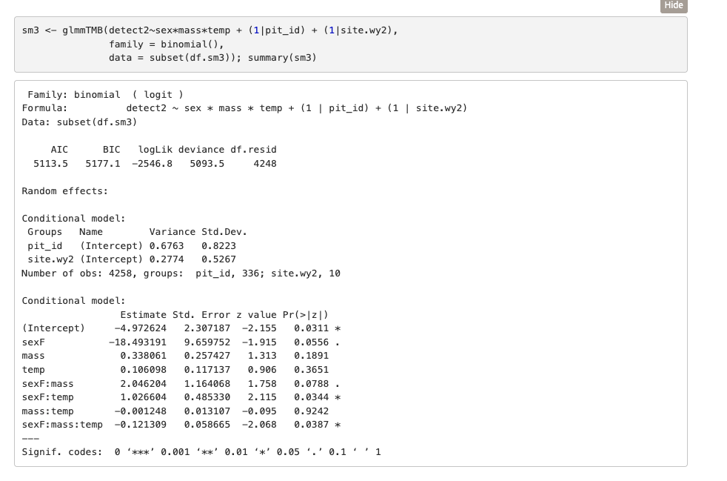
Example statistical tables:

