Slide 1
Data Visualization
Week 3

Slide 2
Github and assignment housekeeping
Assignment tips on Canvas
Clean up Github folders
Your project should contain:
Some scripts
One . Rproj file
A datafile
ONE readme.md file that tells you how these things go together
All of your scripts should run from beginning to end with no errors
Your README file should only contain a log, not actual code. Put your code in your scripts. (See example here: https://github.com/VTQuantMethodsEEB/klangwig/blob/master/README_example.md)
Every time you submit an assignment:
You will need to do a new COMMIT and type something in the box
Second, you will need to PUSH to share any changes to your files with me and send them to GitHub.
Each week you will need to PULL to see my comments on your scripts. Then, commit and push to send me your assignment.
Please annotate your code
If you have a question about something, you can ask in your code annotation
#I would like to print the names of the species that are higher than the mean, but I’m not sure how to do that
I will (try) to help and push back the script to you with how to do this! (Hopefully…)

Slide 3
Preparation
Install package “ggplot2”
Install package “gridExtra”
Fun extras:
Install package “viridis”
Install package “cowplot”
Install package “ggforce”
Install package ”shiny” (maybe we want to do this as an extension?)
Install package “ggthemes”
This is really awesome – use themes based on plots from The Economist, STATA, Excel 2003, Fivethirtyeight, WSJ, etc.

Slide 4
Goals
Participants will learn to think broadly about the effective uses of visualization
Understand previous research on visualization
Learn the ggplot2 package and some extensions

Slide 5
Check-In
How are you feeling today?
What questions do you still have from last week?
What do you already know about data visualization?

Slide 6
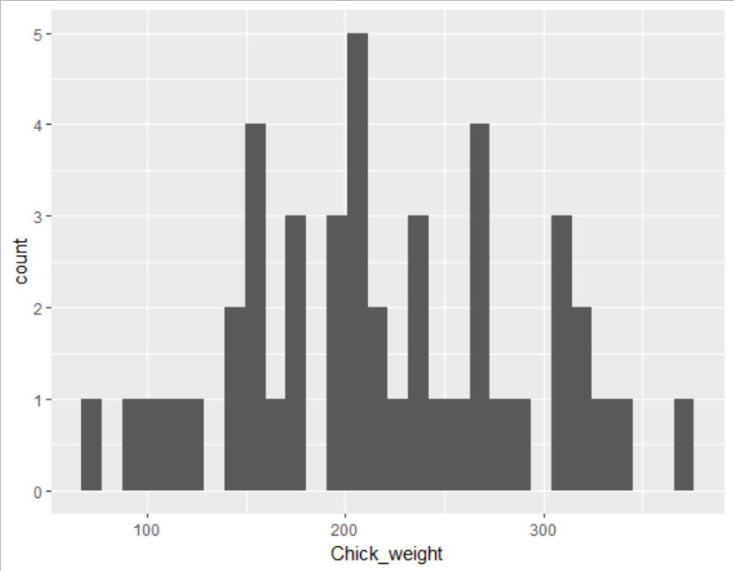
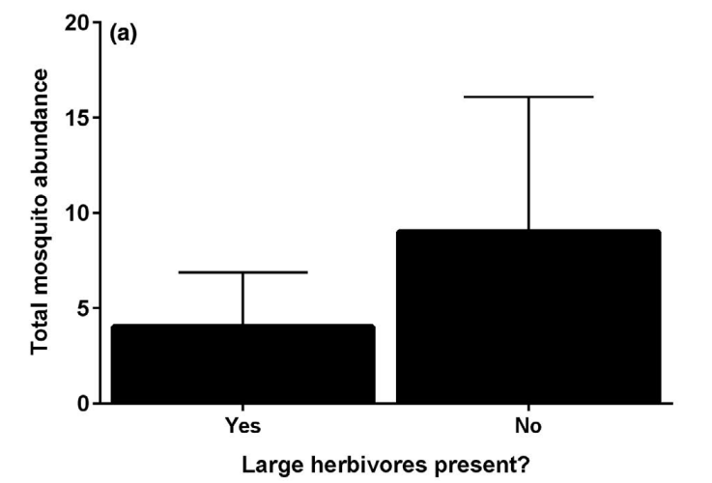
Why do We Make Graphs and Figures?
Understanding your data
Communicating your findings
Tchouassi et al. 2020

Slide 7



In-Class Exercise: How do we use figures to visualize different types of data?
Step 0: Get into groups of 3-4, each group take a handout sheet from the same packet. DO NOT look at anyone else’s paper!
Notes:
So we’re going to start off with an in-class exercise to get you thinking about what makes a figure an effective communication tool. We’re going to do this activity in groups of 4-6. Please divide yourselves up into groups of no smaller than 4 and no larger than 6. As I pass out these handouts please keep the packets face down and hand one out to each member of your group.
3 min

Slide 8

In-Class Exercise: How do we use figures to visualize different types of data?
Step 0: Get into groups of 3-4, each group take a handout sheet from the same packet.
Step 1: Read the finding at the top of your sheet and draw a figure that uses data to communicate the finding.
FOLD the top of the paper back on the dotted line
PASS the paper to the next person in your group
Notes:
1 min

Slide 9

In-Class Exercise: How do we use figures to visualize different types of data?
Step 2: You should see just a figure drawn by your group member at the top of your page. Write a statement that describes the pattern you see in the figure.
Notes:
1 min

Slide 10
In-Class Exercise: How do we use figures to visualize different types of data?
STEP 3: THINK about these questions:
How did you choose what type of figure to draw?
Which features were most important to understanding the figures drawn by your group members? Which were unimportant? Which missing features would have helped you understand?
Notes:
1 min

Slide 11
In-Class Exercise: How do we use figures to visualize different types of data?
STEP 4: DISCUSS your answers with your team members
How did you choose what type of figure to draw?
Which features were most important to understanding the figures drawn by your group members? Which were unimportant? Which missing features would have helped you understand?
Notes:
3 min pair
4 min share
15 min activity
Focus this on what is necessary to include
17:45 to here

Slide 12
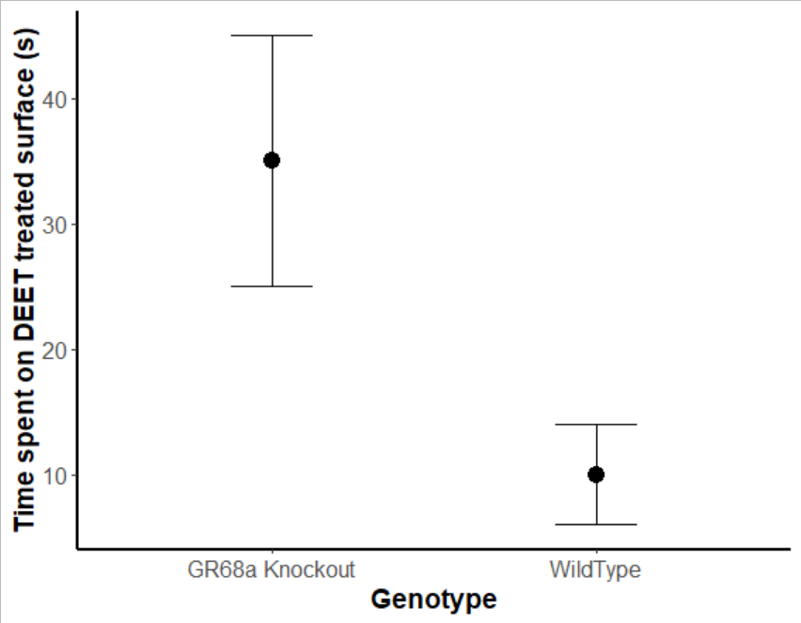
What features of a figure are most important?
*

Slide 13
What features of a figure are most important?
*
Clearly labeled axes tell the reader what the data represent

Slide 14
What features of a figure are most important?
*
Clearly labeled axes
Data presented as summaries (means) make interpretation easier

Slide 15
What features of a figure are most important?
*
Clearly labeled axes
Data (often presented as summaries)
Units and values let the reader interpret the size of the effect biologically

Slide 16
What features of a figure are most important?
*
Clearly labeled axes
Data presented as summaries
Units and values
Summaries of variation (like error bars) let the reader interpret the size of the effect statistically
Notes:
Error bars can be different things and should be specified

Slide 17
What features of a figure are most important?
*
Clearly labeled axes
Data presented as summaries
Units and values
Summaries of variation
Statistical significance markers tell the reader whether a statistical test found an effect to be statistically significant
Notes:
Clarify that we’ve already covered statistical significance

Slide 18
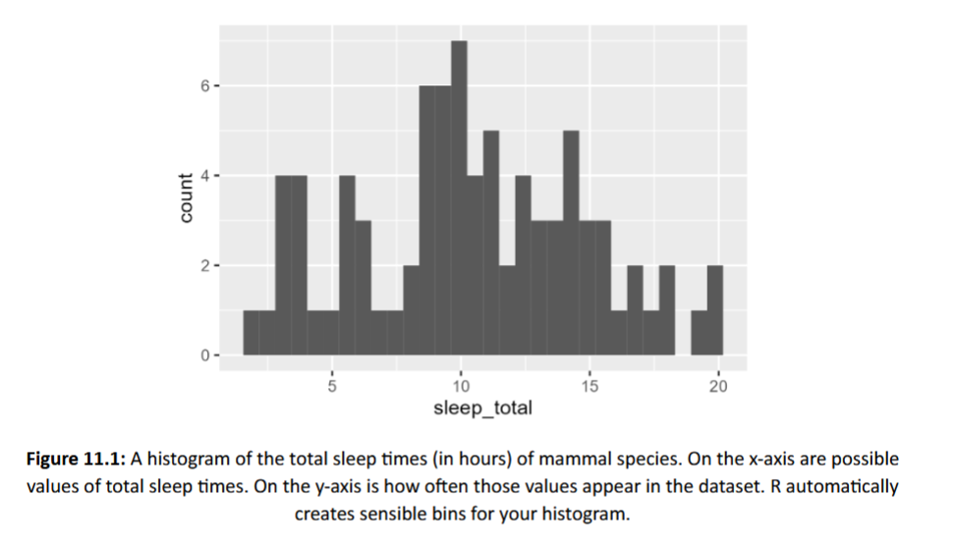
Histograms Display the distribution of a single quantitative variable across a dataset

Slide 19
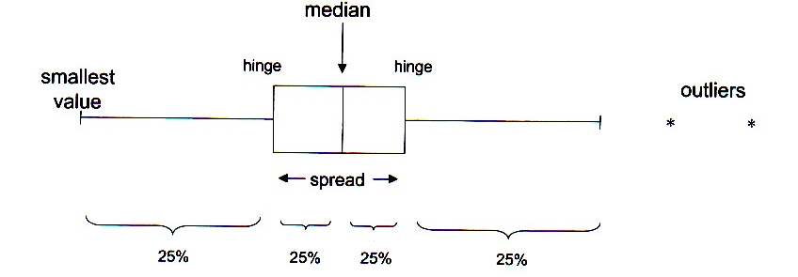
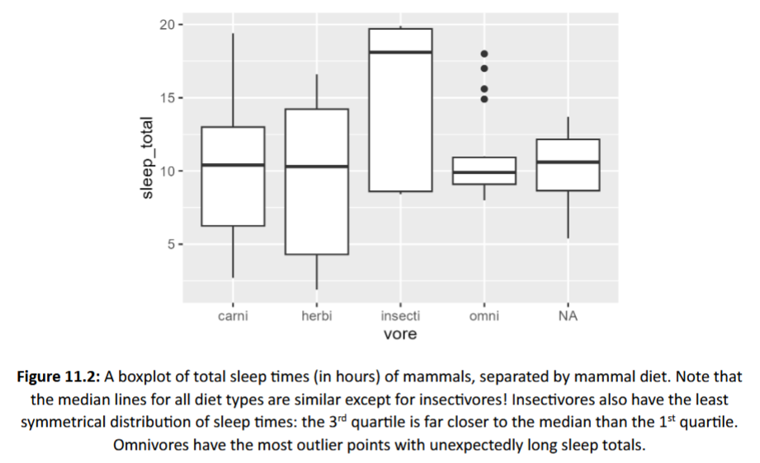
Boxplots Display the distribution of a single quantitative variable separated according to a categorical variable

Slide 20
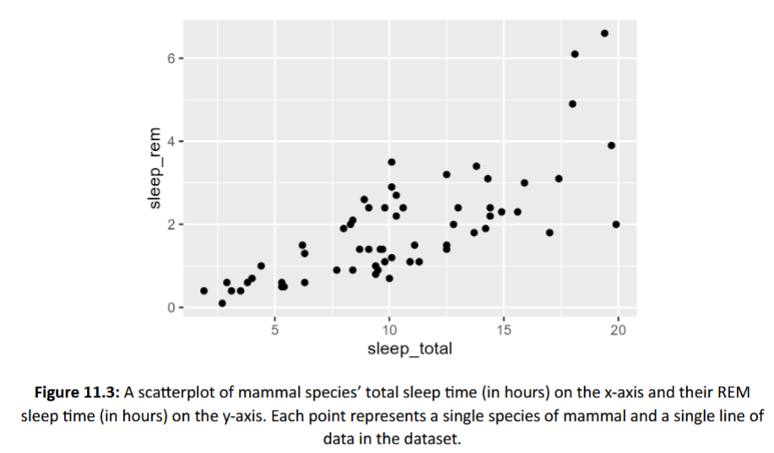
Scatterplots Display the value of each individual case for 2 separate quantitative variables

Slide 21
Some history on data visualization
There is a HUGE field dedicated to the perception of data (e.g. marketing, business, art)
Scientists rarely take these classes or know anything about it
There are a few exceptions that have “broken through” into our field

Slide 22
Cleveland & McGill 1984 Jour. Of the American Statistical Association.
They outline the problem – graphs are presented haphazardly
What’s in it? The paper describes a series of experimental studies to understand how basic visual primitives (e.g. color, length, size) compare in delivering quantitative information.
Why is it important? It presented a hierarchy for understanding data to best portray quantitative information.

Slide 23
Hierarchy (most to least accurate in perception of quantitative data)
Position along a common scale
Positions along non-aligned scales
Length, direction, angle
Area
Volume, curvature
Shading, color saturation

Slide 24
Examples of the elementary perceptual task
Saturation: not included because “expense” of color figs
Shading and hue: excluded from study because they do not have an unambiguous method for ordering from large to small
Notes:
Position along a common scale (bar chart, dot plots)
Positions along nonaligned, identical scales (small multiples)
Length, direction, angle (pie chart)
Area (treemap)
Volume, curvature (3-D bar charts, area charts)
Shading, color saturation (heat maps, choropleth maps)

Slide 25
Edward Tufte
Chartjunk: stuff that isn’t necessary to understand the graph

Slide 26
Edward Tufte
Small multiples:
A series of similar graphs using the same scale or axes
Prevalence of fungal infections on bats at multiple sites

Slide 27
Edward Tufte
Direct labeling:
Put the text on the figure

Slide 28
Direct labeling

Slide 29
Principles of Information Design
Tell the truth
Get to the point
Pick the right tool for the job
Highlight what is important
Keep it simple

Slide 30
The graph shows the relationship between cort and noise in all three species and two life stages. Baseline cort levels for both adults and nestlings were negatively affected by noise (Left and Center Columns, respectively), while acute stress-induced cort levels in nestlings were positively affected by noise (Right Column). For each model, the effect of noise was consistent across species, irrespective of species-specific cort levels. The gray-shaded areas indicate the 85% CIs for each estimated effect.
Kleist 2018 PNAS

Slide 31
Dengue epidemiology in Pakistan in 2013. (A) The location of dengue cases throughout Pakistan and the number of cases per week by tehsil. Tehsils that reported at least 15 cases are shown on the map with corresponding color shown in the time series. The majority of cases were reported in Karachi (gray), Lahore (blue), and Mingora (orange). The dengue season in the entire country lasted 35 wk, with the first reported case in Karachi during week 18 (end of April). (B) The reported cases (red), temperature (blue), and model fit (black) for Karachi are shown. Using the case and temperature data, the human and vector population dynamics were modeled (Materials and Methods).
Wesolowski 2015 PNAS

Slide 32
Kilpatrick 2006 Proc. Roy. Soc.
Notes:
(a) Relative abundance of birds at two residential sites and three urban sites. For scientific names see AOU (2005). (b) Percent of avian feedings from each host species based on identification of Culex mosquito blood meals by PCR amplification of the cytochrome b gene followed by DNA sequencing. Sample size of mosquito feedings in parentheses. (c) Feeding indices of Culex mosquitoes and 95% CI. Positive values are preferences; negative values designate avoidance and are calculated as (K1/Pi). Columns with an asterisk are minimum avoidance estimates (see §2). All preferences, except hatched columns, are significantly different from 1 (two-tailed p!0.05; all robin preferences p!0.0001). (d) Amplification fraction (proportion of abundance!feeding preference!reservoir competence) of each species, a surrogate for the fraction of West Nile virus infectious mosquitoes resulting from feeding on that avian host.

Slide 33
ggplot2
Best website for help: http://ggplot2.tidyverse.org/reference/
aesthetic mappings: between variables in the data frame and aesthetics, or graphical attributes (x position, y position, size, colour ...)
first two show up as (e.g.) ggplot(my_data, aes(x=age,y=rootgrowth,colour=phosphate))
geoms:
simple: geom_point, geom_line:
For great reference: www.r-graph-gallery.com
SWITCH TO CONSOLE

