Slide 1
Week 6 Science Writing & Distributions

Slide 2
Reading
Short paper on writing a scientific paper, quiz on Canvas
General suggestions for writing scientific results
Also note:
Tips for turning in Assignments

Slide 3
Scientific Writing Goals
Explain how to format a scientific paper
How to write statistical results
How to write figure and figure captions

Slide 4
Introduction
4-5 paragraphs
P1: General Scientific Background
P2: System Background Relevant to broader scientific question
P3: System background of relevance to more specific system question
P4: Here we do, xx in order to accomplish xx. We hypothesize ….

Slide 5
Methods and Materials
Written in active voice in past tense
Correct: We analyzed
Not: We are analyzing OR Data was analyzed
Two sections:
Field/Lab Methods:
swallows: See biology letters paper, bats: See Hoyt 2020 PNAS
One write paragraph here summarizing them and refer reader to those papers
Statistical Analyses
Written by you

Slide 6
Results section
Figures and Statistical results (written in relation to biology)
Should include estimate of size of effect (e.g. on average xx bigger, or coef=xx +- SE)
Should include standard errors of coefs
Should include p-values
Should be written based on directionality
Good statement:
Temperatures of hibernacula increased as outside climate temperatures increased (coef = 3.88 +/- 1.03, P = 0.0081).
Bad statement:
Hibernacula temperature was correlated with outside climate temperature (P < 0.05)

Slide 7
Discussion
4-5 paragraphs
Usually Goes from Broad to Narrow to Broad
P1: restates and addresses the original question from the introduction and includes how the results answer this question, restates main finding
P2: Secondary findings of interest
P3: caveats
P4: Broad conclusion of the work and future directions

Slide 8
Review – linear models and tests
We learned about tests and linear models
We learned that some tests have assumptions of normality and linearity

Slide 9
Goals
Understand the general concept of probability distributions
Describe discrete versus continuous distributions
Solve problems in probabilistic terms, choosing the correct distribution for your response variable

Slide 10
Distributions
Assessing knowledge
What distributions do you know?
Although the normal distribution is most commonly taught and used for general linear models and tests, there is an entire WORLD of probability distributions
For any variable you might plot on your y-axis, there is a distribution that exists
You do NOT need to always normalize your data to do analyses
Finding the proper distribution and running a different kind of model (generalized linear models) is usually a better solution
Today we will learn about what distributions you might use in the future

Slide 11
What is a probability distribution?
A probability distribution is a mathematical function that describes the occurrence of different outcomes in your study or experiment
In math, this is described as the possible outcomes of a “random” variable after conducting an “experiment”
The easiest way to think of this is a coin flip
What are the possible outcomes of this experiment?

Slide 12
Discrete probability distributions
Discrete = individually separate and distinct
The outcome distribution can only take specific numbers
A coin flip is a discrete distribution
Counts of animals are discrete. Why?
The list of outcomes is known as a probability mass function.
It gives the probability that your experimental outcome is exactly equal to some value.

Slide 13
Continuous probability distributions
Used when the outcome of an experiment can take on “real” numbers
Real number = value that is any distance on a number line
Temperature and weight would be described by a continuous probability distribution
Other examples?
The probability of an outcome from a continuous probability distribution is called a probability density function (PDF)
What is the probability of a lizard’s being weight exactly = 7.456723464 grams?
PDFs therefore give the relative likelihood – or the probability that the outcome of your experiments falls within a particular range of values
What is the most commonly used continuous probability distribution?

Slide 14
Normal distribution
A type of continuous probability distribution
Also called “Gaussian” distribution
Many things are thought to be normally distributed, and frequently errors after fitting a model (called “residuals”) are thought to be normally distributed
Many statistics (developed under “lamppost theory”) use methods developed for the normal distribution
What tests have we learned about that rely on the normal distribution?

Slide 15
A tree of distributions
curve(dgamma(x,1),0,20)
curve(dgamma(x,10),0,20)
curve(dbeta(x,1,1),0,1)
curve(dbeta(x,10,10),0,1)
curve(dbeta(x,2,5),0,1)
curve(dbeta(x,5,2),0,1)

Slide 16
Distribution properties

Slide 17
Means, Variances, and higher moments
Every distribution has an average value that is called its mean or expectation
Important to remember though: calculating the mean and variance is not always the same as for the normal distribution

Slide 18
Binomial distribution
Discrete distribution
Binomial distributions are used when you have a fixed number of subsamples or trials, and each trial can have 1 of 2 possible values
For your purposes, you will use this when your outcome variables are 0 or 1, alive or dead, red or blue, etc.
When calling a binomial in a glm, also called “logistic regression”

Slide 19
Probability mass function of binomial distribution
a function that gives the probability that a random observation is exactly equal to some value
E.g. the probability of getting exactly 5 (k) heads in 8 (n) coin flips (fair coin p = 0.5)
We can write the function for the PMF of the binomial distribution
The “parameters” of this distribution are n and p
n is the number of trials (called “size” in R)
p is the success probability of each trial (a value between 0 and 1)
(called “prob” in R)
k is the number of successes (called “x” in R)
Notes:
The probability of getting exactly k successes in n independent Bernoulli trials
N choose k which is n! / k! (n-k)!

Slide 20
Cumulative distribution function
The probability that a random observation will take a value less than or equal to some value
E.g. BLUE LINE, circle:
the probability of getting 10 or fewer heads after 20 coin tosses in a fair coin (prob of getting heads = 0.5)
RED LINE, circle:
the probability of getting only 10 or fewer heads after 40 coin tosses in a fair coin (prob of getting heads = 0.5)
Probability
Number of heads (successes)
Notes:
Shown on right: x-axis is number of heads (success), N is number of times you flipped it in a row, p is the probability of success (heads) on each flip.
What is the probability of getting 10 or fewer heads if you flipped the coin 40 times? (red line)
What is the probability of getting 10 or fewer heads if you flipped the coin 20 times? (blue line)
Why?

Slide 21
Binomial distribution example
We want to determine what we can reasonably expect infection to be at 10 sites if the global probability of infection is 48%
Use code like this to find out the “results” (the fraction of bats infected) from 10 sites of 100 bats (trials), with a 48% probability that a bat will be infected
rbinom(n = 10, size =100, prob = 0.48)/100
What is the fraction of bats that will be infected in a population of 100? 1,000? 1,000,000?
Notes:
As we get larger numbers, we converge on 48%

Slide 22
Poisson distribution
Discrete
Gives the distribution of the number of individuals, arrivals, events, counts
The numbers in your experimental outcome can be infinity, but the numbers need to be round numbers
E.g. The number of butterflies in your plots, the number of plants in a quadrat
The binomial distribution had 2 parameters, but the Poisson has a single parameter – lambda
The mean of Poisson and the variance of the Poisson are the same value – also both lambda
What problems can you envision when using the Poisson distribution?

Slide 23
Negative Binomial
This is most commonly used for overly dispersed count data (discrete)
(Most count data in ecology seem to be overly dispersed!)
It is a special case of the Poisson
It is not a binomial
Two parameters mean and dispersion
mean (“mu” in R)
dispersion (k, “size” in R)
As the k goes down, dispersion goes up!

Slide 24
Zero-inflated distributions
Discrete mixture distribution
Use when you have count data with a lot of 0s
Possibly include as a separate topic?
Zero-inflated probability distributions are called “mixture distributions”
Often, they model the probability of transitioning from 0 to 1, and 1 to Inf separately (called a “hurdle model”)
The most common version of this is the zero-inflated negative binomial
zeroinfl in pscl package - https://www.rdocumentation.org/packages/pscl/versions/1.5.2/topics/zeroinfl
Options are all discrete!
It is not that complicated though to extend to continuous – see http://seananderson.ca/2014/05/18/gamma-hurdle/

Slide 25
Gamma
Continuous
Two parameter, right skewed distribution
Important: R’s parameterization of this distribution is wacky.
The gamma distribution typically has a shape parameter k and a scale parameter θ .
In R, it has the shape parameter α , and an inverse scale parameter β = 1 / θ
I use the Gamma quite a bit – lots of things are right skewed and continuous
Something to be careful of when we start using gamma glms (I’ll remind you again then)– the canonical link function (the function that makes the outcome linear) is inverse. Therefore, when you interpret your coefficient output, it is the OPPOSITE of what you think – negative coefs are positive, and vice versa.
0 is not included in the gamma distribution; it is not uncommon to add a small “continuity correction” to make your zero values >0 (e.g. add 0.0001 to all values). (Note: I wouldn’t do this is you have a lot of 0s, or if zero means something very specific in your dataset.)
Notes:
Greek letter = theta

Slide 26
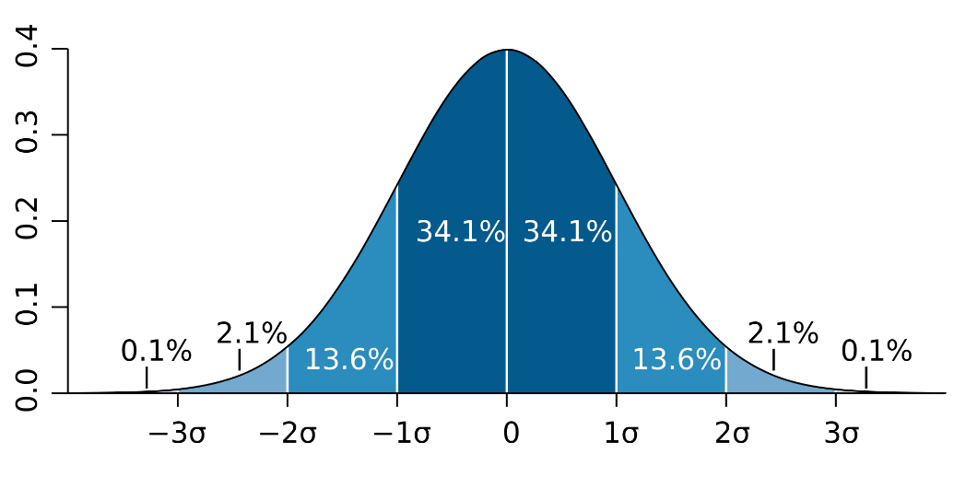
Distributions in R
R has a standard set of functions for each distribution
Normal: dnorm, pnorm, qnorm, rnorm
Binomial: dbinom, pbinom, qbinom, rbinom
Poisson: dpois, ppois, qpois, rpois
Negative binomial: dnbinom, pnbinom, qnbinom, rnbinom
Etc.
Density, (cumulative) distribution function, quantile function and random number generation

Slide 27
Density function (dnorm, dbinom, dgamma, dpois, etc.)
dnorm is the function that calculates the probability density function (PDF) of a normal distribution (or PMF for discrete distributions)
Density functions in R are generally more useful for discrete events than continuous (e.g. binomial distributions rather than normal)
This is because the probability of any given value in a continuous distribution is 0, so you need a range, and you need to add up all the probabilities within that range under the curve (e.g. integrate)
The PDF is essentially used to specify the probability of a random variable (e.g an outcome, like number of lizards perching) falling within a particular range of values, as opposed to taking on any other value

Slide 28
Relationship between PDF/PMF and Likelihood function
The likelihood function give us an idea of how well our data summarizes the parameters of distribution
We will ‘maximize the likelihood’ when fitting models and likelihood is closely tied (often exactly the same) as the PDF
While likelihoods and PDFs look the same, they are a bit different philosophically
PDF: functions of data points that tell you how likely it is that certain data point appears. In our coin flipping example, we think of p as constant (0.5)
Likelihoods: take the data set as given and represents the likeliness of different parameters for your distribution. In our coin flipping example, for a likelihood, we would assume our data are constant and we are estimating p.
Our computer alogorithm will guess values of p and say, given the data, which p is more likely
Imagine we toss a coin 20 times and get 10 heads. Is p 0.5 or 0.47 or 0.51 ?

Slide 29
dbinom
dbinom calculates the PMF of the binomial distribution
Suppose that I know that infection prevalence (e.g. probability of infection) is 20% (e.g. 0.2). What is the probability that one bat out of 25 is infected?
dbinom(x = 1, size = 25, prob = 0.2)
Can also write dbinom(1,25,0.2)
#we use x=1 because we want to know the probability that exactly one 1 bat of 25 is infected at a global infection prevalence of 20%

Slide 30
P functions (e.g. pnorm, pbinom, etc)
Pnorm gives the cumulative distribution function
This means that it gives the sum of all the probability from the lower end of the distribution (e.g –Inf) to q (the value you are interested in a cut off)
Pnorm is the function that replaces the table of probability values and z-scores you might see at the back of a statistics text book
Pnorm says what is the probability that the value is less than or equal to x

Slide 31
pnorm example
Suppose a weight of a lizard is normally distributed with a mean of 17 grams, and a standard deviation 3. What is the probability that a lizard in a given population weighs less than 19 grams?
pnorm(q = 19, mean = 17, sd =3)
#what is the probability a lizard weighs MORE than 19 grams?
pnorm(q = 19, mean = 17, sd =3, lower.tail = F)
Lower tail gives P[X > x]

Slide 32
pbinom example
Suppose that I know that infection prevalence (e.g. probability of infection) is 20% (e.g. 0.2). What is the probability that NO MORE THAN one bat out of a sample size of 25 is infected?
What is your intuition?
Suppose that I know that infection prevalence (e.g. probability of infection) is 20% (e.g. 0.2). What is the probability that NO MORE THAN five bats out of a sample size of 25 are infected?
What is your intuition?
This is a useful way of thinking about sample sizes (e.g. the probability of not detecting a single infected bat given my sample and a presumed prevalence)
Notes:
pbinom(q=1,size=25, prob = 0.2)
[1] 0.02738973
> pbinom(q=5,size=25, prob = 0.2)
[1] 0.6166894

Slide 33
quantiles functions (e.g. qnorm, qbinom, qpois)
The quantile functions calculates the inverse of the cumulative distribution function (which you can think of as the inverse of pnorm)
It says, given a known probability between 0 and 1, what is the percentile of that value?
Given a p between 0 and 1, qnorm will like up the p-th quantile of the distribution

Slide 34
qnorm example
Suppose that femur length of fossilized mammoths is normally distributed with a mean of 115 cm, and a standard deviation of 15 cm. What would the 85th percentile of femur length be?
qnorm(p =0.85, mean=115, sd=15)
“q” functions can tell you how “extreme” your value is if you have a known mean and sd (or other parameters)
Notes:
130.5465

Slide 35
Random draws (rnorm, rbinom, rgamma, rpois)
This function will simulate random variates from a specified distribution with certain attributes
These are very useful for simulation, bootstrapping, etc.

Slide 36
Random draw examples
Let’s take 100 random draws from a Poisson distribution
This distribution has a single parameter! Lambda.
rpois(100, lambda = 3)
Take 50 random draws from a negative binomial distribution
x = rnbinom(50, size = 10, mu = 2)
Ecological parameterization is usually size (dispersion or k) and mu (mean)
Non-intuitively, a smaller “size” means more overdispersion

Slide 37
Two (or more) levels of understanding of distributions
Pragmatic/utilitarian understanding
Properties of distributions
When to use them
Deeper understanding
Theoretical derivation

Slide 38
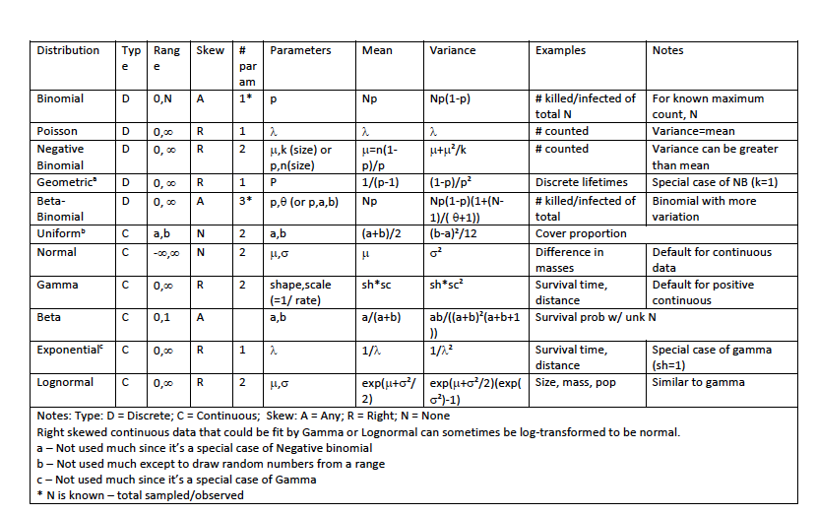
Use this chart to answer the next slide

Slide 39
What distributions would these be?
Counts of bats, microbes, predators
Density of bears, big cats
Weight of soil cores
The number of hatched hellbender eggs
survival time of plants/birds/ extinct organisms (?)
Number of behaviors performed by snakes
Concentration of chemical, pathogens, oxygen
Answer to question: Was the fish nest abandoned?

Slide 40
Exercises
A wolf population has 500 pairs remaining. If each wolf pair normally has around a 4 pups, but the fraction of wolves born with a lethal recessive allele is 0.2, how many live offspring are likely to be born alive? (Hint – you need to draw randomly from 2 different distributions!)
If there are 1000 seeds in a seedbank and each seed has a 2% chance of being eaten and a 1% probability of sprouting each day, how many seedlings would we expect to see sprouting each day?
The number of eggs laid by squid varies dramatically among individuals. The mean number of eggs is 300, but the dispersion is 1. What is the 85th percentile of the number of eggs laid?
I census 15 populations of pikas on 15 mountains. I find that the average population size is 10. What is the probability of a population of more than 12 individuals? (Hint – there is information here that you don’t need…)

