Slide 1
DataDive 2014
Activity Strategic Planning
(Data Clean)

Slide 2
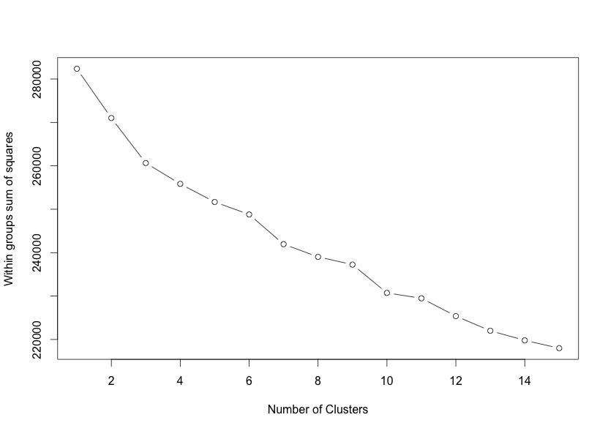
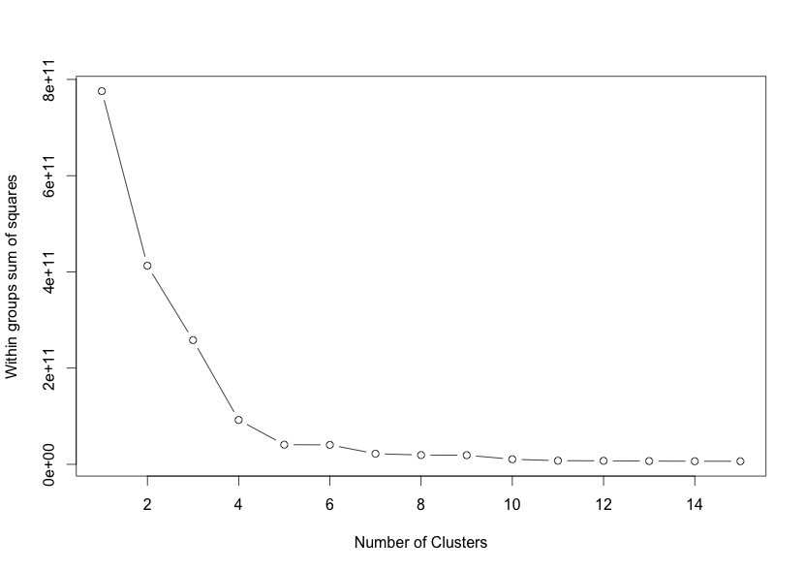
Question
Are there distinct groups of patients that experience different experiences with Shooting Star Chase?
How are they different and what can we do for them?
Groupings highly sensitive to attributes!
Cluster | Priority 1 Visits | Priority 2 Visits | Visits | Minutes
1 | 4.08 | 49.58 | 125.75 | 98,968
2 | 3.34 | 6.81 | 32.00 | 102,157
3 | 1.60 | 11.02 | 16.88 | 30,770
4 | 1.06 | 2.02 | 3.37 | 7,551

Slide 3
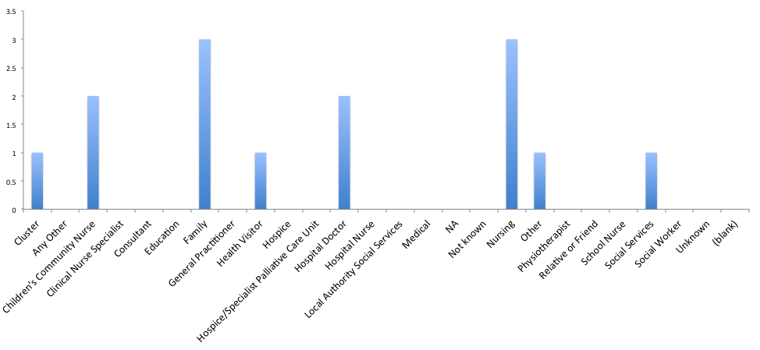
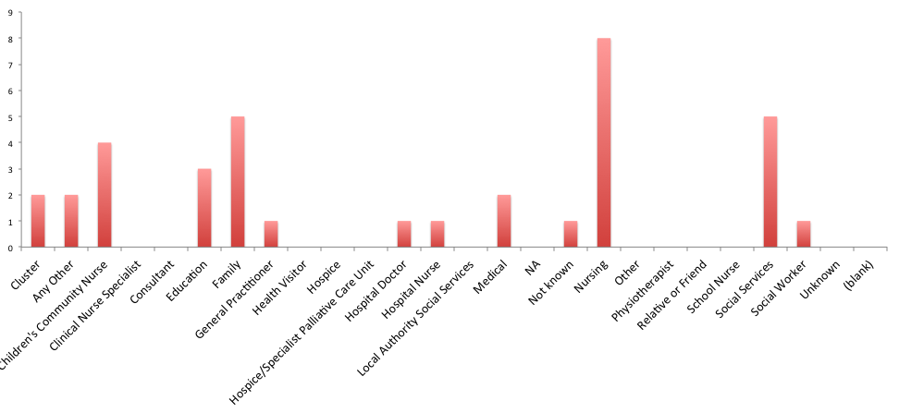
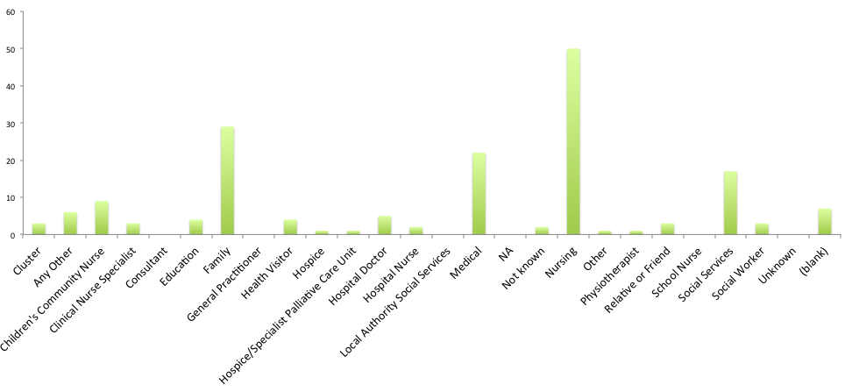
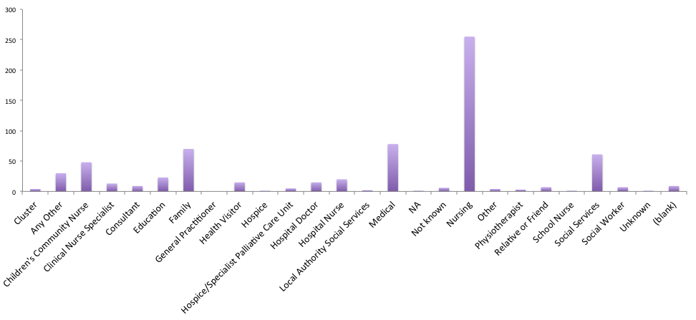
Insights/Findings
Cluster 1
Cluster 2
Cluster 3
Cluster 4

Slide 4
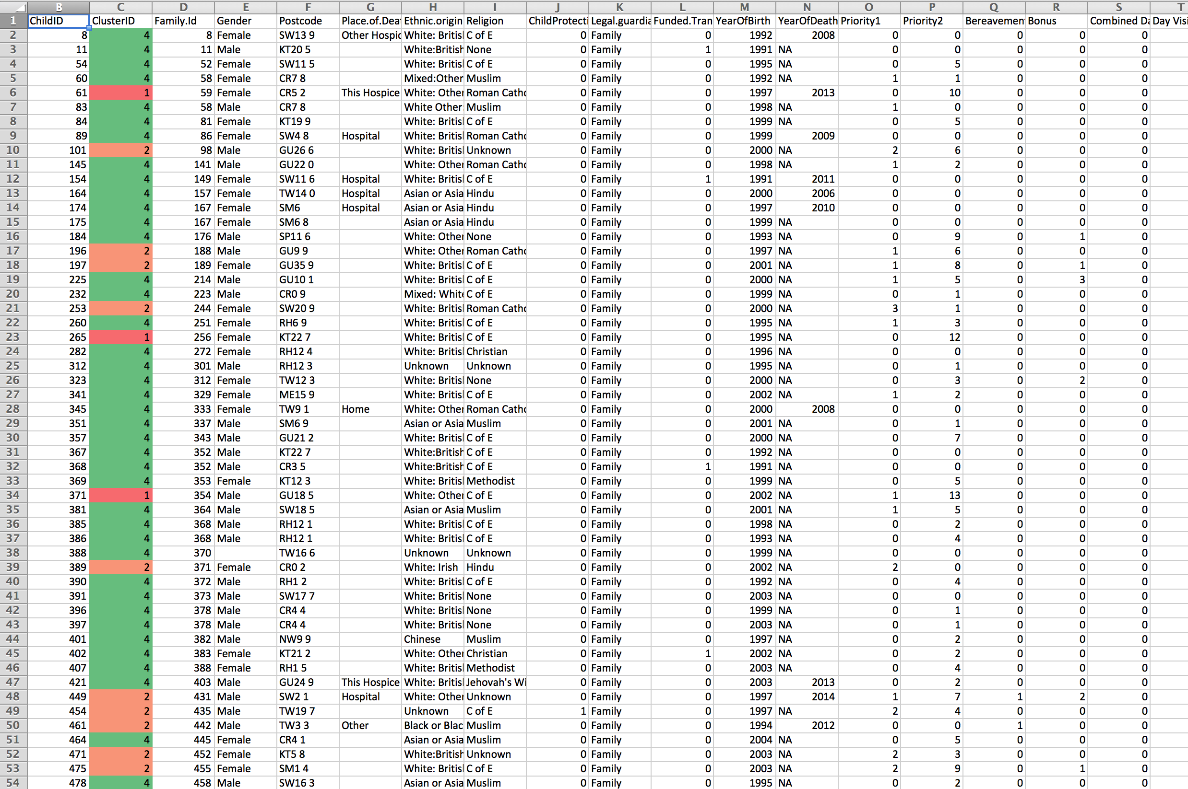
What this means for Jo and SSC
Something to take away with you …

