Slide 1
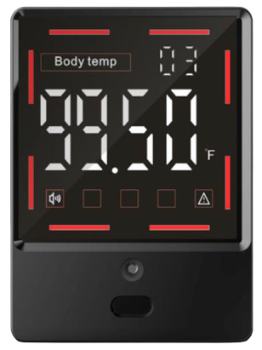
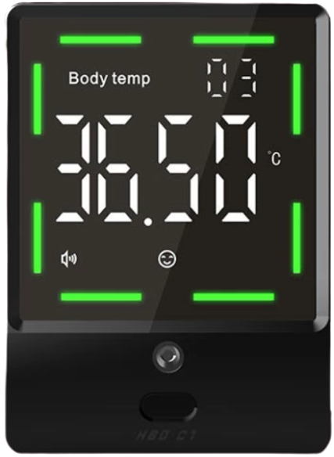

Slide 2

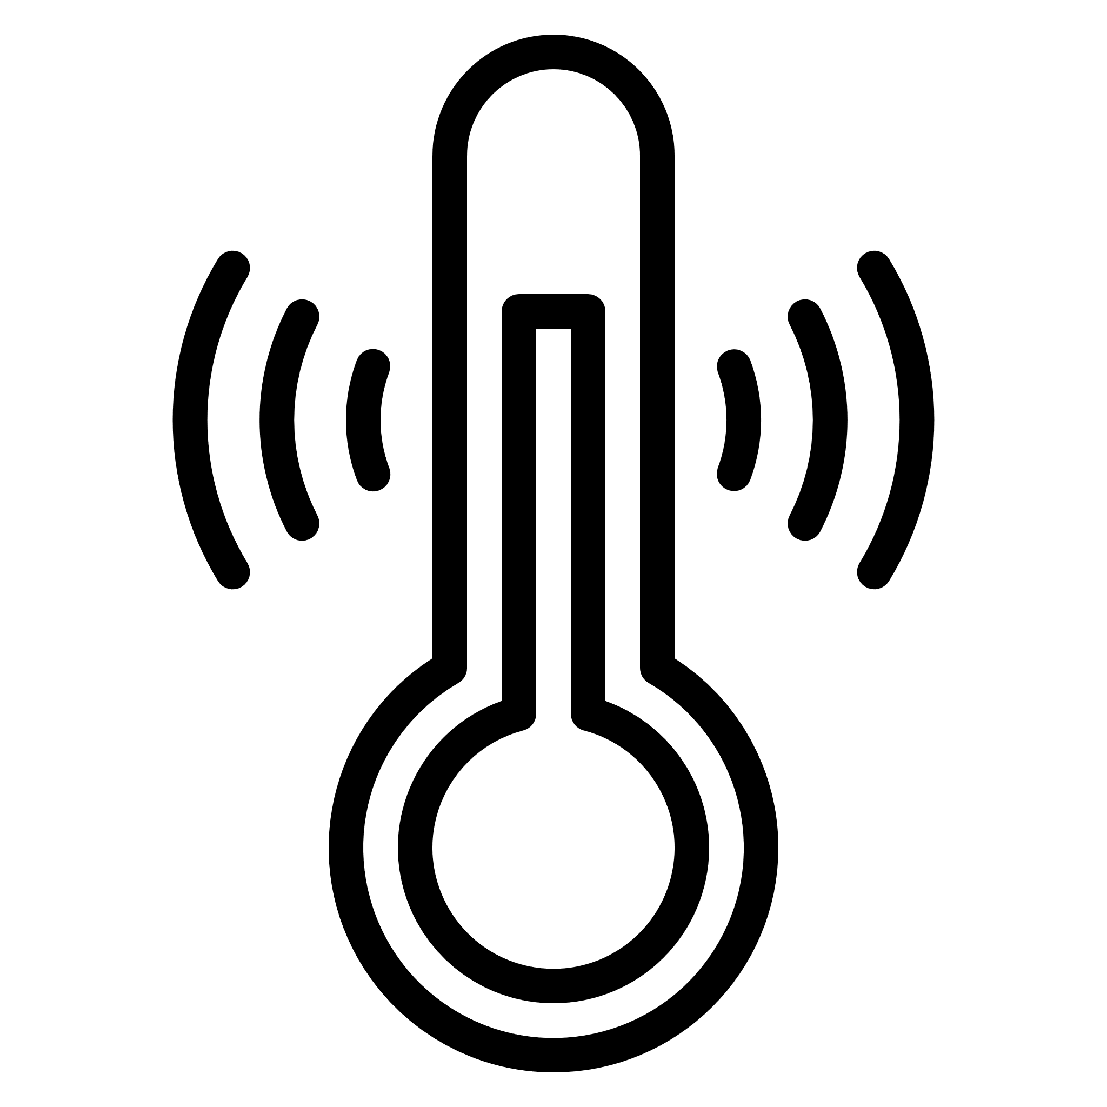

Case 1: Normal temperature is displayed with buzzer
Case 2: High temperature is displayed with buzzer
8 cm – 15 cm
If the core temp. is between 33 & 37.8°C, then the buzzer beeps once with green LED indicating normal temperature.
OR
If the core temp. is between 37.8 & 41°C, then the buzzer beeps thrice with red LED indicating high temperature.
When the person stands within 10 cm, the touchless IR scanner automatically detects skin temperature.

Slide 3
Temperature Measurement Range | 32℃ - 42.9℃
CPU | ST Microelectronics
Screen | Digital display
Storage Temperature | 20℃ - 50℃
Measurement Accuracy | Error value ± 0.2℃
Measuring Distance | 8cm - 15cm
Power Supply | AAA battery
Result Time | 2 sec
Warranty | 1 year on Manufacturing

Slide 4
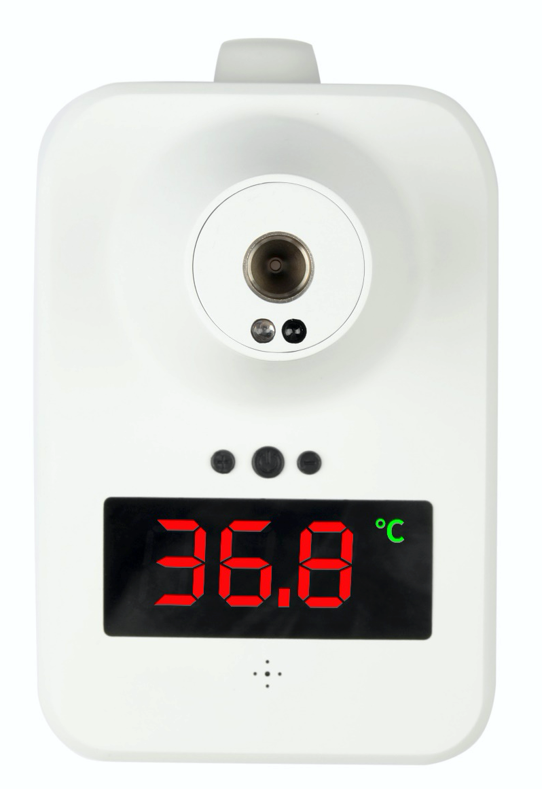
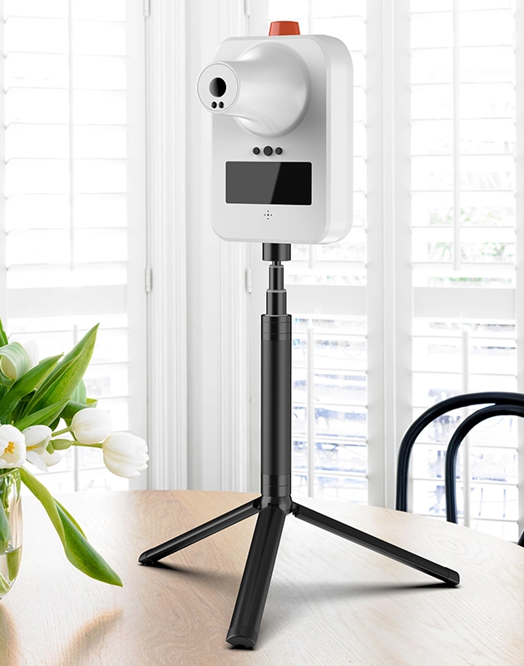

Slide 5
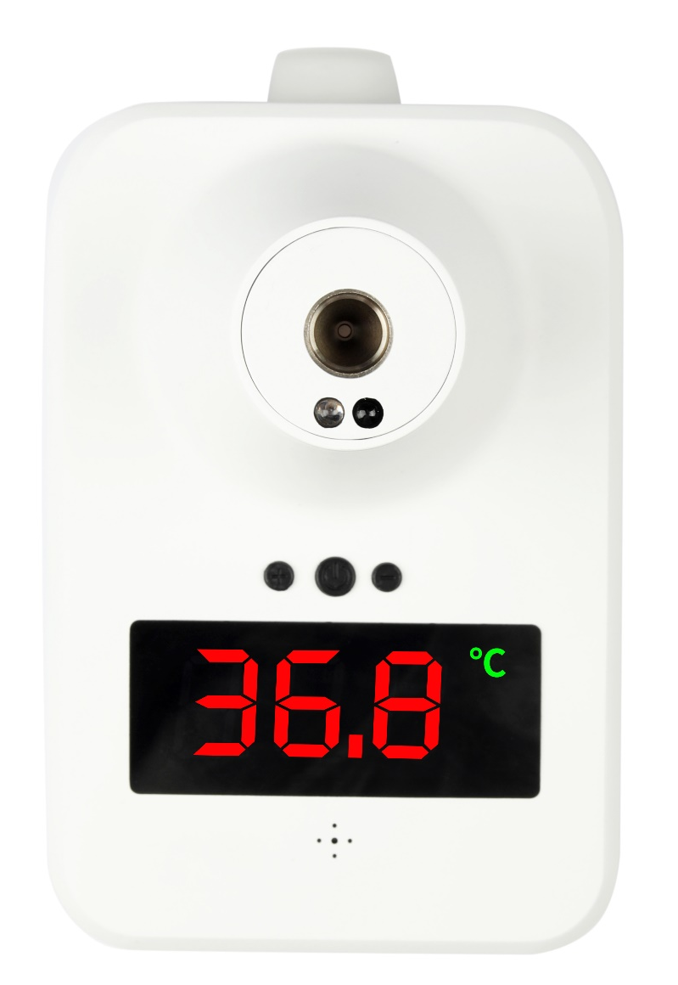
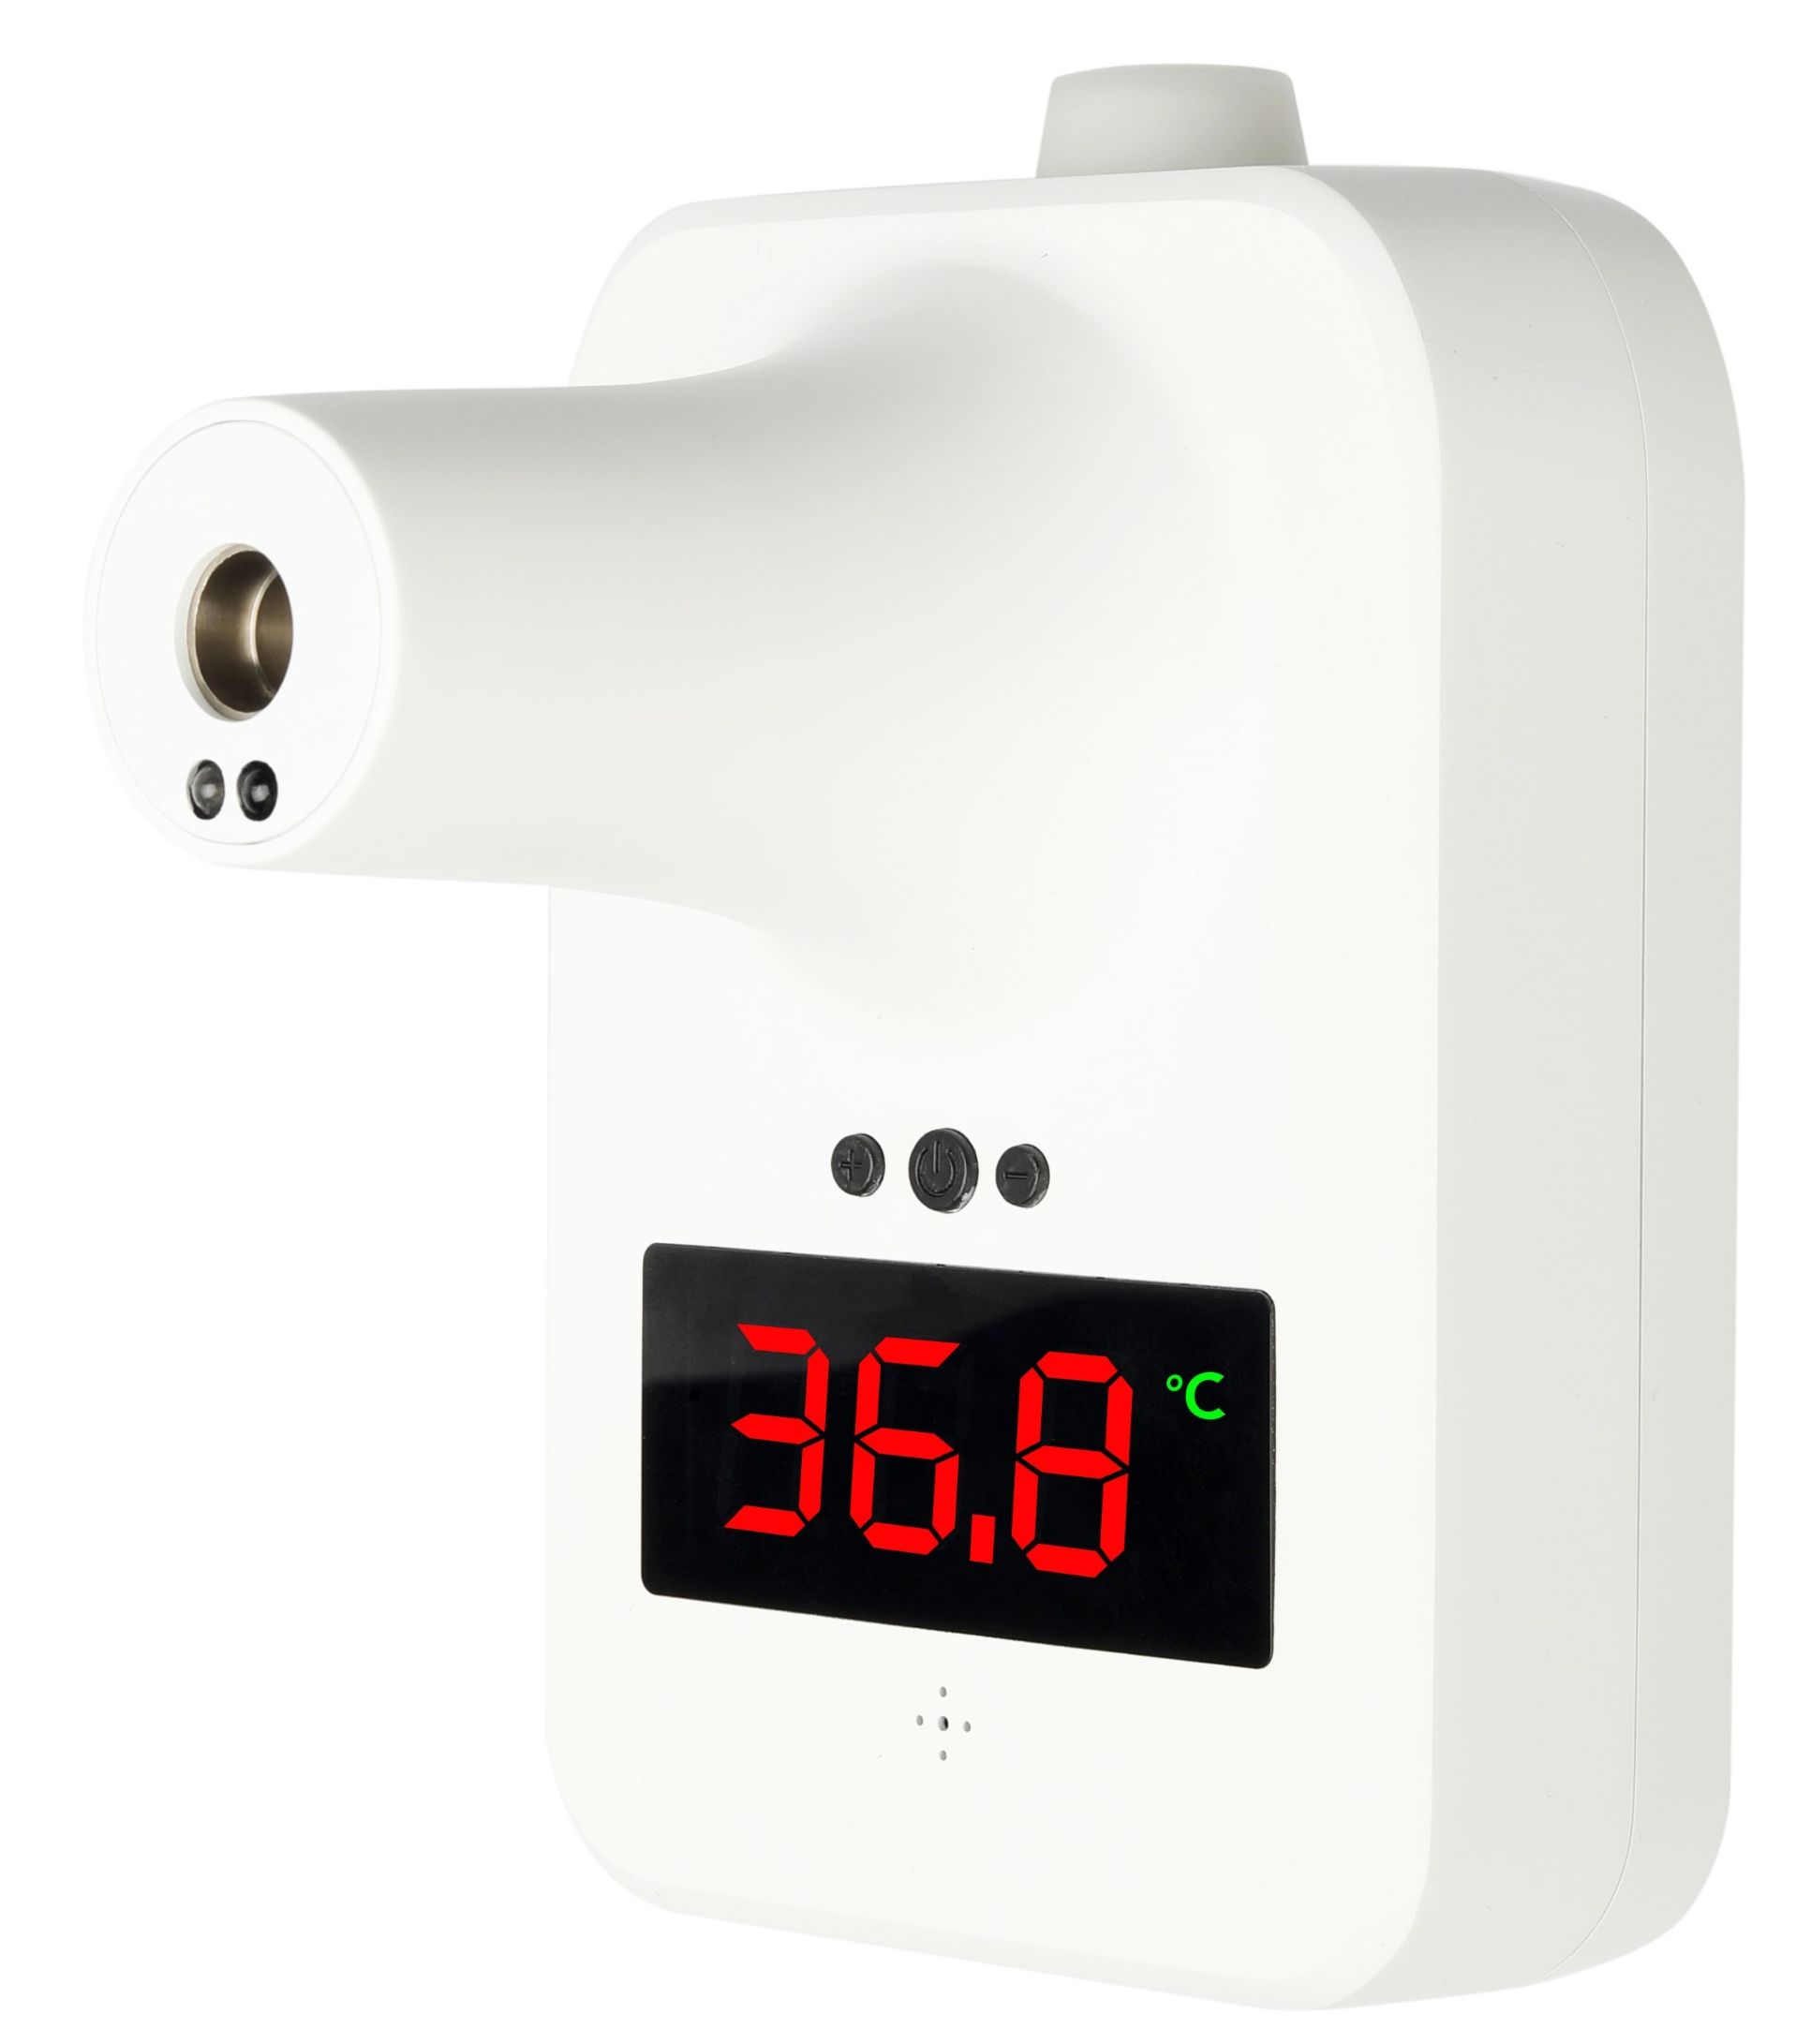
Case 1: Normal temperature is displayed with buzzer
Case 2: High temperature is displayed with buzzer
10 cm
If the core temp. is between 33 & 37.8°C, then the buzzer beeps once with green LED indicating normal temperature.
OR
If the core temp. is between 37.8 & 41°C, then the buzzer beeps thrice with red LED indicating high temperature.
When the person stands within 10 cm, the touchless IR scanner automatically detects skin temperature.

Slide 6
Temperature Measurement Range | 0℃ - 50℃
Ambient Temperature | 10℃ - 40℃
Screen | Digital display
Storage Temperature | -20℃ - 50℃
Measurement Accuracy | Error value ± 0.2℃
Measuring Distance | 5cm - 10cm
Input | USB DC 4.2-5V
Result Time | 0.5 sec
Warranty | 1 year on Manufacturing

Slide 7
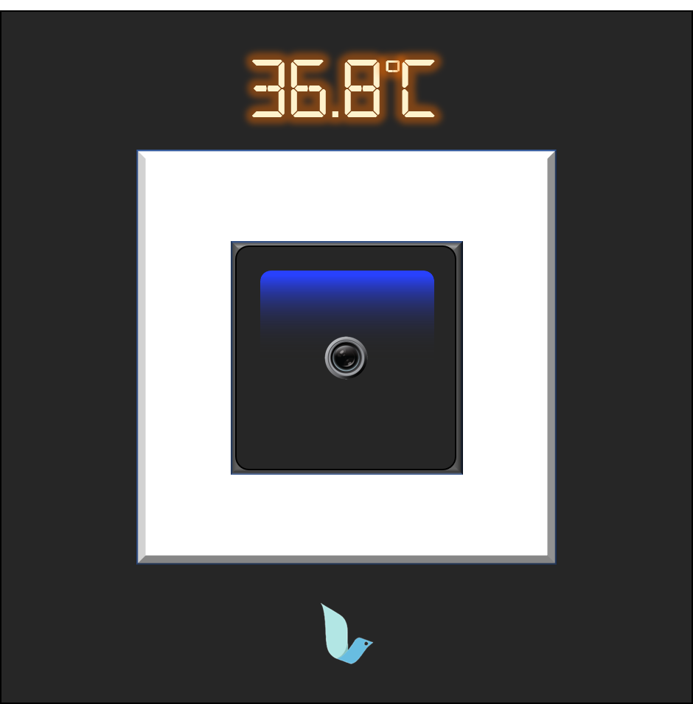
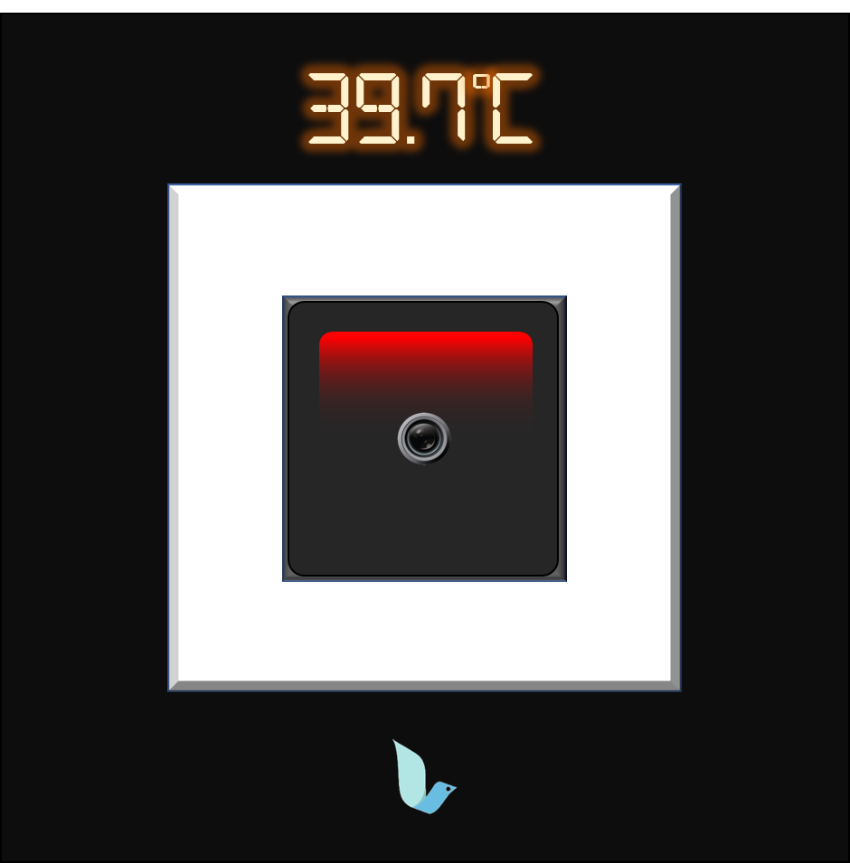

Slide 8
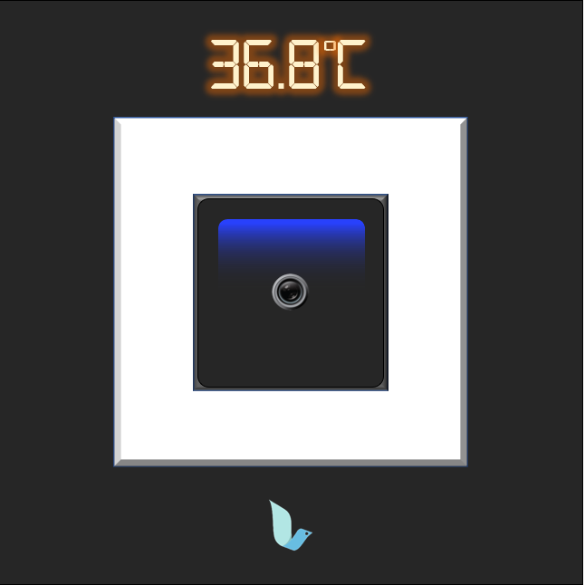
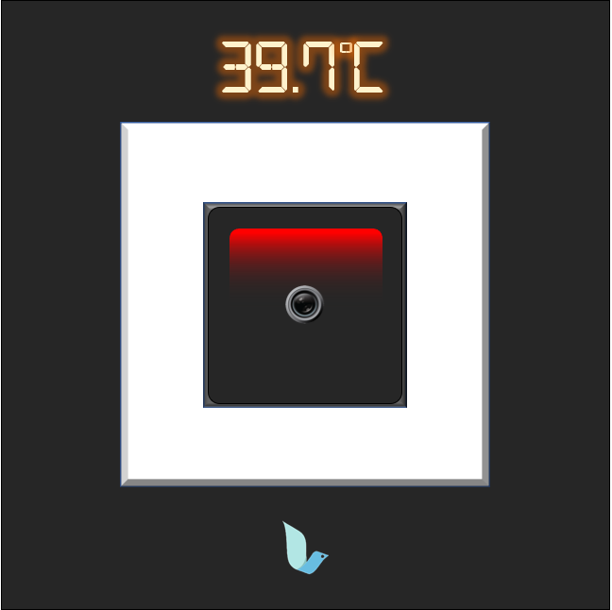
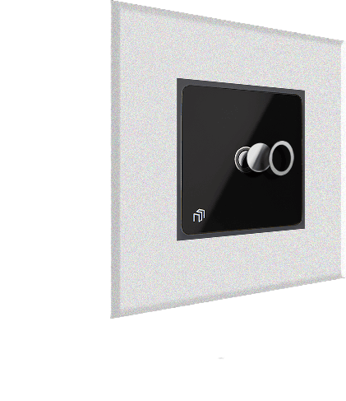
Case 1: Normal temperature is displayed with buzzer
Case 2: High temperature is displayed with buzzer
10 cm
If the core temp. is between 33 & 37.8°C, then the buzzer beeps once with green LED indicating normal temperature.
OR
If the core temp. is between 37.8 & 41°C, then the buzzer beeps thrice with red LED indicating high temperature.
When the person stands within 10 cm, the touchless IR scanner automatically detects skin temperature.

Slide 9
Temperature Measurement Range | 0℃ - 50℃
Ambient Temperature | 10℃ - 40℃
Screen | Digital display
Operating Temperature | 20℃ - 35℃
Measurement Accuracy | Error value ± 0.2℃
Measuring Distance | 5cm - 10cm
Input | 85 – 265 V AC, 50 – 60 Hz
Result Time | 1 sec
Warranty | 1 year on Manufacturing

Slide 10
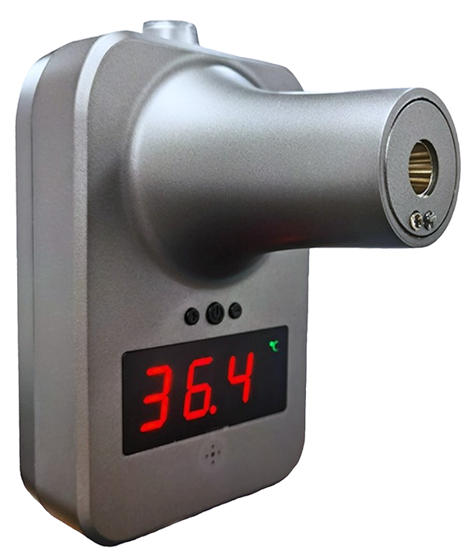
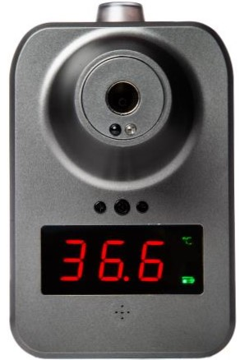

Slide 11

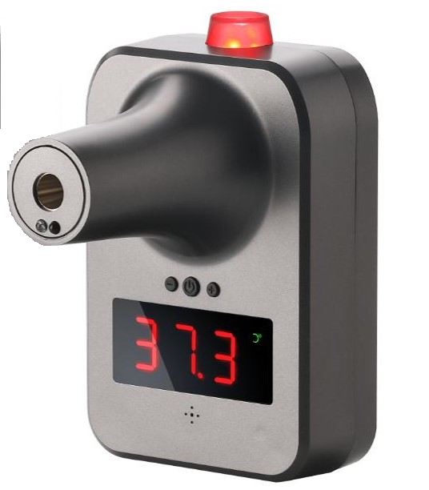


Cloud
Case 1: Normal temperature & entry to premises is allowed
Case 2: High temperature & entry to premises is denied
WiFi
OR
If the core temp. is between 33 & 37.8°C, then the buzzer beeps once with green flash indicating normal temperature. Door access is allowed through wireless relay connection (up to 30 meters).
OR
If the core temp. is between 37.8 & 41°C, then the buzzer beeps once with red flash indicating high temperature. Door access is denied through wireless relay connection (up to 30 meters).
10 cm
Step 1. The person stands within 10 cm, taps their ID card (Company or NRIC)
Step 2. The scanner automatically detects body temperature.
Entry Allowed
Entry Prohibited

Slide 12
Temperature Measurement Range | 0℃ - 50℃
Ambient Temperature | 10℃ - 40℃
Screen | Digital display
Storage Temperature | -20℃ - 50℃
Measurement Accuracy | Error value ± 0.2℃
Measuring Distance | 5cm - 10cm
Input | USB DC 4.2-5V
Result Time | 0.5 sec
Warranty | 1 year on Manufacturing

