Slide 1

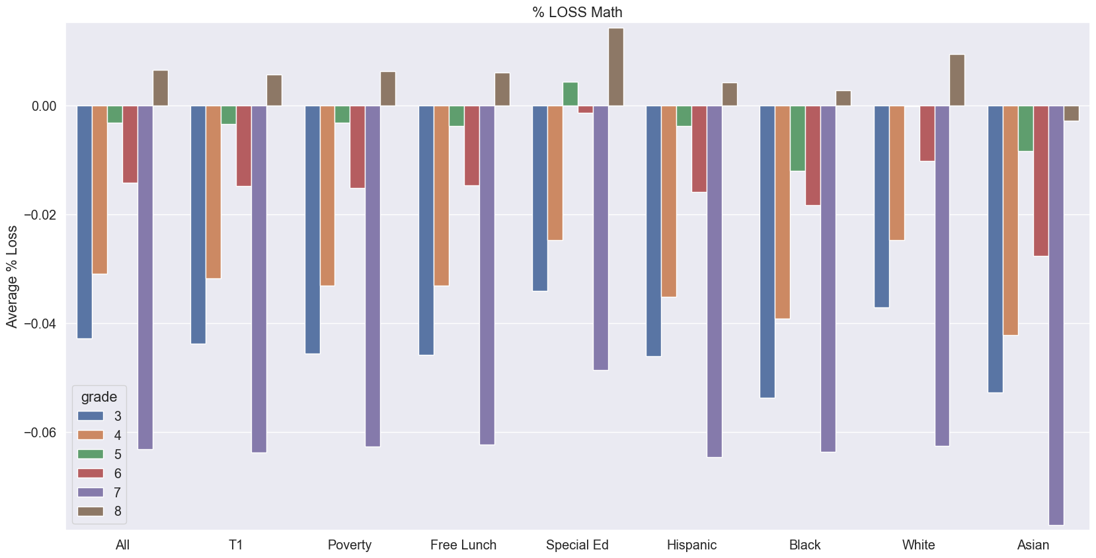
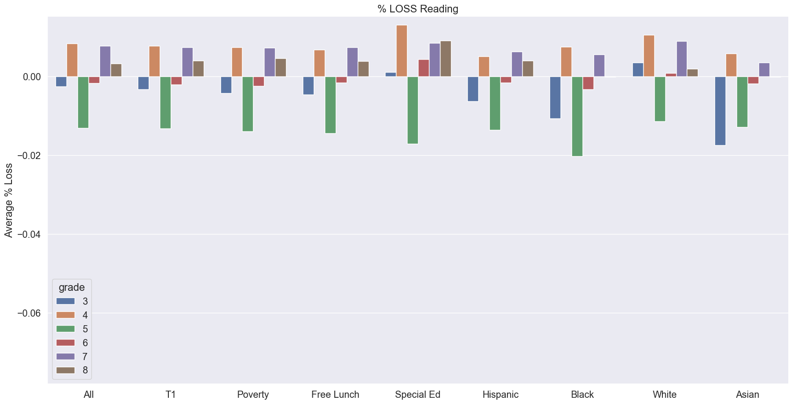
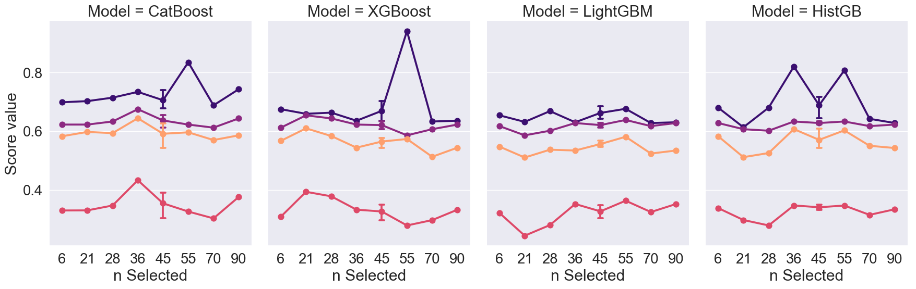
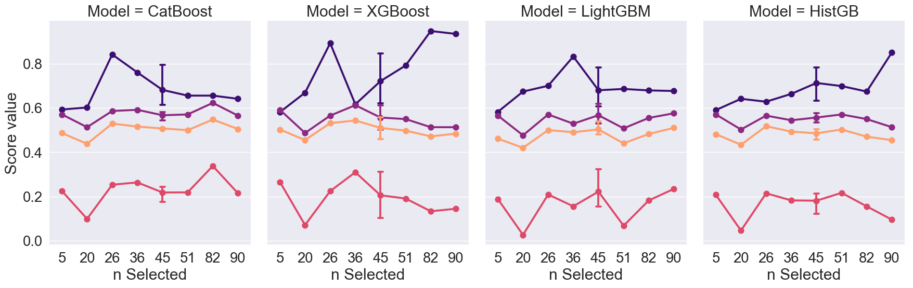
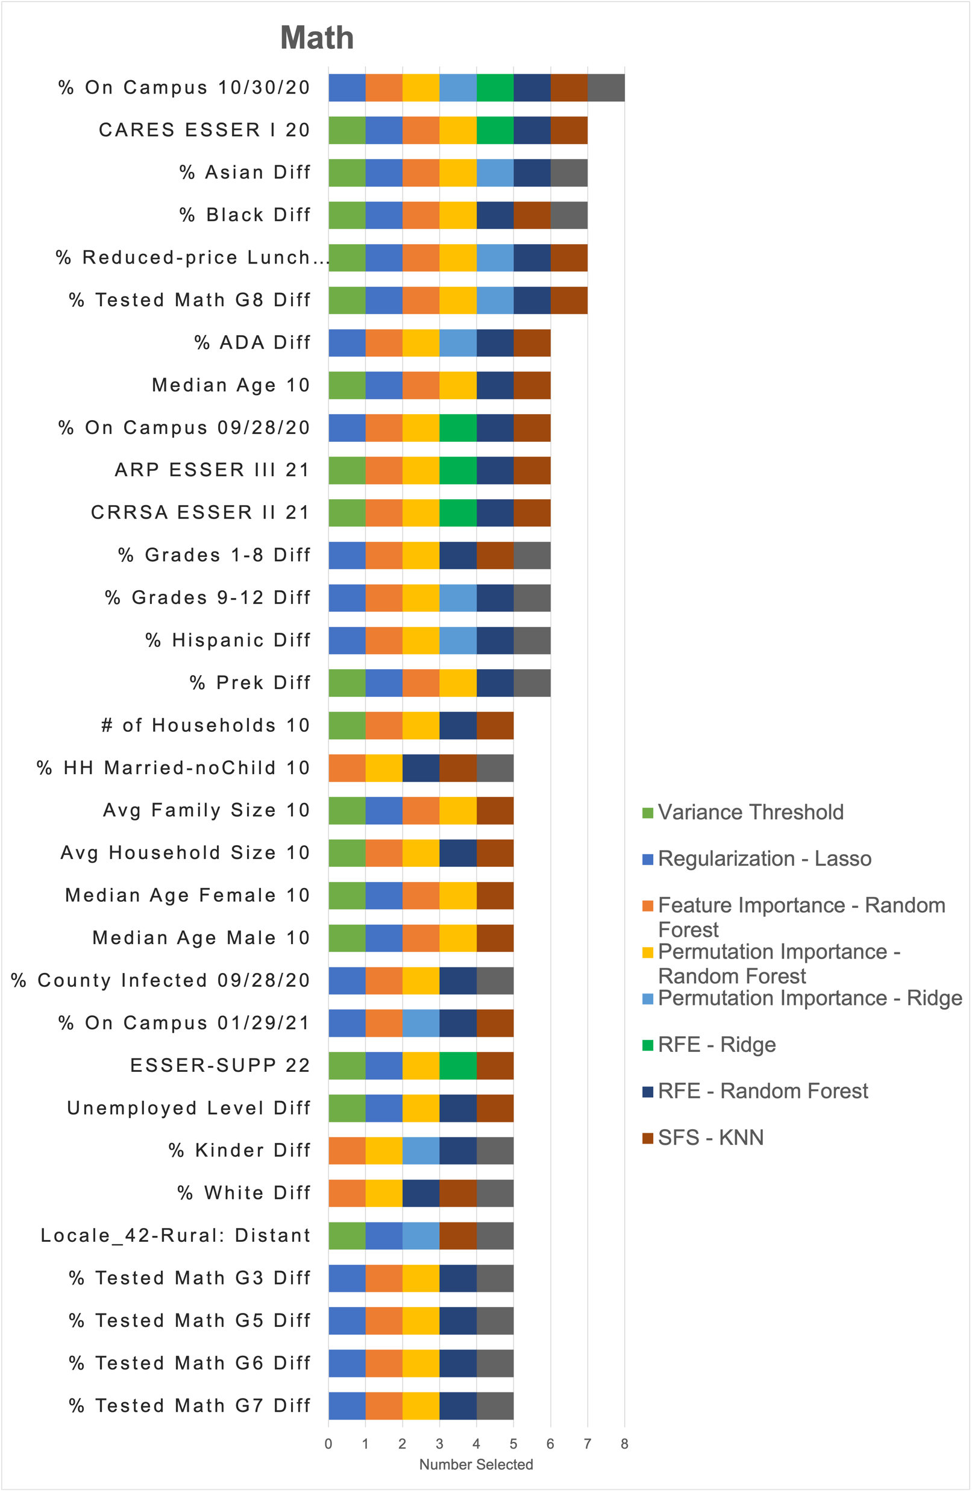
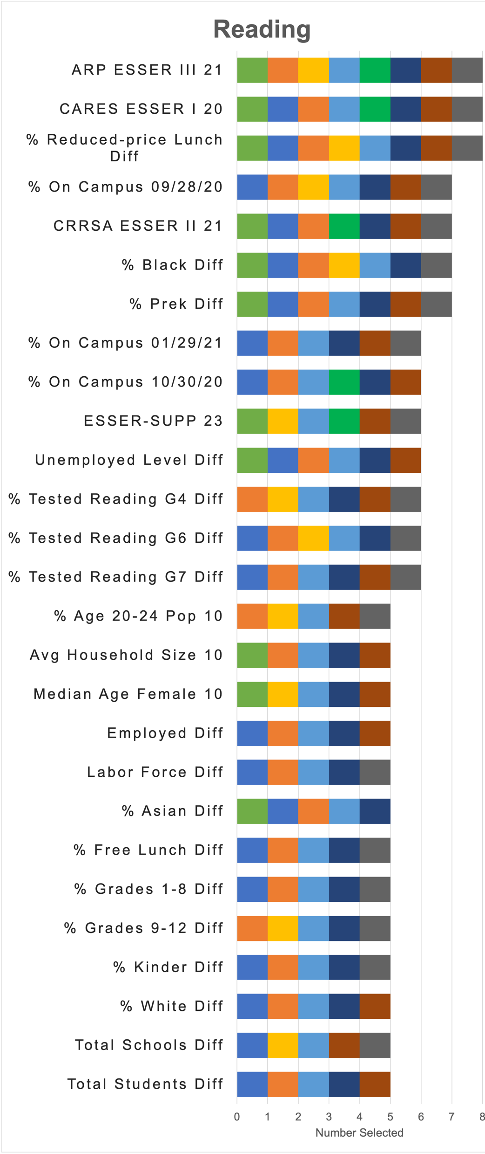

Identifying Resilience Factors in Texas Public Schools
June Yu, Daniel Payan, Dr. Jelena Tešić Dr. Li Feng
Department of Computer Science Department of Finance and Economics
http://DataLab12.github.io/
Motivation
Exploratory Data Analysis​
Gradient Boosting
COVID-19 school reopening decisions were difficult for policymakers since there was no consensus on the impact of school reopening on the spread of COVID-19
Learning loss was documented in many states including Texas
If we can identify most impactful factors on learning loss from publicly available data sources during pandemic, we can help policy makers make more informative decisions on learning recovery
Gain
Loss
Figure 1: Learning Loss % for Math(left) and Reading(right) for group of students: Title 1, Poverty, Free Lunch, Special Ed, Hispanic, Black, White, Asian
Research Questions
$$\frac{Average Score 2021−Average Score 2019}{Average Score 2019}$$
Learning loss is calculated by getting STARR score differences
Math shows more severe learning loss throughout the most student groups compared to Reading
3 classes label has been created:
Can we quantify the impact of the mode of instruction(hybrid, remote, in-person) on the learning loss?
Do school district reopening decision influence the learning loss experienced by students?
Are students from low-income background and minority students experience more learning loss?
Do students from different grade level experienced learning loss differently?
Loss < 25th
25th percentile $≤$Expected $≤$ 75th percentile
75th < Gain
Figure 3: Four Gradient Boosting Models scores for Math (top) and Reading (bottom)
Impactful Factors
Train Accuracy Test Accuracy MCC F1
The most impactful predictors are identified using 9 different feature selection methods:
Filter Methods:
Variance Threshold
Embedded Methods:
L1 (Lasso) Regularization
Random Forest Feature Importance
Wrapper Methods:
Permutation Importance - Random Forest
Permutation Importance - Ridge
Recursive Feature Elimination - Random Forest
Recursive Feature Elimination - Ridge
Sequential Feature Selection - KNN
Sequential Feature Selection - Ridge
The state-of-an-art gradient boosting models were built on the feature sets selected from 9 methods to examine dimensionality reduction effects on predicting learning loss
Hyperparameters such as tree structure constraints, learning rate, L2 regularization were tuned to avoid overfitting and increase accuracy
Feature space does not have significant influence for performance of the gradient boosting models
Data Acquisition and Integrations
Data are acquired from 7 different sources below and integrated by matching School District ID and County FIPS Code with 79 variables from 1,165 school districts in 253 counties:
STAAR test results, math and reading, by grade in 2019 and 2021 from the Texas Education Agency
COVID case data, # of students on campus reported to the Texas Health and Human Services per county
Student race/ethnicity, Title 1/Free lunch, Teacher-Student ratio per district from Common Core Data from the National Center for Education Statistics(NCES)
Local Area Unemployment Statistics(LAUS) per county from U.S. Bureau of Labor Statistics
Average Daily Attendance(ADA) per district from Texas Education Agency
2010 Census Block Group data from Texas Education Agency/Census Bureau
Elementary and Secondary School Emergency Relief(ESSER) Grant from Texas Education Agency
Conclusion
Add STARR exam scores for 2022 to confirm the resilience factors effects
Update Census Block Group data for 2020 to grasp the characteristics of socioeconomic factors up-to-date
Compare outcome for missing values and pre-processing approaches
Acknowledgements
The work has been supported by Community Health and Economic Resilience Research (CHERR) @ Data Lab (DataLab12.github.io)
Findings:
The most impactful predictors for math are. the ratio of students on campus on 10/30/20 Covid aid in 2020, student’s race, reduced-price lunch eligibility
The most impactful predictors for reading are Covid aid given in 2020 and 2021, reduced-price lunch eligibility, and student’s race, the student ratio on campus on 09/28/20 and the ratio of pre-k students.
Figure 2: Number of Predictors Selected by 9 feature selection methods

