Slide 1

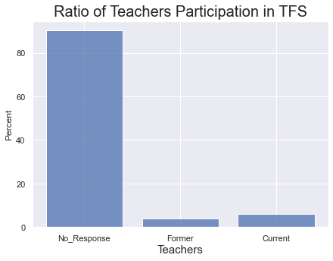
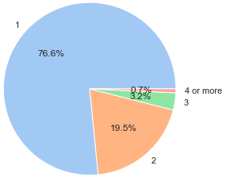
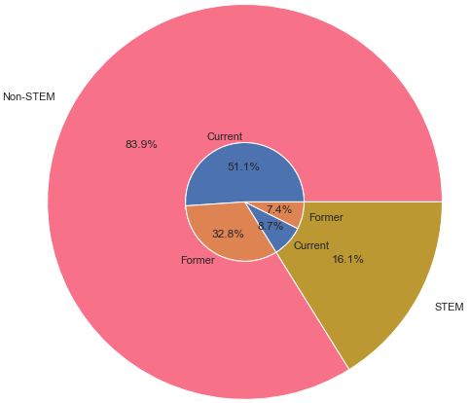
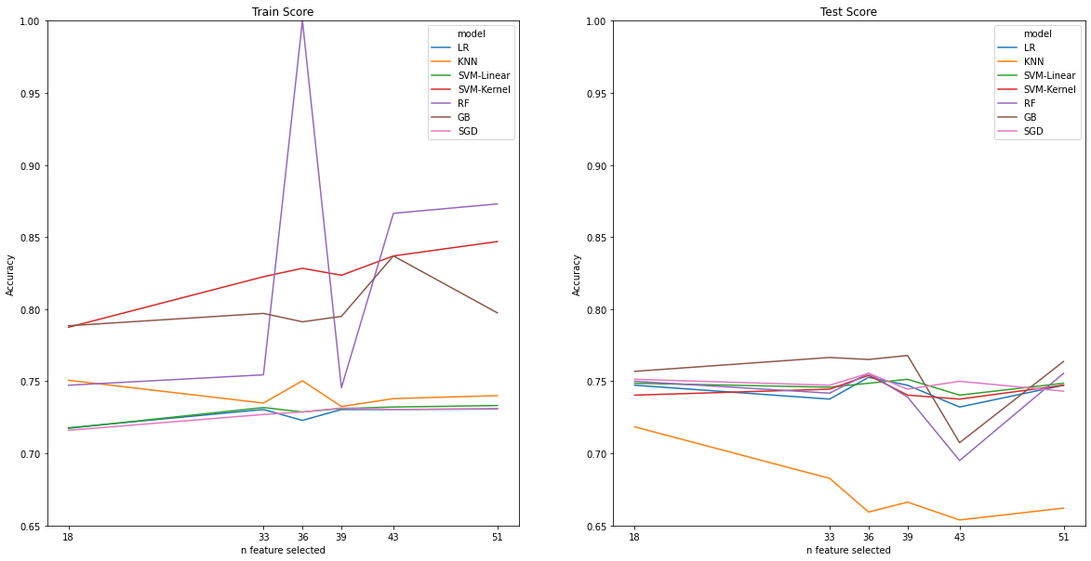
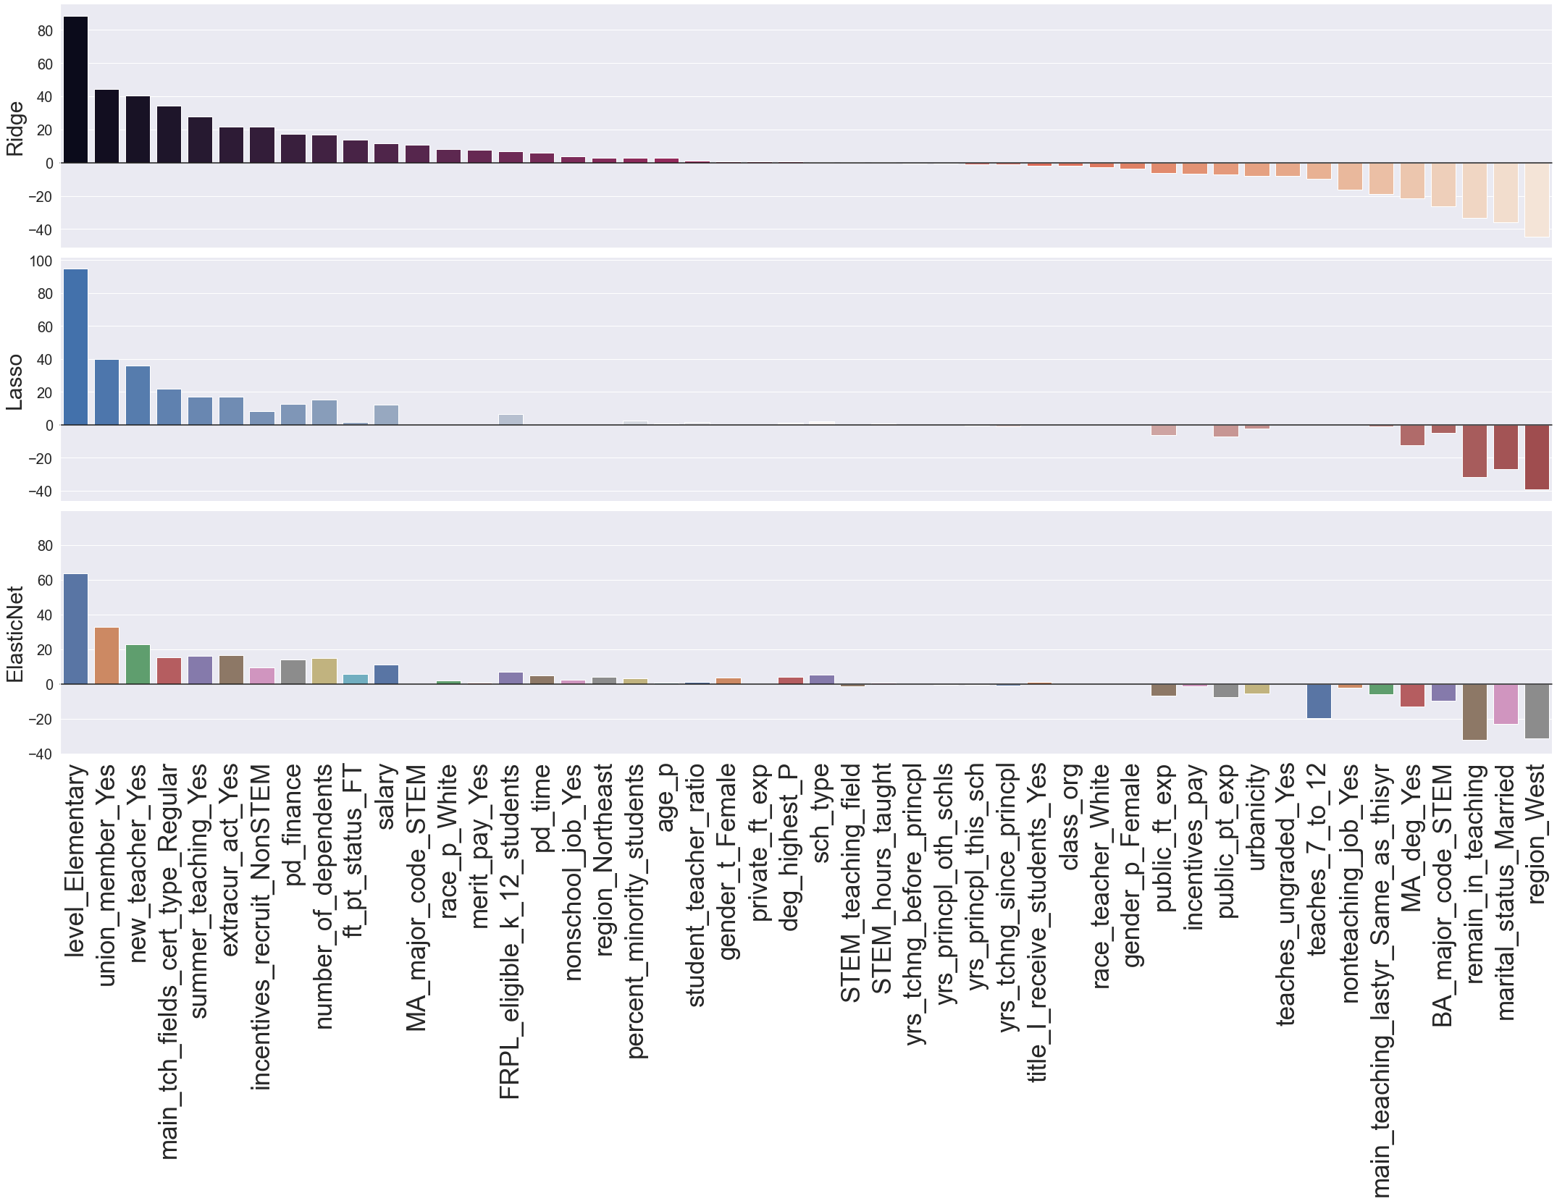
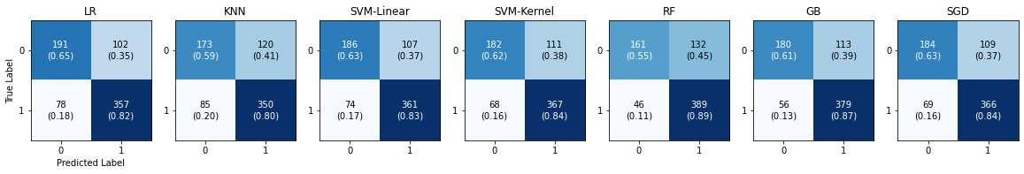
Predicting Public School Teachers Retention Status with SASS and TFS data
June Yu Dr. Jelena Tešić Dr. Li Feng
Department of Computer Science Department of Finance and Economics
http://DataLab12.github.io/
Motivation
Initial Exploratory Data Analysis
Machine Learning Classifier
How to address the teacher shortage in public school districts using the state-of-art machine learning techniques? In this work, we take a data science look at National Center for Education Statistics (NCES) survey data to identify strongest predictors of retention rate in school districts to inform the policy makers.
Research Questions
Do teachers’ demographic, education/training, or teaching experience influence their retention status?
Do principals’ age, gender, ethnicity, teaching experience affect teachers’ retention?
Are public schools’ level, type, region, urban/rural location, poverty level, share of minority students correlated with the teachers’ retention?
Does incentives to recruit teachers or merit pay improve the teachers’ retention?
Figure 1. Ratio of Teacher Participation in TFS
From 42,086 public teachers that participated in SASS under 10% (4,156) participated in TFS, and that includes 2477 current and 1679 former teachers
Figure 2. Number of Teachers per School
Some teachers do not have associated principal, so we end up analyzing 3,640 teachers working for 2,838 schools
Figure 3. Teaching Assignment Field STEM vs. Non-STEM
STEM teachers are 16% of the population but tend to have higher turnover rate than Non-STEM teachers
Relevant Predictors
Step 1. Correlation Filtering: if any pair of features have high correlation, one of them is removed, or the pair is aggregated into either categorical or continuous type
Step 2. Shrinkage with ML models: Lasso, Ridge and ElastiNet.
Step 3. Binary to categorical values
Findings
The initial 131 predicates are reduced to 51.
Elementary Level is the strongest predicator.
Type of STEM field teachers taught was not indicative of teacher’s decision to quit or stay.
The hold-out set for SASS and TFS integrated data is used for selecting relevant predictors:
Data Acquisition and Integrations
National Center for Education Statistics (NCES) public-use data
Schools and Staffing Survey (SASS) studies the K-12 educator labor market in 1999-2000. The survey consists of Public/Private Teacher, School, Principal, and Public District components.
The Teacher Follow-Up Survey (TFS 2000-2001) was conducted the year after the SASS to determine how many teachers remained or left teaching. The public survey provides 2 components - Former and Current Teacher
The surveys include the information on the teacher/principal characteristics, working conditions, teacher compensation, hiring and retention practices, and basic characteristics of student population.
Data Integration
All data are filtered by Public Sector before integrating to focus on public teachers
SASS and TFS are integrated based on matching School Control Number and Teacher/Principal Control Number
Public District Component is not integrated due to missing of matching District Control Number
Figure 5. Seven ML Model Score Comparison on Train vs. Test Set
Figure 6. Seven ML Model Confusion Matrix Comparison on Test Set
We have built multiple classifiers to predict whether the teacher will leave or stay.
Train set and test set ratio is 8:2 w shuffling and stratification and classification used.
Next Step
Revisit predictor selection: identify and interpret the best set of predictors for teachers’ retention status
Predictor Normalization
Selecting the best classification model
Figure 4. Shrinkage Method Feature Importance Comparison
Notes:
Fix figure numbers and fonts -> Done
Fix Machine learning figures -> Done
Add what was test and train data split -> Done
Fix figure numbers -> Done

