Slide 1
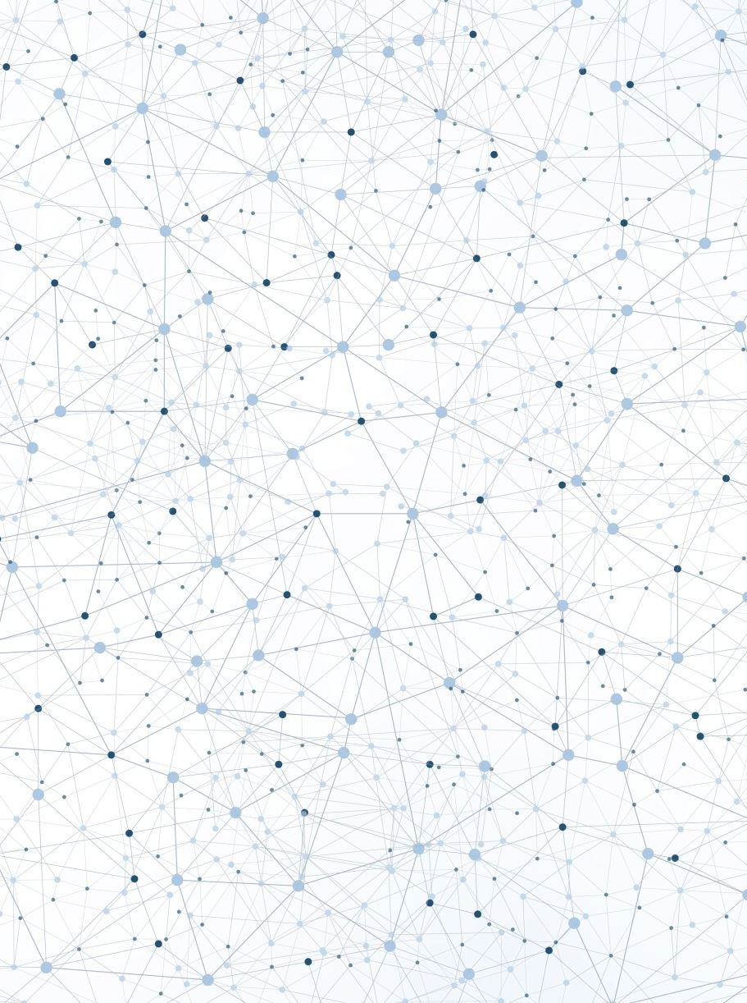
Convolutional Neural Network
Creating a Deep learning Algorithm to analyze imagery

Slide 2
Introduction
We would like to develop a conventional neural network model for the CIFAR-10 object classification dataset.
The dataset is comprised of 60,000 32×32 pixel color photographs of objects from 10 classes, such as frogs, birds, cats, ships, etc. The class labels and their standard associated integer values are listed below.
0: airplane 1: automobile 2: bird 3: cat 4: deer 5: dog 6: frog 7: horse 8: ship 9: truck

Slide 3
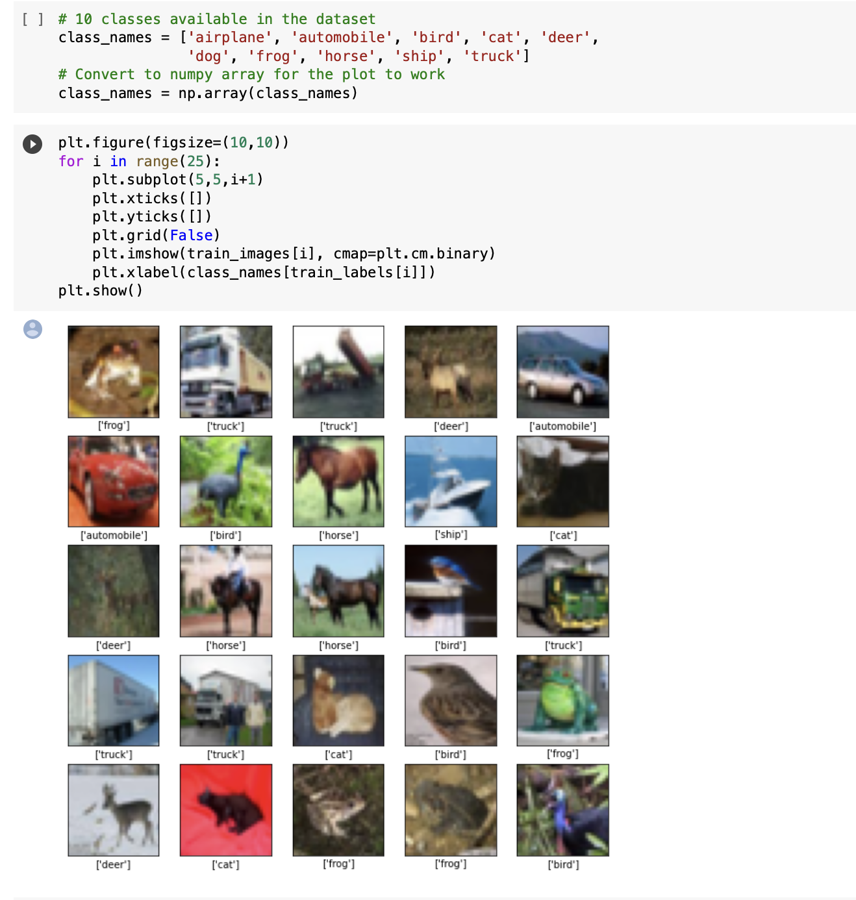
We know that the images are all pre-segmented (e.g. each image contains a single object), that the images all have the same square size of 32×32 pixels, and that the images are color. Therefore, we can load the images and use them for modeling almost immediately.
After plotting 25 images, we can see that the images are very small and have a low resolution which might lead to low performance of the algorithm.

Slide 4
Approach
We ran 5 different CNN models with different configurations. Our aim is to obtain the best model based on the following criteria:
Training Accuracy
Test accuracy
Precision
Recall
f1 score
Confusion matrix
Accuracy and loss per epochs

Slide 5
CNN model Configurations:
Configuration 1: 1 layer, 32 neurons
Configuration 2: 1 layer. 128 neurons
Configuration 3: 2 layers. 32 neurons each
Configuration 4: 2 layers, 32 neurons in layer 1 and 64 in layer 2
Configuration 5: 2 layers, 64 neurons in layer 1 and 128 in layer 2

Slide 6
Results
Model number | 1 | 2 | 3 | 4 | 5
Training Accuracy | 80.58% | 79.28% | 73% | 85% | 92.3%
Test Accuracy | 62.7% | 63.8% | 66% | 67.8% | 71.2%
Precision | 68.5% | 69.5% | 74.1% | 72.1% | 74.58%
Recall | 57.5% | 58.7% | 58.9% | 64.2% | 68.71%
F1 Score | 62.5% | 63.7% | 65.6% | 70% | 71.5%

Slide 7
Conclusion
Looking at the results we can see that configuration 5 has the best scores especially when it comes to test accuracy. The model reaches a 92% accuracy on the training dataset after 6 epochs. This is why we can stop at epoch 3 since it is the closest to the test accuracy ( 74% and 71%)

