Slide 1

Faculty Senate Meeting
10/07/22

Slide 2
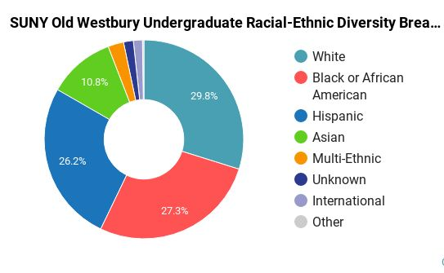
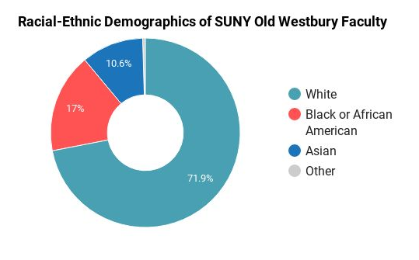
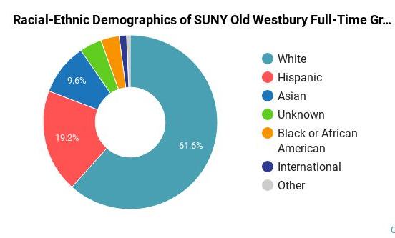
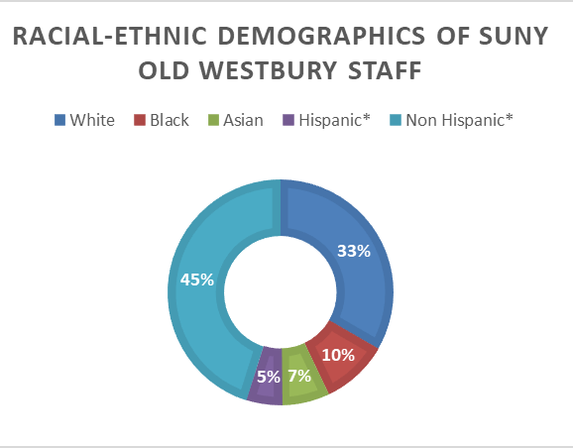
Diversity/Equity
(
Marketplace ​
Surrounding Area​
Matching Demographics
College Factual
College Factual.com
SUNY OW/HR

Slide 3

Talent Selection
Search Committees

Slide 4
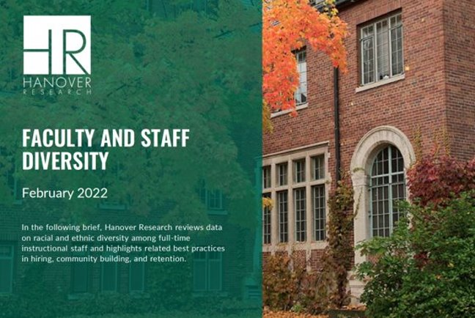

OW Hiring Guide

Slide 5

Social Justice Center
Multicultural Center
Community Policing

Slide 6


