Slide 1
Full Faculty Meeting 9/23/22
Agenda
1) Governor Hochul/SUNY One-time Funding
2) Social Justice Center
3) Meeting with SGA leadership

Slide 2
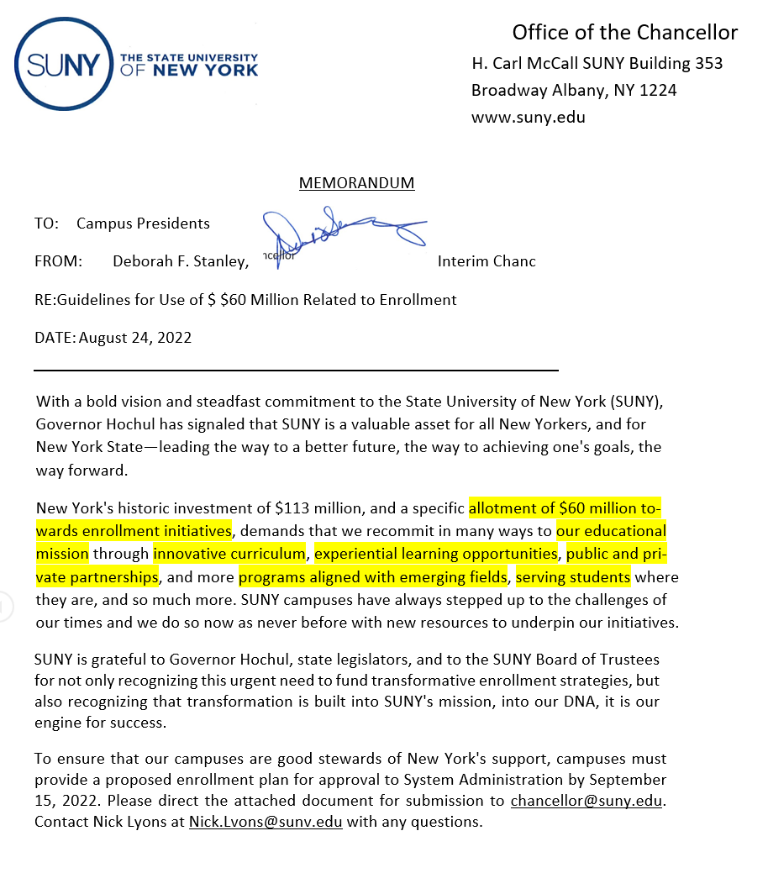

Slide 3
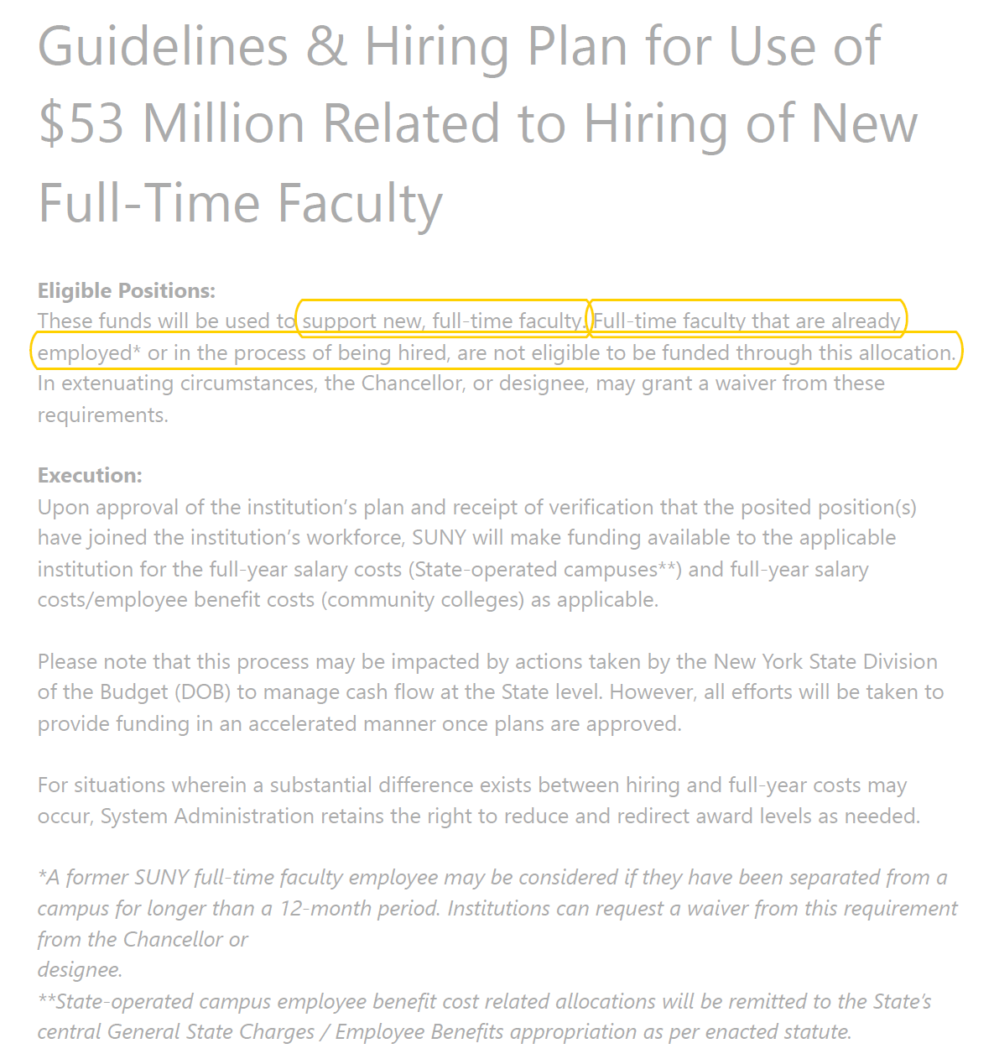

Slide 4
Governor Hochul/SUNY $60M & $53M (FYE ‘23)
$60 M ($337K & $1M possible (proposal) for OW) | $53 M ($1 M for OW)
Enrollment Initiatives -transformative enrollment strategies -innovative curriculum -experiential learning -partnerships -programs-emerging fields, serving students… | New Faculty – no existing lines Diversify faculty *Tenure (uncertain) -1-year appointment -Move to tenure track upon permanent funding (search required) Up to 8 new positions (OW pays benefits)
$200K Enrollment Management (statewide & technology) $75K OW Model (faculty & grad fellows) $75K DEI/Multicultural Affairs (Multicultural Center-AV) $25K Social Justice Center (organizing) $925K Faculty and Staff Housing in AV (9) PBC approved and recommended | Social Justice Fellows (2 & 1 load) a) Organic Chemistry b) Philosophy of Justice c) Performing Arts d) Data Analytics e) Public Health and Social Justice f) Mental Health Counseling Program g) OW STEM h) Special/Childhood Education The cohort could form the foundation of Social Justice Center
SUNY Considerations -DEI -Innovation -Enrollment -SUNY Priorities -MSI -Pre K-12 Teacher Education -One time funding -STEM & Workforce Development -Mental Health | OW Considerations - Mission - Performance Plans - OW Model (thematic) - No neg. impact upon school’s budget - PRODiG Model
CAP Recommended

Slide 5
Full Faculty Meeting 9/23/22
2) Social Justice Center
Building in Woodlands
Departments, Offices, Academic/support, Art Collection, Multipurpose (inc. classroom)
1st floor academic, 2nd & third floor thematic communities (all four years)
Jermaine Archer is nudging this process/work
3) Meeting with SGA leadership
Food is much improved
Do not move juniors and seniors back to Woodlands
Excited about Multicultural Center in AV
Energetic and engaged frosh
Love the “First 6 Weeks”
Concerns
Party Support
Class cancelations/move to remote during first days of classes (notification on doors)
Survey @ Club Bash
Students came to OW: less expensive, close to home, complete studies
Desire more/better faculty support (advising)

