Slide 1
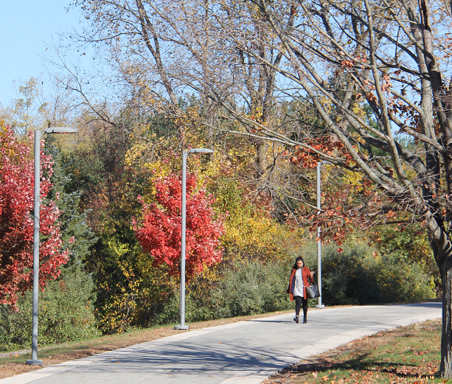

Fall Planning & Preparation
COVID-19 & The Campus
May 28, 2021

Slide 2
Planning Process for Fall
Guidance on key issues still forthcoming (from NYSDOH & SUNY)
Being developed using structure of Fall 2020 plan
Members of College Cabinet leading many areas of the development
VPs, School Deans/Directors
Health & Safety section being developed by COVID-19 Campus Safety Workgroup
Cross-discipline, cross-functional interaction being sought
Multiple scenarios being required
“100” percent
50 percent
Remote

Slide 3
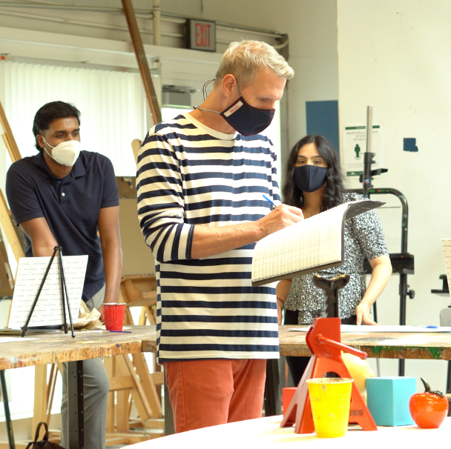
Masks, Ventilation & Vaccines
Masks:
Currently required of State employees indoors/outdoors whether vaccinated or not.
Campuses for the summer can determine whether masks are required for all, especially when social distancing cannot be achieved.
Campus constituents have the right and ability to choose to wear a mask if they feel it appropriate/necessary.

Slide 4
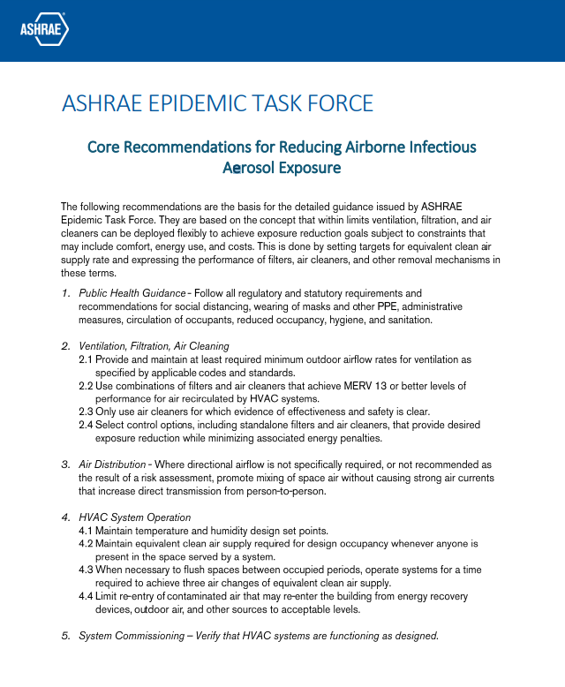
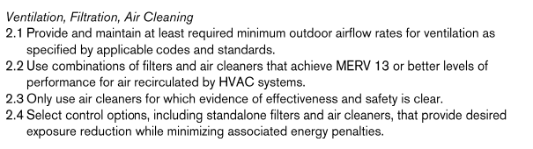
Ventilation
Source: ASHRAE Epidemic Task Force (January 6, 2021) https://www.ashrae.org/file%20library/technical%20resources/covid-19/core-recommendations-for-reducing-airborne-infectious-aerosol-exposure.pdf

Slide 5
Ventilation (continued)
NAB
11 air handlers all using MERV 8 pre-filters and MERV 13 internal filters
All handlers have fresh air input monitored through the building management system
Natural Science Building
9 air handlers all using MERV 8 pre-filters and MERV 13 internal filters
All handlers have fresh air input monitored through the building management system
Campus Center
Has a total of 29 air handlers
Three in Library were upgraded during renovation (all have UV sanitization and MERV 14 filters
Student Health Center unit has UV sanitization and MERV 14 filter
Four serving the H-Wing have MERV 8 pre-filters and MERV 14 filters
Work remains on 21 handlers as part of an ongoing SUCF project. Currently, using MERV 13 filters.
All handlers have fresh air input monitored through the building management system

Slide 6
Ventilation (cont.)
Student Union
7 air handlers using MERV 8 pre-filters and MERV 13 filters
All handlers have fresh air input monitored through the building management system
Residence Halls
Individual rooms use fan-coil units that do not have fresh air capabilities nor have the ability to use MERV 13/14 filtration.
All rooms in Residence Halls are having air purifiers installed over the summer.
Air handlers for hallways and common areas have fresh air input monitored through the building management system and use MERV 13/14 filtration.
University Police Department
1 air handler using MERV 13 filters
All handlers have fresh air input monitored through the building management system
Clark Center
3 air handlers using MERV 13 filters
All handlers have fresh air input monitored through the building management system

Slide 7
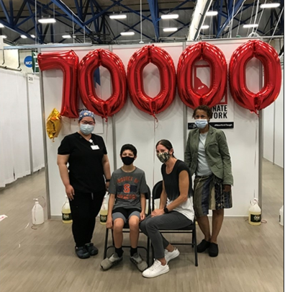
Vaccines
Those vaccinated (students and employees) will be exempt from weekly COVID-19 testing
Some surveillance testing of vaccinated campus members may still be required. Final decision pending.
Mandated student vaccines are not in place yet:
Requires action by SUNY Board of Trustees.
Will be contingent on full approval of a vaccine by the FDA.
HR is working on a process to request employees to volunteer vaccine status (as it is not information we can require at this time).

Slide 8
Thank you!

