Slide 1
Enrollment Numbers as of 3/30/22
4,002 First Year applications received, on par with last year
2,950 accepted students already notified
75 EOP students already accepted; 2 months ahead of schedule.
Took until 5/13/21 to accept 2,950 in 2021.
194 already deposited compared to 74 this time last year (163% increase)
571 Transfer applications received, 15% decline from 2021
268 transfers accepted
57 deposits
191 Graduate applications received
24 accepted
Speed to review critical to our success in yielding students

Slide 2


OPPORTUNITY ANALYSIS
Opportunity Analysis
March 16, 2022
Wes Butterfield, Senior Vice President
1

Slide 3

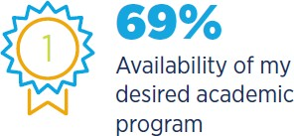
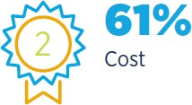
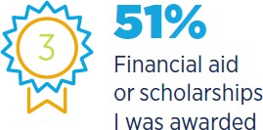
Most important factors in the students’ decision to attend a particular institution
2020 RNL High School Perceptions of College Financing Report

Slide 4



Most commonly used search terms during the college search process
60%
College financing terms financial aid scholarships affordable
tuition cost grants
48%
Subject area or Major field of study major and location
major and type of institution
24%
Name of the school
12%
Location state city
region of the country
2021 RNL High School E-Expectations Report

Slide 5

General Observations
SUNY Old Westbury has the key elements for success!
People care about SUNY Old Westbury, your mission, & the students you serve.
There is excitement about the new President and direction for the campus.
Goal setting is loose. Need more numeric goals – by Counselor, by program – for both recruitment and retention.
Urgency for enrollment planning not permeating with all on campus.
Your identity defined differently by different groups.
Growing our Graduate & Online programs needs to be lifted in priority.
5

Slide 6
General Observations
SUNY Old Westbury has the key elements for success!
Institutional Advancement & Athletics both need databases.
Strengthen ties between Admissions, Financial Aid and Athletics.
Being thinly staffed carries risks.
There is a general tiredness across the campus, caused by the Pandemic. Look for opportunities to thank people who have been asked to do more with less.
The academic unit would love to have a “student reset.” Need/desire to ensuring students understand their academic responsibilities.
Need to train, understand and use information from Institutional Research for decision-making.
One-Stop in its infancy & a good idea. Align these key function areas with a single Vice President.
6

Slide 7
Graduate Program Considerations
Lots of growth opportunities here. Need to develop a strategic plan for Graduate and prioritize the work and investment.
Highly decentralized model contributes to varied student experiences. The recruitment and admissions process seems to vary quite a bit by program.
Need data driven analysis to determine which programs to grow and in what modality (on-campus/hybrid/online).
Speed of response to inquiry and applications important. We are not built to meet this type of contact model.
The Graduate market is competitive, must have high-performing SEO. Driving searches to your new program pages.
35

Slide 8
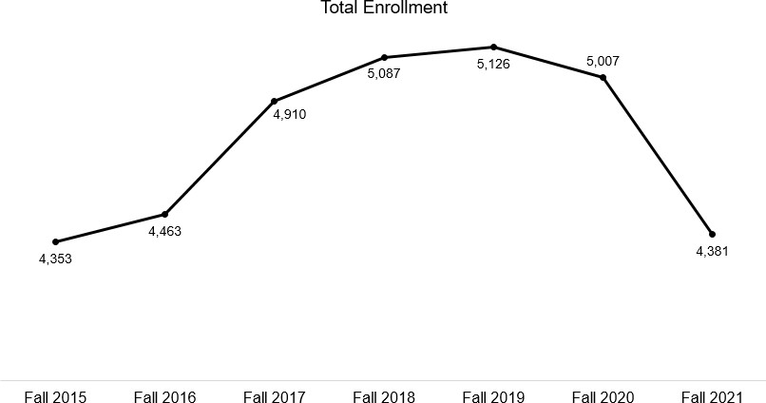
SUNY Old Westbury Funnel Trends: Total Enrollment
Goal: 4,800-5,200 total enrollment
8

Slide 9
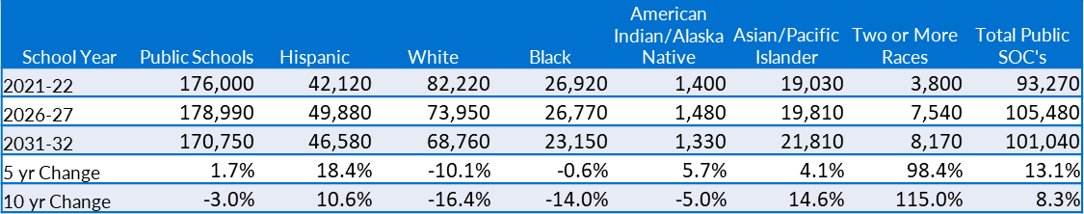
Projected number of high school graduates
New York 2017-36
220,000
210,000
200,000
190,000
180,000
170,000
160,000
Western Interstate Commission for Higher Education, Knocking at the College Door: Projections of High School Graduates, 2020, www.knocking.wiche.edu
42

Slide 10
Admission Observations and Recommendations
We are heavily dependent on Long Island. Expand our marketplace (beyond the traditional 18-22 population).
Audit all communications from Admissions, Marketing, Financial Aid, etc. to ensure messages are compelling and clear.
Develop a stronger “first choice” population.
Create a set of standard enrollment and retention reports & disseminate them to all stakeholders.
Establish Recruiter goals to reach projected enrollment targets.
The Honors program should be used to drive applications.

Slide 11
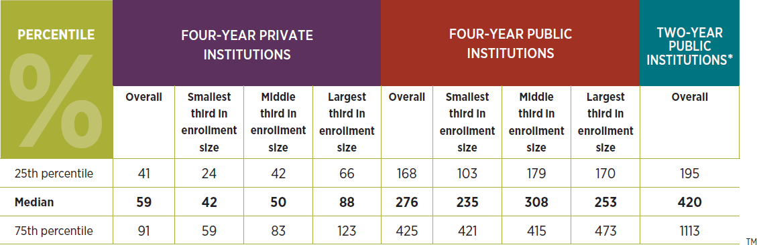
Number of new Undergraduates for each FTE employee involved in face-to-face Undergraduate outreach
© Ruffalo Noel Levitz, LLC.
Cost of Recruiting an Undergraduate Student for Four-Year and Two-Year Institutions

Slide 12
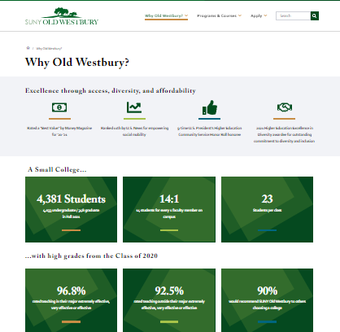

Marketing, Website, and SEO Recommendations
Create an integrated marketing & recruitment plan linking strategies, resources, and timing.
Develop consistent Points of Distinction.
Update the “Why Old Westbury” web page.
Highlight value and affordability.
Create 30-second elevator speech plus a 3-minute and 30-minute version of the key messages.
Augment catalogue pages with compelling academic pages that sell programs.

Slide 13
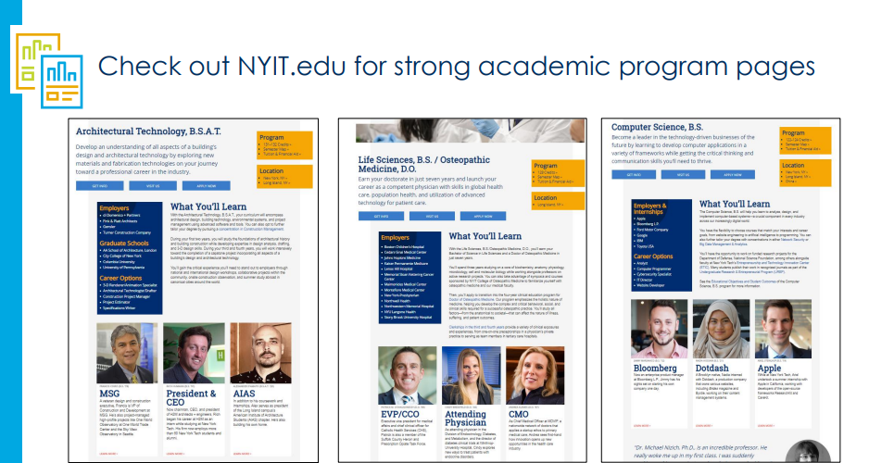
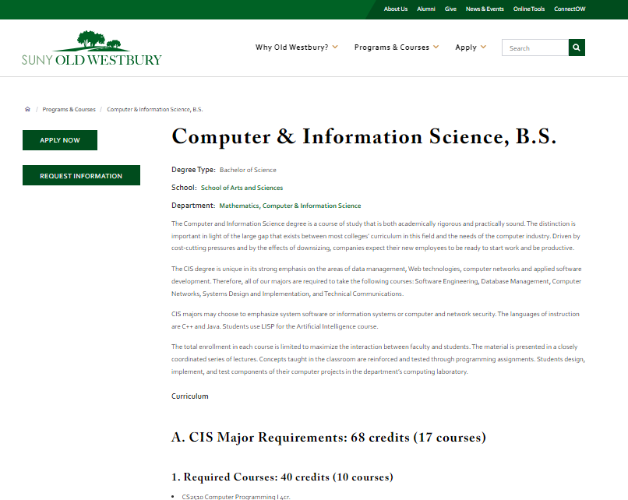

Slide 14
Financial Aid Observations and Recommendations
Very traditional approach to financial aid with its lower cost and limited institutional aid.
Strengthen the actual award letter.
Families may have a difficult time understanding balance due information.
We need to communicate the financial aid process (step-by-step) and highlight affordability to students and their families early on.
We need to have strong cross training between Admissions and Financial Aid.

Slide 15
Financial Aid Observations and Recommendations
Copy parents on Financial Aid Award letter.
Create post-award notification communications reinforcing the value of a SUNY Old Westbury education and investment.
Provide Early Payment Plan communication.
Continual retaining our chat bot is essential.

Slide 16
Athletic Engagement
The Athletic department does not have a database and has not been sharing the inquiries it receives on the athletic website with Admissions.
Create a two-way street:
athletic prospect receive admission communications as early as sophomore year in high school
athletics receives reports of which applicants expressed interest in athletics.

Slide 17
New York
The competition factor
 | In-state Counts | Percentage | Rank
2021-22 High School Seniors* | 206,590 |  | 4th
Institutions of Higher Education** | 318 |  | 2nd
College Continuation*** | 180,929 | 87.6% | 2nd
Leave the State to Go to College*** | 33,654 | 16.3% | 20th
Largest Institutions*** | In-state Freshman*** | Estimated Market Share^
CUNY Borough of Manhattan Community College | 6,361 | 3.52%
Suffolk County Community College | 4,627 | 2.56%
University at Buffalo | 3,714 | 2.05%
Nassau Community College | 3,474 | 1.92%
CUNY New York City College of Technology | 3,356 | 1.85%
Remaining Students | Remaining Institutions | Students Per Institution
125,743 | 313 | 402
Sources:
*Western Interstate Commission for Higher Education, Knocking at the College Door: Projections of High School Graduates, 2020, www.knocking.wiche.edu
**National Center for Education Statistics, IPEDS, 2020
***National Center for Education Statistics. Freshman Migration Data for 2018-19
41

