Slide 1
Division of Student Affairs Faculty Senate Presentation

Slide 2

Division of Student Affairs Departments
Athletics
Career Planning and Development (CPD)
Center for Student Leadership and Involvement (CSLI)
Counseling and Psychological Wellness (CPW)
Student Health Services
Office of Residential Life
Office of Services for Students with Disabilities (OSSD)
Office of the Dean of Students (DOS)
Office of the Vice President for Student Affairs (VPSA)

Slide 3
Agenda
Student Behavior
Engaging Students
Career Opportunities

Slide 4



Behavioral Assessment Team (BAT) Overview
Multidisciplinary team from the OW community who work strategically and intentionally to provide support and resources to students of concern
Primary focus is to take a proactive approach in identifying students who are struggling and provide early intervention, resources and referrals
We lead with care, concern and compassion

Slide 5
When to.....
Immediate Threat- call UPD first
Any immediate or time sensitive concern for student or others
Any immediate safety concern
General concern- Fill out a BAT report
No immediate threat to self, others or general safety
For a student in distress to receive additional support
To discuss complex student issue
Fill out a BAT form after contacting UPD

Slide 6
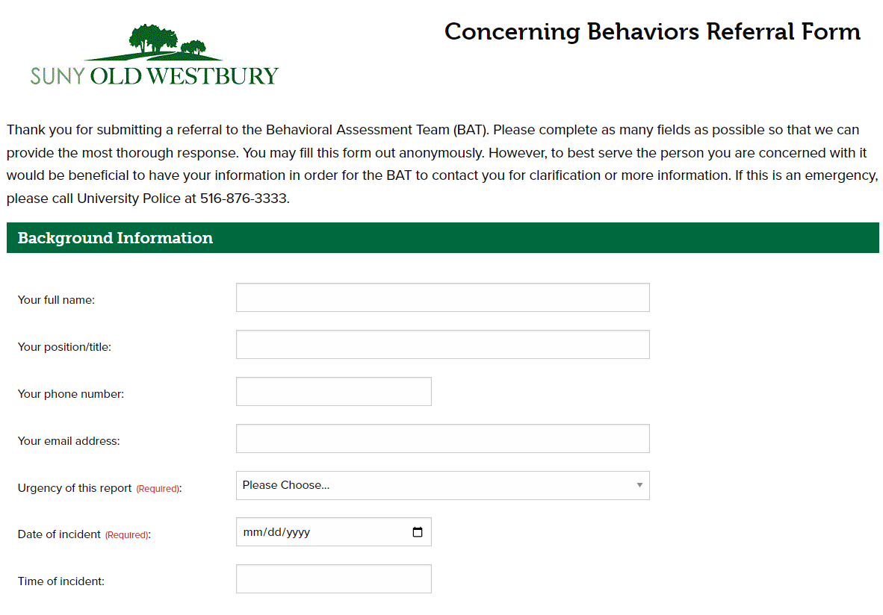

Slide 7
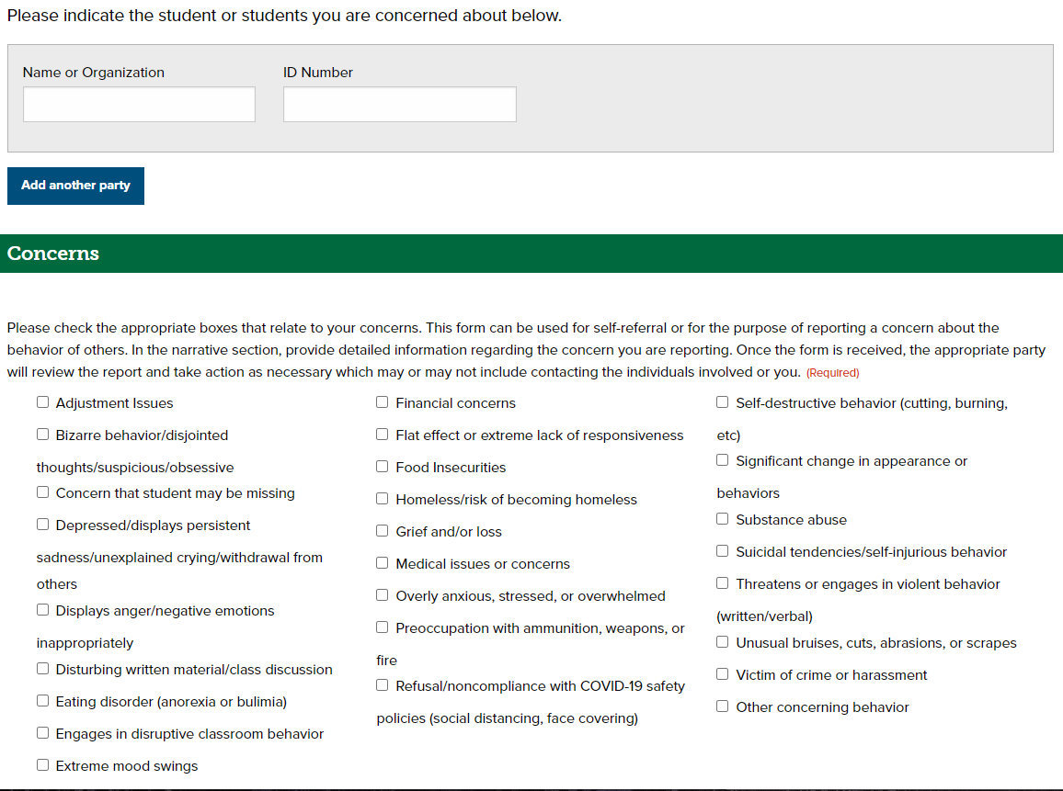

Slide 8
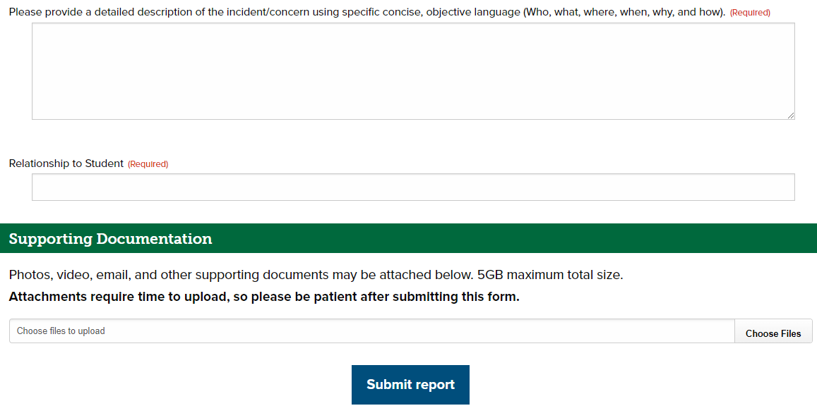

Slide 9
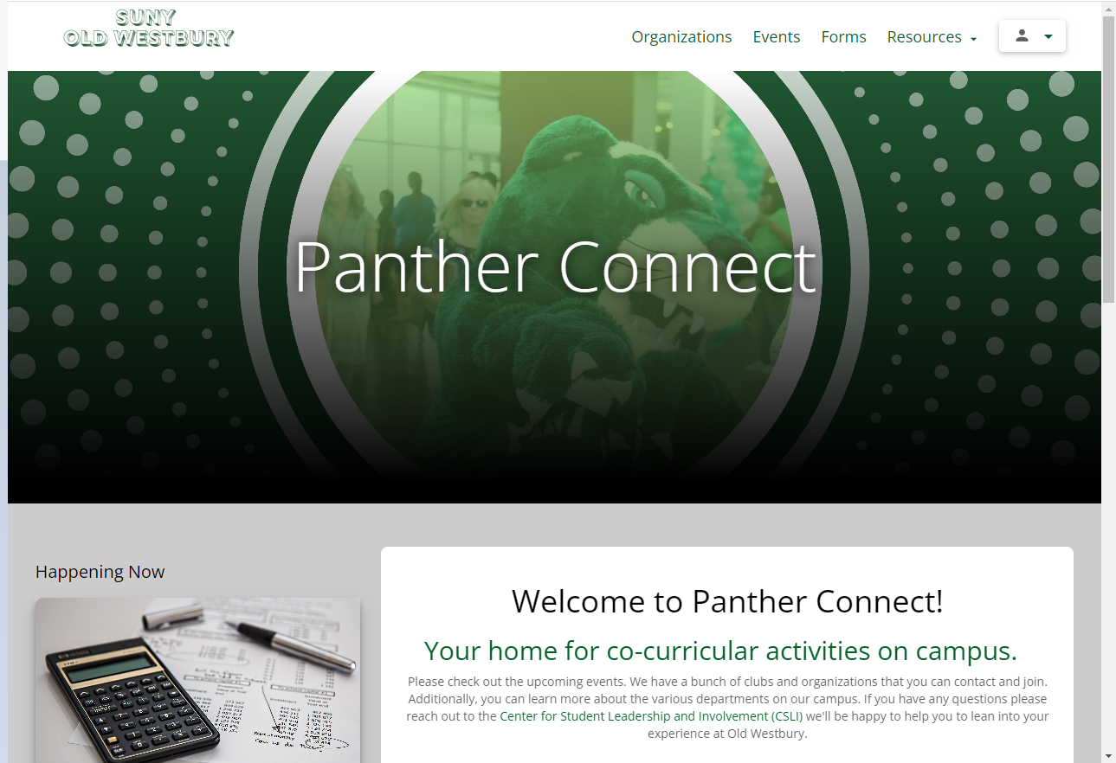
Presence aka Panther Connect
Presence is a web and mobile software platform that connects the campus community to opportunities for involvement and information about upcoming events in one place.
On our campus our website that is hosted on Presence is called Panther Connect.

Slide 10
What Information is Available on Panther Connect?
All Student Government Association (SGA) recognized organizations have a page on Panther Connect under the Organizations link (top right on the web version). All approved upcoming events are displayed under the events link (top right on the web version).
Any offices or departments interested in having a page/the ability to put events into Panther Connect should contact CSLI@oldwestbury.edu

Slide 11
What Information is Available on Panther Connect?
The phone app allows users to see all organizations, upcoming events and the ability to add events to your calendar!
Any offices or departments interested in having a page/the ability to put events into Panther Connect should contact CSLI@oldwestbury.edu

Slide 12
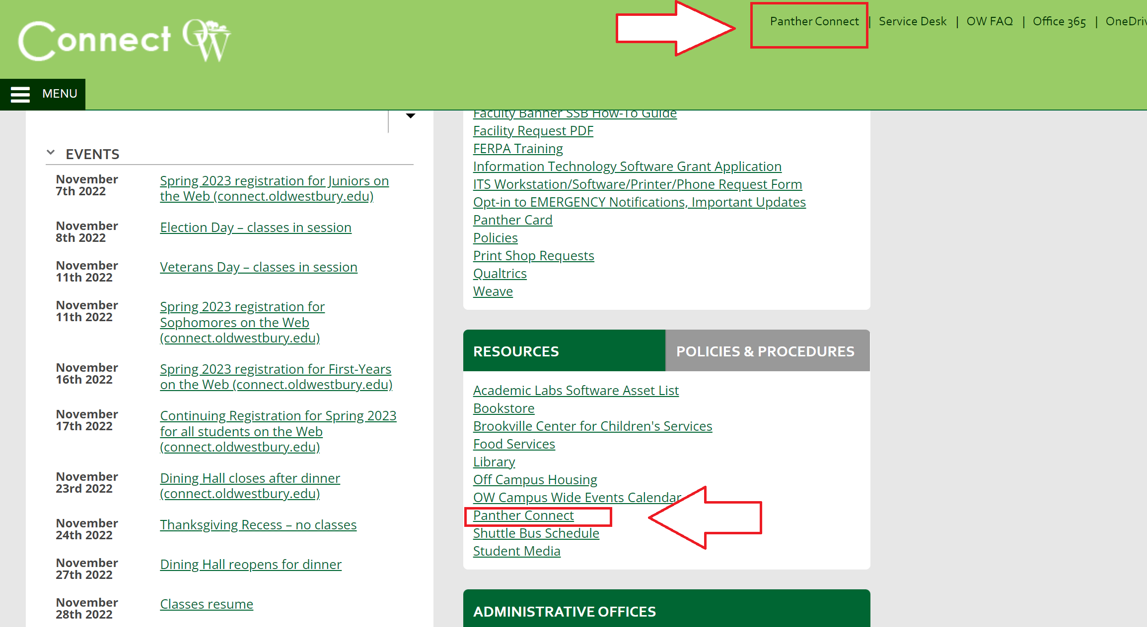

How to Access Panther Connect
All students/faculty/staff have an account and access to Panther Connect.
Connect OW Portal – linked under Resources
Direct link – oldwestbury.presence.io
Modern Campus Presence App (NEW!)

Slide 13

Get started on Handshake
https://sunyoldwestbury.joinhandshake.com/
SUNY Old Westbury is on Handshake!
It's the #1 way college students find jobs.
Fortune 500 companies recruit students through Handshake, giving students access to jobs and internships not available anywhere else.

Slide 14

Handshake continued...
Students can:
Create a profile (similar to LinkedIn) & highlight experiences & accomplishments
Follow companies they are interested in
Save searches, favorite companies, and jobs
Read and write career related advice on the "Explore questions & answers" page
Register for recruitment events, workshops, and career fairs

Slide 15



Careerplanning@oldwestbury.edu
Find us on MS Teams:
Career Planning & Development
Follow us:
ow_cpd

Slide 16

On behalf of Student Affairs, thank you to Faculty Senate for this time! Coming Attractions: Faculty Resource Info Card Multicultural Center

