Slide 1

Residential College:
A College’s Organizing Framework For its Student’s Educational Experience

Slide 2
… liberal arts college that fosters academic excellence through close interaction among students, faculty and staff. (Old Westbury Mission)
At a large university, residential colleges seek to provide for an intimate intellectual and developmental educational experience through residentially based cohorts organized around academic pursuits and/or thematic interests. In essence they are seeking to replicate the magic of small colleges.
Small residential colleges are organized around the principle of providing for a close educational experience (often liberal arts) that deepens student’s intellectual capacity and broadens their horizons of possibilities.

Slide 3

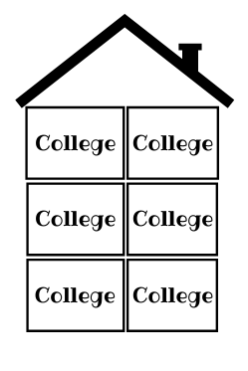
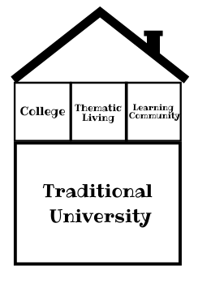

Residential College: Overview
Yale, Oxford, Cambridge
University of Virginia, Michigan, UC San Diego, NYIT, Cornell, Binghamton University, Rutgers, Central Michigan, UC Berkely, Appalachian State
Williams College, Amherst College, Swarthmore College, Vassar College, Colby College, Barnard College

Slide 4
What is in a Residential College?
Living and Learning Communities (can be throughout the undergraduate experience)
First Year experience (belonging, developmental, skills, academic programs) WE ARE ALREADY DOING THIS
Sophomore Experience (reflective, engagement, selecting a major, developmental) WE ARE BEGINNING TO DO THIS
Academic Cohorts
STEM House
Education House
Performing Arts House
American Studies House
Criminal Justice House
Business House
Thematic Housing
Sustainability House
Global Challenges House
International House
Social Justice House
Honors House
Capstone, undergraduate research, externship, "tinkering", practicums, praxis center (labs)
Badging, Intrusive advising and faculty mentor

Slide 5
What About Commuters?
At OW, residential cohorts can consist of both on-campus and commuter students organized around learning and living, academic, and thematic communities. “Residential” does not mean in residence.
A cohort can be anchored within a thematic house with the residential community and span across the college.
Therefore, commuters have a “home and community” throughout their undergraduate years.

Slide 6
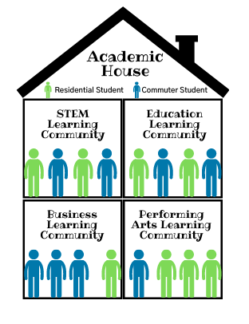
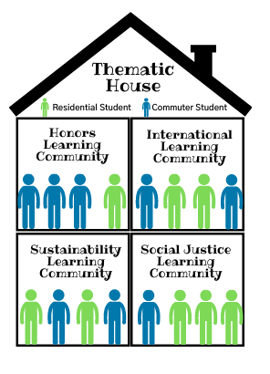
Woodlands Hall 6
Academic Village Hall A
Notes:
At OW, residential cohorts can consist of both on-campus and commuter students organized around learning and living, academic, and thematic communities. “Residential” does not mean in residence.
A cohort can be anchored within a thematic house with the residential community and span across the college.
Therefore, commuters have a “home and community” throughout their undergraduate years.

Slide 7


Suggested RCM Outcomes
Close Liberal Arts Education/Community-Life of the Mind
Increase Student Success
Social and Environmental Justice Education, and Impact.
Deep and Broad Knowledge of and Commitment to Chosen Fields of Study- Life of the Practitioner
STEAM Education to Include Revival of Performing Arts
Signature and Dynamic Programs
Wow!
Old Westbury Identity
A RC is more than just coursework and more than just co-academic programs. It is what happens when the two are aligned to meet desired learning and developmental outcomes for students. It is the programmatic collision points between academics and co-academics, where mutualism is achieved for the benefit of students and the College.

Slide 8
OW Undergraduate Residential College Educational Experience
FYE | Belonging Aca. Engagement/support Dev. support OW Identity | Living and Learning Majors and interests Common reads Developmental activities WOW! | Anchored within Woodlands with programs managed by FYE, Faculty and Student Affairs. | Honors STEM Education Business Badging
SYE | Reflection Broad engagement Leadership Major specific activities (confirm) Dev. support | Living and Learning communities around anticipated majors, civic engagement, leadership. Internships and undergraduate research help to confirm selection of major Undergraduate research Wow! | Anchored within Woodlands with programs managed by SYE, Faculty and Student Affairs. | Living & Learning Communities Civic Engagement Leadership Development Badging Advising and Mentorship Wow!
JYE | Deepen and broaden knowledge Sharpen focus on interests and pursuits Clarify "What am I going to do and how will I do it?” | Academic & Thematic living leading to undergraduate research, internships, entrepreneurial behaviors and endeavors, and workforce and career skills development | Anchored within AV Faculty led thematic housing/cohort experience Social and Environmental Justice Center Undergraduate Research Praxis Centers | Academic & Thematic Housing Sustainability, STEM, Global Challenges, Social Justice, Performing Arts Maker Space, Business Incubator, Career Services Praxis Centers sponsored by Schools and Depts. Badging and Certificates
SeYE | Prepare for post graduate life & impact Degree Completion | Academic & Thematic living leading to careers, continued research interests, vocational and career pursuits, graduate school and entrepreneurial opportunities | Anchored within AV Faculty led thematic housing/cohort experience Social and Environmental Justice Center Undergraduate Research Praxis Centers | Academic & Thematic Housing Sustainability, STEM, Global Challenges, Social Justice, Performing Arts Maker Space, Business Incubator, Career Services Praxis Centers sponsored by Schools and Depts. Badging and Certificates

Slide 9

Hanover

Slide 10
Background & Overview
HANOVER’S SOLUTION
Hanover provides unlimited access to customized research – including data analytics, survey design, administration, and analysis, peer benchmarking, and best-practice research – in order to serve higher education as an adjunct planning group or extension of the executive team.
Hanover offers this access to institutional leaders for a fixed, annual fee. This provides budget visibility and creates a lower-stress environment where Hanover can serve as a one-stop shop for all research-related issues.
WHY HANOVER?
Custom and proprietary research based on your unique on-going needs and special initiatives
Flexible capacity model that can execute on a pre-planned agenda, or execute specific projects as and when needs arise
Specialized expertise that can serve a wide variety of use cases
Networking opportunity to interact with other higher education partners in your role across the country
Fixed-fee for 12 months of ongoing support is simple and affordable

Slide 11
What is Cabinet?
Mission-centric
College Senior Strategic Leadership
Vision-Big Picture
Ethical
Balanced
Policies
Organization-wide
Core Competencies
Infrastructure
Planning
Capital
Data informed
Best Practices
Methodical

Slide 12
Potential Future Projects To Consider (1)
ENROLLMENT MANAGEMENT
ACADEMIC DEVELOPMENT
STUDENT EXPERIENCE
ACADEMIC
FINANCE
ADVANCEMENT
MARKETING
ADMINISTRATIVE
METHODOLOGY
TYPE
PRIMARY
QUANTITATIVE
QUALITATIVE
MIXED
SECONDARY

Slide 13


Development of the Customized Research Action Plan
2) Translation of goals and priorities into research questions.
4) Selection of research methodologies to collect, (possibly create), and analyze data
CONTENT & RELATIONSHIP
DIRECTOR
SUNY OLD WESTBURY
1) Identification and discussion of institutional strategic goals and priorities
3) Determination of data sources necessary to address and answer research questions
5) Craft a roadmap of potential projects with scope of work outlines known as a Research Action Plan
Individual project work gets completed; results and recommendations shared. The Research Action Plan gets reassessed and realigned as necessary
‹#›

Slide 14

Research Library
Hanover Digital Portal (2)
Hanover’s online client portal comprises a suite of tools and resources to complement members’ custom research queues.
Access a repository of more than 1,600 research studies.
Share relevant studies with others in your institution.
Receive weekly research spotlight emails with the latest available reports.
Access to actionable research and tools 24/7
Share user access across your team
Explore Hanover Research news and thought leadership
Request new projects
Receive access to exclusive Roundtables and webinars designed for 2-year college leaders
Connect to custom dashboards
Data Lab
More than 12 million data points
3,000+ institution peer comparisons
Connect to 7 on-demand dashboards
Notes:
Slide 17 – HANOVER DIGITAL PORTAL
I know we’re getting to the end of our time today, but there is one other valuable resource we didn’t get a chance to talk about, which is called Hanover Digital. All of our Members have access to this online portal and there is no limit to log-ins across campus. Within the portal you can access our research library of 1400+ redacted reports and explore five interactive benchmarking dashboards on new program opportunities, retention rates, graduation and transfer rates, financial health and international student enrollment.
What I’d like to do next is go ahead and hold a few minutes at this same time next week, so I can do a screenshare and demo the Hanover Digital portal for you. So if it’s alright with you I’ll send you a planner a week from today, same time – for 20-30 minutes so I can walk you through this valuable tool.

Slide 15
Three Studies for 2021-2022
Enrollment Management
Academic Portfolio Optimization
Spring 2022
Fall 2021
Summer 2022
Branding and Marketing

Slide 16

Hanover
Selected from Among 5 Vendors

Slide 17

Announcements/Updates
COVID Cases Reporting and Response
In classroom…move to remote
In workspace…reduce density (including moving to remote)
Student surveillance testing to begin
Ongoing Electrical Work about 40% completed with the repair/upgrade work
SUNY Capital Matching Grant
Athletics Fields (upgrade and repositioning of the fields)
Building A (AV) (Social and Environmental Justice Center & Performing Arts space)
Rathskeller (AV)
Trainor House (Daycare and Student Social Services Support Center)
Add classroom space
5. Employee Benefits
6. Introducing Dr. David Tomanio, Interim Director of Human Resources

