Slide 1
SCHOLARSHIP RECIPIENT REPORT 2017-18 Faculty Senate Friday, April 13, 2018

Slide 2
SUNY OLD WESTBURY CAMPUS HISTORY
The College at Old Westbury was chartered in 1965 by then SUNY Chancellor, Samuel B. Gould, who sought to add to the state system a college that was innovative in curricula and academic policy.
The College’s first president, Harris Wofford, envisioned the creation of a small experimental institution centered on a common core of courses and individualized student projects that would draw a diverse but talented group of students and faculty together.
The concept of one-third, one-third, and one-third.
SUNY Board of Trustees appointed Calvin O. Butts, III, President in September 1999. As Pastor of the historic Abyssinian Baptist Church in New York City, he was/is recognized for his work as a community activist.
As the College celebrated its 50th anniversary, diversity remains a trademark that sets it apart from other campuses within the State University of New York system.

Slide 3
Student Profile by Gender Fall 2017
OLD WESTBURY* SUNY**
Female 58.3% 54%
Male 41.7 46
*SUNY Old Westbury, Student Profiles Fall 2017, Office of Institutional Research & Assessment (January 2018)
**www.suny.edu/about/fast-facts

Slide 4
Student Profile by Race Fall 2017
OLD WESTBURY* SUNY**
Asian 11.6% (+.2)*** 6.2 (+.9)
Black 27.2 (-.3) 11.0 (+.4)
Hispanic/Latino 25.3 (+.8) 13.0 (+1.5)
URM=52.5% URM=24.0%
Two or More 0.1 (-2.3) N/A
White/ 31.6 (+.3) 56.5 (-1.5)
Non-Hispanic
*SUNY Old Westbury, Student Profiles Fall 2017, Office of Institutional Research & Assessment (January 2018) **www.suny.edu/about/fast-facts/
***Percent differential from previous year

Slide 5
OW Commuter vs. Residential Students by Race Fall 2017*
Commuters Residential
Asian 13.0% (+.3)** 5.0 (-.5)
Black 22.9 (+1.0) 53.1 (+1.1)
Hispanic/ 25.3 (+1.7) 26.7 (+.4)
Latino
URM=48.2% URM=79.8%
Two or More 0.1 (-2.4) 0.0 (-3.5)
White/ 35.7 (-1.4) 10.3 (+.5)
Non-Hispanic
*SUNY Old Westbury, Student Profiles Fall 2017, Office of Institutional Research & Assessment (January 2018)
**Percent differential from previous year

Slide 6
Income Disparity by Permanent Residence
Average Annual Household Income
Nassau County 50.4% $93,696*
Suffolk County 24.2 $85,196*
New York City/ 21.5 $44,850**
(Brooklyn)
*https://www.newyorkfed.org/data-and-statistics/regional-data-center/.../longisland.html
**https://http://www.slate.com/articles/business/moneybox/2014/01/new_york_city_census_data

Slide 7
THE OFFICE OF INSTITUTIONAL ADVANCEMENT
Donor Development
Donor Relations
Donor Stewardship
Fundraising Events/Strategies
Alumni Relations
Support the College’s priorities and initiatives.

Slide 8
SCHOLARSHIP RECIPIENTS 2017-18 A FEW FAST FACTS
The Old Westbury College Foundation Awarded 128 Scholarships for Academic Year 2017-18

Slide 9
SCHOLARSHIP RECIPIENTS BY GENDER 2017-18
Scholarships OW
Female: 93 students 72.66% 58.3
Male: 35 27.34 41.7

Slide 10
SCHOLARSHIP RECIPIENTS BY CLASS STANDING 2017-18
Scholarships OW
Freshman: 13 10.16% 20.4
Sophomore: 21 16.41 13.1
Junior: 30 23.44 27.0
Senior: 54 42.18 30.7
Graduate:10 7.80 4.9

Slide 11
SCHOLARSHIP RECIPIENTS BY RACE 2017-18
Scholarships OW
Asian: 18 14.60% 11.6
Black: 40 31.25 27.2
Hispanic/Latino: 11 8.59 25.3
White/Non-Hisp: 48 37.50 31.6
Other: 2 1.57
Unreported: 9 7.03

Slide 12
SCHOLARSHIP RECIPIENTS COMMUTER VS. RESIDENTIAL 2017-18
Scholarships OW
Commuter: 104 81.25% 82.3
Residential: 24 18.75 17.7

Slide 13
SCHOLARSHIP RECIPIENTS BY SCHOOL 2017-18
Scholarships OW
School of Arts & Sciences: 92 71.88% 67.2
School of Business: 15 11.71 16.9
School of Education: 20 15.63 8.6
School of Professional Studies:1 .78 3.1

Slide 14
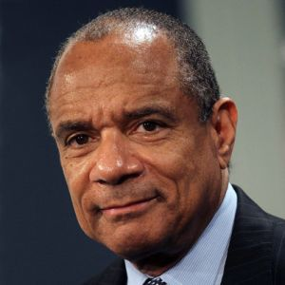
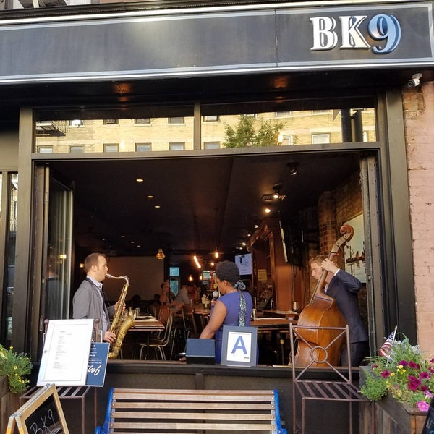

Institutional Advancement Upcoming Events – Spring 2018
Executive Leadership Forum w/ Ken Chenault, Chairman & Managing Director of General Catalyst, Board of Directors Facebook and former Chairman & CEO of American Express – Wed, April 18, 2018 @ Crest Hollow Country Club, Woodbury (11:30 am – 2:00 pm)
Alumni Reunion – Wed, May 2, 2018 @ Jericho Terrace, Mineola
(5:00 – 9:00 pm)
Alumni Reunion –
June 2018 @ BK9, Brooklyn
(Date/Time TBD)
Polo Match (Date/Time TBD)

Slide 15

If We Live Up To Our Mission
The continued awarding of scholarships helps the College attract talented students, providing them opportunities to succeed academically and in the workplace post-graduation.

