Slide 1
Enrollment Trends &
Strategies
Monica Calzolari
Interim VP of Enrollment
2/15/22

Slide 2
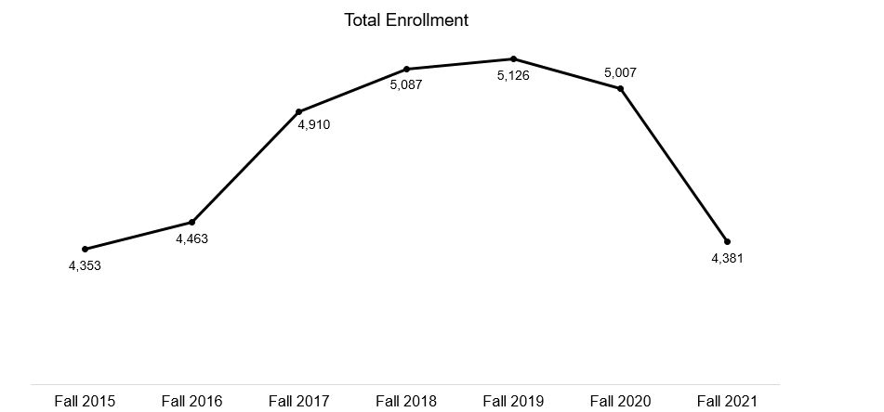
Goal: 4,800-5,200 total enrollment

Slide 3
Goal
Projected Enrollments Fall 2022
First Year | 554
Transfer | 603
Graduate | 152
Continuing Undergrads | 2,801
Continuing Grads | 224
Total | 4,334
Goal: 4,800-5,200 total enrollment

Slide 4
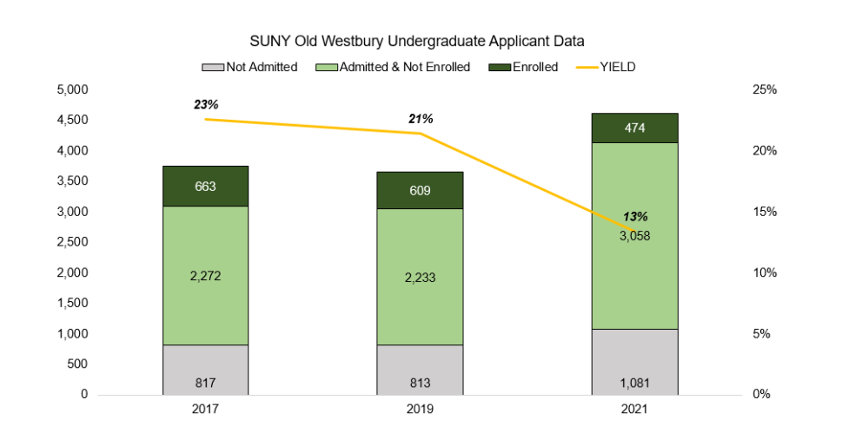

Slide 5
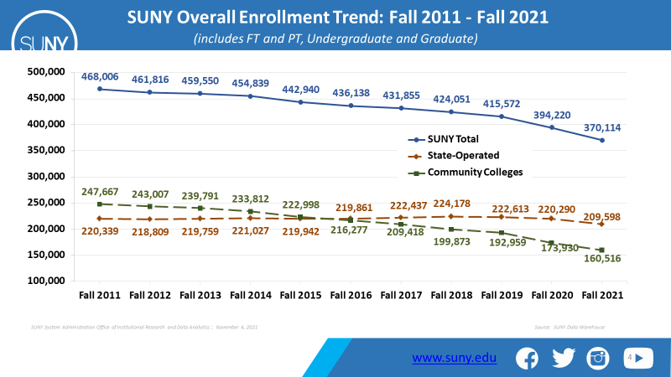

Slide 6
Long-term Trends of SUNY and PK-12 Enrollment, 1976-2021
700,000
3,500
3,307,381
600,000
3,000
NYS PK-12 Public School Enrollment (in thousands)
2,455,261
(Fall 2020)
500,000
2,500
SUNY Fall Enrollment
400,000
370,114
(Fall 2021)
2,000
342,855
300,000
1,500
209,598
(Fall 2021)
191,539
200,000
1,000
160,516
(Fall 2021)
100,000
151,316
500
0
-
Recession SUNY Total
Office of Institutional Research and Data Analytics :: November 7, 2021
State Operated
Community Colleges PK-12 Public
Sources: SUNY historical tables and SUNY Data Warehouse; NYSED

Slide 7

SUNY State-Operated Enrollment by Sector: Fall 2011 - Fall 2021
(includes FT and PT, Undergraduate and Graduate)
120,000
111,299
112,265
113,127
112,239
105,408
105,998
107,422
109,030
101,664
102,205
104,285
100,000
92,783
90,908
89,701
89,442
80,000
87,764
85,633
86,301
85,613
Doctoral Institutions Comprehensive Colleges
83,674
81,181
73,882
60,000
Technology Colleges
40,000
25,892
25,696
25,773
26,177
26,180
26,806
27,106
27,266
26,674
25,982
23,477
20,000
0
Fall 2011 Fall 2012 Fall 2013 Fall 2014 Fall 2015 Fall 2016 Fall 2017 Fall 2018 Fall 2019 Fall 2020 Fall 2021
SUNY System Administration Office of Institutional Research and Data Analytics :: November 4, 2021 Source: SUNY Data Warehouse
www.suny.edu
5

Slide 8
Our Top Ten Competitors
Farmingdale State College (a SUNY)
Nassau Community College
CUNY Borough of Manhattan Community College (BMCC)
CUNY Queens College
Buffalo State College (a SUNY)
CUNY New York City College of Technology
CUNY John Jay College of Criminal Justice
SUNY Stony Brook
Saint John's University
CUNY Brooklyn College
Source: National Student Clearinghouse

Slide 9
Profile of OW Student
89% Commuters
at $8,379 Tuition & Fees
11% Residents
at $20,689 incl. Room & Board
480 residents/4391 total
70% students of color
Many first-generation college students
78% FY, full-time receive some Financial Aid
For 52%, state and federal aid covers tuition
47% Pell eligible, low-income students
EOP goal: 75 new students per year
200 Athletes, some out-of-state; international

Slide 10
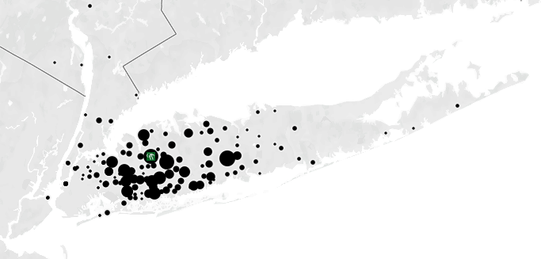
NYC & LI, a Gold Mine of Opportunity
99.9% from New York, mostly Long Island
96% first-time, full-time pay in-state tuition

Slide 11

NYS Residency Enrollment Trend: Fall 2011 - Fall 2021
(includes FT and PT, Undergraduate and Graduate)
450,000
426,147
419,520
415,974
412,119
400,311
394,465
390,866
400,000
383,895
376,050
359,276
350,000
334,799
300,000
297,009
288,709
282,633
275,719
262,271
255,143
251,465
250,000
245,456
240,035
NYS Residents Total Upstate
Long Island
New York City
227,274
212,188
200,000
150,000
100,000
89,815
89,898
91,248
91,790
92,046
92,446
91,780
90,727
89,183
85,261
79,722
50,000
39,323
40,913
42,093
44,610
45,994
46,876
47,621
47,712
46,832
46,741
42,889
0
Fall 2011
Fall 2012
Fall 2013
Fall 2014
Fall 2015
Fall 2016
Fall 2017
Fall 2018
Fall 2019
Fall 2020 Fall 2021
13
Source: SUNY Data Warehouse
SUNY System Administration Office of Institutional Research and Data Analytics :: November 4, 2021

Slide 12
Objective: Attract More Residential Students
Expand recruitment in NYC, Brooklyn, Queens, The Bronx, and Staten Island
Attract students interested in Historically Black Colleges & other Minority Serving Institutions (athlete from Morgan State)
Recruited at Harlem Week, August 2021
Recruited in Buffalo, Syracuse, and Rochester in fall 2021
Invested in College Fairs in Phila. & New Jersey
Marketing OW to 4,000 NYS Guidance Counselors

Slide 13
Objective: Increase Yield
Achieved 99% yield on summer campus tours due to pent-up demand
Hosted 2 Open Houses
New content: Welcome from the President, Director of Financial Aid, a student panel, and faculty member.
Invested in new phone system with call reports to increase accountability
Already mailed 2,500 acceptance packages for Fall 2022
Introducing Yield Events: 3 in NYC; 5 on campus by May 1

Slide 14
Objective: Tell a More Compelling Story
Creating all new recruiting materials with Communications:
New Why OW? PowerPoint
Feature residential halls; the most diverse SUNY
Highlight our proximity to NYC
Emphasize Financial Aid
6 new student videos
“Apply to OW” video
Introduced text messaging 2021

Slide 15
Objective: Attract more Honors students
Secured $150,000 for 25 Honors Scholarships/yr. up to $1000 for fall 2022
Revised Honors brochure
Introduced Honors Scholarship at Open House
Grow the Honors College using financial incentives

Slide 16
Objective: Adopt Enrollment Best Practices
Invested in Hanover Enrollment Survey
to understand our applicants’ motivations and needs better
Investing time with Ruffalo Noel Levitz
to assess enrollment operations and retention

Slide 17
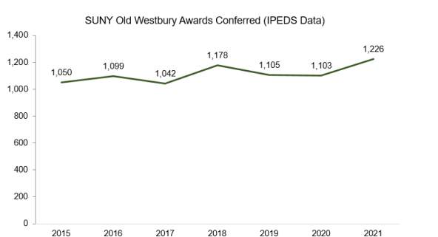
Good news:
Reached record graduation rates in 2021
Achieved 93% of new student goal after financial cancellation Sept. 2021
Achieved 108% of new student goal before fin. cancellation Feb. 2022
Retention rate declined: 81% in 2014 to 73% in 2020 for first-time, FT
Need to replace students who graduate & retain more students

Slide 18
