Slide 1

BRIEF INSTITUTIONAL ADVANCEMENT PRIMER for our Faculty senate
Friday, February 18, 2022
Jeffrey Fischer-Smith
Vice President for Institutional Advancement

Slide 2
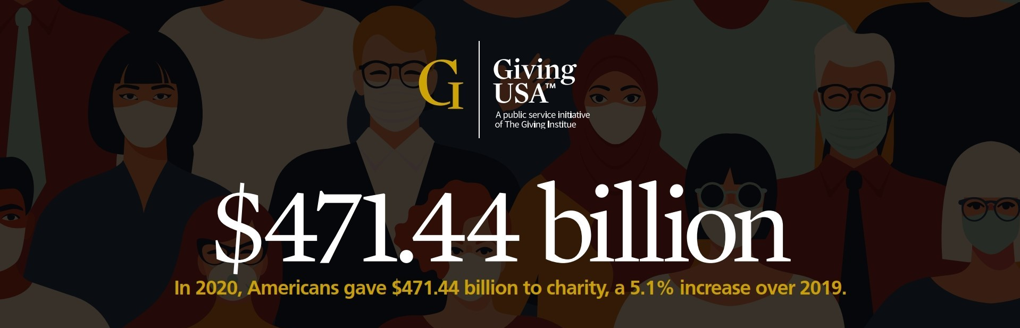
Notes:
Total of charitable contributions in 2020: $471.44 billion: +5% over 2019. Specifically, 2020 saw a 7.3% increase in the number of donors and a 10.6% increase in donations.
Giving in 2020 saw a sharp increase as compared to 2019. Galvanized by the racial justice protests and the coronavirus pandemic, charitable giving in the United States reached a record $471 billion in 2020.
The Giving USA report says Americans gave more to charity last year than in 2019, despite an economic downturn that disrupted the paychecks of millions. Faced with greater needs, estates and foundations also opened up their pocketbooks at increased levels — resulting in a 5.1% spike in total giving from the $448 billion recorded for 2019, or a 3.8% jump when adjusted for inflation.
According to the Giving USA 2020 Report, we saw an astounding $471 billion contributed to social good organizations during 2020, representing the highest amount ever recorded.

Slide 3
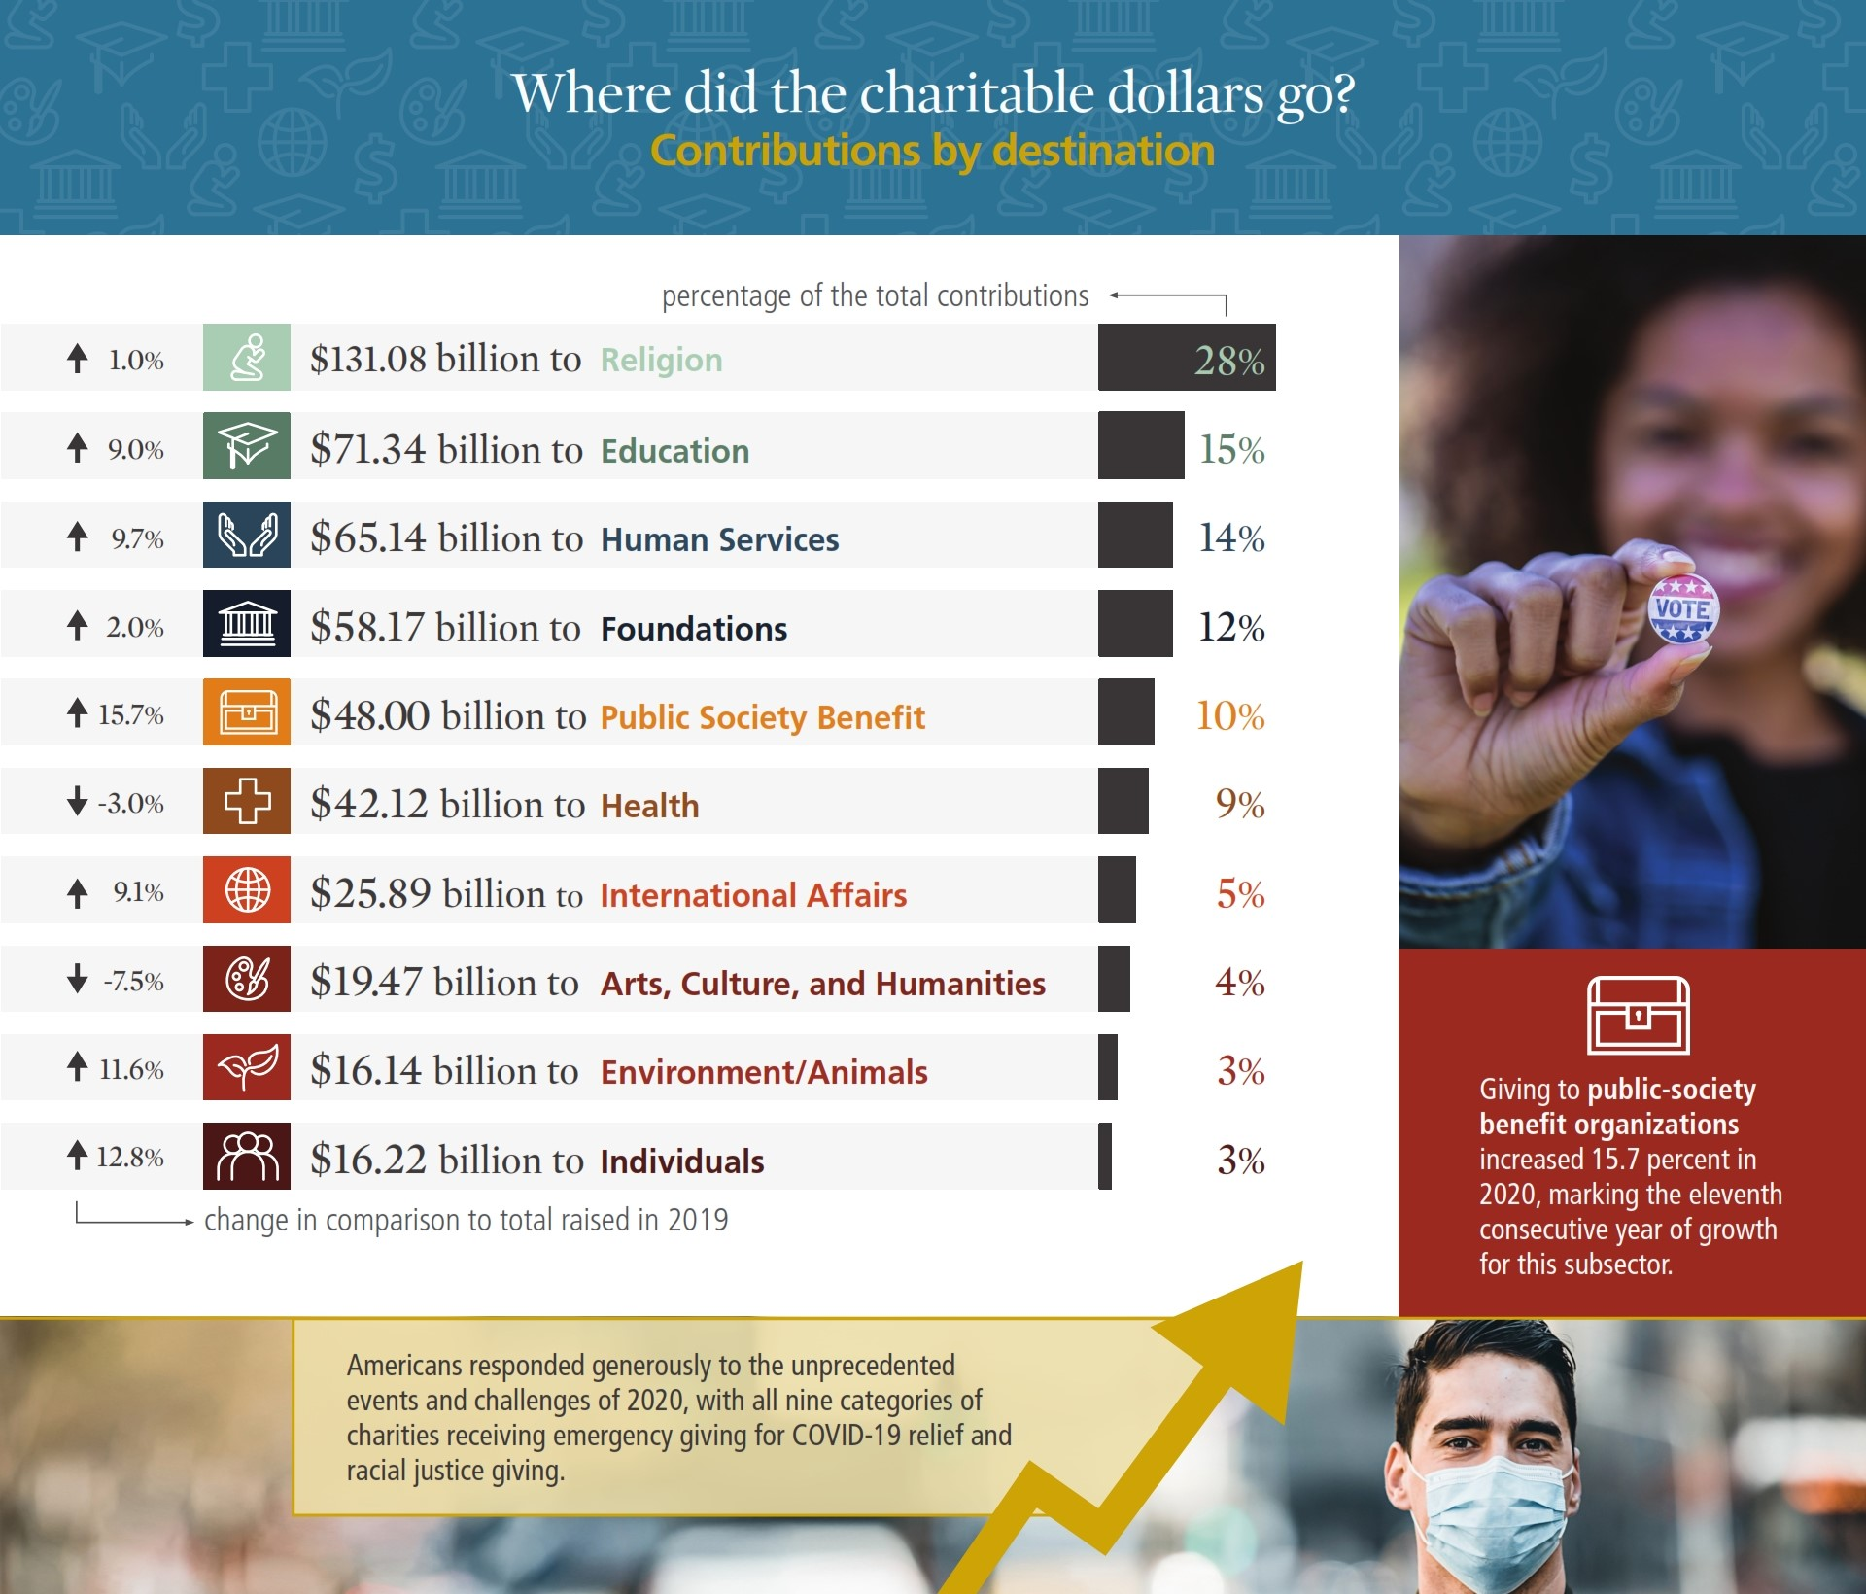
Notes:
Q: What is the #1 area or cause that people give to?
A: Religion – more than one-quarter of all giving – because people ask – weekly.
Education is second at 15%.

Slide 4
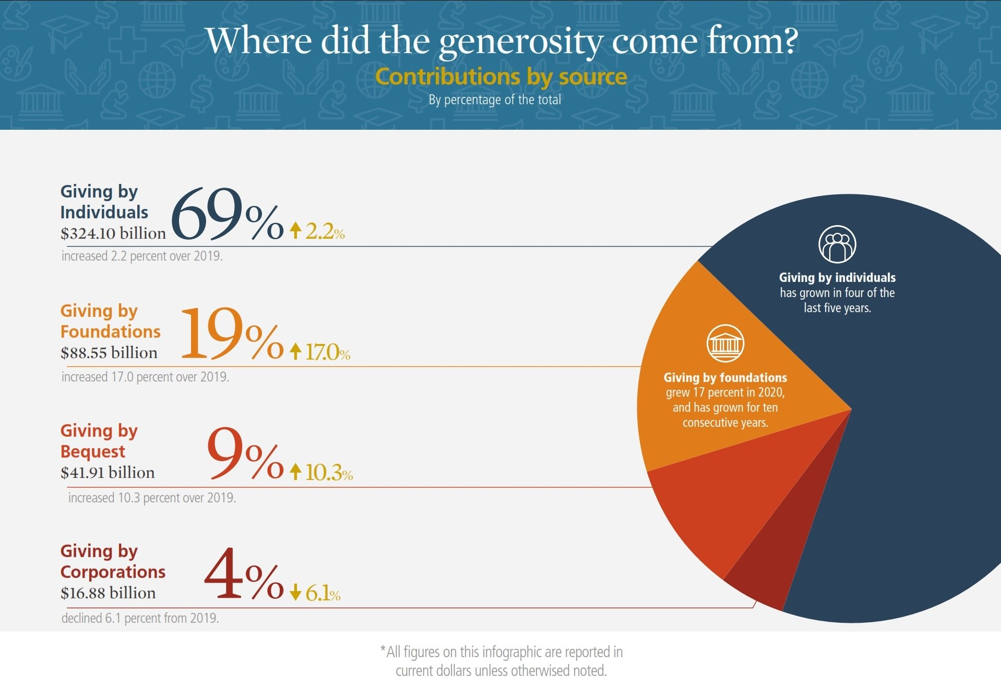
Notes:
Giving by individuals, which made up a majority of the donations last year, rose by approximately 2%.
The biggest uptick came from foundations, who, in total, increased their giving by 17% for an estimated $88.5 billion in contributions. Those donations made up about 19% of the total share of contributions, the largest that has ever come from foundations.
By contrast, companies gave about 6% less in 2020 than they did in 2019, the report said. Experts note giving by corporations is closely tied to GDP and pre-tax profits, which both declined last year.
Una Osili, the associate dean for research and international programs at the Lilly School, says that’s partly because a large chunk of pandemic-related donations went to vaccine research and other direct services offered by university hospitals. Those donations were counted as educational gifts, which saw a 9% spike compared to 2019. That growth was further fueled by billionaire Mackenzie Scott’s unrestricted donations to historically Black colleges and Universities, tribal colleges and other schools.

Slide 5
Corporate giving
Cause-related marketing
Good customer relations
Tax deductions
Access
Notes:
The business of business is business.
Again, this is the smallest part of the giving pie, at 4%. That said, 17 billion is a lot of money.

Slide 6
Corporate giving @ SUNY Old westbury
Explore philanthropy with vendors.
What companies employ our students?
What companies have our alums founded?
What research / services do we provide that synch with what companies?
What in-kind donations would benefit our students?
Employee volunteers.
Notes:
Are we a coke or a pepsi campus?
Look for cash donations, gifts of time, and gifts of expertise.
Company-sponsored foundations.
Matching gifts programs.
Employee volunteer programs.
Employee happiness. Employees vote on the causes they want the company to support.
Sponsorships.

Slide 7
Foundation giving
Often founded by a wealthy person or family.
Large vs. small family foundations.
Often very easy to determine what they support.
Notes:
Account for 19% of giving in the overall giving pie chart; however, tend to represent a higher amount of the pie for colleges and universities, especially research universities or those with medical branches.
Entity that supports charitable activities by making grants to unrelated organizations or institutions or to individuals for scientific, educational, cultural, religious, or other charitable purposes.
Foundation directory online.

Slide 8
Foundation giving @ SUNY Old westbury
Smart area for staff growth.
Work directly with deans, faculty and staff on proposals.
Research foundation prospects. Identify who is funding peer universities.
Often first funders when creating a development program.
Notes:
Need to put someone in place to begin a CFR program.
Foundations do like a bit of a track record although some are willing to invest in high-risk new programs.

Slide 9
Individual giving
By far, most – if not all – giving is actually from individuals.
Annual → Mid-level → Major → Planned
Pareto Principle
Notes:
Represents 69% of giving. But Bequests are also from individuals, most foundations are setup by individuals, and all have a Board; companies, while not individuals, are made up of individual decision-makers.
Pareto principle: 80% of your funding comes from 20% of your donors. Moving towards 90/10 or even 95/5.

Slide 10
The top 7 reasons Why individuals give
They’re mission-driven.
They trust your organization.
They get to see the impact.
They have a personal connection to your cause.
They want to be part of something.
You’ve caught their attention.
They want tax benefits.

Slide 11
The #1 reason Why individuals STOP giving
They don’t know how
their gift is being used.

Slide 12
Individual giving @ suny old westbury
#1 area for SUNY Old Westbury to invest.
Need strong annual fund.
Need major gift officers.
Compelling Case for Support.
Funding priorities.

Slide 13
WHat will the Outcome BE -- a culture of philanthropy @ suny old westbury
All staff are informed about the university’s activities.
Everyone shares in SUNY Old Westbury’s successes with one other.
Further, everyone fully understands the university's mission and cares about the university's success toward achieving its mission.
Staff and faculty understand they are all ambassadors representing the university.

Slide 14
Thank you! Questions?
Friday, February 18, 2022
Jeffrey Fischer-Smith
Vice President for Institutional Advancement

