Slide 1

Adding the OW Campus Wide Events Calendar to Your Personal Calendar
Outlook, Google Calendar, and iCal

Slide 2
Overview & Links
Using the URLs below, you can use your preferred calendar system to subscribe to the calendar.
In the next slides/pages are some basic instructions to subscribe to calendars using some popular apps. The calendar will update automatically as changes are made if you follow the instructions provided in the guide.
Links to Calendar
HTML: https://outlook.office365.com/owa/calendar/fe39056faa1c459faa351e0d39fa181d@oldwestbury.edu/d7c2918d17a84b68b737319b87f88dc714403933047019543533/calendar.html
ICS: https://outlook.office365.com/owa/calendar/fe39056faa1c459faa351e0d39fa181d@oldwestbury.edu/d7c2918d17a84b68b737319b87f88dc714403933047019543533/calendar.ics

Slide 3
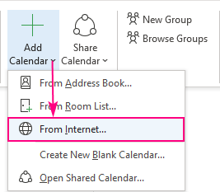
Outlook Desktop App
Open your Outlook calendar.
On the Home tab, in the Manage Calendars group, and click Add Calendar > From Internet…
In the New Internet Calendar Subscription dialog box, paste the link that ends in .ics.
Outlook will ask you to confirm that you want to add this Internet Calendar and subscribe to updates. Click Yes to import the calendar with the default settings, which work just fine for the most part, or click Advanced to configure custom settings.
In a moment, the Internet calendar will appear under Other Calendars in your Outlook.

Slide 4
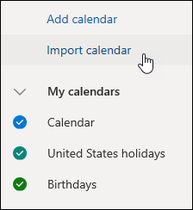
Outlook Online/365
Sign in to Outlook on the web.
Select Calendar to go to Calendar.
In the navigation pane, select Import calendar.
Under Import calendar, select From web.
Under Link to the calendar, type the URL for the linked calendar.
Under Calendar name, type the name you want to use for the calendar.
Select Import.

Slide 5
Google & Android Calendar
On your computer, open Google Calendar.
On the left, next to "Other calendars," click Add From URL.
Enter the calendar's address.
Click Add calendar. The calendar appears on the left, under "Other calendars."
It might take up to 12 hours for changes to show in your Google Calendar.

Slide 6
Apple Calendar
In the Calendar app on your Mac, choose File > New Calendar Subscription.
Enter the calendar’s web address, then click Subscribe.
Enter a name for the calendar in the Name field, then click the adjacent pop-up menu and choose a color.
Click the Location pop-up menu, then choose an account for the subscription.
To get the calendar’s event attachments or alerts, deselect the appropriate Remove checkboxes.
Click the Auto-refresh pop-up menu, then choose how often to update the calendar.
To prevent alerts from appearing for this calendar, select “Ignore alerts.”
Click OK.
To make changes later, click the name of the calendar, then choose Edit > Get Info.

