Slide 1
RESOLUTION ON THE APPROVAL OF CANDIDATES FOR GRADUATION
SPRING 2022
WHEREAS, the Registrar has prepared the list of candidates for graduation at the commencement ceremony on May 22, 2022; and
WHEREAS, the Registrar will award the diploma only to those students who have met all requirements for the specific degree, as certified in conjunction with the faculty; therefore
BE IT RESOLVED that the Faculty approve the list of candidates for the Spring 2022 commencement.

Slide 2
MSCHE Continuous Improvement for AA: Policy Concerns & Institutional Efficiencies
Budgetary Planning and Allocations (in consultation with PBC to define some particulars for AY 2022-23, but best practice involves multiple areas, hiring, procurement, curriculum management, resource management – e.g., facilities)(Anticipate update at next faculty senate meeting, May 6th and provost meeting, May 11th)
Technology Procurement Practices
Silo-busting (where possible, consider interdivisional, inter-unit shared services – enterprise licensing that serves the broader institution as opposed to one school, one department, one unit, etc.). Include technology inventory information in non-academic assessment plans.
Comply with Information Technology Purchasing Policy
Personnel Actions
AA working on procedures to improve processes (including addressing interdivisional parameters for processing)
Conformance (e.g., Extra Service, Campus Policies)

Slide 3
Continuous Improvement: Best Practices In Course Scheduling
Opportunity to improve utilization of space and maximize institutional capacity.
Opportunity to reconsider course scheduling as a tool that supports student success (e.g., time to degree; flexible learning options – synchronous/asynchronous, A/B semester options (accelerated and late start term options); off semesters, etc.)
Opportunity to improve the overall educational experiences of students (access, affordability, engagement)
Opportunity to examine scheduling as part of our student success strategy “story” (e.g., course completion, passing rates, etc.)
Opportunities to grow our enrollment in light of space limitations (i.e. considering the right blend of course modalities that include distance education options)
Opportunity to more closely examine options that improve enrollments for adult learners (e.g., peak scheduling during evening periods, off period scheduling)
Opportunity to fine tune operations as we implement new tools and curricular changes (e-Catalog/curriculum management/course scheduler, complete year in advance scheduling, new GE framework, etc.)

Slide 4
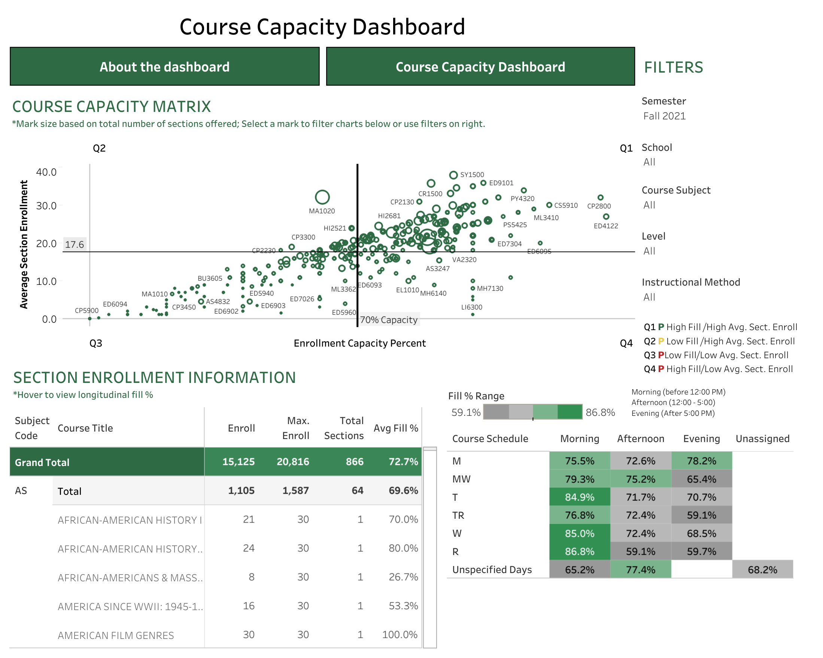
Dashboard to assist depts. with course scheduling and review
https://public.tableau.com/app/profile/oldwestbury/viz/CourseEnrollmentandCapacityDashboard/Coverpage

