Slide 1


Monika Pathak
6/08/2026

Slide 2

Outline
Executive Summary
Introduction
Methodology
Results
Conclusion
Appendix

Slide 3
Executive Summary
The commercial space age is here, for that reason our company Space Y was born. Space Y wants to make the space travels affordable for everyone.
Summary of methodologies
Summary of results
Data Collection from API
Data Collection from Web scrapping
Data Wrangling
Exploratory Data Analysis(EDA) using SQL, Pandas and Matplotlib.
Interactive Visual Analytics and Dashboard with Folium
Interactive Dashboard with Plotly Dash
Machine Learning Prediction.
Success Rate over Time: An improvement in success rate was observed over time.
Success Rate by Launch Site: KSC LC-39A shows the highest success rate of all launch sites.
Success Rate by Orbit: ES-L1, SSO, HEO and GCO were observed to have the highest success rate.
Payload: Heavier payloads have a high failure rate early on with significant improvement over time.
Predictive Analysis: The Decision Tree Classifier algorithm has proven highly accurate in predicting landing outcomes.

Slide 4
Introduction
The objective is to evaluate the viability of the new company Space Y to compete with Space Y to compete with Space X.
Desirable answers:
The best way to estimate the total cost for launches, by predicting successful landings of the first of rockets;
Where is the best place to make launches.

Slide 5

Section 1

Slide 6
Methodology
Executive Summary
Data collection methodology:
Data from SpaceX was obtained from two sources:
SpaceX Api: https://api.spacexdata.com/v4/rockets/
Web Scraping data from wiki: "https://en.wikipedia.org/w/index.php?title=List_of_Falcon_9_and_Falcon_Heavy_launches&oldid=1027686922"
Perform data wrangling
Collected data was enriched by creating a landing outcome label based on outcome data after summarizing and analyzing features.
Perform exploratory data analysis (EDA) using visualization and SQL
Visualize variable relationships
Look at the data in aggregate.
Perform interactive visual analytics using Folium and Plotly Dash
Mark all launch sites on a map
Mark successful and failed launches
Calculate distance to proximate locations
Provide for interactive exploration of the data
Perform predictive analysis using classification models
Data that was collected this step were normalized, divided in training and test data sets and evaluated by four different classification models, being the accuracy of each model evaluated using different combination of parameters.

Slide 7
Data Collection
Data sets collected from SpaceX API and web scraping Wikipedia
The information obtained by the API and rocket, launches, payload information.
The Space X API URL is api.spacexdata.com/v4/
The information obtained by the webscrapping of Wikipedia and launches, landing, payload information
URL: https://en.wikipedia.org/w/index.php?title=List_of_Falcon_9_and_Falcon_Heavy_launches&oldid=1027686922
SpaceX Rest API call
API returns JSON file
Make Dataframe from JSON
Clean Data and export it
Get HTML response from wikipedia
Extract data with Beautifulsoup
Make Dataframe
Export Data

Slide 8
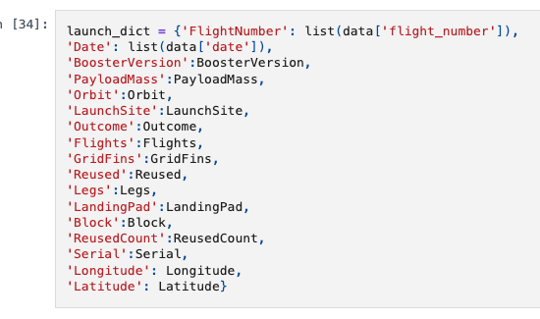
Data Collection - SpaceX API
Getting Response from API 5. Create Dataframe
spacex_url=“https://api.spacexdata.com/v4/launches/past" data=pd.DataFrame.from_dict(laucnh_dicy)
response = requests.get(spacex_url)
Convert Response to JSON file
response = requests.get(static_json_url).json()
data = pd.json_normalize(response) 4. Create dictionary with data 6.Filter dataframe
data_falcon9 = data[dara[‘RoosterVersion’]!=’Falcon1’]
Transform data
getBoosterVersion(data)
getLaunchSite(data) 7. Export to file
getPayloadData(data) data_falcon9.to_csv(‘dataset_part_1.csv’, index=False)
getCoreData(data)

Slide 9
Data Collection – Scraping
Web scraping workflow:
Send HTTP Get to Falcon 9 Launch page at Wikipedia, to retrieve the HTML source
Create a BeautifulSoup object to extract the tables containing launch data
Populate a Pandas DataFrame using the extracted columns
Github URL
HTTP Get Falcon9 Wikipedia URL
Find all matching tables
Identifying columns names
Transform columns values for each table row
Populate Dataframe for further analysis

Slide 10
Data Wrangling
• Goals:
o Use Exploratory Data Analysis (EDA) to find patterns in the data.
o Determine the labels for training supervised models.
• Steps:
o Find missing values as a percentage of each attribute
o Identify column types, numerical or categorical
o Show launches per Launch Site
o Show distribution of Orbit type in the data set
o Explore outcomes, and group them by binary outcome (success or failure)
o Store outcome as "Class" label, to be used as target value in training
Github URL

Slide 11
EDA with Data Visualization
Visualize relationships to gain insight into the importance of each variable:
o Flight Number and Outcome
o Flight Number and Launch Site
o Payload and Launch Site
o Orbit and Outcome o Flight Number and Orbit
o Payload and Orbit
o Yearly success rate
• Expand categorical variables into "dummy" columns
Convert numerical columns into float64

Slide 12
EDA with SQL
• SQL Queries Performed:
Show each unique launch site
Show 5 records where launch site names begin with 'CCA'
Display the total payload mass carried by boosters launched by 'NASA (CRS)'
Display the average payload mass carried by the v1.1 Falcon 9 booster
List the date of the first successful ground landing outcome
List the booster versions with successful outcomes landing on the drone ship with payloads between 4000kg and 6000kg.
List the number of successful and failed mission outcomes
List all of the booster versions that carried the max payload mass
List the month name, outcome, booster version, and launch site for missions with failure outcomes landing on a drone ship in 2015.
Show the distribution of outcomes between June 4th, 2010 and March 20th, 2017
Github URL

Slide 13
Build an Interactive Map with Folium
To find geographical patterns in the data the following items were marked on a map of launch sites:
All Launch Sites
Successful and Failed Launches
Distances between a launch site and proximate landmark
Github URL

Slide 14
Build a Dashboard with Plotly Dash
To enable interactive exploration of the data, a Plotly Dash dashboard was developed
to include:
o A dropdown selector to choose a Launch Site, affecting:
▪ A pie chart
• All sites selected: shows the breakdown of successful outcomes across all sites
• A launch site selected: shows the breakdown of successful vs failed launches for the given site
▪ A scatter plot
• All sites selected: shows outcome by payload mass and booster version for all sites
• A launch site selected: shows outcome by payload mass and booster version for the given site
o A Payload Mass range selector that filters data points on the scatter plot
• Plotly Dash App (GitHub URL)

Slide 15
Predictive Analysis (Classification)
• Load data
• Apply StandardizedScaler on X
• Convert Y to numpy array
• Split training and testing data
• Use GridSearchCV to test hyperparameters for multiple algorithms:
Logistic Regression
SVC
Decision Tree Classifier
K Neighbors Classifier
Notebook(Github URL)

Slide 16
Results
Exploratory data analysis results
Interactive analytics demo in screenshots
Predictive analysis results

Slide 17

Section 2

Slide 18
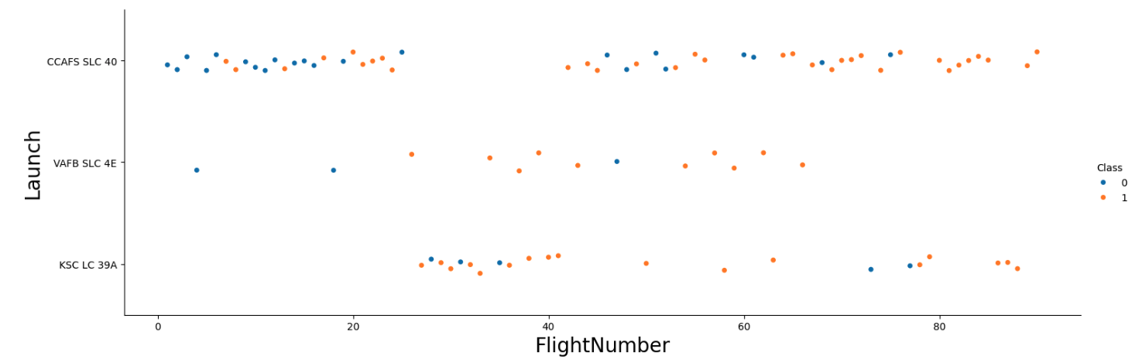
Flight Number vs. Launch Site
All sites show a mix of first stage landing successes and failures, with successes increasing over time.
Early flights predominantly resulted in failures, indicating improvements to technology or process.
While CCAFS SLC 40 has the most total flights, VAFB SLC 4E appears to have a relatively higher.

Slide 19
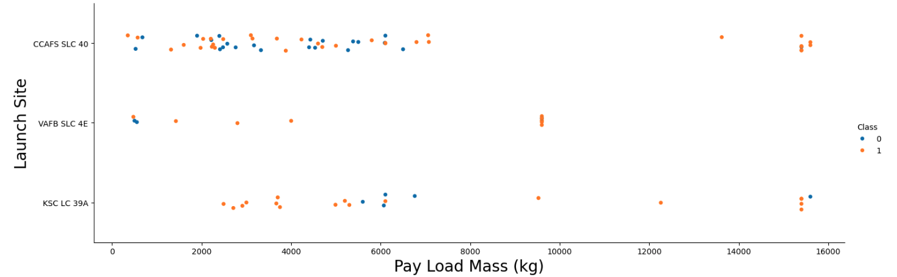
Payload vs. Launch Site
All sites show a wide range of payload weights, from light to heavy payloads.
Early flights trend toward lighter payloads, representing the bulk of the landing failures.
This suggests technological or operational improvements lead to a greater rate of success with heavier payloads.

Slide 20
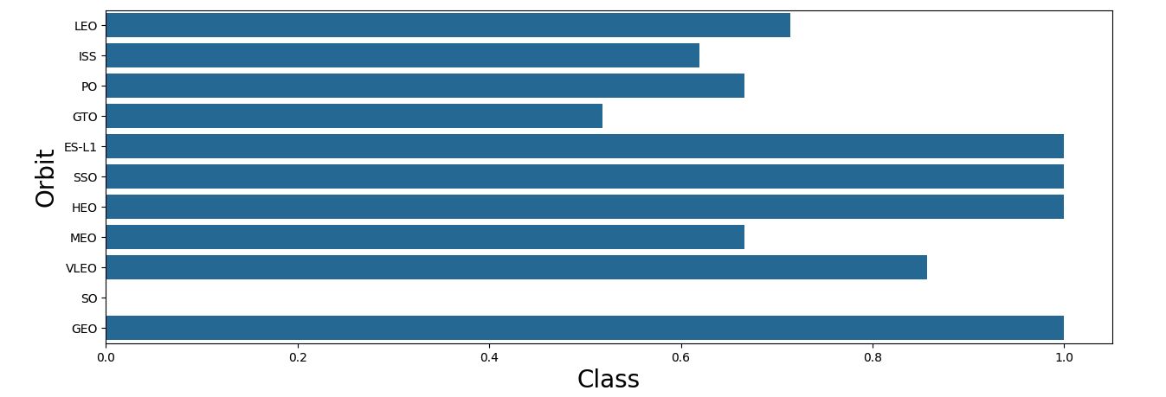
Success Rate vs. Orbit Type
Some orbits, such as ES-L1, SSO, HEO, and GEO consistently show high success rates.
Others such as GTO show more mixed outcomes, suggesting some orbit types may introduce operational or technological challenges.
With only one launch, there is not enough data for the SO orbit type to provide an accurate analysis.

Slide 21
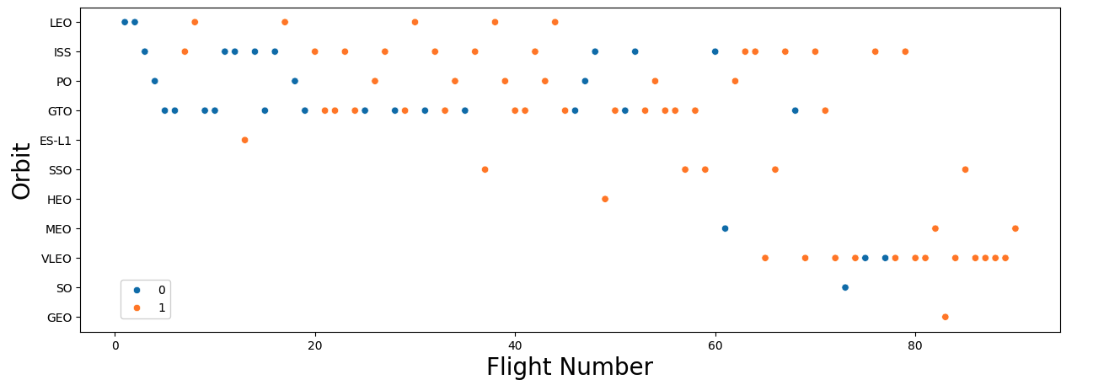
Flight Number vs. Orbit Type
Many orbits are represented throughout the flight number range, some orbits are not attempted until later flights.
There is a noticeable improvement in landing success as flight numbers increase, indicating an accumulation of experience and ongoing improvements.

Slide 22
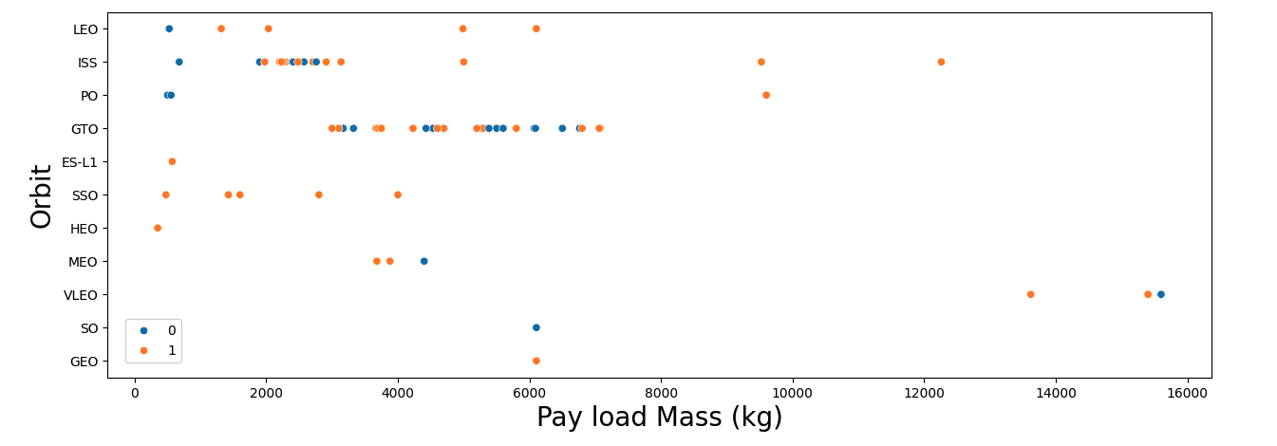
Payload vs. Orbit Type
Many orbits are represented across a wide range of payload masses, but others like SSO, MEO, HEO and GEO show a generally lower range.
Orbits with a constrained payload range, tend to show a higher rate of landing success.
While payload mass does not appear to directly determine mission success, its interplay with orbit suggests a significant correlation.

Slide 23
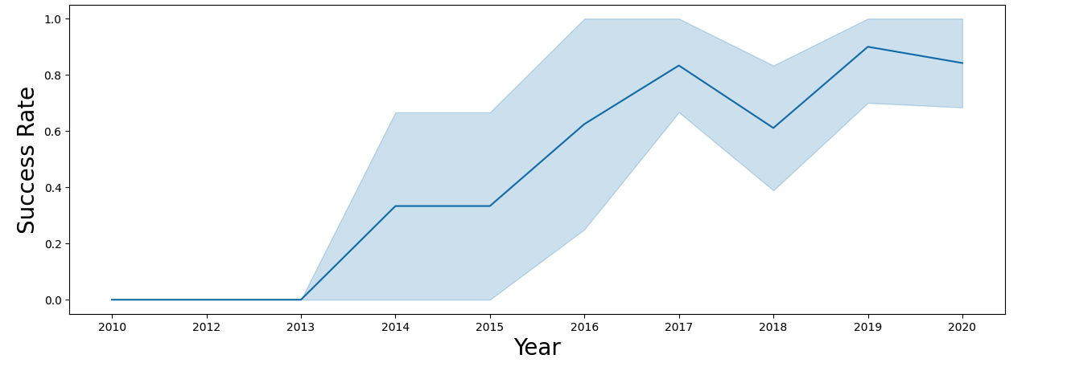
Launch Success Yearly Trend
Yearly trend shows a consistent progression from early challenges to high reliability in first stage landings over time.
From 2016 onward, SpaceX experienced year over year improvement in success rate with a minor setback in 2018.

Slide 24
All Launch Site Names
There are four unique Launch Sites
o CCAFS LC-40
o VAFB SLC-4E
o KSC LC-39A
o CCAFS SLC-40
SELECT DISTINCT Launch_Site FROM SPACEXTABLE;

Slide 25
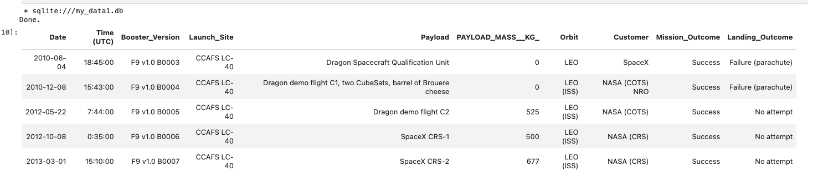
Launch Site Names Begin with 'CCA'
• First five records where launch sites begin with `CCA`
RE Launch_Site LIKE 'CCA%' LIMIT 5;
SELECT * FROM SPACEXTABLE WHERE Launch_Site LIKE 'CCA%' LIMIT 5;

Slide 26
Total Payload Mass
The total payload carried by boosters from NASA (CRS) is 45,596kg.
SELECT SUM(PAYLOAD_MASS__KG_) AS TOTAL_PAYLOAD
FROM SPACEXTABLE WHERE Customer = 'NASA (CRS)';

Slide 27
Average Payload Mass by F9 v1.1
The average payload mass carried by booster version F9 v1.1 is 2,534.67kg.
SELECT AVG(PAYLOAD_MASS__KG_) AS AVG_PAYLOAD_MASS
FROM SPACEXTABLE WHERE Booster_Version LIKE 'F9 v1.1%';

Slide 28
First Successful Ground Landing Date
The first successful landing outcome on ground pad occurred on December 22nd, 2015.
SELECT MIN(Date) as LaunchDate
FROM SPACEXTABLE
WHERE Landing_Outcome = 'Success (ground pad)';

Slide 29
Successful Drone Ship Landing with Payload between 4000 and 6000
The boosters which have successfully landed on drone ship and had payload mass greater than 4000 but less than 6000 are:
SELECT Booster_Version, PAYLOAD_MASS__KG_
FROM SPACEXTABLE
WHERE Landing_Outcome = 'Success (drone ship)'
AND PAYLOAD_MASS__KG_ BETWEEN 4000 AND 6000;
Booster | Payload Mass
F9 FT B1022 | 4,696kg
F9 FT B1026 | 4,600kg
F9 FT B1021.2 | 5,300kg
F9 FT B1031.2 | 5,200kg

Slide 30
Total Number of Successful and Failure Mission Outcomes
Total number of successful and failure mission outcomes
SELECT CASE
WHEN Mission_Outcome LIKE 'Success%' THEN 'Success'
WHEN Mission_Outcome LIKE 'Failure%' THEN 'Failure'
END as Mission_Status, COUNT(*)
FROM SPACEXTABLE
GROUP BY Mission_Status;
Mission Status | Count
Failure | 1
Success | 100

Slide 31
Boosters Carried Maximum Payload
• The maximum payload sent was 15,600kg.
• The boosters that carried the maximum payload are:
SELECT DISTINCT Booster_Version, PAYLOAD_MASS__KG_
FROM SPACEXTABLE
WHERE PAYLOAD_MASS__KG_ = (SELECT MAX(PAYLOAD_MASS__KG_) FROM SPACEXTABLE)
ORDER BY Booster_Version;
Booster Version
F9 B5 B1048.4
F9 B5 B1048.5
F9 B5 B1049.4
F9 B5 B1049.5
F9 B5 B1049.7
F9 B5 B1051.3
F9 B5 B1051.4
F9 B5 B1051.6
F9 B5 B1056.4
F9 B5 B1058.3
F9 B5 B1060.2
F9 B5 B1060.3

Slide 32
2015 Launch Records
List the failed landing_outcomes in drone ship, their booster versions, and launch site names for in year 2015:
SELECT
CASE strftime('%m', Date)
WHEN '01' THEN 'January'
WHEN '02' THEN 'February'
WHEN '03' THEN 'March'
WHEN '04' THEN 'April'
WHEN '05' THEN 'May'
WHEN '06' THEN 'June'
WHEN '07' THEN 'July'
WHEN '08' THEN 'August'
WHEN '09' THEN 'September'
WHEN '10' THEN 'October'
WHEN '11' THEN 'November'
WHEN '12' THEN 'December'
END as Month,
Landing_Outcome, Booster_Version, Launch_Site, Date
FROM SPACEXTABLE
WHERE strftime('%Y', Date) = '2015' AND Landing_Outcome = 'Failure (drone ship)';
Month | Outcome | Booster | Launch Site
January | Failure (drone ship)
April | Failure (drone ship)

Slide 33
Rank Landing Outcomes Between 2010-06-04 and 2017-03-20
Rank the count of landing outcomes (such as Failure (drone ship) or Success (ground pad)) between the date 2010-06-04 and 2017-03-20, in descending order:
SELECT Landing_Outcome, COUNT(*) as Count
FROM SPACEXTABLE
WHERE Date BETWEEN '2010-06-04' AND '2017-03-20'
GROUP BY Landing_Outcome
ORDER BY Count DESC;
Landing Outcome | Count
No attempt | 10
Success (drone ship) | 5
Failure (drone ship) | 5
Success( ground pad) | 3
Controlled (ocean) | 3
Uncontrolled (ocean) | 2
Failure (parachute) | 2
Preclude (drone ship) | 1

Slide 34

Section 3

Slide 35
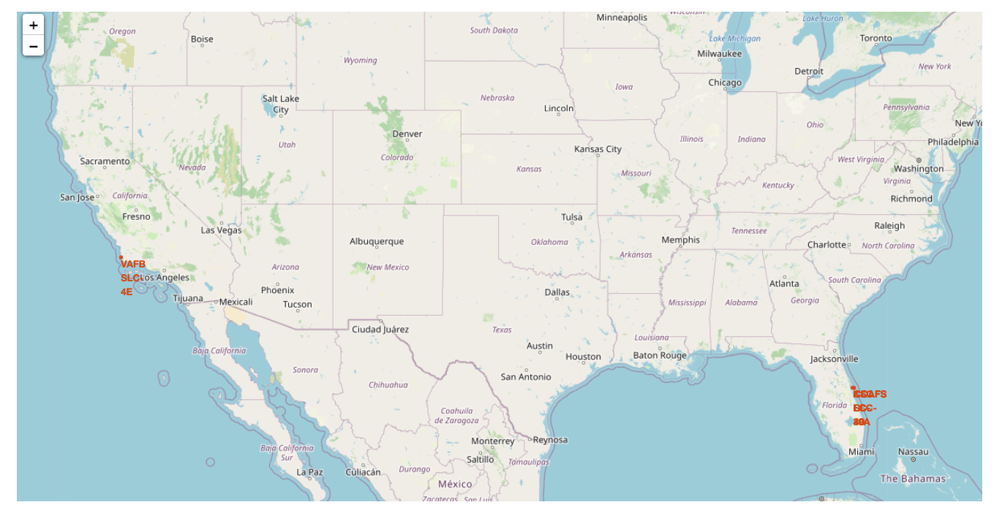
Launch Site Location
Launch sites are located near coastal region in Florida and California to reduce risk of catastrophic failures affecting human activities.

Slide 36
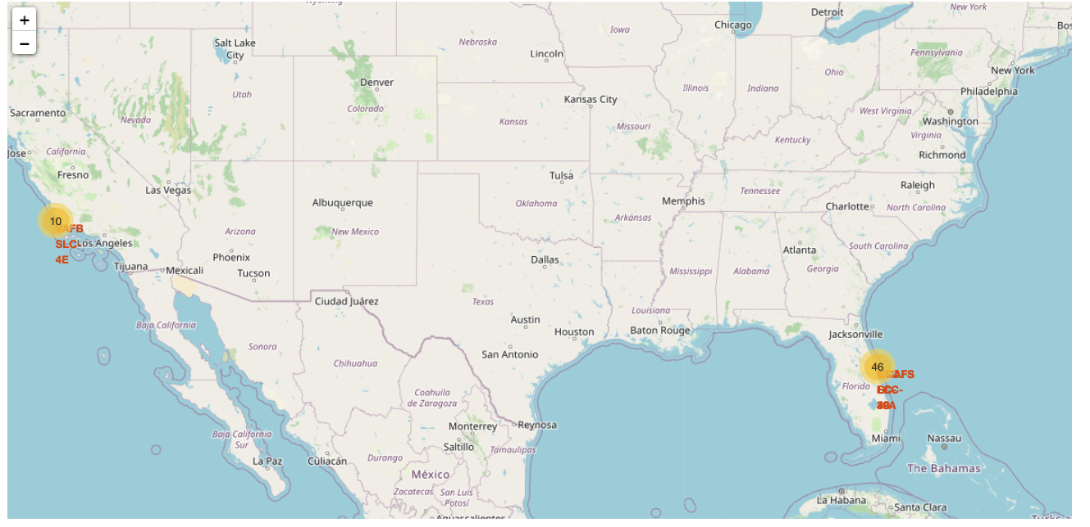
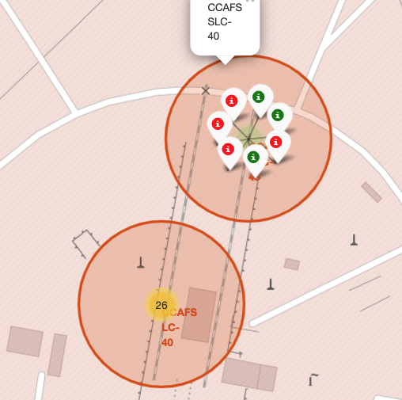
Launch Outcomes

Slide 37
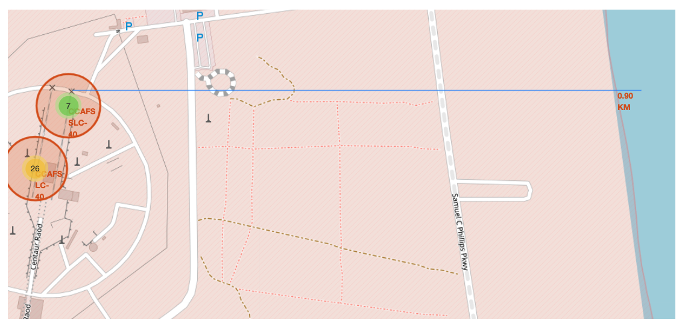
Notable Proximate Locations
Notable locations shows
Railway (1.02KM)
Roadway (0.59KM)
Coast (0.86KM)

Slide 38

Section 4

Slide 39
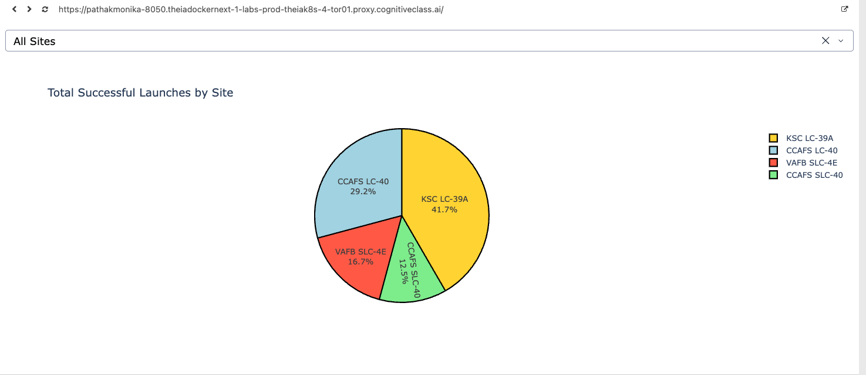
All Launch Sites: Successful Landings
KSC LC-39A experienced the highest proportion of successful landings, followed by CCAFS LC-40.
VAFB SLC-4E and CCAFS SLC-40 the lowest.

Slide 40
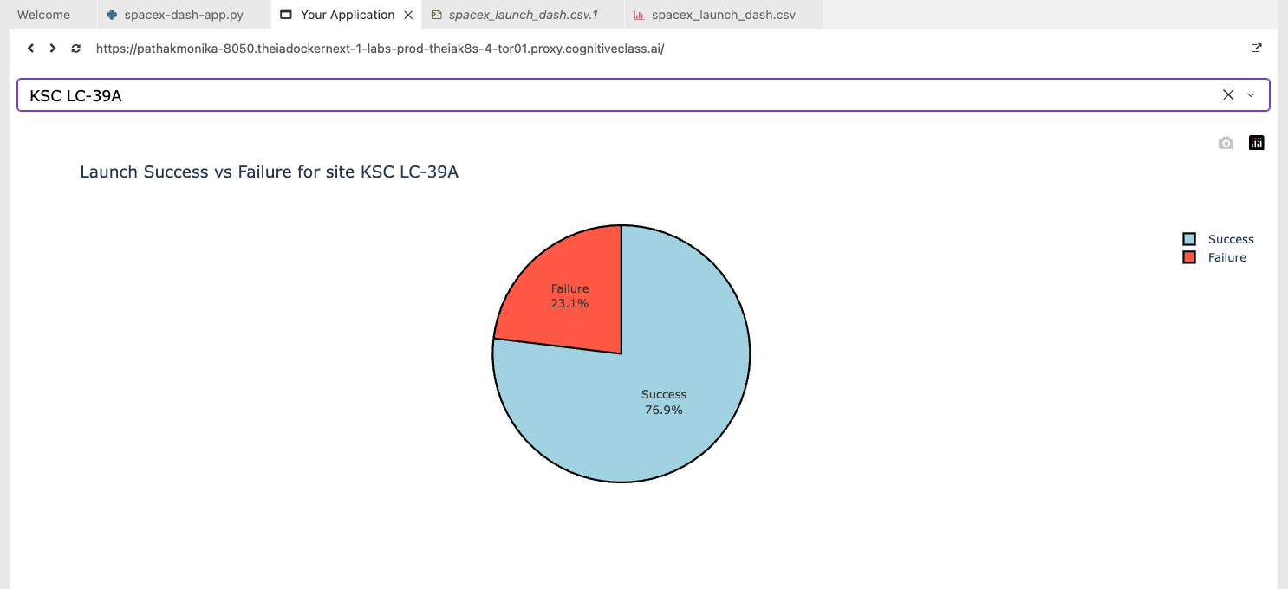
Per-Site Launch Success Ratio: High
KSC LC-39A had the highest ratio of successful landings

Slide 41
<Dashboard Screenshot 3>
Replace <Dashboard screenshot 3> title with an appropriate title
Show screenshots of Payload vs. Launch Outcome scatter plot for all sites, with different payload selected in the range slider
Explain the important elements and findings on the screenshot, such as which payload range or booster version have the largest success rate, etc.

Slide 42

Section 5

Slide 43
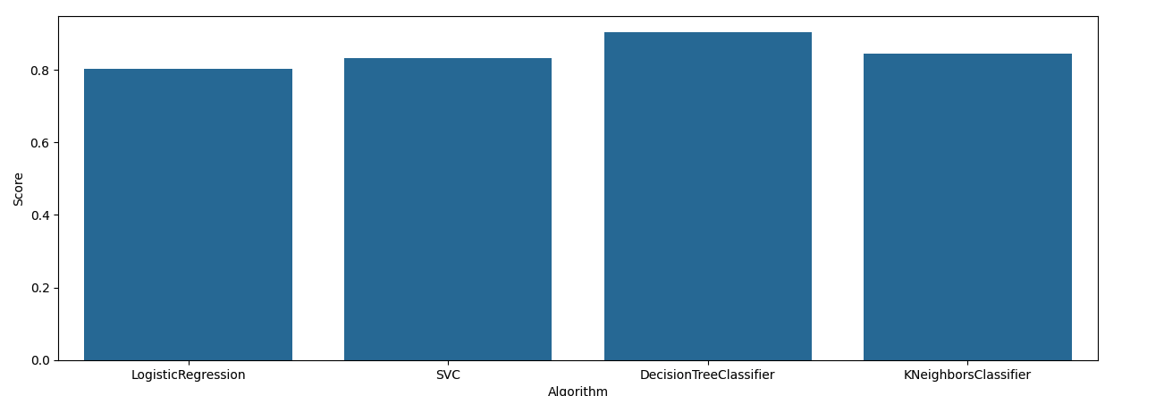
Classification Accuracy
The most accurate algorithms tested Decision Tree Classifier was the most accurate:

Slide 44
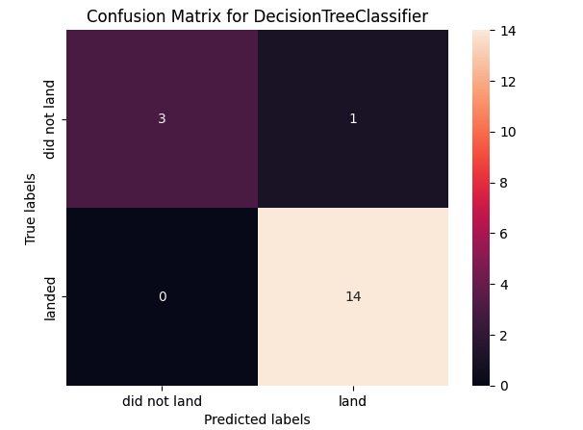
Confusion Matrix
14 observations were correctly predicted as successful landings (true positive)
3 observations were correctly predicted as failed landings (true negative)
1 observation was incorrectly predicted as a successful landing (false positive)
No observations were incorrectly predicted as a failed landing (false negative)

Slide 45
Conclusions
Success rates increase over time, across all factors, which indicates continuous and incremental operational improvements and technological advancements.
Different orbits have varying success rates, with ES-L1, SSO, HEO, and GEO showing
consistently successful outcomes.
Launch site was a highly predictive factor, with KSC LC-39A being a top performer, closely
followed by CCAFS LC-40.
Many of the predictive models evaluated were able to predict landing outcome with an acceptable level of accuracy. In the testing performed, DecisionTreeClassifier produced best results with high accuracy, precision, and recall.

Slide 46
Appendix
Data Sources
SpaceX API : dataset_part_1.csv
Wikipedia: List of Falcon 9 and Falcon Heavy launches (June 2021)
Data after wrangling: dataset_part_2.csv
Geographical data: spacex_launch_geo.csv
Interactive data source: space_launch_dash.csv

Slide 47


