Slide 1
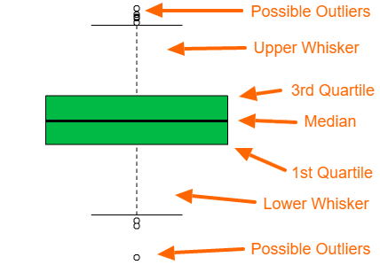
Box Plots
It is a way to visualize numerical data based on a 5-way summary
Interquartile Range(IQR) or The Box:
1st Quartile (Q1): The 25th percentile. 25% of the data falls below this value.
3rd Quartile (Q3): The 75th percentile. 75% of the data falls below this value.
Equation :
IQR = Q3- Q1
2. Median: Thick black line (Q2) that represents the middle value of the dataset. Not to be confused with the mean.
3. The Whiskers:
The dashed lines extending from the box are the Whiskers. They represent the spread of the data outside the middle 50%, typically extending to the furthest data point that is not considered an outlier.
Upper Whisker: Q3 + (1.5 IQR)
Lower Whisker: Q1 - (1.5 IQR)
Outliers are above the upper whisker and below the lower whisker.

Slide 2
One Hot Encoding
In order to avoid word data, and our data does NOT NEED TO BE ORDERED, we do the following:
0: No
1: Yes
Color
Red
Green
Blue
Green
Blue
Color | Red | Green | Blue
Red | 1 | 0 | 0
Green | 0 | 1 | 0
Blue | 0 | 0 | 1
Green | 0 | 1 | 0
Blue | 0 | 0 | 1

Slide 3
Label Encoding
We have data (strings or words) that can be ORDERED!! Like a ranking system.
Otherwise, our machine learning will face issues and gives us inaccurate results.
Education Level
Bachelors
Masters
PhD
Masters
PhD
Education Level
0
1
2
1
2
Here, the data stays on one table.
NOTE: THE CODE PICKS THE RANKS AND WE DON’T MANUALLY CHOOSE. EVEN IF IT IS NOT WHAT YOU MAY RANK IT, THE MACHINE KNOWS WHAT IS BETTER.

Slide 4
Supervised ML Models
Supervised Learning is a type of machine learning where the model is trained on a labeled dataset, meaning each input has a known output (y). The goal is for the model to learn the mapping between inputs and outputs so it can predict correct outputs for new, unseen data.

Slide 5
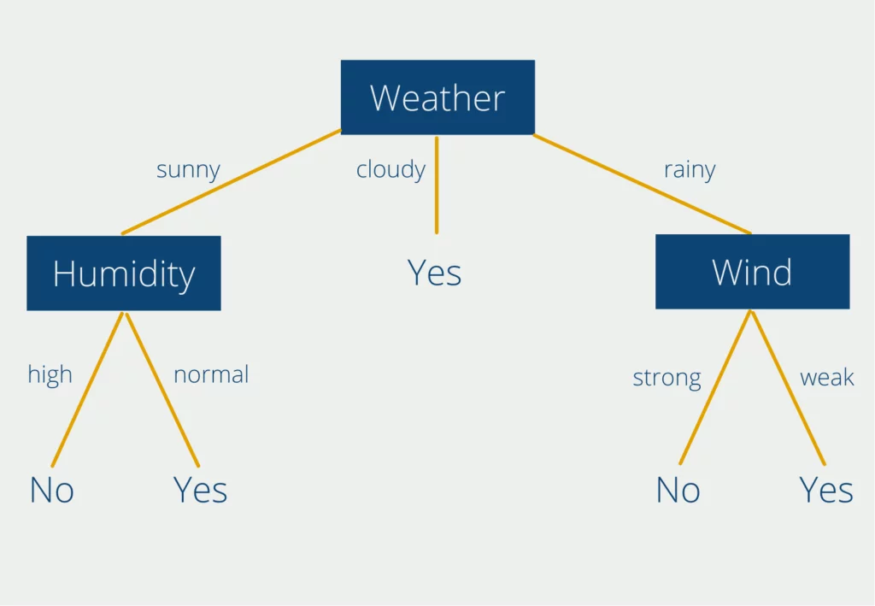
Decision Trees (Classification)
A decision tree works by asking a series of questions about the data, like temperature or humidity, and splitting the data step by step until it reaches a final prediction.
Root Node: Our initial question (What is the weather?)
Then it branches of to possible answers(sunny ? Cloudy? Rainy?....)
Internal Nodes: The other questions( Is the humidity High or Low? …)
Leaf Nodes: Final Answers.

Slide 6
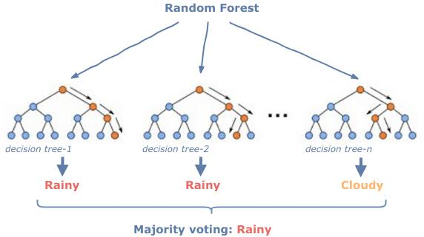
Random Forest (Classification)
Random forest uses MORE THAN 1 decision trees to provide a more precise and accurate result than 1 decision tree. There is a lower margin of error.
Instead of trusting one decision tree, we ask many trees and take the majority answer.
Each tree makes a prediction, and the final output is based on the majority vote.

