Slide 1

Incident Analysis and Prediction for 2025
BI Report for Football Stadiums by The AI IT Company

Slide 2
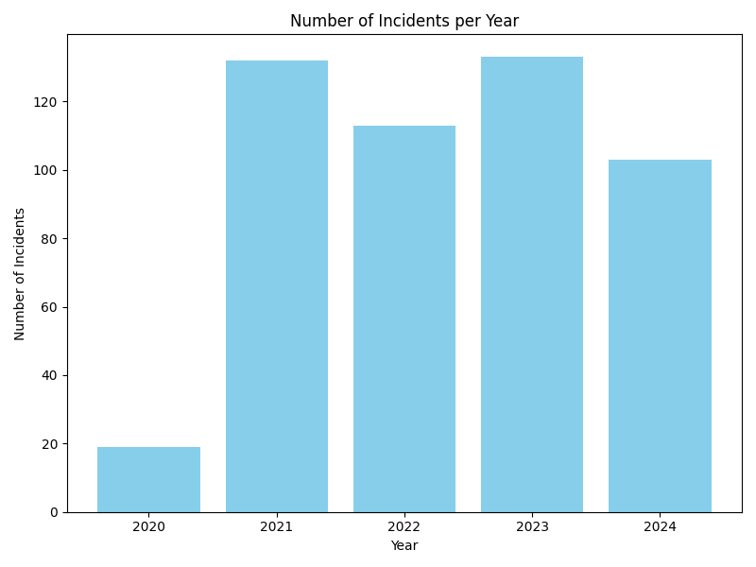
Historical Overview of Incidents

Slide 3
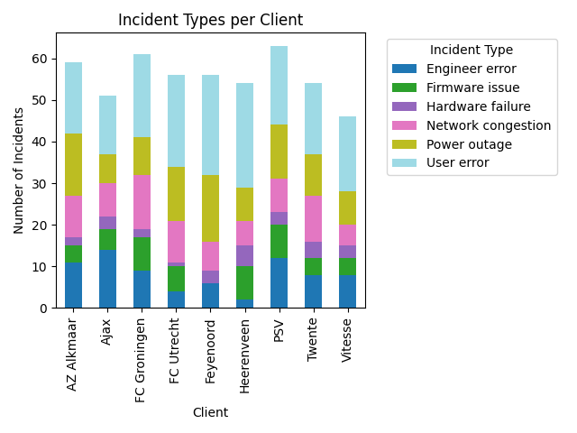
Incident Types per Client

Slide 4
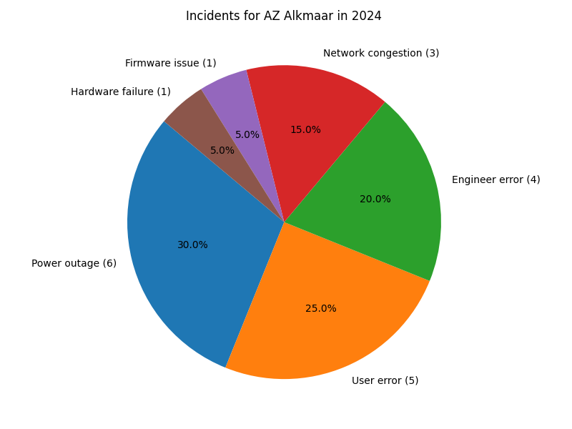
Incidents for AZ Alkmaar in 2024

Slide 5
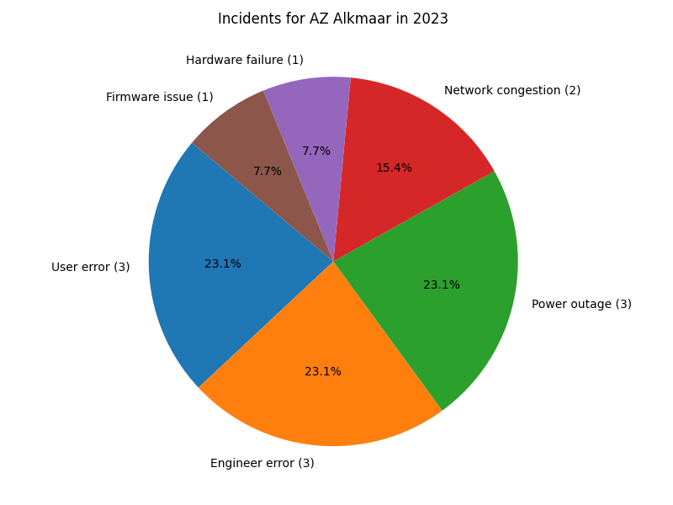
Incidents for AZ Alkmaar in 2023

Slide 6
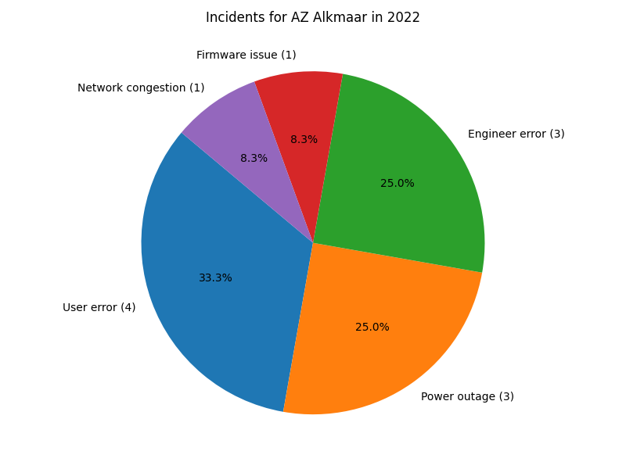
Incidents for AZ Alkmaar in 2022

Slide 7
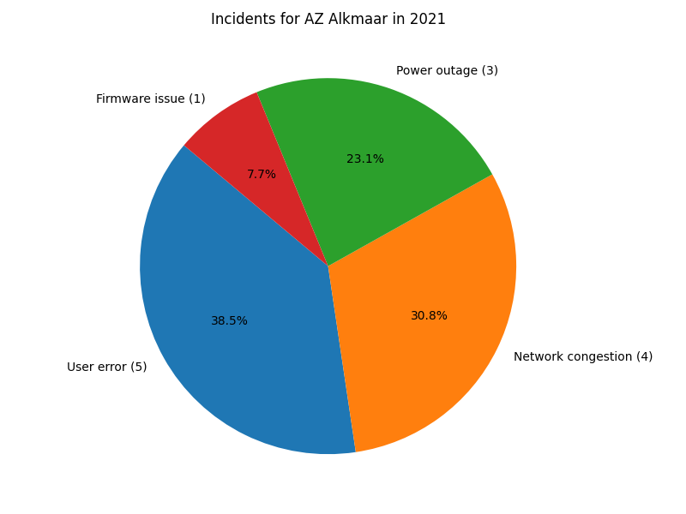
Incidents for AZ Alkmaar in 2021

Slide 8
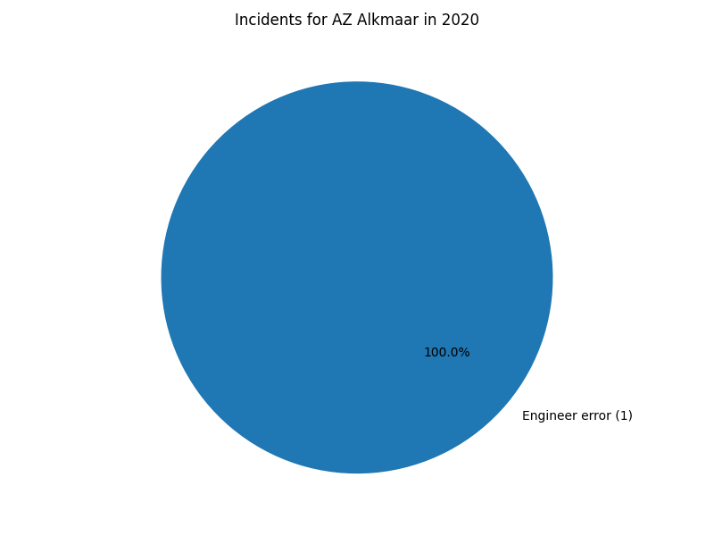
Incidents for AZ Alkmaar in 2020

Slide 9
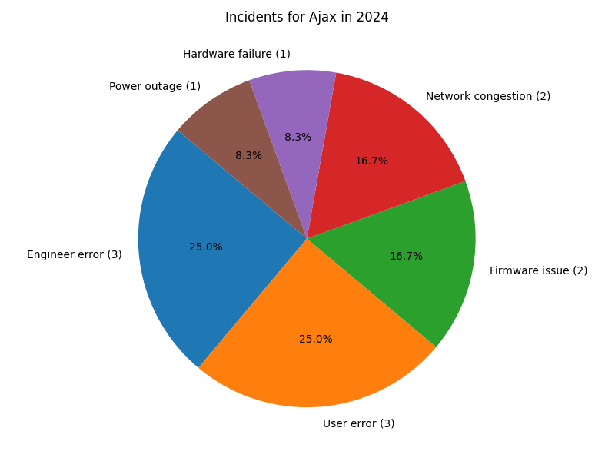
Incidents for Ajax in 2024

Slide 10
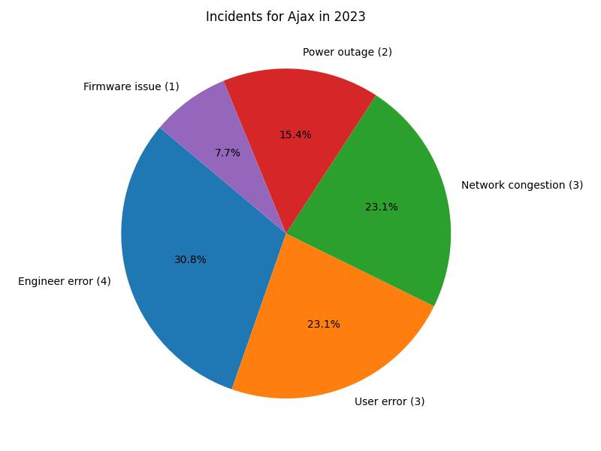
Incidents for Ajax in 2023

Slide 11
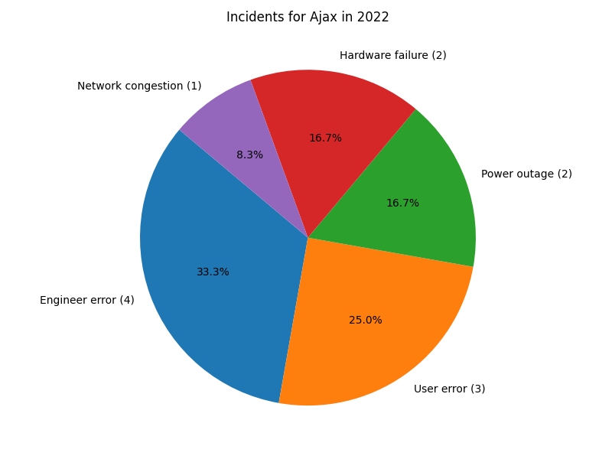
Incidents for Ajax in 2022

Slide 12
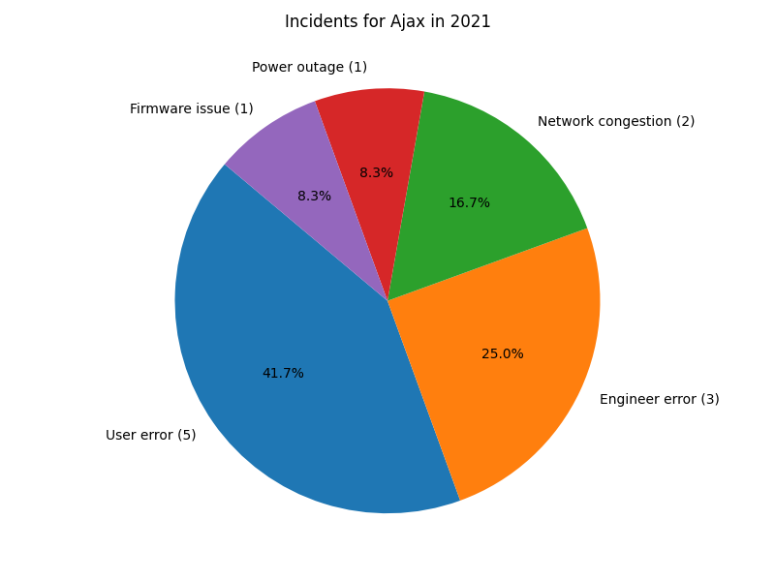
Incidents for Ajax in 2021

Slide 13
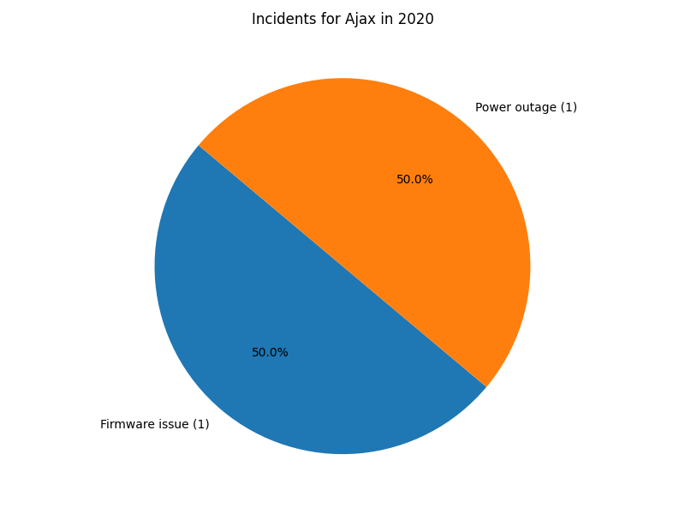
Incidents for Ajax in 2020

Slide 14
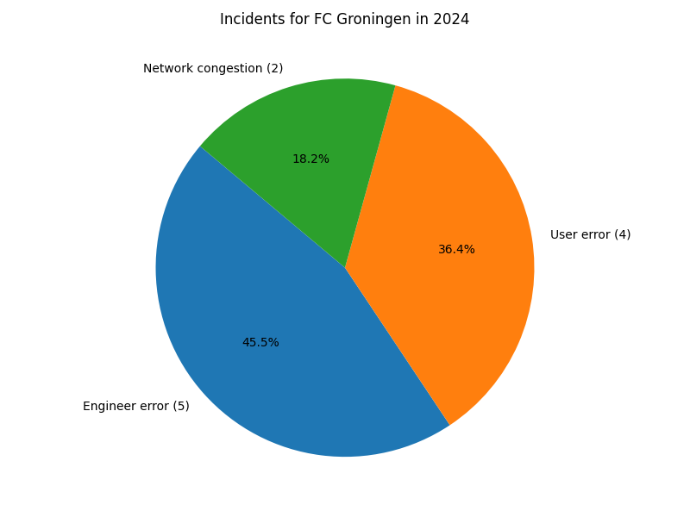
Incidents for FC Groningen in 2024

Slide 15
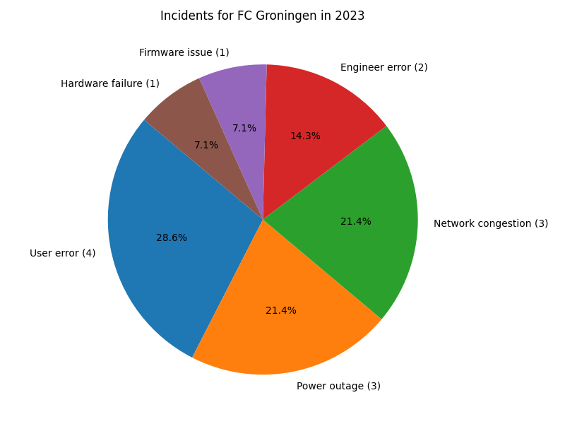
Incidents for FC Groningen in 2023

Slide 16
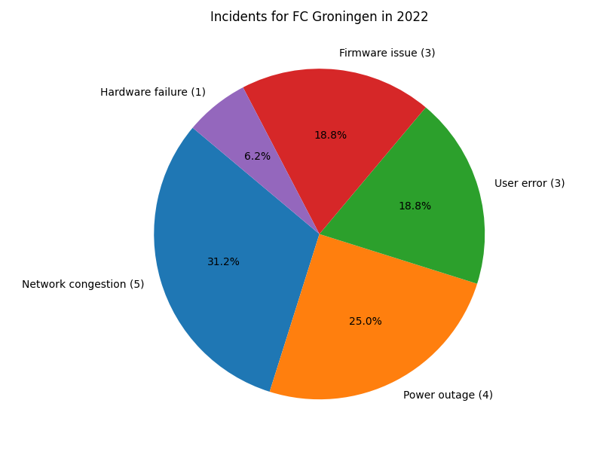
Incidents for FC Groningen in 2022

Slide 17
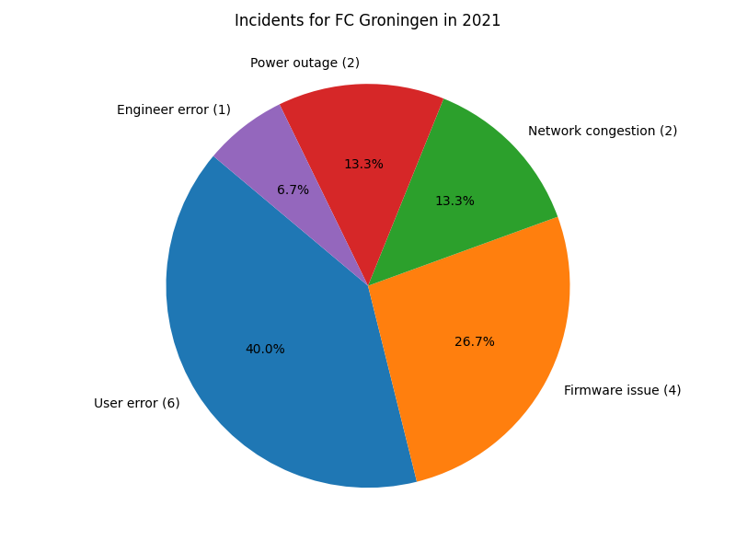
Incidents for FC Groningen in 2021

Slide 18
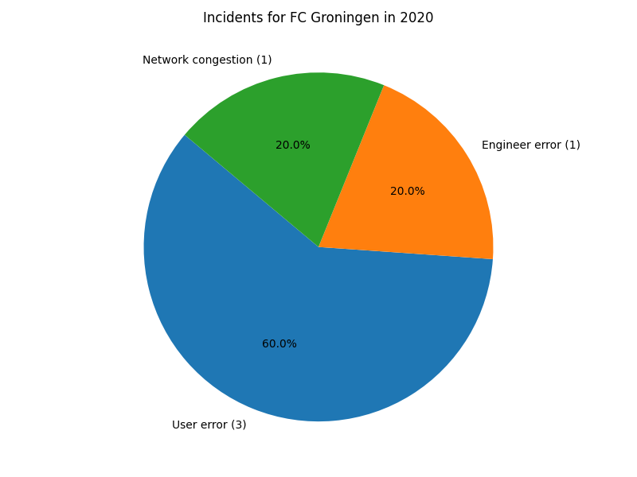
Incidents for FC Groningen in 2020

Slide 19
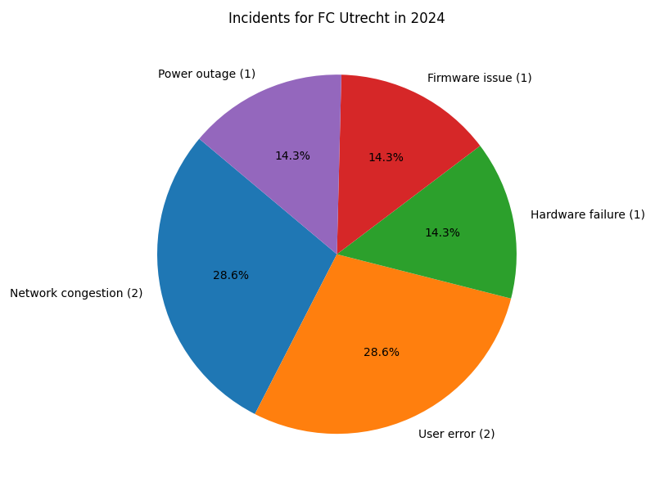
Incidents for FC Utrecht in 2024

Slide 20
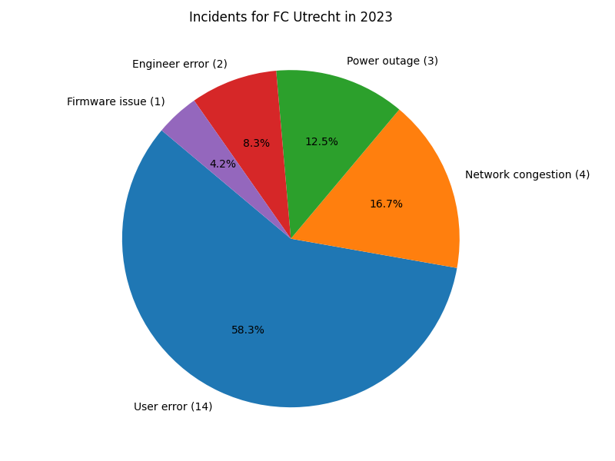
Incidents for FC Utrecht in 2023

Slide 21
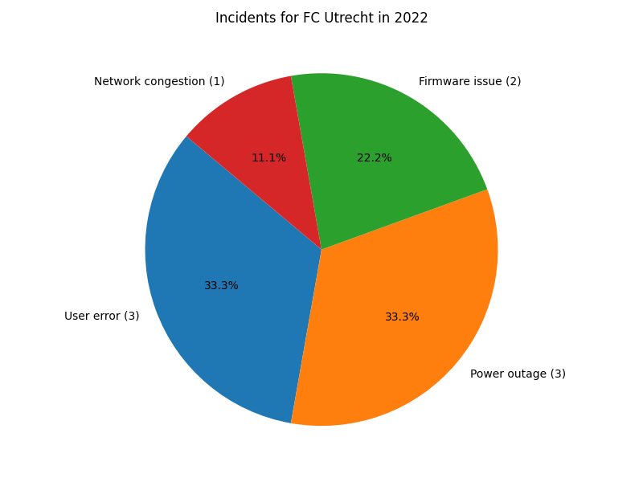
Incidents for FC Utrecht in 2022

Slide 22
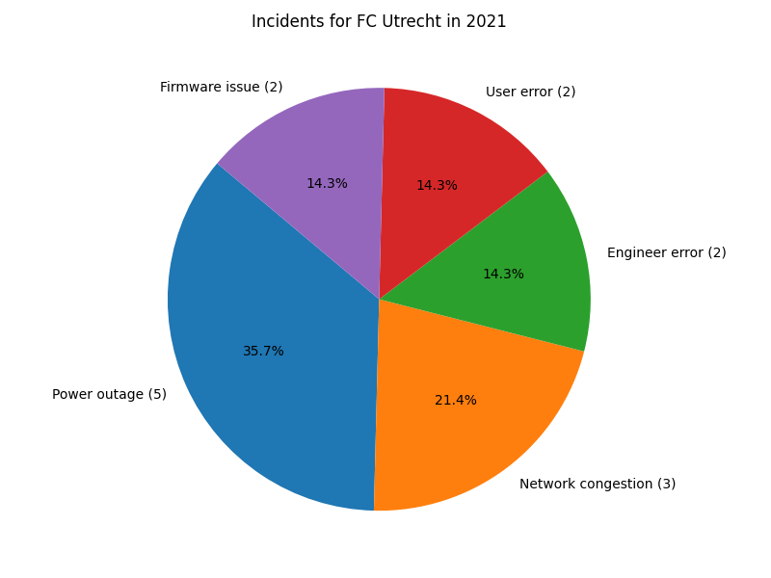
Incidents for FC Utrecht in 2021

Slide 23
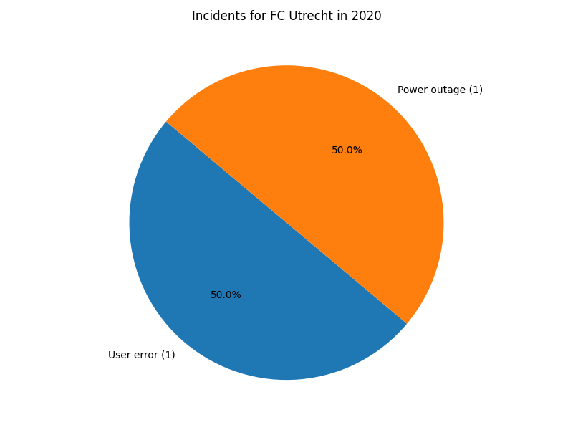
Incidents for FC Utrecht in 2020

Slide 24
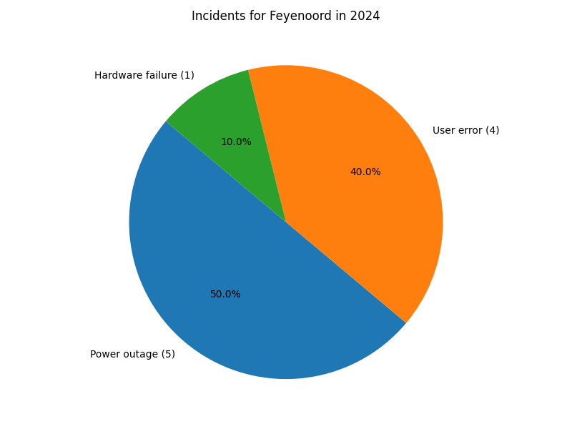
Incidents for Feyenoord in 2024

Slide 25
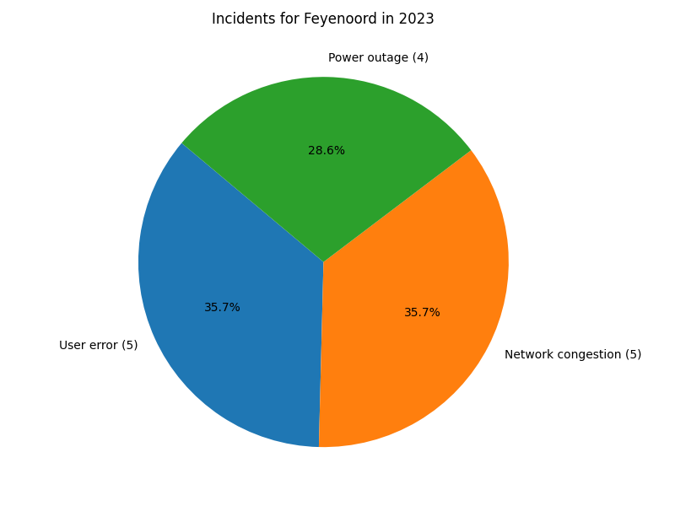
Incidents for Feyenoord in 2023

Slide 26
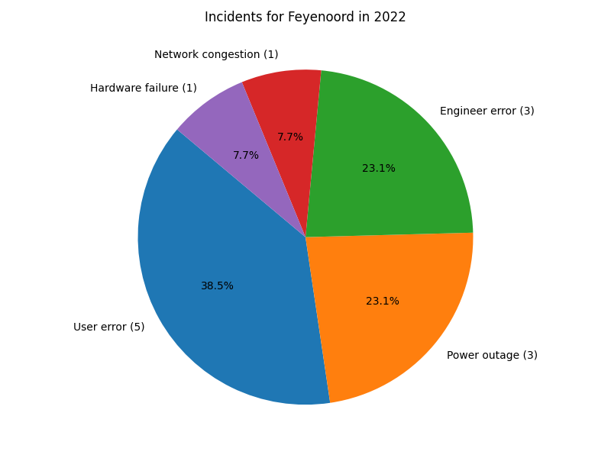
Incidents for Feyenoord in 2022

Slide 27
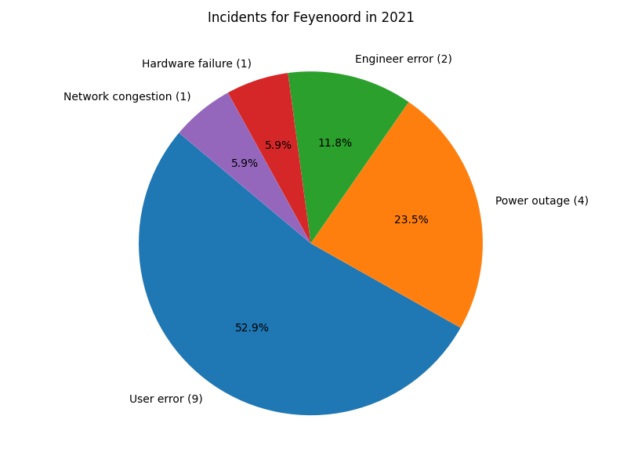
Incidents for Feyenoord in 2021

Slide 28

Incidents for Feyenoord in 2020

Slide 29
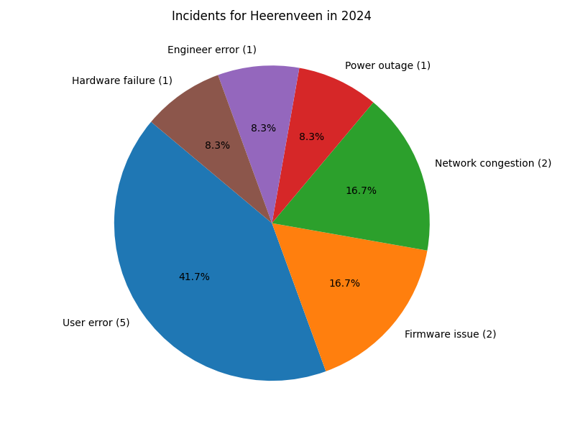
Incidents for Heerenveen in 2024

Slide 30
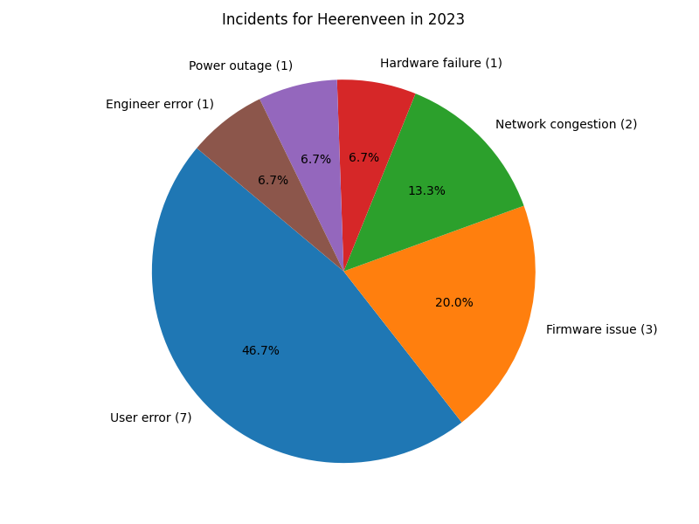
Incidents for Heerenveen in 2023

Slide 31
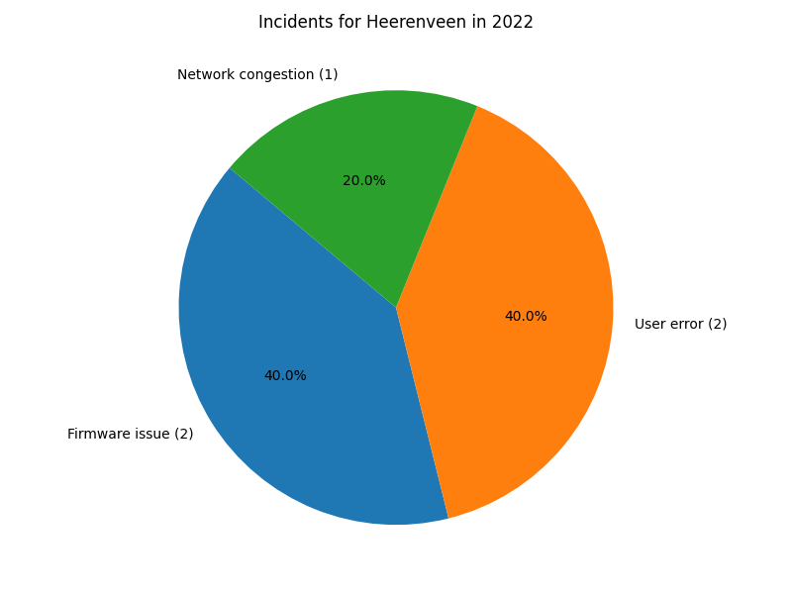
Incidents for Heerenveen in 2022

Slide 32
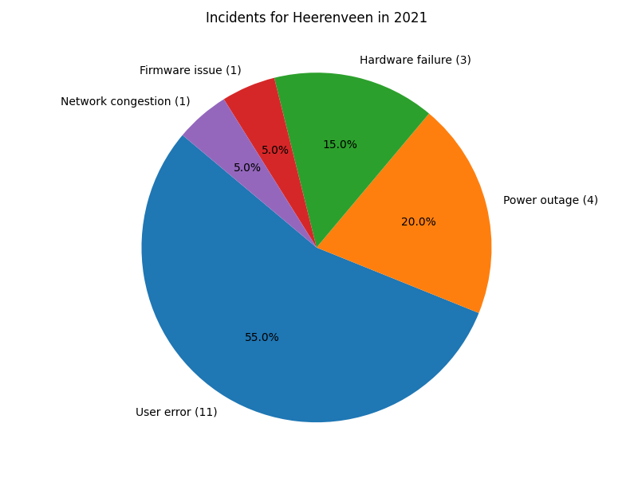
Incidents for Heerenveen in 2021

Slide 33

Incidents for Heerenveen in 2020

Slide 34
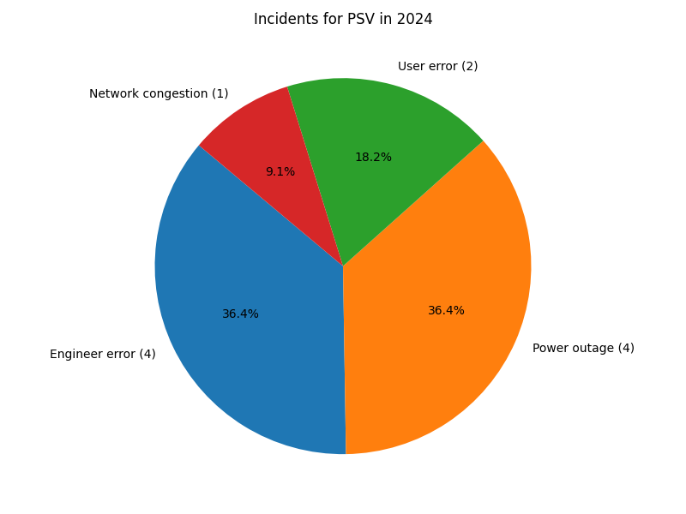
Incidents for PSV in 2024

Slide 35
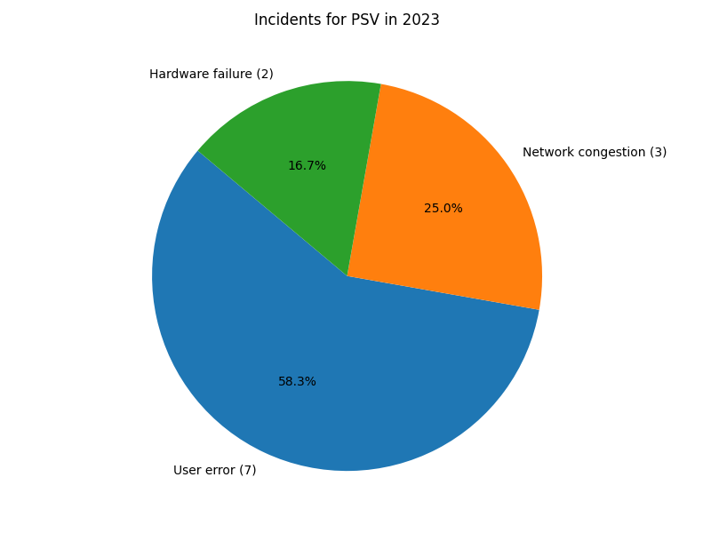
Incidents for PSV in 2023

Slide 36
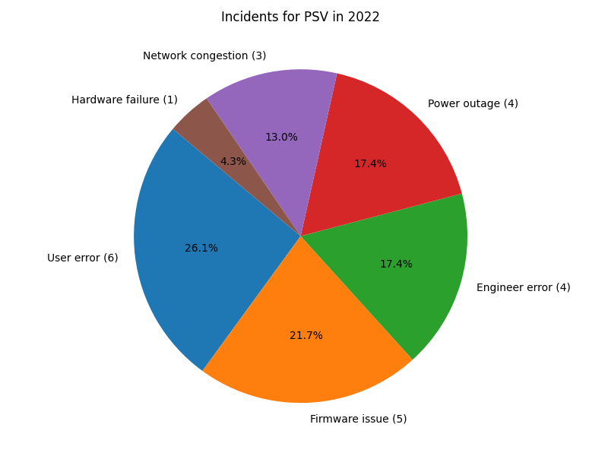
Incidents for PSV in 2022

Slide 37
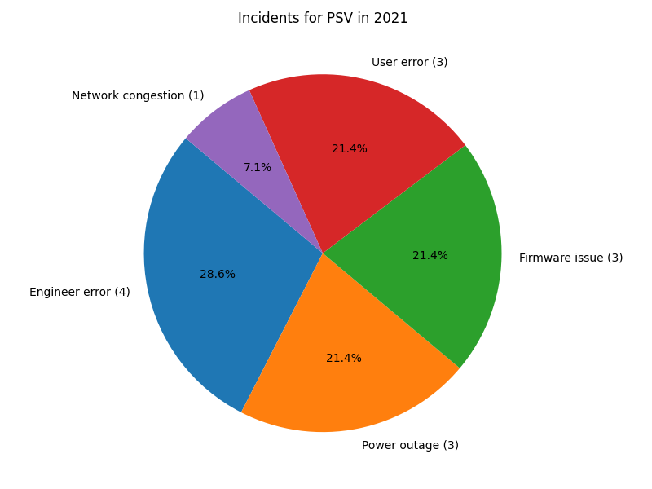
Incidents for PSV in 2021

Slide 38
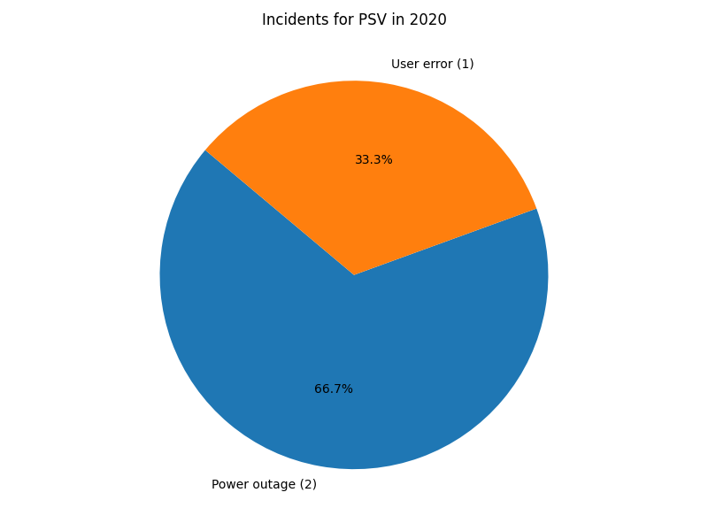
Incidents for PSV in 2020

Slide 39
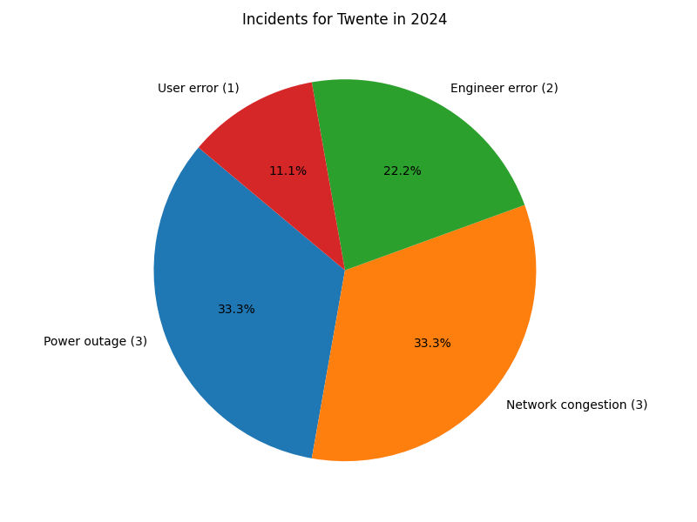
Incidents for Twente in 2024

Slide 40
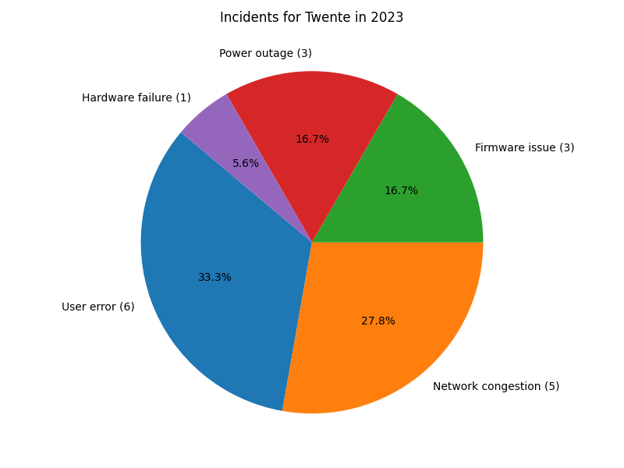
Incidents for Twente in 2023

Slide 41
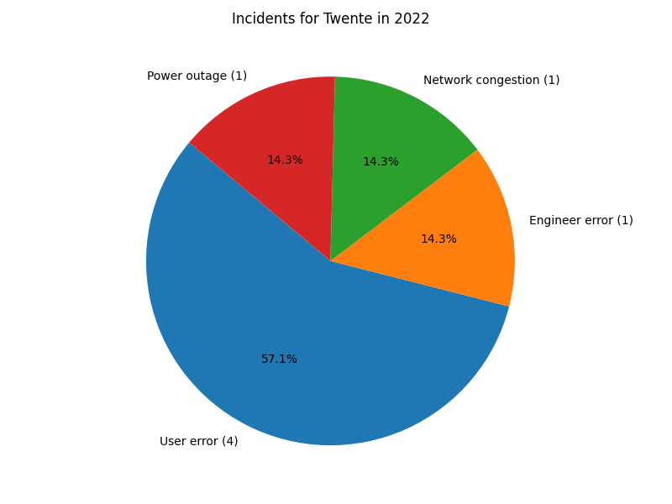
Incidents for Twente in 2022

Slide 42
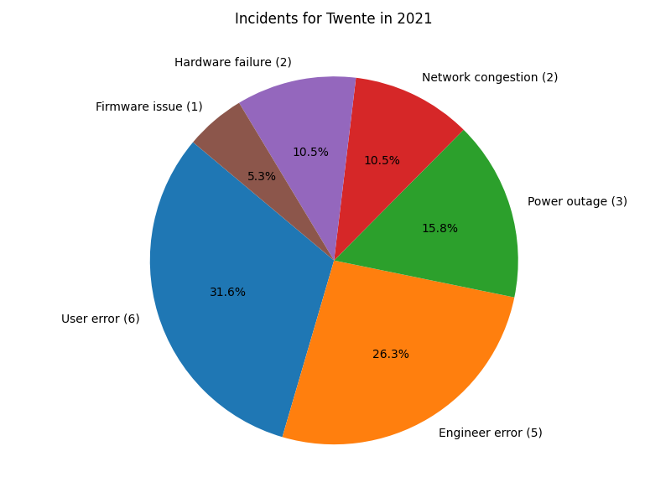
Incidents for Twente in 2021

Slide 43

Incidents for Twente in 2020

Slide 44
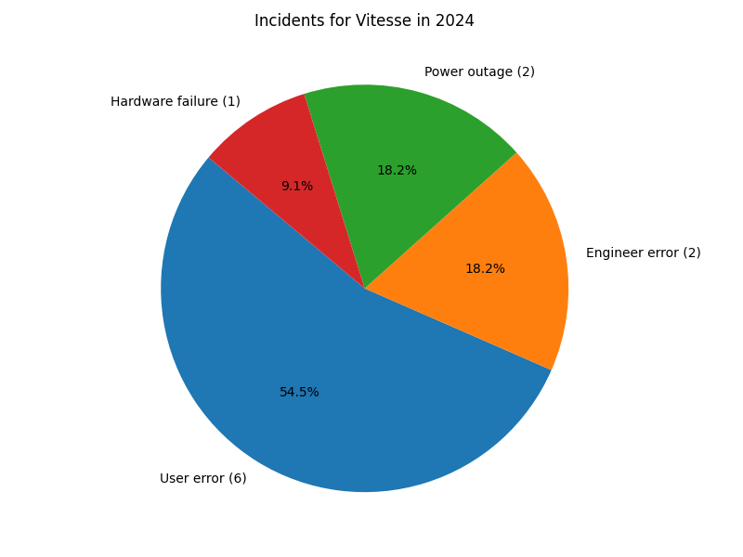
Incidents for Vitesse in 2024

Slide 45
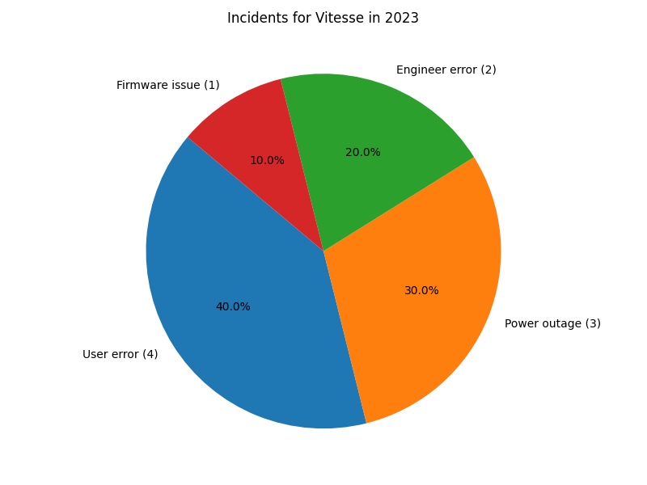
Incidents for Vitesse in 2023

Slide 46
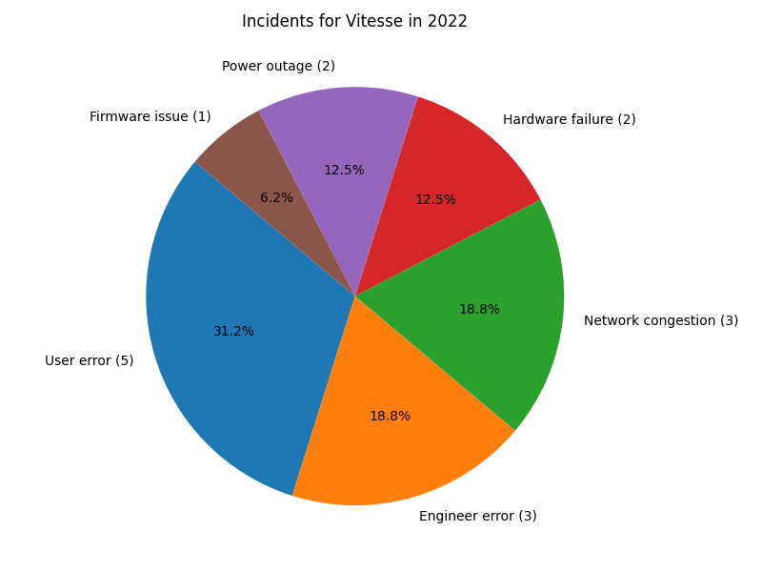
Incidents for Vitesse in 2022

Slide 47
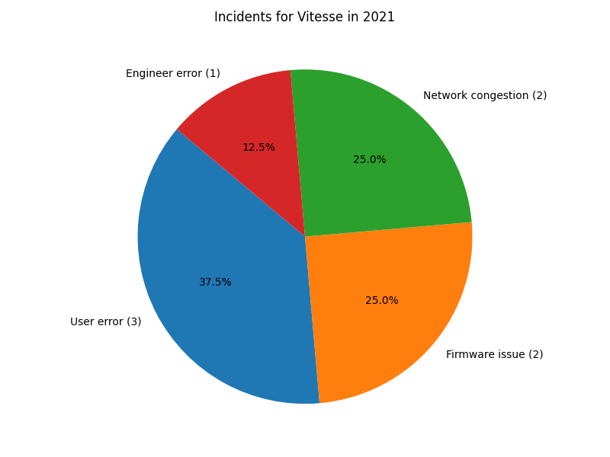
Incidents for Vitesse in 2021

Slide 48

Incidents for Vitesse in 2020

