Slide 1


Empirical Analysis of Sorting Algorithms
This paper presents an empirical study comparing five well-known sorting algorithms: Selection Sort, Bubble Sort, Insertion Sort, Merge Sort, and Quick Sort. We investigate their time complexities by measuring execution times for randomly generated integer arrays of sizes 10^2, 10^3, and 10^4.
by Toghrul Tahirov

Slide 2
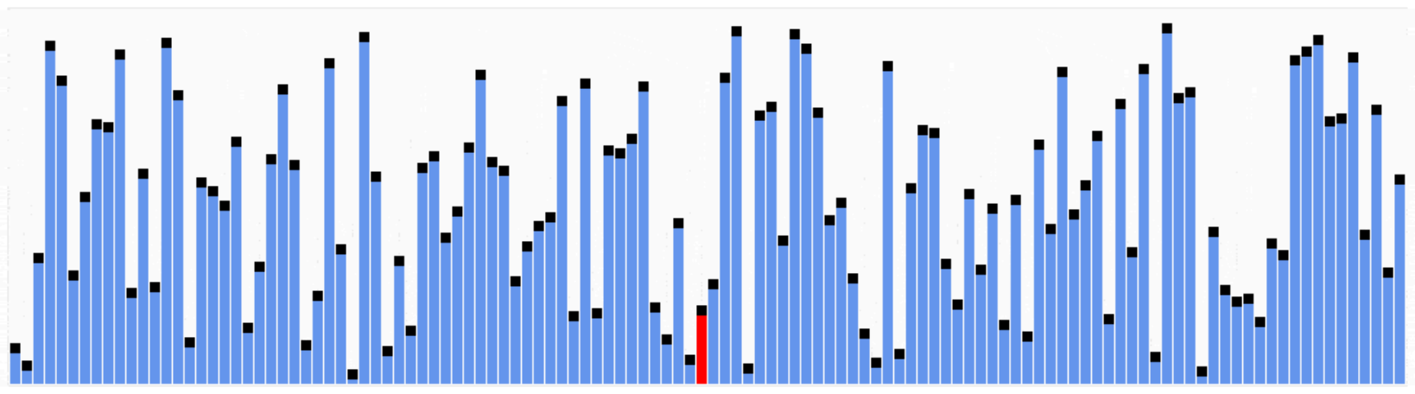
Sorting Algorithms: A Theoretical Overview
Selection, Bubble, and Insertion Sorts
Merge Sort and Quick Sort
These algorithms are straightforward in logic and require repeated comparisons or swaps, leading to worst-case and average-case time complexities in O(n^2).
These algorithms rely on divide-and-conquer paradigms, achieving average and best-case time complexities of O(n log n). However, Quick Sort can degrade to O(n^2) in the worst case.

Slide 3
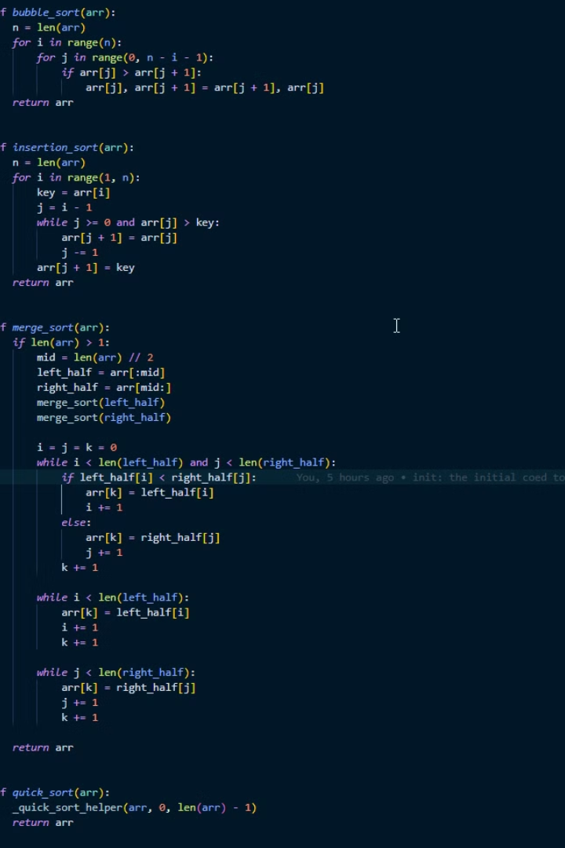
Experimental Setup and Methodology
1
Implementation
2
Data Generation
All algorithms were implemented in Python.
Random arrays of positive integers within the range \[1, 1000\], of sizes 10^2, 10^3, and 10^4 were generated.
3
Execution Time Measurement
4
Visualization
Results were appended to a CSV file, then read using a Python script that produced two visualizations: one plot on a linear scale and another on a log-log scale.
Each algorithm was tested multiple times (three runs per array size), and the mean execution time was recorded using time.perf_counter_ns.

Slide 4
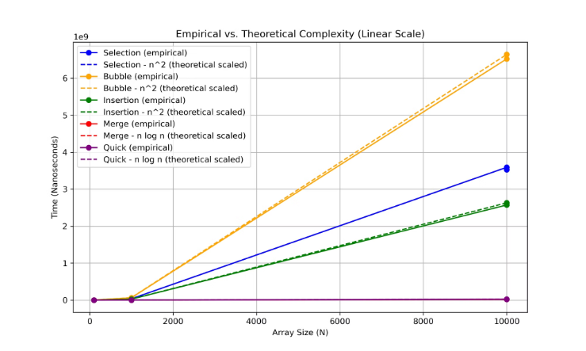
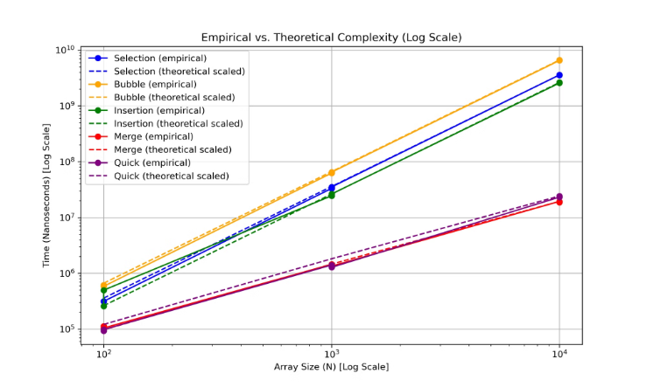


Empirical Analysis Results
Linear Scale
Log-Log Scale
For n = 10^2 and 10^3, the O(n^2) algorithms occasionally perform comparably to the more complex O(n log n) algorithms, especially in smaller input ranges.
As n increases (particularly approaching 10^4), Merge Sort and Quick Sort generally outperform Selection Sort, Bubble Sort, and Insertion Sort, confirming their superior scaling behavior.

Slide 5



Discussion of Findings
Empirical Validation
1
The empirical analysis aligns closely with the theoretical complexities.
Scalability
2
The O(n^2) algorithms experience a more pronounced increase in execution time, whereas the O(n log n) algorithms exhibit better scalability.
Implementation Details
3
Implementation details such as recursive function overhead for Merge Sort or pivot selection strategy for Quick Sort can cause minor deviations from pure theoretical expectations.

Slide 6

Conclusion and Future Directions
—
Key Takeaway
While Merge Sort and Quick Sort tend to excel for large datasets, simpler algorithms like Insertion Sort can be more practical for smaller arrays or when low constant factors and coding simplicity are desired.

