Slide 1
Class Information
Access to SAS via PCs
lectures and class exercises
Emphasis on reading and processing data
Goal: Gain experience in SAS for TA and RA work and general use as a Biostatistician
Notes:
Instructor: Greg Grandits
Materials: Course packet of slides and other info
Textbook: The Little SAS Book, 5th Edition
www.biostat.umn.edu/~greg-g/studenttraining2017.html

Slide 2
SAS Usage
Used extensively at academic and medical device and pharmaceutical companies
Many analyses of publications in medical journals use SAS

Slide 3
SAS OS/Environment
Windows PC
UNIX

Slide 4
What is SAS ?
SAS is a programming language that reads, processes, and performs statistical analyses of data.
A SAS program is made up of programming statements which SAS interprets to do the above functions.
Note: Programming statements are sometimes referred to as “syntax” or programming “code”. A program is sometimes called a “syntax” file.
Notes:
Well, what exactly is SAS. Here is my short definition. SAS is a programming language that reads, processes, and performs statistical analyses of data. A SAS program is made up of programming statements, executed in order, which SAS interprets to do the above functions. You may hear the term “syntax” or “syntax” file. This is a modern term to refer to the program code or file containing the code.
On the side – SAS is pronounced SAS and does not stand for anything, at least now. It once stood for Statistical Analyses System. However, as applications using SAS expanded beyond what some would call statistical analyses, the company dropped this and always refers to it simply as SAS.
Other software you may have heard of to do statistical analyses are SPSS, BMDP, STATA, MiniTab, and R. The Little SAS Book has appendices that briefly compares some of these packages.

Slide 5
Parts of SAS Program
DATA step
  Reads in and processes your raw data and makes a SAS dataset.
Procedures (PROCS)
  Performs specific statistical analyses
  Some procedures are utility procedures such as PROC SORT that is used to sort your data
Notes:
Lets look at the structure of a SAS program. Remember, a program is made up of commands that SAS will interpret. There are two parts to a SAS program. The first part, called the DATA step, contains statements that read in and process your raw data and makes what is called a SAS dataset. In the DATA step you can also create new variables based on the data read-in. These new variables will be included on the dataset.
The second part of a SAS program contains statements that read your SAS dataset and perform specific statistical analyses. These are called procedures or PROCs. Most procedures do a certain type of analyses. This ranges from simple procedures that compute the average values of your numeric variables to procedures that perform analysis of variance. There are also a few procedures that perform some sort of utility like sorting your dataset. Your program will often have just one DATA step but may have several procedure calls.

Slide 6
* This is a short example program to demonstrate what a
SAS program looks like. This is a comment statement because
it begins with a * and ends with a semi-colon ;
DATA demo; * SAS statements end with a semi-colon;
INFILE DATALINES;
INPUT gender $ age marstat $ credits state $ ;
if credits > 12 then fulltime = 1; else fulltime = 2;
if state = 'MN' then resid = 1; else resid = 2;
DATALINES;
F 23 S 15 MN
F 21 S 15 WI
F 22 S 09 MN
F 35 M 02 MN
F 22 M 13 MN
F 25 S 13 WI
M 20 S 13 MN
M 26 M 15 WI
M 27 S 05 MN
M 23 S 14 IA
M 21 S 14 MN
M 29 M 15 MN
;
RUN;
PROC PRINT DATA=demo ;
VAR gender age marstat credits fulltime state ;
RUN;
DATA STEP
SAS PROCEDURE
Notes:
OK, Let’s look at a complete SAS program. This program reads in some data on students, creates a SAS dataset called demo, and then displays the data using the PRINT procedure. The program consists of a series of statements. Statements can be viewed as instructions – telling SAS what to do. SAS only understands it’s own language, i.e. SAS. So if you give it a statement that is not valid SAS syntax, SAS will not understand what to do. When that happens SAS will tell you I don’t understand and give you an error.
So learning SAS means learning how to speak or more precisely write SAS code, learning how to tell SAS what to do, using the language of SAS.
Note the code in the first large box is the code for the DATA STEP. It starts will a DATA statement and end with a RUN statement. The code in the small box on the bottom is a SAS PROCEDURE or SAS PROC.

Slide 7
1 DATA demo; Create a SAS dataset called demo
2 INFILE DATALINES; Where is the data?
3 INPUT gender $ What are the variable
age names and types?
marstat $
credits
state $ ;
4 if credits > 12 then fulltime = 1;
else fulltime = 2;
5 if state = 'MN' then resid = 1;
else resid = 2;
Statements 4 and 5 create 2 new variables
New variable definitions go here
Notes:
Let’s take a closer look at each statement and see what each statement does. The first statement: DATA demo tells SAS to create a dataset called demo. The DATA statement is always the first statement of the DATA step. The next statement is the INFILE statement. The INFILE statement tells SAS where to find the data. In this case we will be entering the data right within the program –so we use the DATALINES option. The next statement is the INPUT statement which names the variables and tells SAS whether the variable is character or numeric. Character variable are noted with a $ after their name. Statements 4 and 5 create new variables based on the data read-in. Statement 4 creates a new character variable called fulltime that is either ‘Y’ or ‘N’ depending on whether the student is taking more than 12 credits. Statement 5 creates a new character variable called resid which equals “Y” if the student is from Minnesota and ‘N’ otherwise.

Slide 8
6 DATALINES; Tells SAS the data is coming
F 23 S 15 MN
F 21 S 15 WI
F 22 S 09 MN
F 35 M 02 MN
F 22 M 13 MN
F 25 S 13 WI
M 20 S 13 MN
M 26 M 15 WI
M 27 S 05 MN
M 23 S 14 IA
M 21 S 14 MN
M 29 M 15 MN
; Tells SAS the data is ending
7 RUN; Tells SAS to run the statements above
Notes:
Statement 6 is simple the key word DATALINES which tells SAS the data will be following this statement. The next 12 lines are the data, each variable separated by a space. We tell SAS the data is ended by placing a semi-colon on a single line after the last row of data. The RUN statement tells SAS to run the statements above.

Slide 9
Structure of Data
Made up of rows and columns
Rows in SAS are called observations
Columns in SAS are called variables
Together they make up the dataset
An observation is all the information for one entity (patient, patient visit, clinical center, county)
SAS processes data one observation at a time
Notes:
Before looking at a SAS program let’s make sure we understand the structure of data and some of the terms SAS uses to describe data. Data is made up of rows and columns. Rows in SAS are referred to as observations. Columns in SAS are referred to as variables. The rows and columns together make up the dataset.
An observation is all the information for one entity, for one patient, or one patient visit, or one clinical center, or one county. Most of us are familiar with Excel spreadsheets. I use a spreadsheet to keep track of grades for students in this class. My row is a student, identified by name or student ID. The columns or variables are things like test and homework grades
SAS processes data one observation at a time. This will become important as we study the DATA step.
.

Slide 10
Raw Data Sources
You type data into the program
Text file (.csv or .txt)
Spreadsheet like Excel
Database like Oracle or Access
SAS dataset
Need to know SAS code to bring in each type of data

Slide 11
Data delimited by commas
(.csv file)
C,84,138,93,143
D,89,150,91,140
A,78,116,100,162
A,,,86,155
C,81,145,86,140
Note: Missing data is identified by multiple commas.
There are also .txt files that are delimited by tabs
Notes:
This is a similarly formatted structure, except multiple commas are used to indicate missing data. This is called a CSV file which stand for Comma Separated Variables.
We will see how to read this data into SAS in this lecture.

Slide 12
* Reading data from an external file;
DATA bp;
INFILE ‘C:\SAS_Files\bp.csv' DSD FIRSTOBS = 2;
INPUT clinic $ dbp6 sbp6 dbpbl sbpbl ;
TITLE 'Reading in Data from an External File';
PROC PRINT DATA=bp;
RUN;
clinic,dbp6,sbp6,dbpbl,sbpbl
C,84,138,93,143
D,89,150,91,140
A,78,116,100,162
A,,,86,155
C,81,145,86,140
Program 2
Content of bp.csv
Notes:
In the examples in program 1 the data was contained within the program. Usually, however, your data will be stored in an external file. To tell SAS to read from an external you replace DATALINES on the INFILE statement with the file path of the file containing the data. The entire file path is placed in quotes (either single or double quotes but do not mix types). Be careful to type the file path correctly with no extra blanks anywhere within the quotes. Other INFILE options apply as before.
Here weuse list input to read the data contained in the file bp.csv, the contents of which is displayed here. The first row of the data is column headings which we would get from an Excel dump. We do not want to read that row as data so we can either go into the file and delete the first line or (perhaps better) tell SAS to skip the first row by using the FIRSTOBS option. Here we tell SAS to start with row 2. We use the DSD option as before.

Slide 13
* Using PROC IMPORT to read in data ;
* Can skip data step;
PROC IMPORT DATAFILE=‘C:\SAS_Files\bp.csv'
OUT = bp DBMS = csv
REPLACE ;
GETNAMES = yes;
GUESSINGROWS = 9999;
TITLE 'Reading in Data Using PROC IMPORT';
PROC PRINT DATA=bp;
PROC CONTENTS DATA=bp;
Uses first row for variable names
Notes:
SAS is always trying to make it easier for you to read-in data. There is a utility procedure called PROC IMPORT that will read certain types of raw data files and create SAS datasets from them.
Here is an example where the raw data is a CSV file, the same file we just read in using a DATA step. The DATAFILE option gives the path and file name of the raw data file, in OUT you give the name of the SAS dataset you want created, the database management system option (DBMS) is set to csv. The replace option tells SAS to write over the SAS dataset if it exists, and GETNAMES if set to YES tells SAS to use the first row of the CSV file for the names of the variables.
The DBMS keyword can be omitted if the file extension of the CSV file is .csv.
You would want to display the data and do a PROC CONTENTS and PROC PRINT to help you know if the data was brought in correctly.
Although this is a nice utility because it eliminates the DATA step and all the coding involved in that, caution is needed in using this procedure since SAS has to make some decisions about whether your column of data is character or numeric by reading the data rather than you explicitly telling SAS in the INPUT statement. It will also sometimes make character variables much larger in length then they need to be.

Slide 14
The CONTENTS Procedure
Data Set Name WORK.BP Observations 5
Member Type DATA Variables 5
Alphabetic List of Variables and Attributes
# Variable Type Len Format Informat
1 Clinic Char 1 $1. $1.
2 DBP6 Num 8 BEST12. BEST32.
4 DBPBL Num 8 BEST12. BEST32.
3 SBP6 Num 8 BEST12. BEST32.
5 SBPBL Num 8 BEST12. BEST32.
Notes:
Here is the output from PROC CONTENTS on the dataset created with PROC IMPORT. We see we have 5 variables, the character variable clinic which is length 1 and four BP variables which are numeric. We will look more closely at the output from proc contents when we discuss permanent SAS datasets. For now just know that proc contents lists all the variable names on your dataset and tells you whether they are character or numeric.

Slide 15
* Using PROC IMPORT to read in data ;
* Separated by tabs;
PROC IMPORT DATAFILE=‘C:\SAS_Files\bp.txt'
OUT = bp DBMS = tab
REPLACE ;
GETNAMES = yes;
GUESSINGROWS = 9999;
TITLE 'Reading in Data Using PROC IMPORT';
PROC PRINT DATA=bp;
PROC CONTENTS DATA=bp;
Uses first row for variable names
Notes:
SAS is always trying to make it easier for you to read-in data. There is a utility procedure called PROC IMPORT that will read certain types of raw data files and create SAS datasets from them.
Here is an example where the raw data is a CSV file, the same file we just read in using a DATA step. The DATAFILE option gives the path and file name of the raw data file, in OUT you give the name of the SAS dataset you want created, the database management system option (DBMS) is set to csv. The replace option tells SAS to write over the SAS dataset if it exists, and GETNAMES if set to YES tells SAS to use the first row of the CSV file for the names of the variables.
The DBMS keyword can be omitted if the file extension of the CSV file is .csv.
You would want to display the data and do a PROC CONTENTS and PROC PRINT to help you know if the data was brought in correctly.
Although this is a nice utility because it eliminates the DATA step and all the coding involved in that, caution is needed in using this procedure since SAS has to make some decisions about whether your column of data is character or numeric by reading the data rather than you explicitly telling SAS in the INPUT statement. It will also sometimes make character variables much larger in length then they need to be.

Slide 16
Syntax for Procedures
PROC PROCNAME DATA=datasetname <options> ;
substatements/<options> ;
The WHERE statement is a useful substatement available to all procedures.
PROC PRINT DATA=demo ;
WHERE state = 'MN';
RUN;
Notes:
Procedure calls have a common structure. The keyword PROC is followed by the name of the procedure followed by the keyword DATA, an equals sign, and then the dataset name. This is followed by various options that will depend on the procedure. After any options is a semi-colon that ends the PROC statement.
Under the PROC statement are one or more sub-statements that depend on the procedure. For example VAR is a sub-statement for both the PRINT and MEANS procedures. Options on sub-statements are placed after a slash (/).
The WHERE statement is a useful statement that can be used in all procedures. This statement filters the rows of the dataset in which the procedure operates on. In the example here we display the variable marstat from the demo dataset only for observations where state equals Minnesota.
If you forget the syntax for a procedure you can go to the SAS help under the procedure you wish to run.

Slide 17
Some common procedures
PROC PRINT
displays your data
PROC CONTENTS
displays dataset information including variable names
PROC MEANS
descriptive statistics for continuous data
PROC FREQ
descriptive statistics for categorical data
PROC UNIVARIATE
detailed descriptive statistics for continuous data
PROC TTEST
performs t-tests (continuous data)
PROC SGPLOT
displays various types of plots
Notes:
We conclude this introductory section with a list of common SAS procedures, some of which we saw in the example program.
PROC PRINT is used to display the values of one or more of your variables. This is always a good idea to make sure the data was read-in correctly and that any new variables you created have values you expect.
PROC MEANS display descriptive statistics for numeric variable.
PROC FREQ displays counts and percentages for categorical data. The actual data may be character or numeric.
PROC UNIVARIATE gives very detailed statistics for numeric variables. This procedure can be used to find percentiles, for example.
PROC TTEST performs t-tests comparing the means of continuous variables between 2 groups.
We will look at these procedures in detail in upcoming sessions.

Slide 18
SAS Environment
Main SAS Windows (PC)
Editor Window – where you type your program
Log Window –lists program statements processed, giving notes, warnings and errors.
Always look at the log window !
Tells how SAS understood your program
Results Viewer – gives the output generated from the PROCs
Results Window – index to all of your output
Submit program by clicking on run icon
Notes:
Let’s look at the environment in which you enter and submit your program. When you invoke SAS a set of windows will appear. The first window is called the program editor window. This is where you type in your program. After you type in your program you will then need to submit the program. You do this by clicking on the run icon. This will generate a log in what is called the log window. The text in the window will list the statements processed, giving notes, warnings, and errors. The log contains information about how SAS understood your program. This is very important to look at.
The third window is the output window. If all goes well the output window will display the output generated from the statistical procedure or procedures you ran. This of course is what you are after.
There is also a results window which is an index to all your output. Clicking on the appropriate tag will bring you that portion of output in the output window.
There are also other windows that come up from time to time such as the explorer window. But the windows listed above are the most important.
Note programs typed in the editor window can be and usually are saved to an external file. This is done from the file menu. These programs can then be opened in a later SAS session.

Slide 19
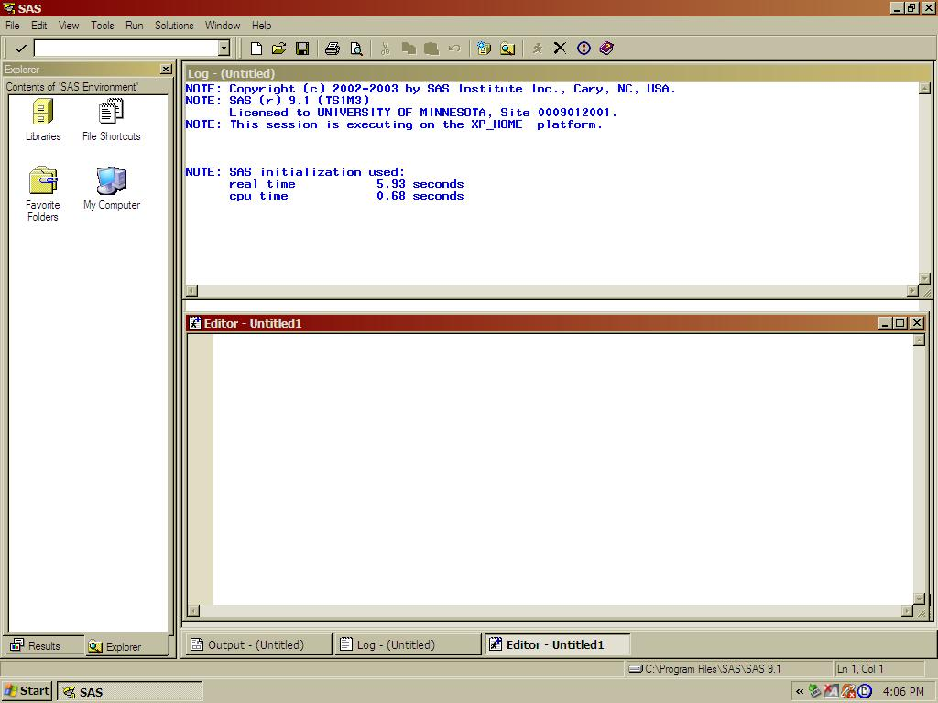
SAS Windows
Notes:
Here are the windows you will see when you start up SAS. Refer to the tutorial on getting started in SAS for an explanation of the different windows and how to type in your program and run SAS.

Slide 20
Messages in SAS Log
Errors – fatal in that program will abort
Warnings – messages that are usually important
Notes – messages that may or may not be important
(notes and warnings will not abort your program)
Notes:
There are 3 types of messages that appear in your log. Errors are just that – the code you submitted was incorrect in some way – SAS could not understand one or more statements. SAS will abort (i.e. stop) your program and you will usually not get any output . Errors show up in red so they are easy to spot.
Warnings are messages that are usually important – SAS saw something that was odd in your program – but SAS understood your program well enough to continue. Before looking at your output you would want to understand the warning.
Lastly, there are notes. These give you information about what SAS did, like how many observations were read-in or how much CPU time was used. Notes can sometimes give you important information. If a Note tells you 100 observations were read-in but you expected 1000, then you would want to check your program.
A common mistake new SAS programmers make (and old SAS programmers alike) is to ignore the log and go right to the output. This can be a serious mistake.
One final note: all windows is SAS generate cumulative information. The log window will contain the cumulative log of all your session runs. This can make it difficult to find the information contained in the latest run. For this reason I recommend you clear the log and perhaps also the output before you resubmit or run a new program. This can be done from the pull down menu or typing the command “clear log” in the little command window.

Slide 21
LOG WINDOW (or file)
NOTE: Copyright (c) 2002-2010 by SAS Institute Inc., Cary, NC, USA.
NOTE: SAS (r) Proprietary Software Release 9.3 (TS1M1)
Licensed to UNIVERSITY OF MINNESOTA, Site 70127161.
NOTE: This session is executing on the WINDOWS 7 platform.
NOTE: SAS initialization used:
real time 7.51 seconds
cpu time 0.89 seconds
1 * This is a short example program to demonstrate what a
2 SAS program looks like. This is a comment statement because
3 it begins with a * and ends with a semi-colon ;
4
5 DATA demo;
6 INFILE DATALINES;
7 INPUT gender $ age marstat $ credits state $ ;
8
9 if credits > 12 then fulltime = 'Y'; else fulltime = 'N';
10 if state = 'MN' then resid = 'Y'; else resid = 'N';
11 DATALINES;
NOTE: The data set WORK.DEMO has 12 observations and 7 variables.
NOTE: DATA statement used:
real time 0.38 seconds
cpu time 0.06 seconds
Notes:
This is the contents of the log window when we submit the program. You see a whole bunch of notes, coded in blue. The top notes just give you information about the version and license we are running. We will get that each time. The second last note on the bottom tells us that the dataset work.demo has 12 observations and 7 variables. This is what we would expect – we know we had data on 12 students; the number of variables is the 5 we read in and the two we added. With no other notes, warnings, or errors, we can be pretty sure the data was read-in correctly.

Slide 22
OUTPUT or Results WINDOW
Running the Example Program
Obs gender age marstat credits fulltime state
1 F 23 S 15 Y MN
2 F 21 S 15 Y WI
3 F 22 S 9 N MN
4 F 35 M 2 N MN
5 F 22 M 13 Y MN
6 F 25 S 13 Y WI
7 M 20 S 13 Y MN
8 M 26 M 15 Y WI
9 M 27 S 5 N MN
10 M 23 S 14 Y IA
11 M 21 S 14 Y MN
12 M 29 M 15 Y MN
The MEANS Procedure
Variable N Sum Mean
----------------------------------------------
age 12 294.0000000 24.5000000
credits 12 143.0000000 11.9166667
-----------------------------------------------
The FREQ Procedure
Cumulative Cumulative
gender Frequency Percent Frequency Percent
-----------------------------------------------------------
F 6 50.00 6 50.00
M 6 50.00 12 100.0
SAS 9.4 will display html output by default into the results viewer.
Notes:
The contents of the output window gives the output generated from the three procedures. The top section is from proc print, which displays the variables form the dataset created. The middle section is from proc means, displaying the mean ages for age and credits. We see that the mean age of the students is 24.5. The last section is output generated from proc freq which displays the number of females and males. There are 6 men and 6 women.

Slide 23
Exercise 1
Let's Write Our First Program!
Click on SAS icon

