Slide 1
Lecture 2
Topics
- Descriptive Procedures
- Creating new variables in data step

Slide 2
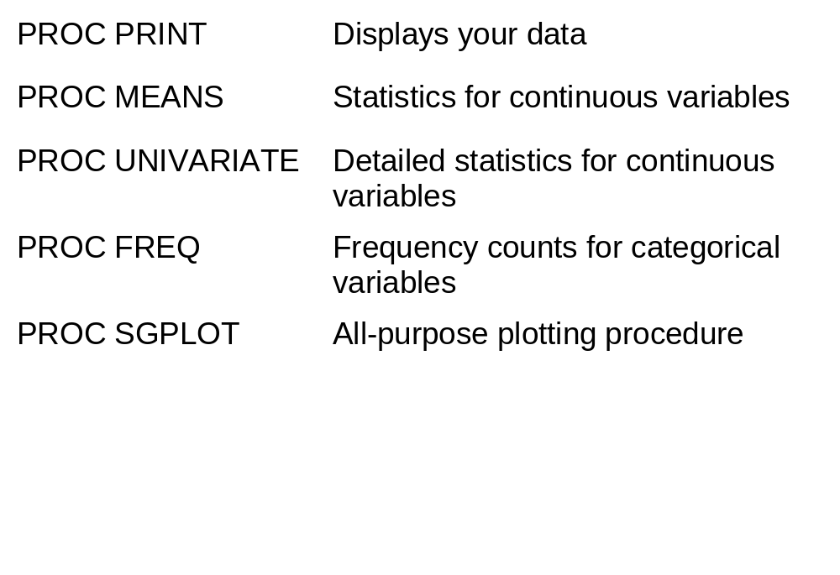
Descriptive Procedures In SAS
Notes:
**This is a list of the most commonly used descriptive procedures, some of which we have seen before. PROC PRINT displays values of variables, PROC MEANS displays summary statistics like the mean and standard deviation for continuous variables. PROC UNIVARIATE gives additional statistics for continuous variables beyond that of PROC MEANS and can display certain plots. PROC FREQ displays one and multi-way frequency distributions for categorical data.
PROCs PLOT and CHART display X-Y plots and bar charts in text mode. PROCs GPLOT and GCHART produce high resolution versions of these plots. New in version 9.2 is the SGPLOT procedure which is a single procedure that does most types of graphing. The example I use in this class will use the new SGPLOT procedure, the S standing for statistical.

Slide 3
Data Layout of tomhs.data
In Course Notes
Variable Type Len Pos Inform Description
PTID Char 10 1 $10. Patient ID
CLINIC Char 1 12 $1. Clinical center
RANDDATE Num 6 14 mmddyy10. Randdate
SBPBL Num 3 115 3. SBP at baseline
DATA tomhs;
INFILE ‘folderpath\tomhs.data';
INPUT @1 ptid $10.
@12 clinic $1.
@14 randdate mmddyy10.
@115 sbpbl 3. ;
Note: You can give any legal variable name.

Slide 4
Program 3
DATA weight;
INFILE ‘C:\SAS_Files\tomhs.data' ;
INPUT @1 ptid $10.
@12 clinic $1.
@25 group 1.
@30 sex $1.
@58 height 4.
@85 weight 5.;
@115 sbpbl 3.
@123 sbp12 3.;
bmi = (weight*703.0768)/(height*height);
sbpchg = sbp12 - sbpbl;
if group = 6 then active = 2; else active = 1;
RUN;
Notes:
OK, let’s look at program 3 which gives examples of descriptive procedures. We start by creating a dataset called weight, reading in 5 variables from the TOMHS study file, tomhs.data. We input the id, clinical center, sex, and height and weight of the patient. The input positions can be obtained from the data layout in the course notes. We then compute a new variable called bmi which is calculated as weight divided by height squared. The value 703.0768 is the number that converts inches into meters and pounds into kilograms, so that bmi is in kilograms per meter squared. This is a common measure of obesity.
Note: The * notation indicates multiplication; the / indicates division.

Slide 5
PROC PRINT DATA = weight (OBS=5) NOBS;
VAR ptid clinic sex height weight bmi;
TITLE
'Proc Print: Five observations from the TOMHS Study';
RUN;
PROC MEANS DATA = weight;
VAR height weight bmi;
TITLE 'Proc Means Example 1';
RUN;
PROC MEANS DATA = weight MEAN MEDIAN STD MAXDEC=2;
VAR height weight bmi;
TITLE 'Proc Means Example 2 (specifying options)';
RUN;
Notes:
We now run several procedures on the dataset weight. Note that you can just “PROC away”, i.e. once the dataset is created you can run multiple procedures in a row by just listing them one under the other. Here we have one PROC PRINT followed by two PROC MEANs. The output generated in your output window will be in this same order.
For the PROC PRINT we use the data set option OBS that limits the observations displayed, here set to 5. This is an option available in all procedures but is mostly used for PROC PRINT to limit the output. Since there is no VAR statement under the PROC PRINT all variables will be displayed. We add a TITLE which is enclosed in quotes and complete the procedure with the RUN statement.
We follow this with a PROC MEANS that will give descriptive statistics for the 3 variables listed in VAR. The default statistics displayed are the number of non-missing values (N), the mean, the standard deviation, and the minimum and maximum values. The next PROC MEANS tells SAS to display only the mean, median, and the standard deviation. The MACDEC option limits the number of decimals displayed for each statistics to 2. These are all options that are part of the PROC MEANS statement.
To find the entire list of statistics available you can look at the referenced pages of the textbook or look under PROC MEANS in the SAS help.

Slide 6
Proc Print: Five observations from the TOMHS Study
ptid clinic sex height weight bmi
C03615 C 1 71.5 205.5 28.2620
B00979 B 1 69.5 247.3 35.9963
B00644 B 1 60.0 138.5 27.0489
D01348 D 1 71.5 205.5 28.2620
A01088 A 1 72.0 244.8 33.2008
Proc Means Example 1
The MEANS Procedure
Variable N Mean Std Dev Minimum Maximum
--------------------------------------------------------------------------
height 100 68.0750000 3.8536189 58.0000000 77.0000000
weight 100 191.7560000 34.5107254 128.5000000 279.3000000
bmi 100 28.9808397 3.9911476 21.4572336 37.5178852
--------------------------------------------------------------------------
Notes:
Here is the output from PROC PRINT and the first PROC MEANS that would be displayed in your output window. The titles used for each procedure are shown in blue. The average BMI for patients is just less than 29, ranging from 21.5 to 37.5.
.

Slide 7
Proc Means Example 2 (specifying options)
The MEANS Procedure
Variable Mean Median Std Dev
--------------------------------------------------------
height 68.08 67.50 3.85
weight 191.76 192.65 34.51
bmi 28.98 28.02 3.99
--------------------------------------------------------
Notes:
This is the result from the second PROC MEANS. Only the mean, median, and standard deviation are displayed, each to 2 decimals as given by the MAXDEC option.

Slide 8
PROC MEANS DATA = weight N MEAN STD MAXDEC=2 ;
CLASS clinic;
VAR height weight bmi;
RUN;
N
clinic Obs Variable N Mean Std Dev
----------------------------------------------------------
A 18 height 18 67.89 3.04
weight 18 192.73 37.68
bmi 18 29.24 4.50
B 29 height 29 67.76 4.76
weight 29 185.58 34.00
bmi 29 28.39 4.22
C 36 height 36 69.08 3.36
weight 36 202.91 33.74
bmi 36 29.76 3.62
D 17 height 17 66.68 3.61
weight 17 177.65 28.05
bmi 17 28.06 3.79
----------------------------------------------------------
Notes:
If you want to display statistics separately for each level of a categorical variable then add a CLASS statement under PROC MEANS with the name of the categorical variable. Here we display the height, weight, and BMI for each of the four clinical centers.
Other typical class variables are gender, treatment group, and race.
The FW option stands for format width and controls the number of columns used for each statistic. This can be useful to squeeze more columns of statistics onto a page.

Slide 9
T-test Comparing Active and Placebo Groups
PROC TTEST DATA = weight ;
CLASS active;
VAR sbpchg;
RUN;
* Partial output;
Method Variances DF t Value Pr > |t|
Pooled Equal 90 -0.86 0.3941
Satterthwaite Unequal 31.045 -0.92 0.3649
Notes:
If you want to display statistics separately for each level of a categorical variable then add a CLASS statement under PROC MEANS with the name of the categorical variable. Here we display the height, weight, and BMI for each of the four clinical centers.
Other typical class variables are gender, treatment group, and race.
The FW option stands for format width and controls the number of columns used for each statistic. This can be useful to squeeze more columns of statistics onto a page.

Slide 10
PROC UNIVARIATE
PROC UNIVARIATE DATA = weight ;
VAR bmi;
ID ptid;
TITLE 'Proc Univariate Example 1';
RUN;
* Note: PROC UNIVARIATE will give you much output ;
Notes:
The next procedure we will look at is PROC UNIVARIATE which displays extensive statistics for continuous variables. The syntax is similar to that for PROC MEANS. Here we run PROC UNIVARIATE on the variable bmi, listed in the VAR statement. The PLOT option will display three plots: a stem and leaf plot, a box-plot, and a normal probability plot. Among the many statistics displayed is the 5 highest and lowest values for BMI. We use the ID statement to label these values with the patient ID.
PROC UNIVARIATE will give you much output. If you had several variables in your VAR statement you would end up with many pages of output.

Slide 11
Proc Univariate Example 1
The UNIVARIATE Procedure
Variable: bmi
Moments
N 100 Sum Weights 100
Mean 28.9808397 Sum Observations 2898.08397
Std Deviation 3.99114757 Variance 15.9292589
Skewness 0.27805446 Kurtosis -0.8987587
Uncorrected SS 85565.9037 Corrected SS 1576.99663
Coeff Variation 13.7716768 Std Error Mean 0.39911476
Basic Statistical Measures
Location Variability
Mean 28.98084 Std Deviation 3.99115
Median 28.01524 Variance 15.92926
Mode 28.26198 Range 16.06065
Interquartile Range 6.68654
Tests for Location: Mu0=0
Test -Statistic- -----p Value------
Student's t t 72.6128 Pr > |t| <.0001
Sign M 50 Pr >= |M| <.0001
Signed Rank S 2525 Pr >= |S| <.0001
Notes:
Here is the first portion of the output. Note the statistics are placed under categories (Moments, Basic Summary Measure, Tests for Location). Many of these are the same as in PROC MEANS. You may not know the meaning of all of the statistics. But that is OK, just look for the information you need.
The tests for location section provides tests of whether the population mean (or median) of the variable is 0. This would only be relevant for change variables, for example, the change in blood pressure after treatment.

Slide 12
Quantile Estimate
100% Max 37.5179
99% 37.4385
95% 35.8871
90% 34.3378
75% Q3 32.6299
50% Median 28.0152
25% Q1 25.9433
10% 24.1495
5% 22.9373
1% 21.8969
0% Min 21.4572
Extreme Observations
------------Lowest------------ ------------Highest-----------
Value ptid Obs Value ptid Obs
21.4572 A00083 64 35.9963 B00979 2
22.3365 C04206 49 36.3726 B03077 67
22.4057 B00714 8 37.2037 A01166 9
22.6773 A00312 21 37.3592 C05323 92
22.8387 B00262 27 37.5179 B02059 25
Notes:
This section displays the rest of the output. Various quantiles (or percentiles) are given for the variable. The 90th percentile of bmi is 34.34.
The last section is called extreme observations and lists the 5 lowest and highest values. These are identified by the variable in the ID statement, here the patient ID. If you don’t use an ID variable then the observation number only will be displayed. We see the thinnest person is patient A00083 with a bmi of 21.5 and the heaviest person is patient B02059 with a bmi of 37.5. This section of output can used to identify outliers. If we saw an unrealistic value for BMI displayed here could go back to the medical chart for the patient to see if there was data entry error.
You can display more than 5 vales by using the NEXTROBS= option on the PROC UNIVARIATE statement.

Slide 13
* High resolution graphs can also be produced.
The following makes a histogram and normal plot ;
ODS GRAPHICS ON;
PROC UNIVARIATE DATA = weight;
VAR bmi;
HISTOGRAM bmi / NORMAL MIDPOINTS=20 to 40 by 2;
INSET N = 'N' (5.0)
MEAN = 'Mean' (5.1)
STD = 'Sdev' (5.1)
MIN = 'Min' (5.1)
MAX = 'Max' (5.1)/ POS=NW HEADER='Summary Statistics';
LABEL bmi = 'Body Mass Index (kg/m2)';
TITLE 'Histogram of BMI';
PROBPLOT bmi/NORMAL (MU=est SIGMA=est);
RUN;
Notes:
PROC UNIVARIATE can also be used to display high resolution histograms and normal probability plots.
The ODS GRAPHICS ON statement turns on graphics for the procedure that follows. Plots specified in the univariate procedure will be written to an external file in a png format. They can also be viewed by clicking the appropriate link in the results window.
To produce a histogram you use the HISTOGRAM statement. The keyword HISTOGRAM is followed by the name of the variable, followed by options, if any, after a slash (/). Here we produce a histogram for bmi with a normal curve superimposed on the plot. For the X-axis we order values from 20 to 40 with bars of width 2 using the MIDPOINTS option. The INSET statement inserts statistics for bmi on the same plot. The POS option here tells SAS to put the statistics in the north-west part of the plot area. Look under the documentation for PROC UNIVARIATE for several examples on using the inset statement.
The PROBPLOT statement will produce a high-resolution normal probability plot. The MU and SIGMA options tells SAS to estimate the mean and standard deviation from the data.
Needless to say some of this syntax is difficult to remember. However, once you have an example that works you can use it as a template the next time you want to make a histogram.

Slide 14
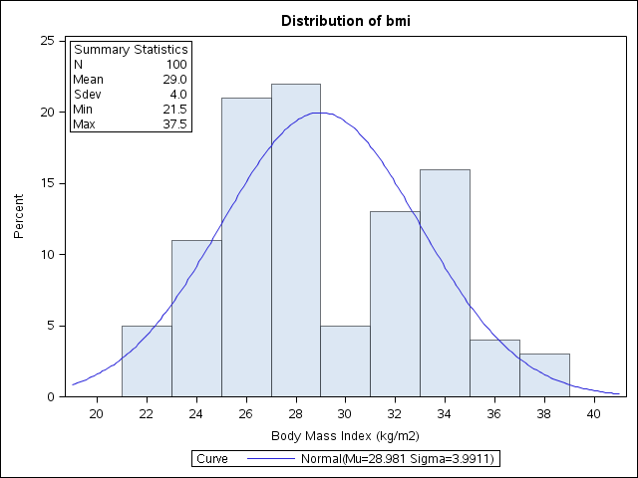
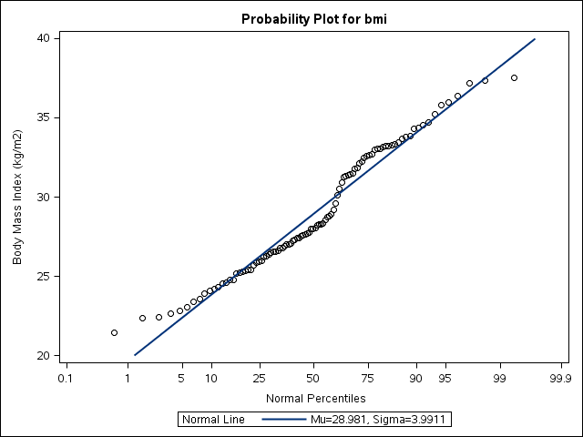
Notes:
Here are the two plots generated. The histogram in combination with the summary statistics in the plot produce a nice summary of the variable. We note the bimodel pattern for BMI.
The probability plot tells us a similar story, in perhaps a less intuitive way.

Slide 15
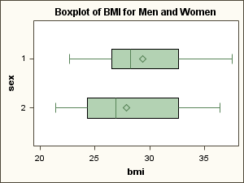
* Using SGPLOT to make side-by-side boxplots;
PROC SGPLOT;
TITLE "Boxplot of BMI for Men and Women";
HBOX bmi/CATEGORY=sex;
RUN;
Notes:
.

Slide 16
PROC FREQ DATA=weight;
TABLES sex clinic ;
TITLE 'Frequency Distribution of Clinical Center and Gender';
RUN;
Frequency Distribution of Clinical Center and Gender
The FREQ Procedure
Cumulative Cumulative
sex Frequency Percent Frequency Percent
-----------------------------------------------------------
1 73 73.00 73 73.00
2 27 27.00 100 100.00
Cumulative Cumulative
clinic Frequency Percent Frequency Percent
-----------------------------------------------------------
A 18 18.00 18 18.00
B 29 29.00 47 47.00
C 36 36.00 83 83.00
D 17 17.00 100 100.00
Notes:
PROC FREQ is used to summarize categorical data, displaying frequency distributions. You can also use PROC FREQ to produce 2-way tabulations and perform traditional Chi-square tests for contingency tables.
Here we tell SAS to display frequency distributions for the variables sex and clinic. Note the sub-statement used is TABLES not VAR. We can list as many variables as we want on the tables statement. We will get a frequency distribution for each variable.
For each category the frequency, percent, cumulative frequency, and cumulative percent is displayed. We see here that there are 73 men and 27 women in the study. There are four clinical sites, A-D, clinic C has the most patients, 36 or 36% of the total.

Slide 17
*2-Way Frequency Tables ;
PROC FREQ DATA=weight;
TABLES sex*clinic/CHISQ ; ;
TITLE 'Cross Tabulation of Clinical
Center and Gender';
RUN;
Notes:
PROC FREQ can also be used to display 2-way classifications. You indicate that by inserting an asterisk (*) between the two variables. The TABLE statement here tells SAS to display a 2-way table of sex and clinic. The variable sex will be the row variable and the variable clinic will be the column variable. Reversing the order will give you the same information, the row and column variables will just be reversed.

Slide 18
Cross Tabulation of Clinical Center and Gender
The FREQ Procedure
Table of sex by clinic
sex clinic
Frequency|
Percent |
Row Pct |
Col Pct |A |B |C |D | Total
---------+--------+--------+--------+--------+
1 | 12 | 20 | 30 | 11 | 73
| 12.00 | 20.00 | 30.00 | 11.00 | 73.00
| 16.44 | 27.40 | 41.10 | 15.07 |
| 66.67 | 68.97 | 83.33 | 64.71 |
---------+--------+--------+--------+--------+
2 | 6 | 9 | 6 | 6 | 27
| 6.00 | 9.00 | 6.00 | 6.00 | 27.00
| 22.22 | 33.33 | 22.22 | 22.22 |
| 33.33 | 31.03 | 16.67 | 35.29 |
---------+--------+--------+--------+--------+
Total 18 29 36 17 100
18.00 29.00 36.00 17.00 100.00
Percent men in clinic A
Notes:
Here is the output from PROC FREQ. When you go from a 1-way to a 2-way table you need to take care in understanding the output, as several counts and percentages are given.
We see here that there are 8 cells (2 levels of sex times 4 levels of clinic) plus the row and column totals. Within each cell are 4 numbers: the cell frequency, the cell percent, the row percent, and the column percent.
Let’s look at the cell sex=1 and clinic = A. The first number, 12, is the number of observations in this cell (12 persons are men and in clinical center A). This is 12.00 percent of all patients (12/100 x 100%). The 3rd number in the cell is 16.44, the percent of all men (12/73 x 100%) that are in clinic A. The 4th number is 66.67, the percent of men patients in clinic A (12/18 x 100%). Usually, either the row or column percentage is the most appropriate statistic to summarize. Here the numbers in blue are the percentages of men in each clinic. Clinic C has the highest percentage of men (83.33%).
Also given are the row and column totals (sometimes called marginal totals). These are the results you would get for a 1-way frequency.
If any of the two variables are missing then that that observation will be excluded from the table.

Slide 19
Statistics for Table of sex by clinic
Statistic DF Value Prob
ƒƒƒƒƒƒƒƒƒƒƒƒƒƒƒƒƒƒƒƒƒƒƒƒƒƒƒƒƒƒƒƒƒƒƒƒƒƒƒƒƒƒƒƒƒƒƒƒƒƒƒƒƒƒ
Chi-Square 3 3.1494 0.3692
Likelihood Ratio Chi-Square 3 3.2986 0.3478
Mantel-Haenszel Chi-Square 1 0.2201 0.6389
Phi Coefficient 0.1775
Contingency Coefficient 0.1747
Cramer's V 0.1775
Notes:
Here is the output from PROC FREQ. When you go from a 1-way to a 2-way table you need to take care in understanding the output, as several counts and percentages are given.
We see here that there are 8 cells (2 levels of sex times 4 levels of clinic) plus the row and column totals. Within each cell are 4 numbers: the cell frequency, the cell percent, the row percent, and the column percent.
Let’s look at the cell sex=1 and clinic = A. The first number, 12, is the number of observations in this cell (12 persons are men and in clinical center A). This is 12.00 percent of all patients (12/100 x 100%). The 3rd number in the cell is 16.44, the percent of all men (12/73 x 100%) that are in clinic A. The 4th number is 66.67, the percent of men patients in clinic A (12/18 x 100%). Usually, either the row or column percentage is the most appropriate statistic to summarize. Here the numbers in blue are the percentages of men in each clinic. Clinic C has the highest percentage of men (83.33%).
Also given are the row and column totals (sometimes called marginal totals). These are the results you would get for a 1-way frequency.
If any of the two variables are missing then that that observation will be excluded from the table.

Slide 20
Creating New Variables
Direct assignments(formulas):
  c = a + b ;
  d = 2*a + 3*b + 7*c ;
  bmi = weight/(height*height);
  If any variable on right hand side is missing then results will be missing
Notes:
Let’s look at how you create new variables in the DATA step - variables that would be then included on the SAS dataset created. There are two types or ways of creating new variables. The first is what I call direct assignments. You put the new variable name followed by an equals sign followed by the formula. Here we see three examples; the last one we have seen before when defining body mass index.
In some cases there is no direct formula; for example when dividing a variable into levels based on cut-points. To do that you will need to use indirect assignments using if statements or if-then-else statements. Here are two examples, one dividing age into two categories and one dividing income into three categories.
We will see how SAS processes these statements next.

Slide 21
If/then/else Statements
With if-then-else definitions SAS stops executing after the first true statement
  if income < 15 then tax = 1; else
  if income < 25 then tax = 2; else
  if income >=25 then tax = 3;
  What if income is 10?
  What if income is 23?
  What if income is 30?
  What if income is missing?
Tax = 1
Tax = 2
Tax = 3
Tax = 1
Notes:
Here is an example of using if-then-else statements to create a new variable. The important thing to remember with these statements is that SAS will stop executing the if statements after the first true statement is encountered.
So what happens when income equals 10? Well, the first if statement will be true so the variable tax will be set to 1. Notice the second if statement is also true; however; as indicated, SAS stops executing the statements when the first statement is true (here when income is less than 15) so the second statement is not executed.
Going through the logic you will note that when income is 23 then tax will be set to 2 (the second if statement is the first true statement) and when income is 30 then tax will be set to 3 (the last if statement is the first true statement).
What if income is missing, what then is the value of tax? It turns out that the variable tax will be set to 1 because missing values are stored as large negative numbers – so the first statement is true when income is missing. This is an important thing to remember when using if-then-else statements to create new variables. So our code here is not exactly what we would want.
We will look at other examples and how to deal with missing data when creating new variables in the next program.

Slide 22
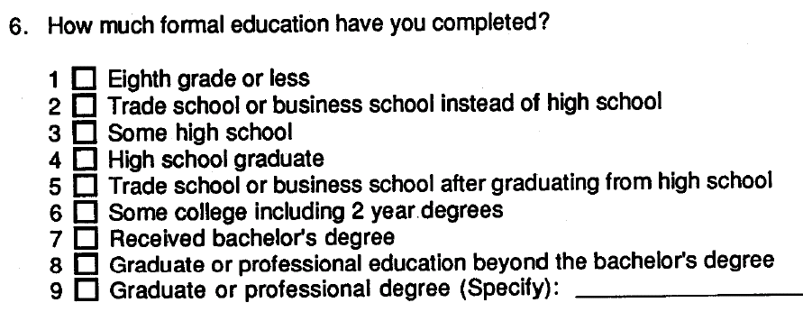
Creating New Variables
Create a new variable with 2 levels, one for college graduates and one for non-college graduates.
Notes:
In TOMHS data on education level was collected as shown here. There are 9 categories of education. Suppose you want to do some analyses combining categories so that there are just 2 levels: college graduate and non-college graduate. To do this you would create a new variable, say called grad, based on the original variable for education. The new variable would have two levels, one value for college graduates and another value for non college graduates. A look at the values for education would indicate that values of 7-9 need to be combined to indicate a college graduate and values of 1-6 need to be combined to indicate a non-college graduate. If the data were missing for education we would want the new variable to also be missing.
There are a few ways to create such a new variable. We will look at them in Program 5.

Slide 23
Program 5
DATA tdata;
INFILE ‘C:\SAS_Files\tomhs.data' ;
INPUT
@ 1 ptid $10.
@ 49 educ 1.
@123 sbp12 3. ;
* This way will code missing values to the value 2;
if educ < 7 then grad1 = 2 ; else
if educ >=7 then grad1 = 1 ;
* The next two ways are equivalent and are correct;
if educ < 7 and educ ne . then grad2 = 2; else
if educ >=7 then grad2 = 1;
* IN is a useful function in SAS ;
if educ IN(1,2,3,4,5,6) then grad3 = 2; else
if educ IN(7,8,9) then grad3 = 1;
New variable defines go after the input statement
Notes:
The program begins by reading in three variables from the TOMHS dataset; variables for patient ID, education, and systolic BP. New variables are defined after the input statement as seen here, i.e. you cannot create a new variable based on education until education is read-in.
We are going to create three new variables to represent college degree status to illustrate the different ways to accomplish this and to show the problems that can occur. Each is going to use IF-THEN-ELSE statements.
The first way defines the variable grad1. If the value for education (variable educ) is less than 7 then grad1 is assigned a value of 2; else if the value of educ is 7 or greater then grad1 is assigned a value of 1. (Note: It does not really matter what 2 values we choose for grad1, just that the values are different. I will talk more on this later). There is only one problem with this syntax: if educ is missing then grad1 is assigned a value of 2. This is because, as noted before, missing values are stored internally by SAS as a large negative value. So the statement educ < 7 is true if educ is missing. We do not want to do this so we have to do a little more coding.
If we replace the first if statement with a compound if statement as seen above (if educ < 7 and educ ne .) we solve the problem. How so? Well, if educ is missing then both IF statements that define grad2 will be false (check this out yourself). Thus grad2 will never be assigned a value through these IF statements and since new variables start out as missing, then grad2 will be (or rather stay) missing.
For the 3rd way we use the IN function. If educ is “in” any of the listed values the statement will be true. This is a great way to define new variables if the original variable takes on integer values and there are not too many of them. Missing values for educ will not be assigned a value for grad3 because both if statements are false if education is missing.

Slide 24
PROC FREQ DATA=tdata;
TABLES educ grad1 grad2 grad3 ;
Cumulative Cumulative
educ Frequency Percent Frequency Percent
---------------------------------------------------------
1 3 3.03 3 3.03
3 4 4.04 7 7.07
4 23 23.23 30 30.30
5 14 14.14 44 44.44
6 12 12.12 56 56.57
7 16 16.16 72 72.73
8 10 10.10 82 82.83
9 17 17.17 99 100.00
Frequency Missing = 1
Cumulative Cumulative
grad1 Frequency Percent Frequency Percent
-----------------------------------------------------------
1 43 43.00 43 43.00
2 57 57.00 100 100.00
Cumulative Cumulative
grad2 Frequency Percent Frequency Percent
-----------------------------------------------------------
1 43 43.43 43 43.43
2 56 56.57 99 100.00
Frequency Missing = 1
Cumulative Cumulative
grad3 Frequency Percent Frequency Percent
-----------------------------------------------------------
1 43 43.43 43 43.43
2 56 56.57 99 100.00
Frequency Missing = 1
Coded the missing value for educ to 2
Notes:
To check that our coding did what we wanted it to do, we can run a PROC FREQ on each of the new variables along with the original education variable. There is one person missing education. For grad1 note there are no missing observations. That is because the observation with education missing got coded as a 2 for grad1.by the way we defined the variable. The coding for grad2 took care of missing data properly so you get the correct coding. The variable grad3 which was defined using the IN function also produces the correct coding.
By displaying the frequency for the original variable and the new variable we can somewhat check our work. We can see that the sum of the first 6 levels for education equals the number for category 2 for the variable grad2.

Slide 25
* Recode sbp12 into 3 levels;
if sbp12 = . then sbp12c = . ; else
if sbp12 < 120 then sbp12c = 1 ; else
if sbp12 < 140 then sbp12c = 2 ; else
if sbp12 >=140 then sbp12c = 3 ;
With if-then-else definitions SAS stops executing after the first true statement
Values < 120 will be assigned value of 1
Values 120-139 will be assigned value of 2
Values >=140 will be assigned value of 3
Missing values will be assigned to missing
Notes:
Now let’s look at another example – this time dividing a variable into more than two categories. We will take our BP variable and divide it into three categories. We will use IF-THEN-ELSE coding to do this. As indicated before, the way these statements work is that after the first IF part is true the statement will stop. If the IF portion is false then the next if portion will execute.
See if you can follow the logic for the coding of the new blood pressure variable. Keep in mind that once an IF portion is true the new value will be assigned and the statement will stop.
If the value for sbp12 is missing (represented as a period) then the new variable sbp12c is set to missing. If the value is less than 120 (but not missing) then a value of 1 is assigned. If the value is less than 140 (but not missing and not less than 120) then a value if 2 is assigned. Lastly if the value is greater than or equal to 140 (but not missing and not less than 120 and not less than 140) a value of 3 is assigned.
As you can notice you need to be very careful in defining new variables using if-then-else statements.
Note also how I lined up the statement. This is for readability and for checking your code. This is a good practice to follow.

Slide 26
PROC FREQ DATA=tdata;
TABLES sbp12c sbp12;
RUN;
OUTPUT
Cumulative Cumulative
sbp12c Frequency Percent Frequency Percent
ƒƒƒƒƒƒƒƒƒƒƒƒƒƒƒƒƒƒƒƒƒƒƒƒƒƒƒƒƒƒƒƒƒƒƒƒƒƒƒƒƒƒƒƒƒƒƒƒƒƒƒƒƒƒƒƒƒƒƒ
1 36 39.13 36 39.13
2 43 46.74 79 85.87
3 13 14.13 92 100.00
Frequency Missing = 8
Cumulative Cumulative
sbp12 Frequency Percent Frequency Percent
ƒƒƒƒƒƒƒƒƒƒƒƒƒƒƒƒƒƒƒƒƒƒƒƒƒƒƒƒƒƒƒƒƒƒƒƒƒƒƒƒƒƒƒƒƒƒƒƒƒƒƒƒƒƒƒƒƒƒ
93 1 1.09 1 1.09
94 1 1.09 2 2.17
101 1 1.09 3 3.26
104 1 1.09 4 4.35
105 1 1.09 5 5.43
(more values)
147 1 1.09 87 94.57
148 1 1.09 88 95.65
149 1 1.09 89 96.74
153 1 1.09 90 97.83
154 1 1.09 91 98.91
158 1 1.09 92 100.00
Frequency Missing = 8
Notes:
Here is the PROC FREQ results for the new and original variables. You should always have the same number of missing values – as you see here there are 8. If they are different there is reason to think your code to define the new variable is incorrect.

Slide 27
Important Facts When Creating New Variables
1. New variables are initialized to missing
2. Missing values are < any value
if var < value (true if var is missing)
3. Reference missing values for numeric variables as .
4. Reference missing values for character variables as ' '
if sbp = . then ... (or if missing(sbp))
if clinic = ' ' then ...
Notes:
Here is a summary of important facts when creating new variables, in particular when using IF-THEN-ELSE logic. First, new variables are initialized to missing; so if none of your IF statements are true when defining the new variable then the new variable will be missing.
Next missing value are less than any value; thus every IF statement of the form IF var < value will be true.
Also, you reference missing numeric variables with a period (.) and missing character variables with a blank (enclosed by quotes). There is also a missing function which you can use to reference missing values whether the variable is character or numeric.

Slide 28
What Value to Set New Variable
if age < 20 then teenager = 1; else
if age >=20 then teenager = 2;
if age < 20 then teenager = 1; else
if age >=20 then teenager = 0;
if age < 20 then teenager = ‘YES’; else
if age >=20 then teenager = ‘NO’;
Notes:
As mentioned earlier when you code a new variable into 2 levels it does not matter what 2 values you use. In the example here the first coding assigns for teenager a value of 1 and 2; the second example uses 1 and 0; the third example defines teenager as a character variable and assigns values of YES and NO.
There are advantages to each. Coding as 1 or 2 will display the affirmative level (the YES value) first in a PROC FREQ (coding 1 or 0 or YES and NO will display the opposite order). Using 0/1 coding has the advantage in that running PROC MEANS on the variable will display the fraction of YES’s in the MEAN statistic and the number of YES’s in the SUM statistic. This can be useful when you have many YES/NO variables. It is also a useful coding when you are using the variable as a dummy or indicator variable in regression analyses (Note coding as 0 and 100 would give you the percent rather than the fraction when using PROC MEANS).
Using character variables to represent the categories is usually not a good practice. For example, you could not use PROC MEANS for this variable or use the variable in a regression equation. It is better to assign them as numeric and use a format, if desired, to clarify the values.

