Slide 1

Sentiment Analysis From Scratch
UVU Data Science Club

Slide 2
objective
Build a Sentiment Analysis model from sratch for the purpose of identifying key indicators of Positive/Negative Sentiment on YouTube Comments.

Slide 3
EXECUTION
To complete this project, we completed the following tasks:
1. Gather Training Data
2. Compute Vectors
3. Generate Benchmark Models
4. Build New Model

Slide 4
Final product

Slide 5
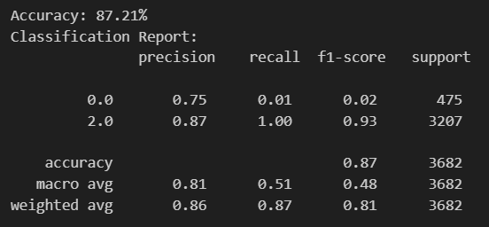
Benchmark Model
Algorithm: Bernoulli Naïve Bayes Hyperparameters: No Stop Words, Unigrams AND Bigrams
Results
Negative
Positive

