Slide 1
Victorious VBA
Day 6
The Data Bootcamp |
August 12, 2017

Slide 2
Refresher

Slide 3
Refresher
Explain like I’m 5:
What is a for-loop?
Notes:
Partner activity

Slide 4
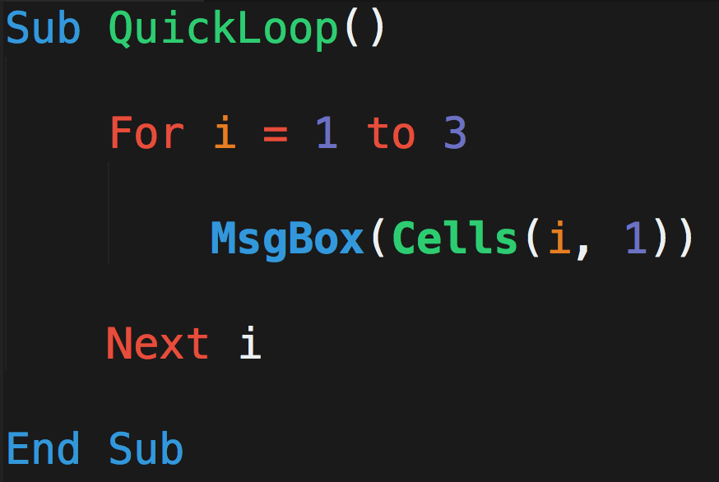
What Will This Code Do?
A
B
C
Michael | Luis | Ruchi
Evan | Mariah | Ricky
Jamie | Ron | Jeff
John | Lakshmi | Baskaran
1
2
3
4

Slide 5
What Will This Code Do?
A
B
C
Michael | Luis | Ruchi
Evan | Mariah | Ricky
Jamie | Ron | Jeff
John | Lakshmi | Baskaran
1
2
3
When i = 1…
4

Slide 6
What Will This Code Do?
A
B
C
Michael | Luis | Ruchi
Evan | Mariah | Ricky
Jamie | Ron | Jeff
John | Lakshmi | Baskaran
1
2
3
When i = 2…
4

Slide 7
What Will This Code Do?
A
B
C
Michael | Luis | Ruchi
Evan | Mariah | Ricky
Jamie | Ron | Jeff
John | Lakshmi | Baskaran
1
2
3
When i = 3…
4

Slide 8
What Will This Code Do?
A
B
C
Michael | Luis | Ruchi
Evan | Mariah | Ricky
Jamie | Ron | Jeff
John | Lakshmi | Baskaran
1
2
3
Nope….
Not going to i =4
4

Slide 9
Refresher
Explain like I’m 5:
What is a nested for-loop?
Notes:
Partner activity

Slide 10
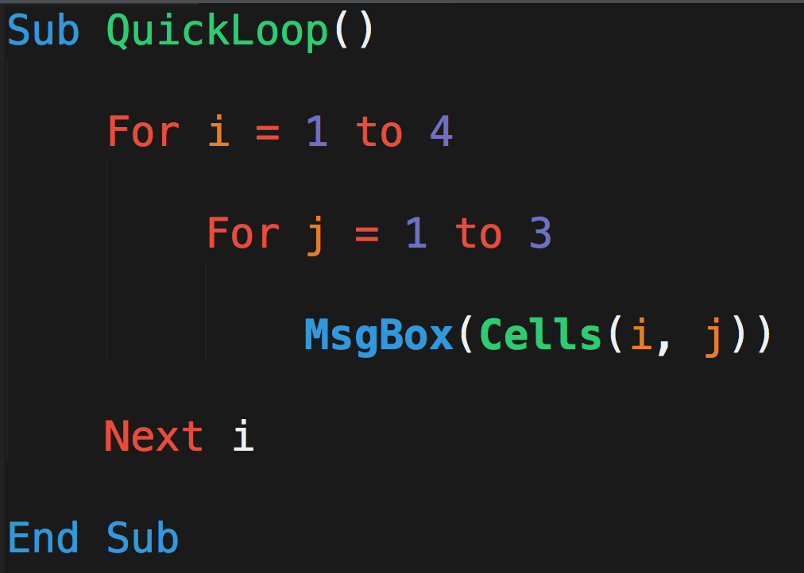
What Will This Code Do?
A
B
C
Michael | Luis | Ruchi
Evan | Mariah | Ricky
Jamie | Ron | Jeff
John | Lakshmi | Baskaran
1
2
3
4

Slide 11
What Will This Code Do?
A
B
C
Michael | Luis | Ruchi
Evan | Mariah | Ricky
Jamie | Ron | Jeff
John | Lakshmi | Baskaran
1
2
3
When…
i = 1
j = 1
4

Slide 12
What Will This Code Do?
A
B
C
Michael | Luis | Ruchi
Evan | Mariah | Ricky
Jamie | Ron | Jeff
John | Lakshmi | Baskaran
1
2
3
When…
i = 1
j = 2
4

Slide 13
What Will This Code Do?
A
B
C
Michael | Luis | Ruchi
Evan | Mariah | Ricky
Jamie | Ron | Jeff
John | Lakshmi | Baskaran
1
2
3
When…
i = 1
j = 3
4

Slide 14
What Will This Code Do?
A
B
C
Michael | Luis | Ruchi
Evan | Mariah | Ricky
Jamie | Ron | Jeff
John | Lakshmi | Baskaran
1
2
3
When…
i = 2
j = 1
4

Slide 15
What Will This Code Do?
A
B
C
Michael | Luis | Ruchi
Evan | Mariah | Ricky
Jamie | Ron | Jeff
John | Lakshmi | Baskaran
1
2
3
When…
i = 2
j = 2
4

Slide 16
What Will This Code Do?
A
B
C
Michael | Luis | Ruchi
Evan | Mariah | Ricky
Jamie | Ron | Jeff
John | Lakshmi | Baskaran
1
2
3
When…
i = 2
j = 3
4

Slide 17
What Will This Code Do?
A
B
C
Michael | Luis | Ruchi
Evan | Mariah | Ricky
Jamie | Ron | Jeff
John | Lakshmi | Baskaran
1
2
3
This continues…
4

Slide 18
So…
Open Questions?

Slide 19
Questions / Discussion
Notes:
It’s important to keep in mind why you joined this class. Let’s talk about your goals.

