Slide 1
Git’n Pro with Python
Day 1

Slide 2
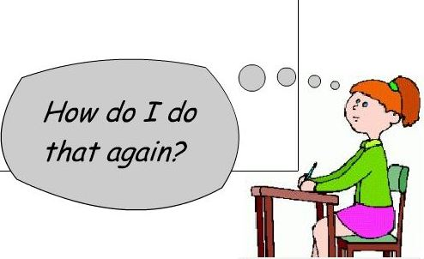
It’s Okay!

Slide 3
Today’s Class!

Slide 4
Today’s Objectives
Understand the importance of Git Version Control and of how to use it.
Create GitHub Repositories, push code into them, and share with class.
Create Python scripts and run them in the terminal
Begin to learn the fundamentals of the Python programing language – variables, conditionals, lists, and loops

Slide 5
> Coding Time!
Activity: Your First Python Script | Suggested Time: 15min
Assignment:
Creating your first Python script!:
Create a new conda environment if not already done using:
`conda create –n py36 python=3.6 anaconda`
Next, activate the the environment.
`source activate py36`
Then navigate to your class folder and create an Python script file inside the local directory called `hello.py`
Run the script using `python hello.py`
Notes:
Windows users should only use git-bash

Slide 6
What / Why Git?

Slide 7
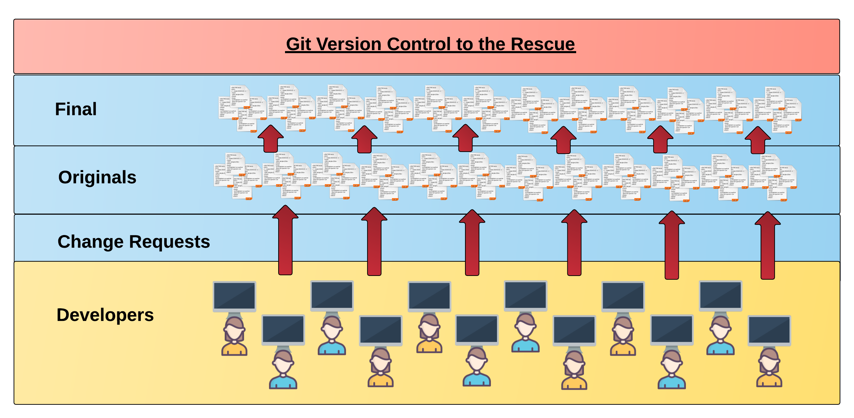
Collaborative Coding
Modern web development is highly collaborative.
Teams are often extremely large and separated across the country — or planet.
Apps sometimes comprise hundreds or even thousands of files.

Slide 8
Version Control
Git Version Control:
The Benefits of Git:
A process for resolving conflicts in code.
Version History.
Provides a organized system for managing code for when multiple developers work on a project at the same time.

Slide 9
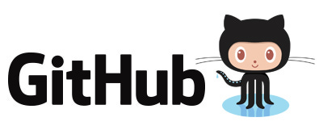
So… What’s this GitHub?
GitHub is a Web-Based hosting service to store code online.
It allows developers to pull (download) code or push (upload) code to the same repository (directory).
It also allows developers to view histories of code changes and to track issues.

Slide 10
Get Started with Git

Slide 11
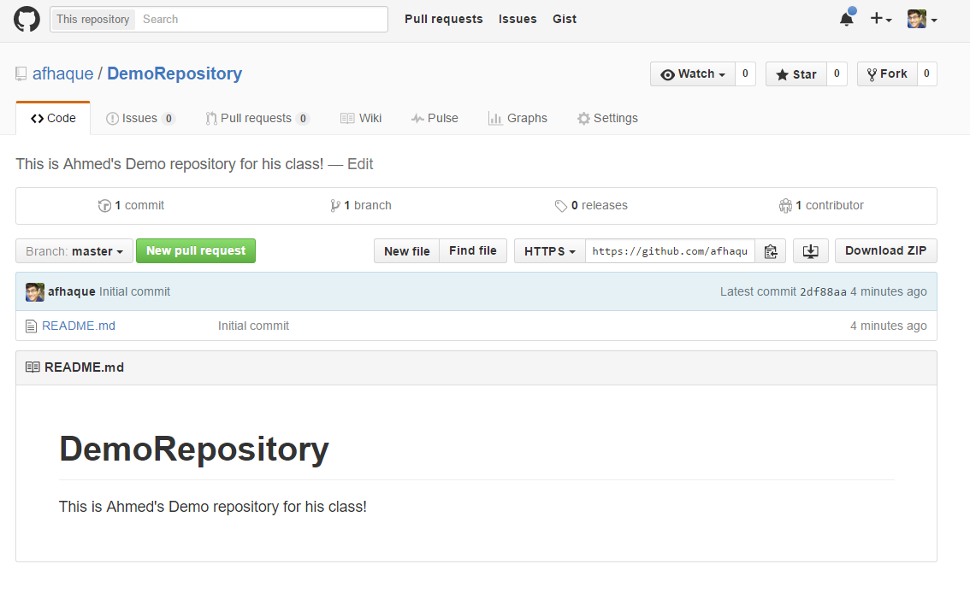
Instructor Git Demo!

Slide 12
Basic Git Commands
At its most basic, these are the five git commands to get started:
git clone
git add
git commit
git push
git pull

Slide 13
Basic Git Commands
At its most basic, these are the five git commands to get started:
git clone – copies an entire repo (to begin).
git add – adds a file for inclusion in Git.
git commit – notes a change to the local repo.
git push – sends changes to hosting service.
git pull – downloads freshest version of repo.

Slide 14
> YOUR TURN!
Activity: Git Add, Commit, Push | Suggested Time: 15min
Assignment:
Using GitHub and the Command Line:
Create a new public GitHub repository and name it whatever you like. Be sure to check the box for “initialize this repository with a README.”
Next, clone the repo to your local directory.
Then create an Python script file inside the local directory.
Add, Commit, and Push the code to GitHub.
Bonus:
Find a partner in class, and fork their repository to your own GitHub account. Clone this forked repository to your local directory.
Add, Commit, and Push the code back to your forked copy.
Finally, submit a pull request to send your changes to your partner’s repo.

Slide 15
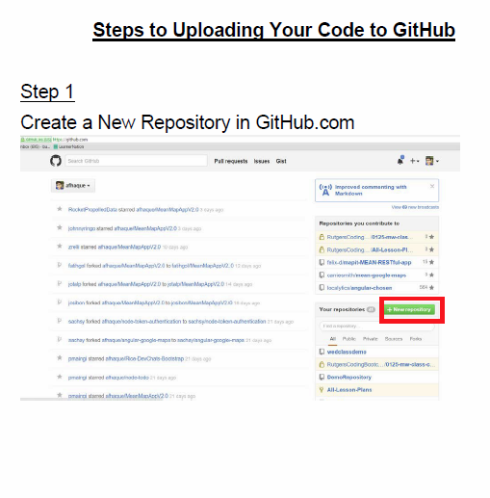
Still a Bit Lost? Never Worry!
Follow this handy Guide!
Practice a few times on your own before our next class.

Slide 16
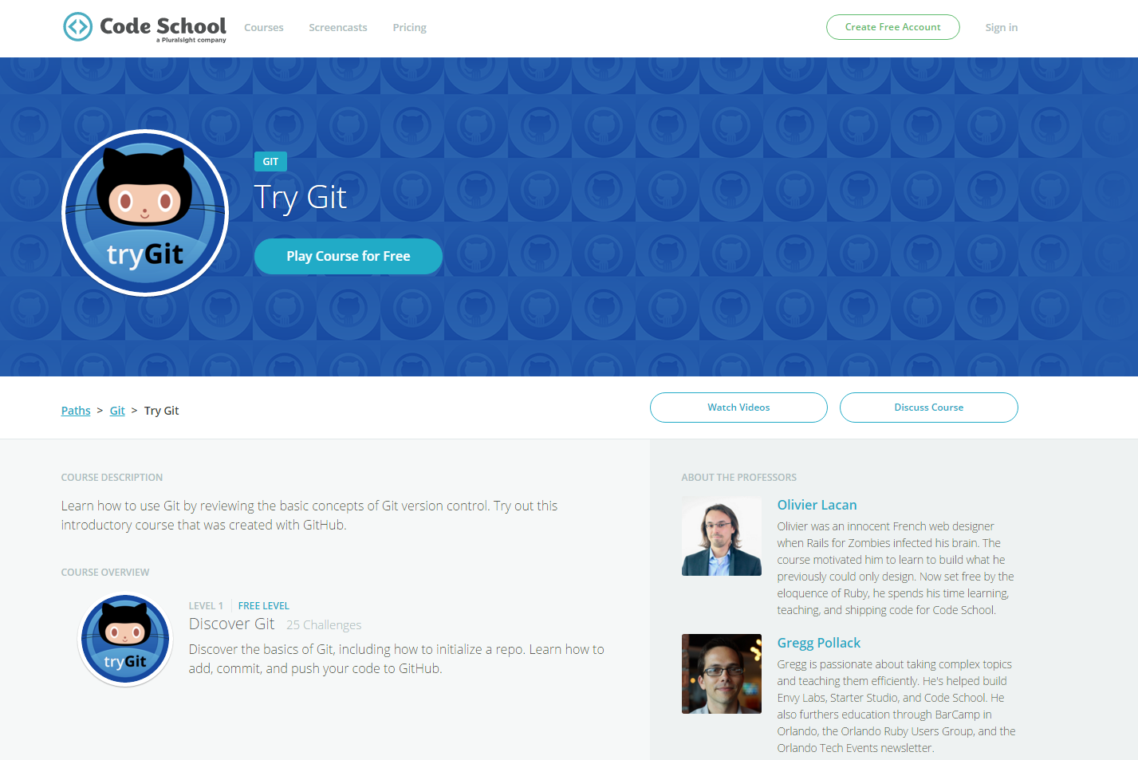
If You’re Still Lost… Here’s a (Free) Course
https://www.codeschool.com/courses/try-git

Slide 17
Coding Time!

Slide 18
Recap + Questions

