Slide 1
To understand D3, imagine ninjas

Slide 2

Or, rather, a play about ninjas
Notes:
Say that you’re a theater director who’s putting on a play about ninjas

Slide 3
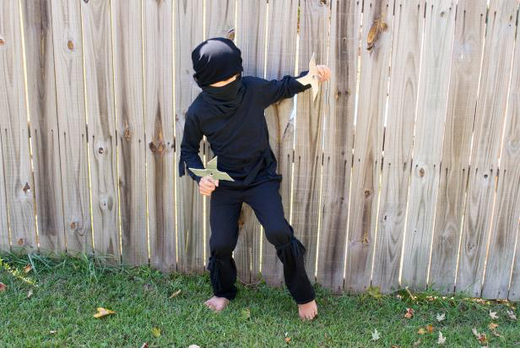
A NINJA requires two things
Actor + costume = NINJA
Notes:
We need both an actor and a costume to have a ninja who’s ready for the stage

Slide 4
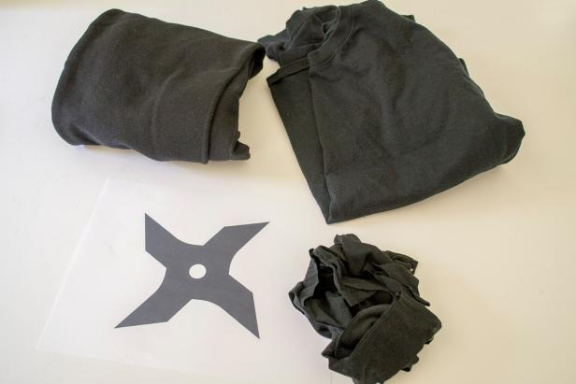

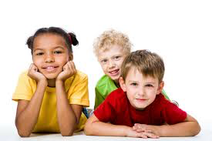
3 costumes + 3 actors = 3 ninjas
+
=
Costumes + Actors = NINJAS
Notes:
If we have 3 costumes, but no actors, we do not have ninjas.
If we have 3 actors, but no costumes, we do not have ninjas.
We need 3 actors and 3 costumes to have 3 ninjas.

Slide 5

A NINJA requires two things
Actor only
= NO NINJA

Slide 6
Costume only = no ninja
Costume only
= NO NINJA

Slide 7
A NINJA requires two things
Actor + Costume
= NINJA

Slide 8

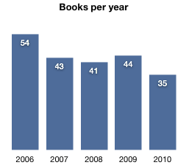
D3 charts are like ninjas
var books = [
{2006:54},
{2007:43},
{2008:41},
{2009:44},
{2010:35}
];
Notes:
Here, each piece of data in the array determines the appearance of each rectangle in the bar chart. The larger the number, the taller the rectangle.
Without the numbers in our array, we do not have a bar chart. That is why they are like actors.
Without the rectangles to represent the numbers, we do not have a bar chart. In that way, SVG elements are like ninja costumes.

Slide 9
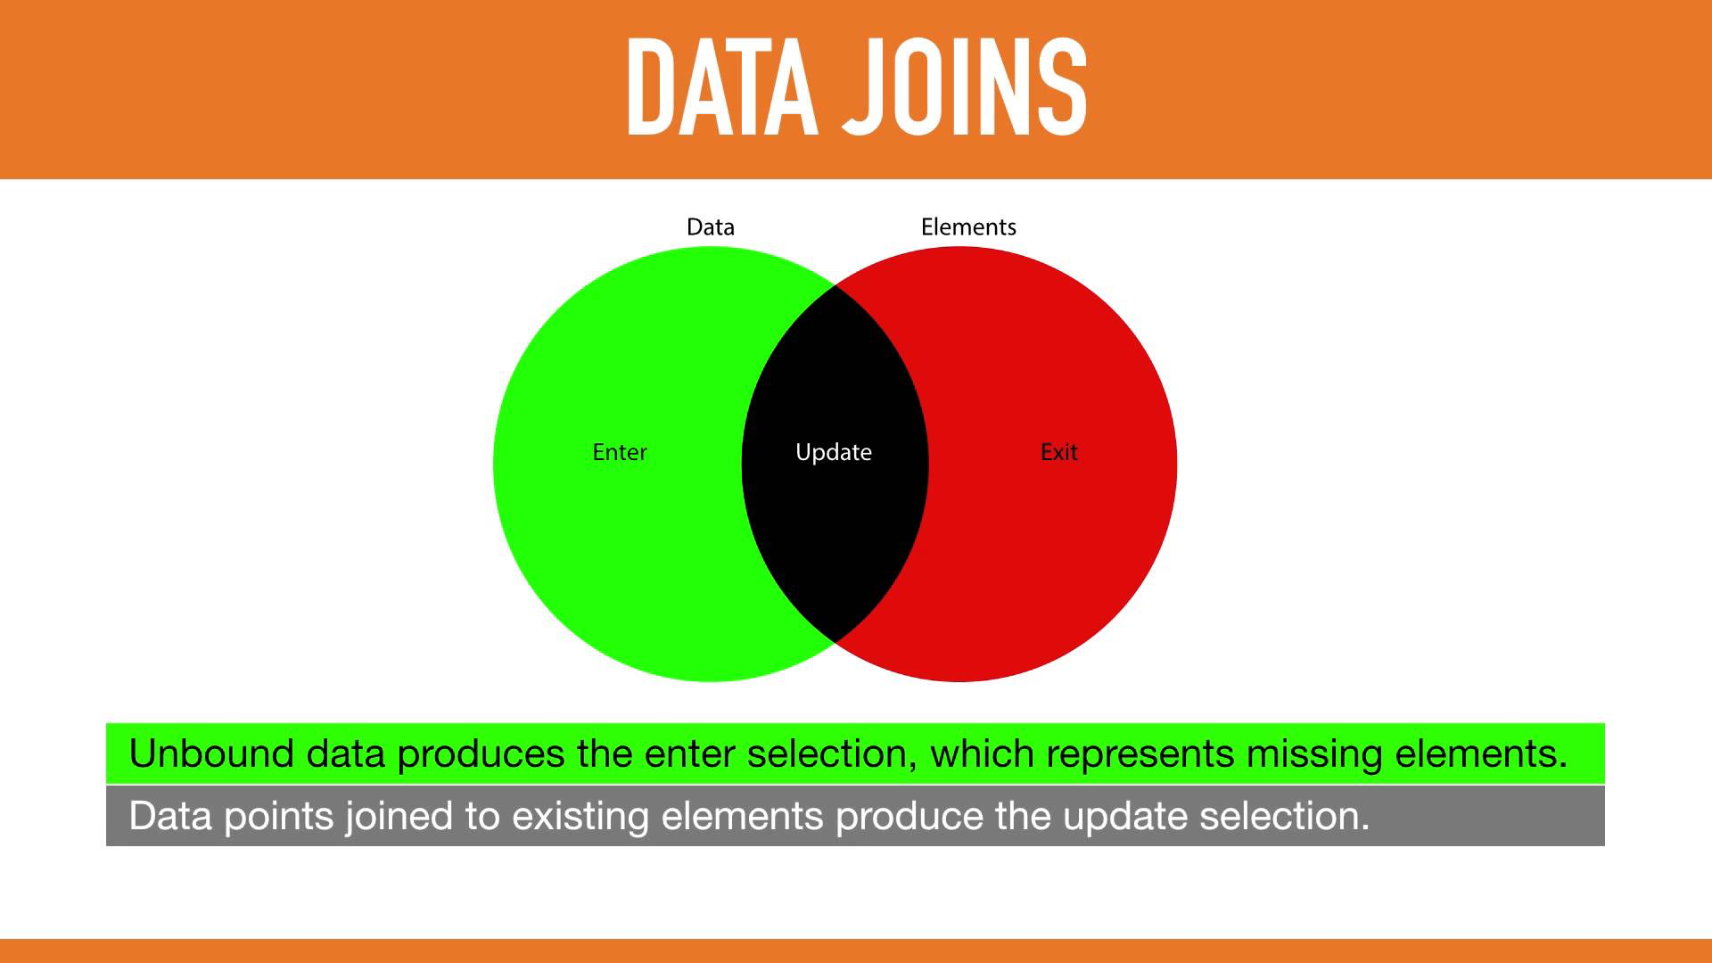
Enter(), Exit(), Update()
Notes:
-In D3, enter() selection means data that have not been joined to onscreen visual elements.
-Exit() selection represents visual elements that are not joined to data.
-And update() selection represents data that are bound to visual elements.

Slide 10

What Does Data Binding Even Do?
Imagine you are putting on a play about ninjas
But the stage is empty…
Notes:
The web is a series of tubes, and they’re full of cats!

Slide 11

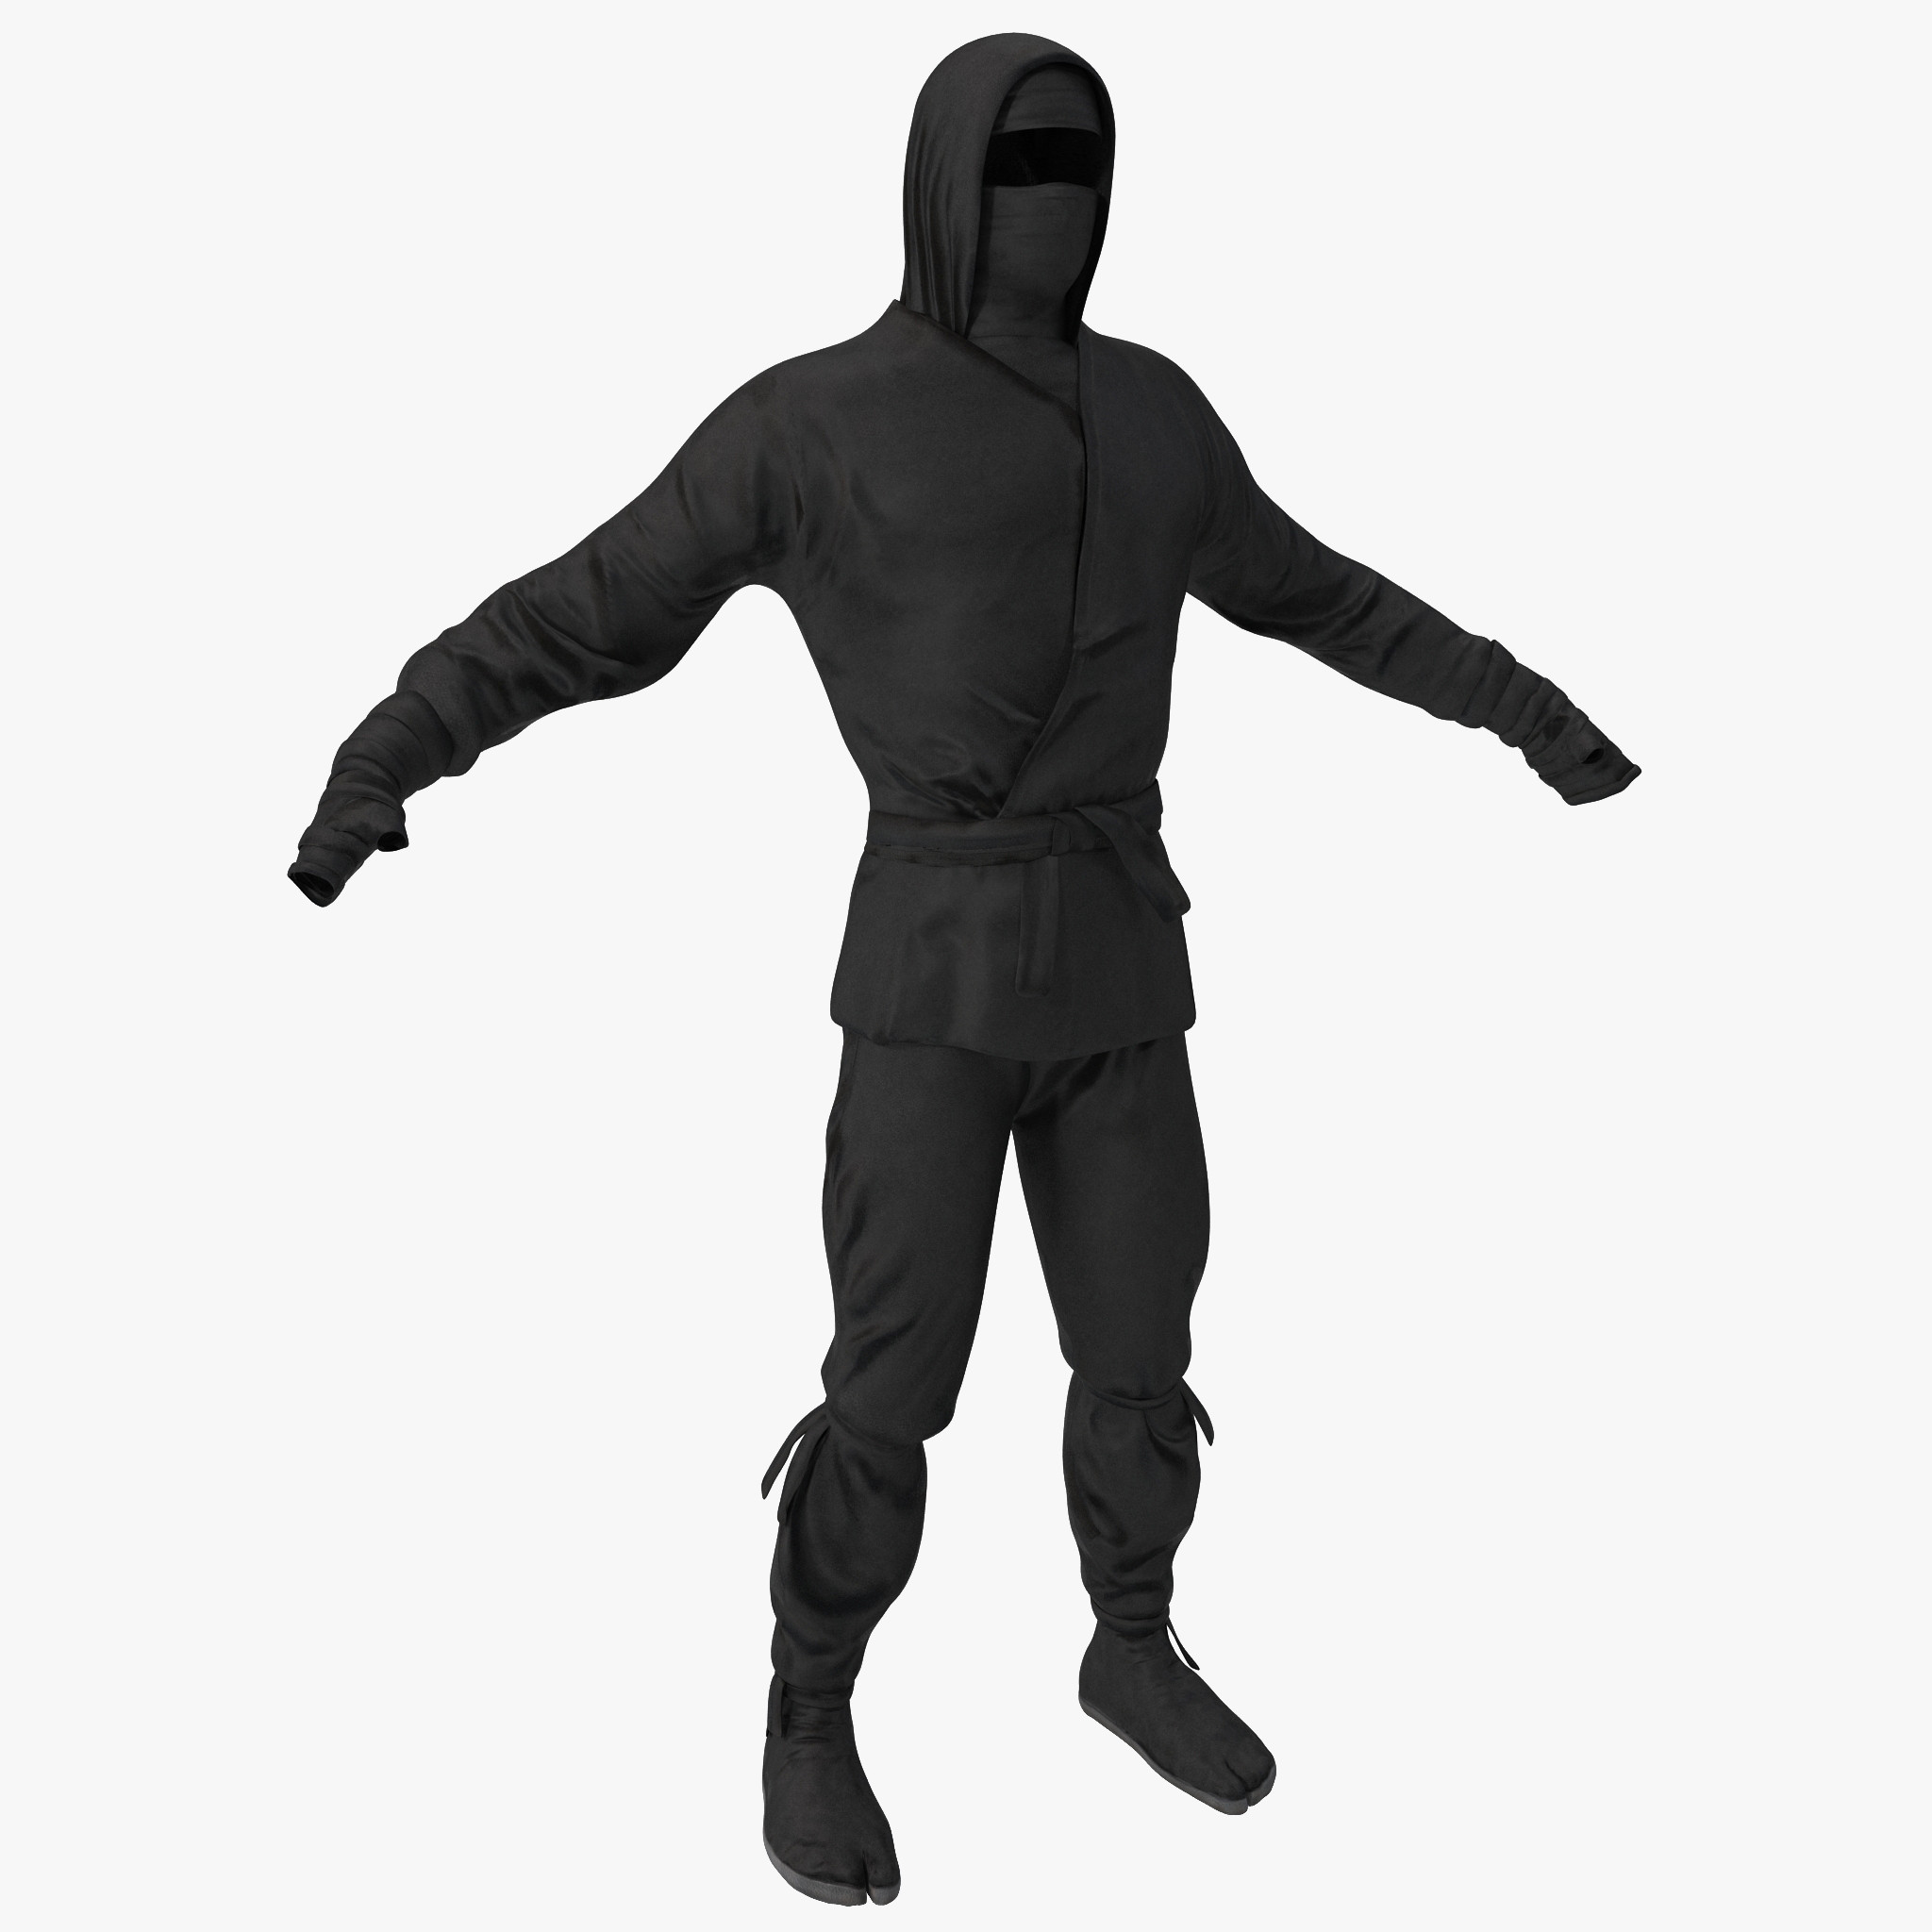
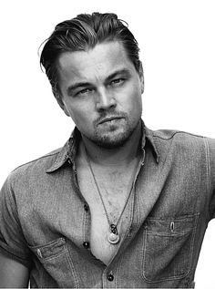

What Does Data Binding Even Do?
In order to put on your play you need three actors
And you need three ninja costumes
Notes:
The web is a series of tubes, and they’re full of cats!

Slide 12
What Does Data Binding Even Do?
Data
Rectangles
In order to put on your play you need three actors
And you need three ninja costumes
Notes:
The web is a series of tubes, and they’re full of cats!

Slide 13
What Does Data Binding Even Do?
First you need to “append” your costumes to the stage.
Notes:
The web is a series of tubes, and they’re full of cats!

Slide 14
What Does Data Binding Even Do?
Then you assign actors to each costume (data binding)
Notes:
The web is a series of tubes, and they’re full of cats!

Slide 15
What Does Data Binding Even Do?
What about me?
If you have more data than svg elements then you need to use .enter() to create the additional elements
Notes:
The web is a series of tubes, and they’re full of cats!

Slide 16
What Does Data Binding Even Do?
If you have more svg elements than data (actors) then you need to use .exit() to remove the extra svg elements
Notes:
The web is a series of tubes, and they’re full of cats!

