Slide 1
Project 2: Algos and Predictions
Jimmy, Jeff, Tyler

Slide 2
Project Purpose
1. Create a strategy that performs well, short term, in bear markets.
2. Create a predictive model that can help with determining the direction of the market.
3. Use that predictive model to help us decide whether or not we should turn on our algo.

Slide 3
Data Clean Up & Model Training
1. Clean up from yfinance just involved removing columns we didn’t need.
2. Problem: Predicting into the actual future with NNs.
3. Automating the data stream to have model continuously

Slide 4
The Strategy
1. Simple SMA strategy that combines both short and long positions.
- When the short SMA crosses above the long SMA, we are long.
- When the short SMA crosses below the long SMA, we are short.
- At no time during this strategy are we neutral.

Slide 5
Why Use This Strategy
1. Intended Purpose is to hedge a buy and hold strategy during poor times.
2. If you think rough times are coming, flip the switch for this strategy and you COULD potentially lose less.
3. IF YOU’RE LUCKY, this strategy can produce astronomical returns in comparison to the Buy and Hold Strategy. Next is a picture of an extreme outlier that should not be expected when using this strategy.

Slide 6
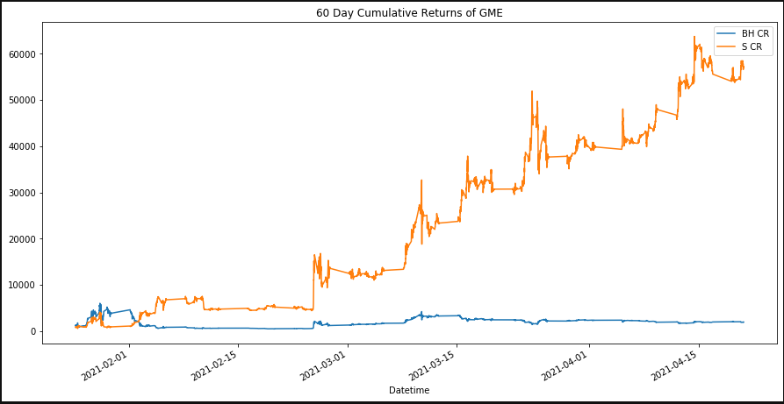
GameStop Cumulative Returns in 60 Days.

Slide 7
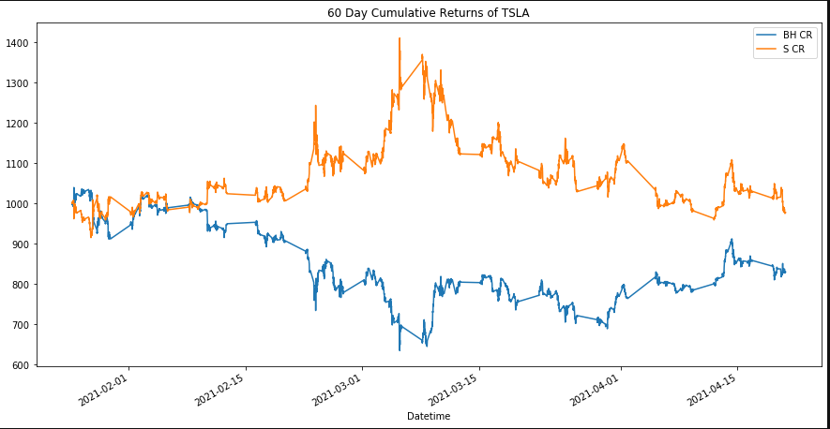
An Intentended and Expected Performance

Slide 8
Conclusions On This Strategy.
1. Works well a lot of the time.
  - At the very least, it doesn’t perform terribly most of the time.
2. Not consistent enough to provide confidence.
  - Doesn’t always do better than a simple buy and hold strategy

Slide 9
Predictions with ARIMA
1. ARIMA model predicts PRICES 5 days in advance.
  - Usually these things predict returns. Ours can predict actual prices.
2. MODEL EVALUATION: AIC is the main determiner for model strength.- Seemed to be one of the most popular on the internet.

Slide 10
How we got the model to predict Prices.
1. We ran the normal ARIMA model that predicts returns.
2. Appended those predictions to the actual returns.
3. Created a new column of the Cumulative Product of those simple returns.
4. Multiplied the initial value by the stock price of the very first day.

Slide 11
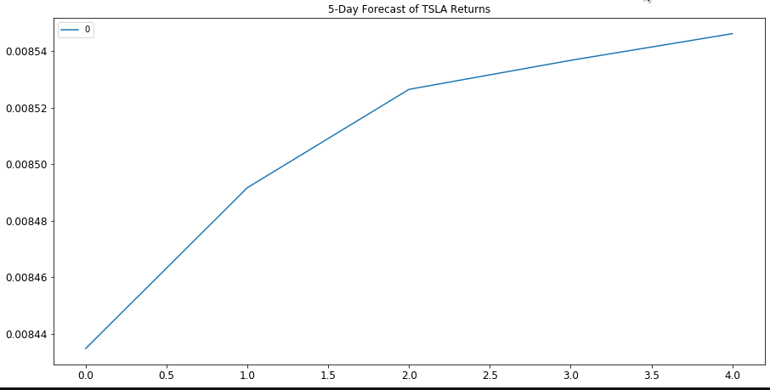
The Original Output

Slide 12
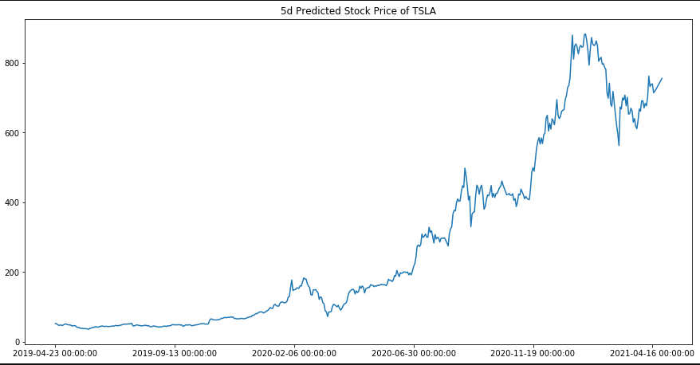
5 Day Stock Prediction

Slide 13
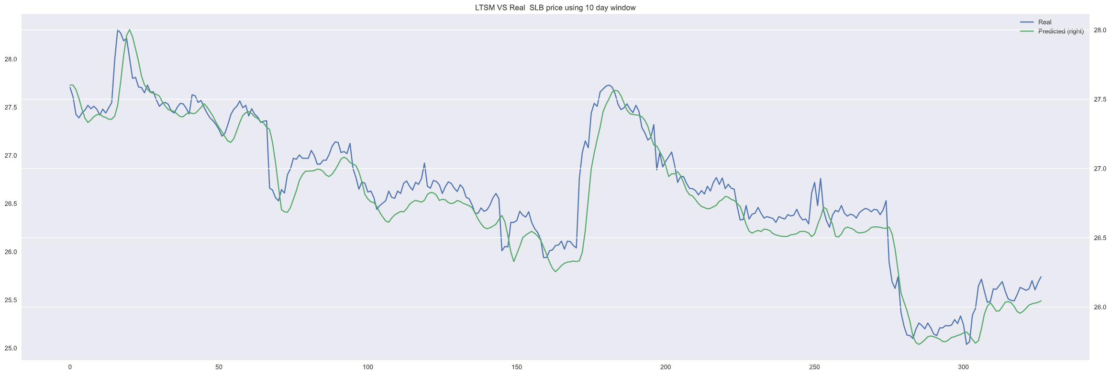
LSTM MODEL & METRICS

Slide 14
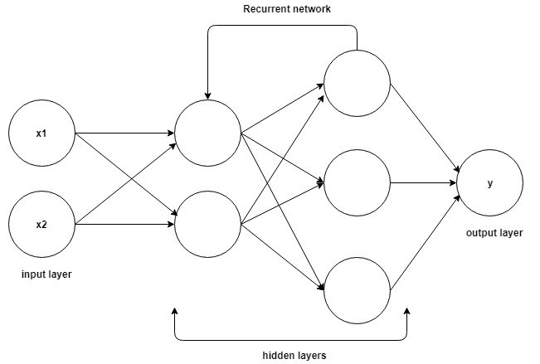
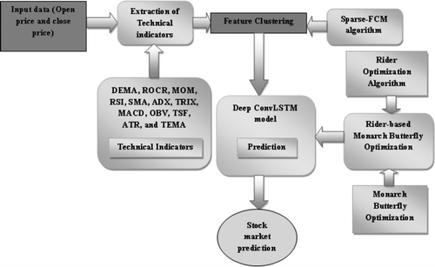
TENSORBOARD

Slide 15
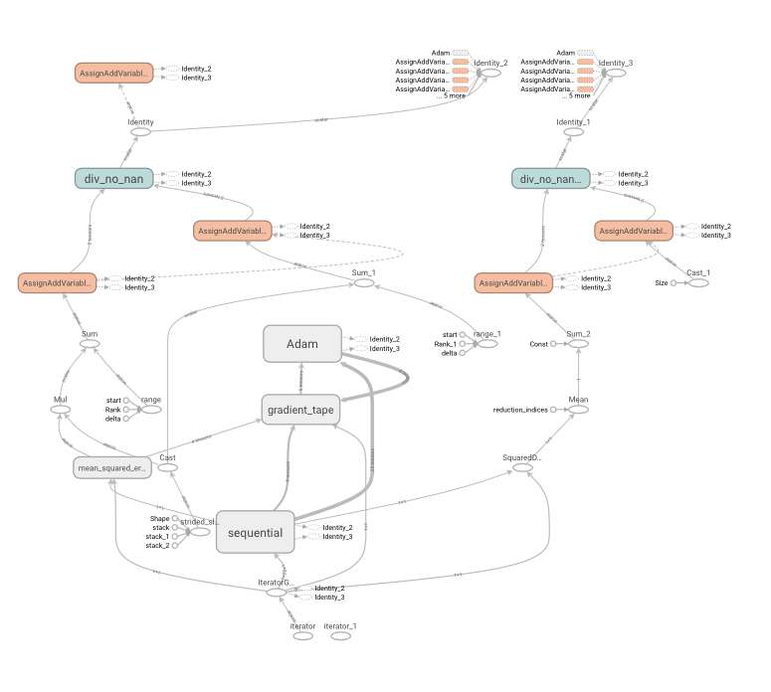
TENSORBOARD

Slide 16
METRICS
epoch_mse

Slide 17
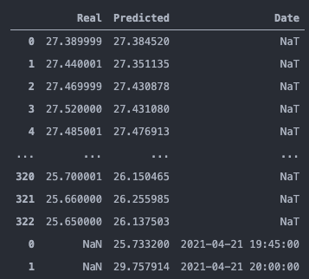
EOD OF DAY RESULTS

Slide 18
Next Steps & Post Mortem.
1. Perfecting the trading strategy.
2. Linking the model predictions to the trading strategy.
3. Linking the trading strategy to a broker account to automate trading.
4. Perfecting the predictions.
  - Though these don’t need to be perfect, they do need to be accurate in direction.

