Slide 1
Movie Data Analysis from 2014 to 2018
Team Members:
Zeyu Yan
George Bendele
Mrinalini Darswal

Slide 2
Project Description
We will analyze all the movie data from 2014 to 2018 (the past 5 years) to see what interesting trends we can reveal. (Finished)
Extra: Train a classifier to classify the sentiment of movie reviews. The accuracy of the classifier should be at least over 85%. (Finished)
Optional: Analyze on all of the Marvel movie data to reveal interesting trends. (Data already gathered, but not enough time to finish)

Slide 3
Where to Get the Data?
Gather detailed movie information through OMDB API.
Crawl lists of movie names for each year from 2014 to 2018 through Wikipedia.
For IMDB movie reviews sentiment analysis, the training and testing data we used are from “Large Movie Review Dataset v1.0”, which is available from Kaggle.
Detailed Marvel movie data are also gathered through a combination of web crawling and OMDB API.

Slide 4
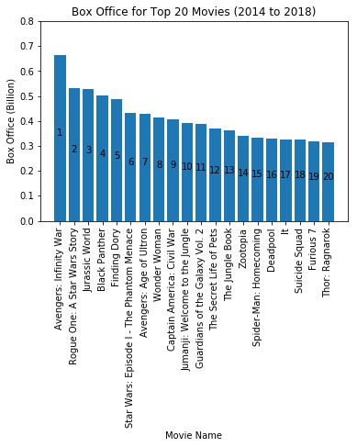
Top 20 Movies in Terms of Box Office
"Avengers: Infinity War" is the box office champion for the past 5 years.
"Rogue One: A Star War Story" and "Jurassic World" are the 2nd and 3rd.

Slide 5
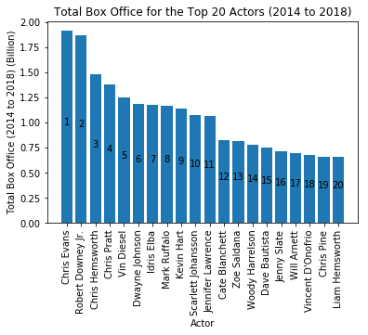
Top 20 Actors with the Highest Accumulative Box Office
Chris Evans is the accumulative box office champion for the past 5 years.
Robert Downey Jr. is right behind him and really close.

Slide 6
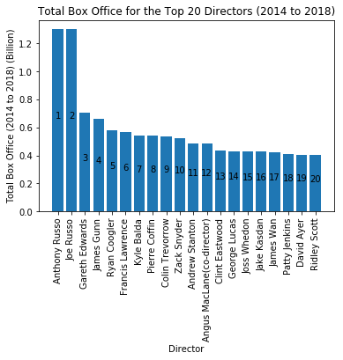
Top 20 Directors with the Highest Accumulative Box Office
Russo Brothers are the accumulative box office champion for the past 5 years.

Slide 7
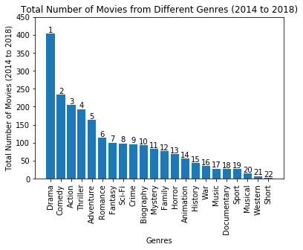
Total Number of Movies from Different Genres
The most popular genre for the past 5 years is "Drama".

Slide 8
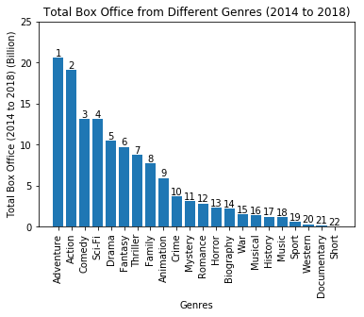
Total Box Office from Different Genres
The genre "Adventure" is the champion for the past 5 years, although the genre "Action" is really close.

Slide 9
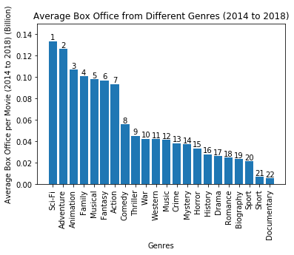
Average Box Office from Different Genres
The genre "Sci-Fi" is the champion for the past 5 years. "Adventure" is right behind it and really close.

Slide 10
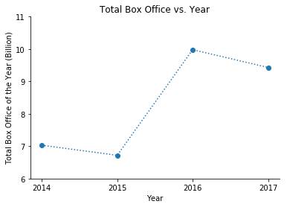
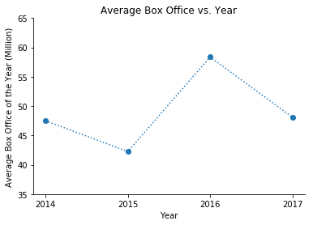
Total & Average Box Office Analysis
The data for 2018 is eliminated for this analysis due to the number of samples are not large enough.

Slide 11
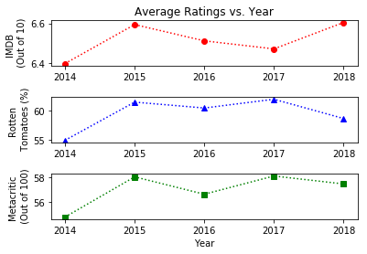
Average Ratings Analysis
The trend of rating from all 3 sources are basically the same.
Year 2015 has the lowest total and average box office, but has the highest average rating among the past 5 years.
This interesting result reveals that this is no direct relation between the rating of the movies and their box office.

Slide 12
IMDB Sentiment Classifier
Data Source: Large Movie Review Dataset v1. 0 available from Kaggle
Preprocessing: String Operations & Regular Expressions
Vectorization: TF-IDF

Slide 13
Baseline Algorithms
Method Name | 10-Fold Avg Accuracy | 10-Fold Accuracy STD
Logistic Regression | 0.8842 | 0.0058
Linear Discriminant Analysis | 0.8591 | 0.0067
Decision Tree | 0.7130 | 0.0065
Gaussian Naive Bayes | 0.8003 | 0.0094
Linear SVC | 0.8746 | 0.0065

Slide 14
Further Parameter Tuning
C Value for LR | 10-Fold Avg Accuracy | 10-Fold Accuracy STD
0.01 | 0.8429 | 0.0074
0.05 | 0.8590 | 0.0070
0.25 | 0.8764 | 0.0064
0.5 | 0.8814 | 0.0057
1 | 0.8842 | 0.0058
Final Test on Testing Dataset:
Logistic Regression: 88.08%
Linear SVC: 87.78%
Therefore, we finally pick LR over LSVC.
C Value for LSVC | 10-Fold Avg Accuracy | 10-Fold Accuracy STD
0.01 | 0.8659 | 0.0068
0.05 | 0.8825 | 0.0053
0.25 | 0.8837 | 0.0040
0.5 | 0.8789 | 0.0041
1 | 0.8746 | 0.0065

Slide 15

Thank You!

