Slide 1
LOD4DataONE
By Aída Gándara
DataONE 2011 Summer Intern
June 25, 2011
PLEASE WAIT: this slideshow will advance automatically.

Slide 2
Understanding Data on the Web
Scientists must traverse URL to URL to compare content
Scientists must visually compare data to make connections between data
Access to data is based on what a portal exposes

Slide 3
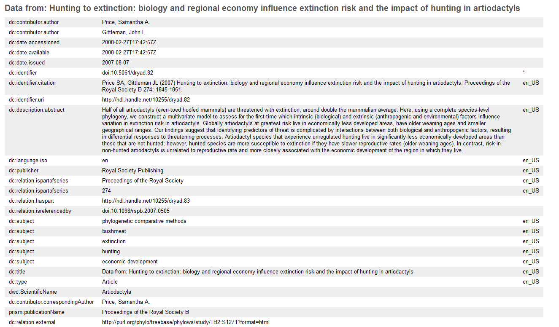
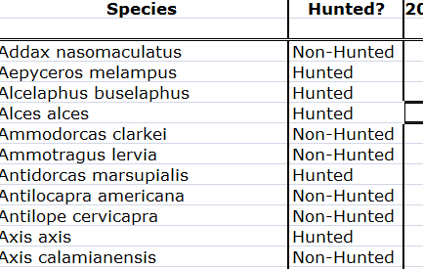
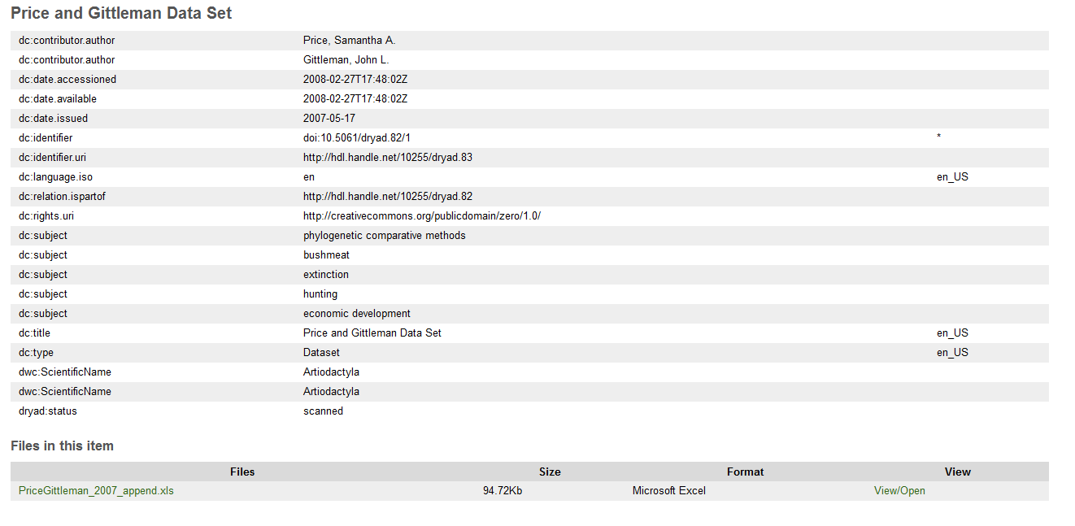
A Dryad Example
In this example – I had to enter URL after URL then download the data file to understand it.
I manually identified relationships between data.
http://datadryad.org/handle/10255/dryad.82?show=full
haspart – dryad.83
ispartof – dryad.82
a data file
PriceGittleman_2007_append.xls
http://datadryad.org/handle/10255/dryad.83?show=full

Slide 4
Consider Data Meaning
There is other knowledge to consider.
Who are these people?
How do I contact this publisher?
What is this scientific name?
Is there more doi info?
What does this relate to in Treebase?
What do these rights mean?
What species are documented here?

Slide 5
Linked Open Data – Phase I
Understand data and its relationship to other data
Identify links to other data : find URIs that provide RDF meaning to the content
Use RDF browser to understand data

Slide 6
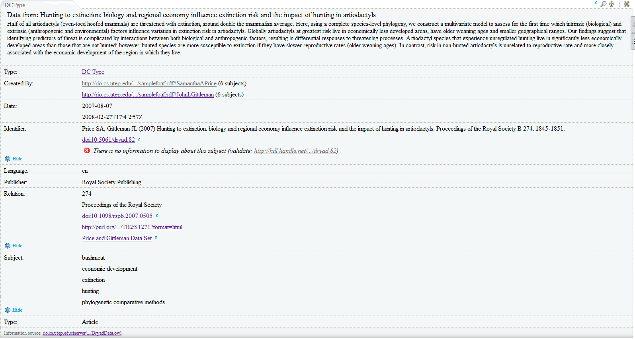
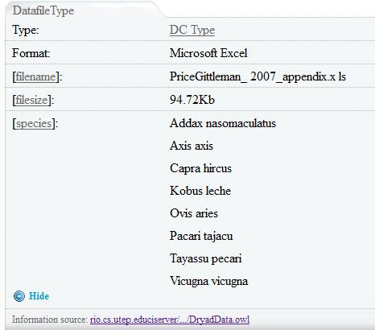
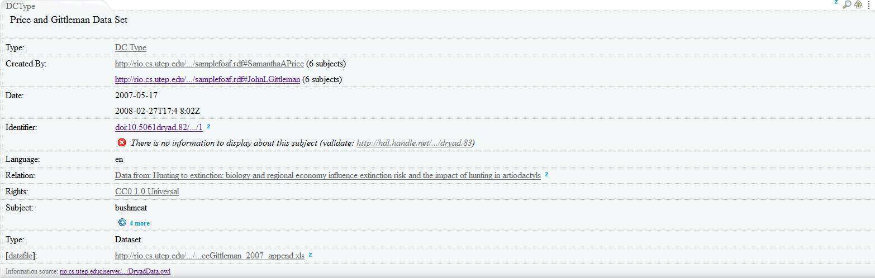
Example: Dryad Data on LOD
http:// … dryad.82
link people to foaf
http:// … xls
extract useful data from datasets – browsers can control view
Link dryad.82 to dryad.83
http:// … dryad.83
make link to derefenceable file URI

Slide 7
Final notes
RDF browsers affect RDF understanding; these examples are in dataviewer.zitgist.com
Some RDF browsing is possible with existing URL content but the data links are not there
Finding URI’s for linkable content is NOT easy – the websites might be there, not the ‘dereferenceable URIs’ or RDF content
These examples use Dryad data due to accessibility issues. I do not foresee this to be an issue for DataONE providers.
DataONE data providers must establish dereferenceable URIs and content negotiation for those URIs

