Slide 1
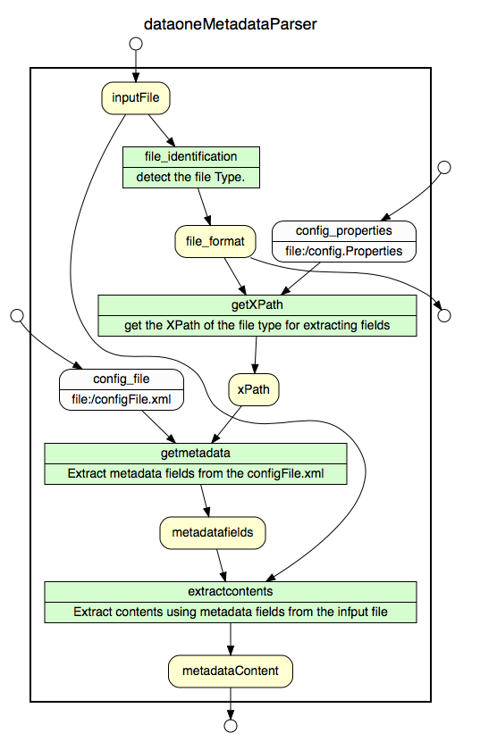
Identification of Science Resources & Tool for Extracting Standard Metadata Properties
Pratik Shrivastava¹, Dave Vieglais² ¹University of Illinois at Urbana-Champaign, ²DataONE
Introduction
Identifying the correct file format is imperative for processing its contents.
Many metadata standards are serialized as XML requires additional details of namespace information for processing.
Packaging data into data packages requires metadata identification and parsing of the files.
A tool for reliable identification makes processing easier.
DataONE Magic file
Gathered a Test corpus for the known DataONE file formats.
Define rules for DataONE file format Identification.
Create Magic files for identifying DataONE file formats.
Compile magic files for the libmagic library of the file command.
Tested magic file using unittest library in python.
DataONE Metadata Extraction Tool Using Tika
A command line tool for detecting and parsing standard metadata properties for science resources.
It uses Tika detector for identification of the file type.
It is a custom namespace aware parsers for extraction of the metadata content from different file formats
Uses a configuration file for extracting the metadata properties either by specifying the element tag or using an XPath values.
Conclusion:
Successful identification of file format using Libmagic and Apache Tika
Easy to add support for new file metadata properties for file extraction using the configuration file.
The output can be exported to JSON, CSV format.
Useful in searching and indexing metadata content.
-----------------------------------------------------------------------------
FILE FORMAT :text/xml; formatid="http://www.isotc211.org/2005/gmd"
-----------------------------------------------------------------------------
Title: Herring Infection Prevalence Data, 2007-2016, EVOS Herring Program
Creator: Paul Hershberger; Paul Hershberger; Paul Hershberger; Paul Hershberger
Subject: Clupea pallasii; Pacific herring, arenque del Pacífico; Prince William Sound; Exxon Valdez; oil spill; Exxon Valdez Oil Spill Trustee Council; EVOSTC; EVOS Herring Survey; EVOS Herring; EVOS Herring Research and Monitoring; infection; viral hemorrhagic Publisher: Carol Janzen
Publisher: Alaska Ocean Observing System
Date: 20170101
# EML (Ecological Metadata Language Format)
0 string <?xml
>&0 regex (eml)-[0-9].[0-9].[0-9]+ formatid="eml://ecoinformatics.org/%s”
# onedcx (DataONE Dublin Core Extended v1.0)
>&0 regex (onedcx/v)[0-9].[0-9]+ formatid="http://ns.dataone.org/metadata/schema/%s"
# ISOTC211 (Geographic MetaData (GMD) Extensible Markup Language)
>&0 regex isotc211
>>&0 regex eng;USA formatid=http://www.isotc211.org/2005/gmd
Aim
Determine the scientific resources using the Linux file command and Apache Tika which are excellent tools for file format identification.
Use Apache Tika for parsing the metadata contents of the resources.
Extraction of standard set of properties from the metadata.
<FileFormat name="isotc211-gmd-noaa">
<namespaces>
<namespace prefix="gco" uri="http://www.isotc211.org/2005/gco" />
<namespace prefix="gmd" uri="http://www.isotc211.org/2005/gmd" />
<namespace prefix="gmi" uri="http://www.isotc211.org/2005/gmi"/>
</namespaces>
<metadataFields>
<field>
//gmi:MI_Metadata/gmd:contact
</field>
</metadataFields>
</FileFormat>
$ file -m dataone.mgc 00_eml-211.xml
00_eml-211.xml: formatid="eml://ecoinformatics.org/eml-2.1.1"
References
http://tika.apache.org
https://github.com/apache/tika
https://github.com/file/file
http://openpreservation.org/blog/2012/08/09/magic-editing-and-creation-primer
https://linux.die.net/man/1/file
https://filemagic.readthedocs.io/en/latest/guide.html
Github
https://github.com/DataONEorg/dataone-tika-parser
https://github.com/DataONEorg/file_identification
File Command
File command performs several additional tests for determining the file format instead of using the file extensions.
Uses the format signatures, known as magic numbers for identifying the file format.
The magic directory contains the files, these files consist of the magic numbers. File command uses a compiled binary file containing the magic files.
Custom File Detector using Tika
Create custom-mimetypes.xml and a jar file for identifying new file format .
The xml supports magic numbers for file Identification.
Tika app with custom-mimtypes.jar is used for file detection.
It uses regex for matching patterns defined in value attribute.
## XPath for DublinCore.
http\://ns.dataone.org/metadata/schema/onedcx/v1.0=//FileFormats/FileFormat[@name='onedcx']/*
## XPath for rdf
http\://www.openarchives.org/ore/terms=//FileFormats/FileFormat[@name='openarchives']/*
## XPath for Mercury
http\://purl.org/ornl/schema/mercury/terms/v1.0=//FileFormats/FileFormat[@name='mercury']/*
## XPath for the datadryad
http\://datadryad.org/profile/v3.1=//FileFormats/FileFormat[@name='datadryad’]/*
## XPath for the FGDC
FGDC-STD-001-1998=//FileFormats/FileFormat[@name='fgdc-001-1998']/*
## XPath for isotc211
http\://www.isotc211.org/2005/gmd=//FileFormats/FileFormat[@name='isotc211']/*
Apache Tika
It is an open source toolkit for detecting and extracting metadata and contents of the files.
Its ability to detect and parse file formats from over a 1000 different formats makes it a useful tool for search engine indexing, content analysis, translation etc.
The new file types can be detected by creating a custom XML file containing the information.
New parsers can be easily created and integrated into the application for fresh file formats.
<mime-type
type="text/xml;formatid=eml://ecoinformatics.org/eml-2.0.0">
<magic priority="60">
<match value="eml://ecoinformatics.org/eml-2.0.0”
type="string” offset="50:1000"/>
</magic>
</mime-type>
<mime-type
type='text/xml;formatid=http://www.isotc211.org/2005/gmd-noaa’>
<magic priority="75">
<match value="gov.noaa.nodc" type="string" offset="50:1000"/>
</magic>
</mime-type>
<mime-type type='application/rdf+xml;formatid="http://www.openarchives.org/ore/terms"'>
<magic priority="75">
<match value="openarchives.org/ore" type="string"/>
</magic>
</mime-type>
Acknowledgments
Supported by NSF under Grant Numbers 0830944 and 1430508.

Slide 2
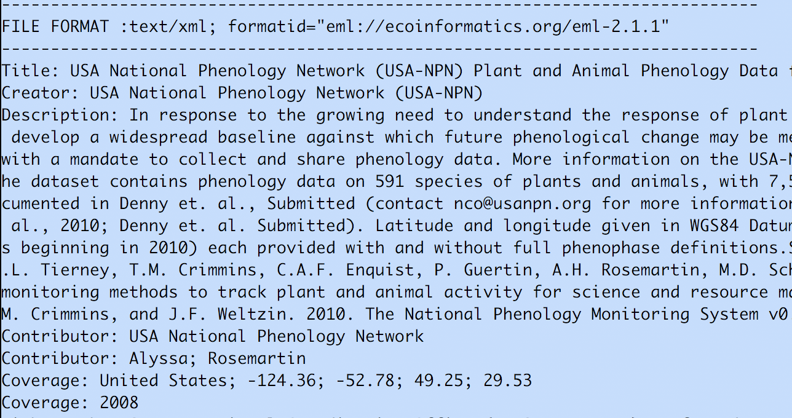


Identification of Science Resources & Tool for Extracting Standard Metadata Properties
Pratik Shrivastava¹, Dave Vieglais² ¹University of Illinois at Urbana-Champaign, ²DataONE
Introduction
Identifying the correct file format is imperative for processing its contents.
Many metadata standards are serialized as XML requires additional details of namespace information for processing.
Packaging data into data packages requires metadata identification and parsing of the files.
A tool for reliable identification makes processing easier.
DataONE Magic file
Gathered a Test corpus for the known DataONE file formats.
Define rules for DataONE file format Identification.
Create Magic files for identifying DataONE file formats
Compile magic files for the libmagic library of the file command.
Tested the magic file using unittest library in python.
# EML (Ecological Metadata Language Format)
0 string <?xml
>&0 regex (eml)-[0-9].[0-9].[0-9]+ formatid="eml://ecoinformatics.org/%s”
# onedcx (DataONE Dublin Core Extended v1.0)
>&0 regex (onedcx/v)[0-9].[0-9]+ formatid="http://ns.dataone.org/metadata/schema/%s"
# ISOTC211 (Geographic MetaData (GMD) Extensible Markup Language)
>&0 regex isotc211
>>&0 regex eng;USA formatid="http://www.isotc211.org/2005/gmd"
Results / Conclusion:
Successful identification of file format using Libmagic and Apache Tika
Easy to add support for new file metadata properties for file extraction using the configuration file.
The output can be exported to JSON, CSV format.
Useful in searching and indexing metadata contents
Aim
Determine the scientific resources using the Linux file command and Apache Tika which are excellent tools for file format identification.
Use Apache Tika for parsing the metadata contents of the resources.
Extraction of standard set of properties from the metadata.
$ file -m dataone.mgc ../examples/eml-211/00_eml-211.xml
../examples/eml-211/00_eml-211.xml: formatid="eml://ecoinformatics.org/eml-2.1.1"
References
http://tika.apache.org
https://github.com/apache/tika
https://github.com/file/file
http://openpreservation.org/blog/2012/08/09/magic-editing-and-creation-primer
https://linux.die.net/man/1/file
https://filemagic.readthedocs.io/en/latest/guide.html
Github
https://github.com/DataONEorg/dataone-tika-parser
https://github.com/DataONEorg/file_identification
Custom File Detector using Tika
Create custom-mimetypes.xml and a jar file for identifying new file format .
The xml supports magic numbers for file Identification.
Tika app with custom-mimtypes.jar is used for file detection.
<mime-type
type="text/xml;formatid=eml://ecoinformatics.org/eml-2.0.0">
<magic priority="60">
<match value="eml://ecoinformatics.org/eml-2.0.0”
type="string” offset="50:1000"/>
</magic>
</mime-type>
<mime-type
type='text/xml;formatid=http://www.isotc211.org/2005/gmd-noaa’>
<magic priority="75">
<match value="gov.noaa.nodc" type="string" offset="50:1000"/>
</magic>
</mime-type>
File Command
File command performs several additional tests for determining the file format instead of using the file extensions.
Uses the format signatures, known as magic numbers for identifying the file format.
The magic directory contains the files, these files consist of the magic numbers. File command uses a compiled binary file containing the magic files.
DataONE Metadata Extraction Tool Using Tika
<mime-type
type="text/xml;formatid=eml://ecoinformatics.org/eml-2.0.0">
<magic priority="60">
<match value="eml://ecoinformatics.org/eml-2.0.0”
type="string” offset="50:1000"/>
</magic>
</mime-type>
<mime-type
type='text/xml;formatid=http://www.isotc211.org/2005/gmd-noaa’>
<magic priority="75">
<match value="gov.noaa.nodc" type="string" offset="50:1000"/>
</magic>
</mime-type>
Apache Tika
It is an open source toolkit for detecting and extracting metadata and contents of the files.
Its ability to detect and parse file formats from over a 1000 different formats makes it a useful tool for search engine indexing, content analysis, translation etc.
The new file types can be detected by creating a custom XML file containing the information.
New parsers can be easily created and integrated into the application for fresh file formats.
A configurable command line tool for extracting standard metadata properties for science resources.
It uses custom detector for identification of the file type.
It is a custom namespace aware parsers for extraction of the metadata content from different file formats.
Uses a configuration file for extracting the metadata properties from a science resource.
Acknowledgments
Supported by NSF under Grant Numbers 0830944 and 1430508.

Slide 3
Introduction
Identifying the correct file format is imperative for processing its contents.
Many metadata standards are serialized as XML requires additional details of namespace information for processing.
Packaging data into data packages requires metadata identification and parsing of the files.
A tool for reliable identification makes it easier.

Slide 4
Aim:
Determine the scientific resources using the Linux file command and Apache Tika which are excellent tools for file format identification.
Use Apache Tika for parsing the metadata contents of the resources.
Extraction of standard set of properties from the metadata.

Slide 5
File Command:
File command performs several additional tests for determining the file format instead of using the file extensions.
It uses the format signatures, known as magic numbers for identifying the file format.
The magic directory contains the files, these files consist of the magic numbers. File command uses a compiled binary file containing the magic files.

Slide 6
Apache Tika:
It is an open source toolkit for detecting and extracting metadata and contents of the files.
Its ability to detect and parse file formats from over a 1000 different formats makes it a useful tool for search engine indexing, content analysis, translation etc.
The new file types can be detected by creating a custom XML file containing the information.
New parsers can be easily created and integrated into the application for fresh file formats.

Slide 7
Method
Create Magic files for identifying DataONE file formats.
Gathered a Test corpus for the known DataONE file formats.
Define rules for DataONE file format Identification.
Compile magic files for the Libmagic library used by the file command.
Create custom-mimetypes.xml file for identification using Tika.
It uses magic numbers as well for identification.
Tika performs detection of the file type and based on that uses parsers for metadata extraction.
Created custom namespace aware parsers for extraction of the metadata content from different file formats.
Created a command line application based on Tika, which uses a configuration file for extracting standard set of metadata fields based on the file type.
It takes file as input and identifies the file format and extract metadata properties.

Slide 8
Results
Successful identification of the file types using Libmagic and Apache Tika.
Used Python for unittest and the latest file version will contain the changes.
Configurable command line application for detecting file types.
Configurable tool for extracting desired set of metadata fields from the input file type.
Configuration file helps in addition of new file formats and the respective metadata fields for extraction.

