Slide 1

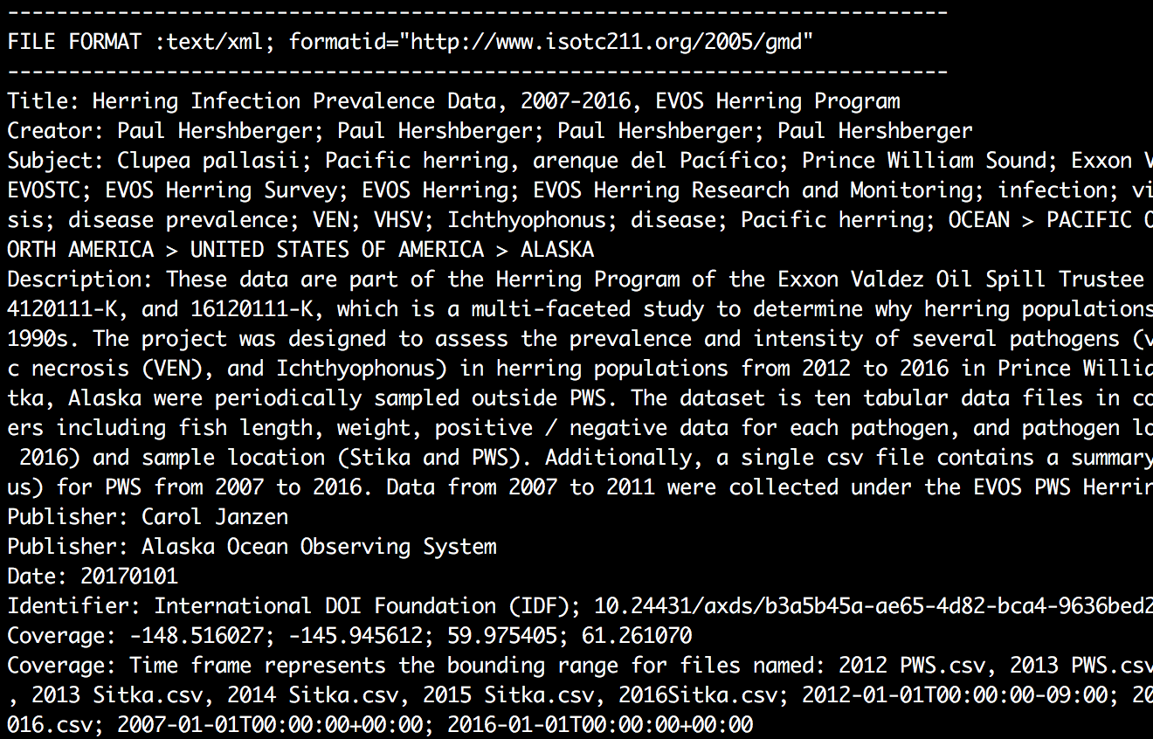
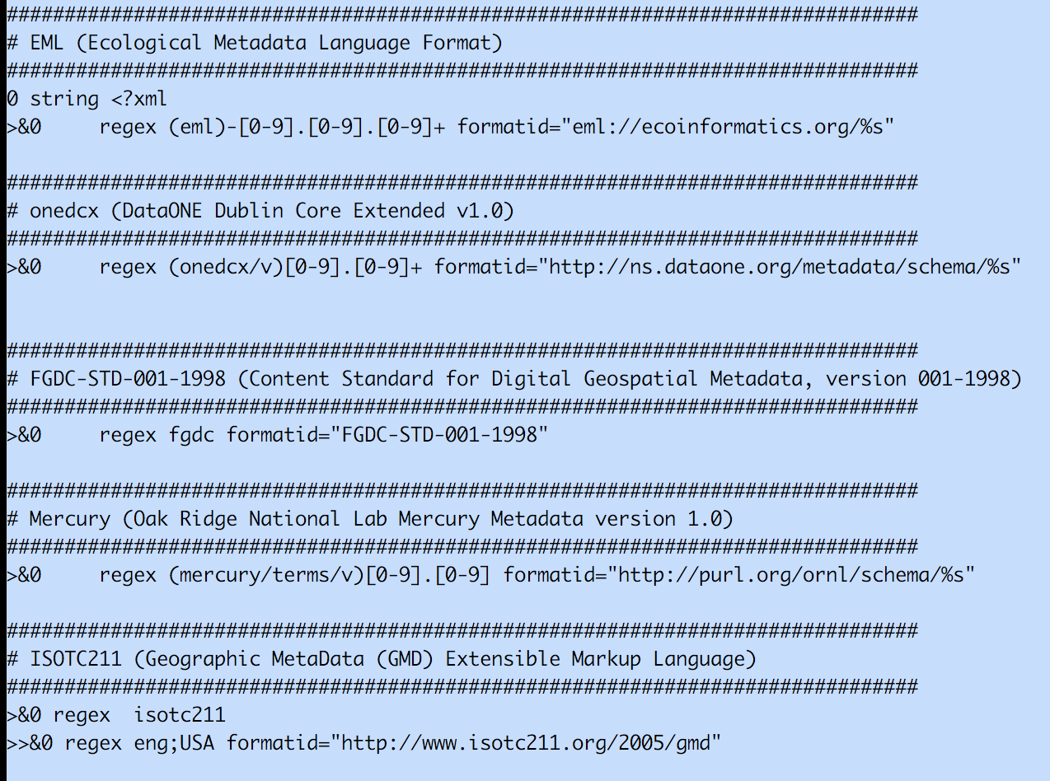
Identification of Science Resources & Extraction of Standard Metadata Properties
Pratik Shrivastava¹, Dave Vieglais² ¹University of Illinois at Urbana-Champaign, University of New Mexico
Introduction
Identifying the correct file format is imperative for processing its contents.
Many metadata standards are serialized as XML requires additional details of namespace information for processing.
Packaging data into data packages requires metadata identification and parsing of the files.
A tool for reliable identification makes it easier.
Apache Tika
It is an open source toolkit for detecting and extracting metadata and contents of the files.
Its ability to detect and parse file formats from over a 1000 different formats makes it a useful tool for search engine indexing, content analysis, translation etc.
The new file types can be detected by creating a custom XML file containing the information.
New parsers can be easily created and integrated into the application for fresh file formats.
Apache Tika Detector & Parser
Create custom-mimetypes.xml file for identification using Tika.
It uses magic numbers as well for identification.
Tika performs detection of the file type and based on that uses parsers for metadata extraction.
Created custom namespace aware parsers for extraction of the metadata content from different file formats.
Created a command line application based on Tika, which uses a configuration file for extracting standard set of metadata fields based on the file type.
It takes file as input and identifies the file format and extract metadata properties.
Aim
Determine the scientific resources using the Linux file command and Apache Tika which are excellent tools for file format identification.
Use Apache Tika for parsing the metadata contents of the resources.
Extraction of standard set of properties from the metadata.
Creating Libmagic file
Create Magic files for identifying DataONE file formats.
Gathered a Test corpus for the known DataONE file formats.
Define rules for DataONE file format Identification.
Compile magic files for the Libmagic library used by the file command.
File Command
File command performs several additional tests for determining the file format instead of using the file extensions.
Uses the format signatures, known as magic numbers for identifying the file format.
The magic directory contains the files, these files consist of the magic numbers. File command uses a compiled binary file containing the magic files.
References
We have created this template with scientific researchers in mind and with the help of feedback we have received. We encourage any comments or suggestions so that we can continue to update and improve this template. Visit this page to make a suggestion.
Acknowledgments
Check to make sure you’ve acknowledged partner and funding agencies, either with text or with their logos.

Slide 2
Introduction
Identifying the correct file format is imperative for processing its contents.
Many metadata standards are serialized as XML requires additional details of namespace information for processing.
Packaging data into data packages requires metadata identification and parsing of the files.
A tool for reliable identification makes it easier.

Slide 3
Aim:
Determine the scientific resources using the Linux file command and Apache Tika which are excellent tools for file format identification.
Use Apache Tika for parsing the metadata contents of the resources.
Extraction of standard set of properties from the metadata.

Slide 4
File Command:
File command performs several additional tests for determining the file format instead of using the file extensions.
It uses the format signatures, known as magic numbers for identifying the file format.
The magic directory contains the files, these files consist of the magic numbers. File command uses a compiled binary file containing the magic files.

Slide 5
Apache Tika:
It is an open source toolkit for detecting and extracting metadata and contents of the files.
Its ability to detect and parse file formats from over a 1000 different formats makes it a useful tool for search engine indexing, content analysis, translation etc.
The new file types can be detected by creating a custom XML file containing the information.
New parsers can be easily created and integrated into the application for fresh file formats.

Slide 6
Method
Create Magic files for identifying DataONE file formats.
Gathered a Test corpus for the known DataONE file formats.
Define rules for DataONE file format Identification.
Compile magic files for the Libmagic library used by the file command.
Create custom-mimetypes.xml file for identification using Tika.
It uses magic numbers as well for identification.
Tika performs detection of the file type and based on that uses parsers for metadata extraction.
Created custom namespace aware parsers for extraction of the metadata content from different file formats.
Created a command line application based on Tika, which uses a configuration file for extracting standard set of metadata fields based on the file type.
It takes file as input and identifies the file format and extract metadata properties.

Slide 7
Results
Successful identification of the file types using Libmagic and Apache Tika.
Used Python for unittest and the latest file version will contain the changes.
Configurable command line application for detecting file types.
Configurable tool for extracting desired set of metadata fields from the input file type.
Configuration file helps in addition of new file formats and the respective metadata fields for extraction.

