Slide 1
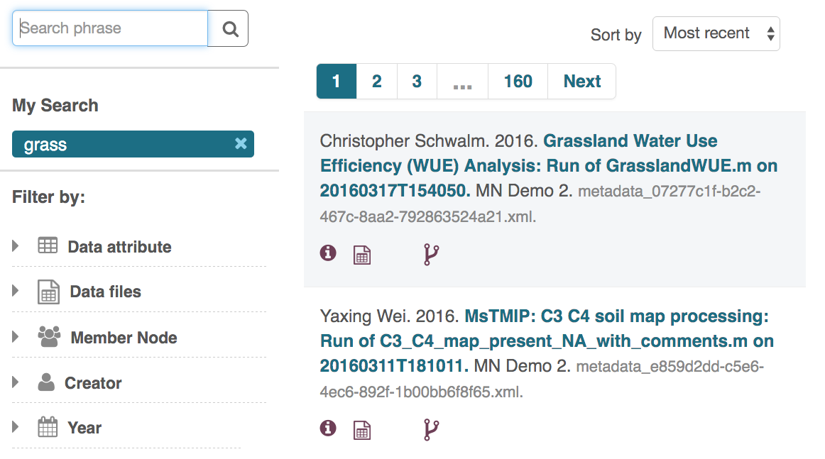
Notes:
In the DataONE Search, we can search for ‘grass’, and two data packages show up. The Yaxing Wei (Alice) soil map processing workflow and the Christopher Schwalm (Bob) analysis workflows both show that they have provenance information associated with the Data Packages (via the icon in the search record). We next will choose the Wei’s Data Package to see the details. This can be seen at https://search-sandbox-2.test.dataone.org.

Slide 2
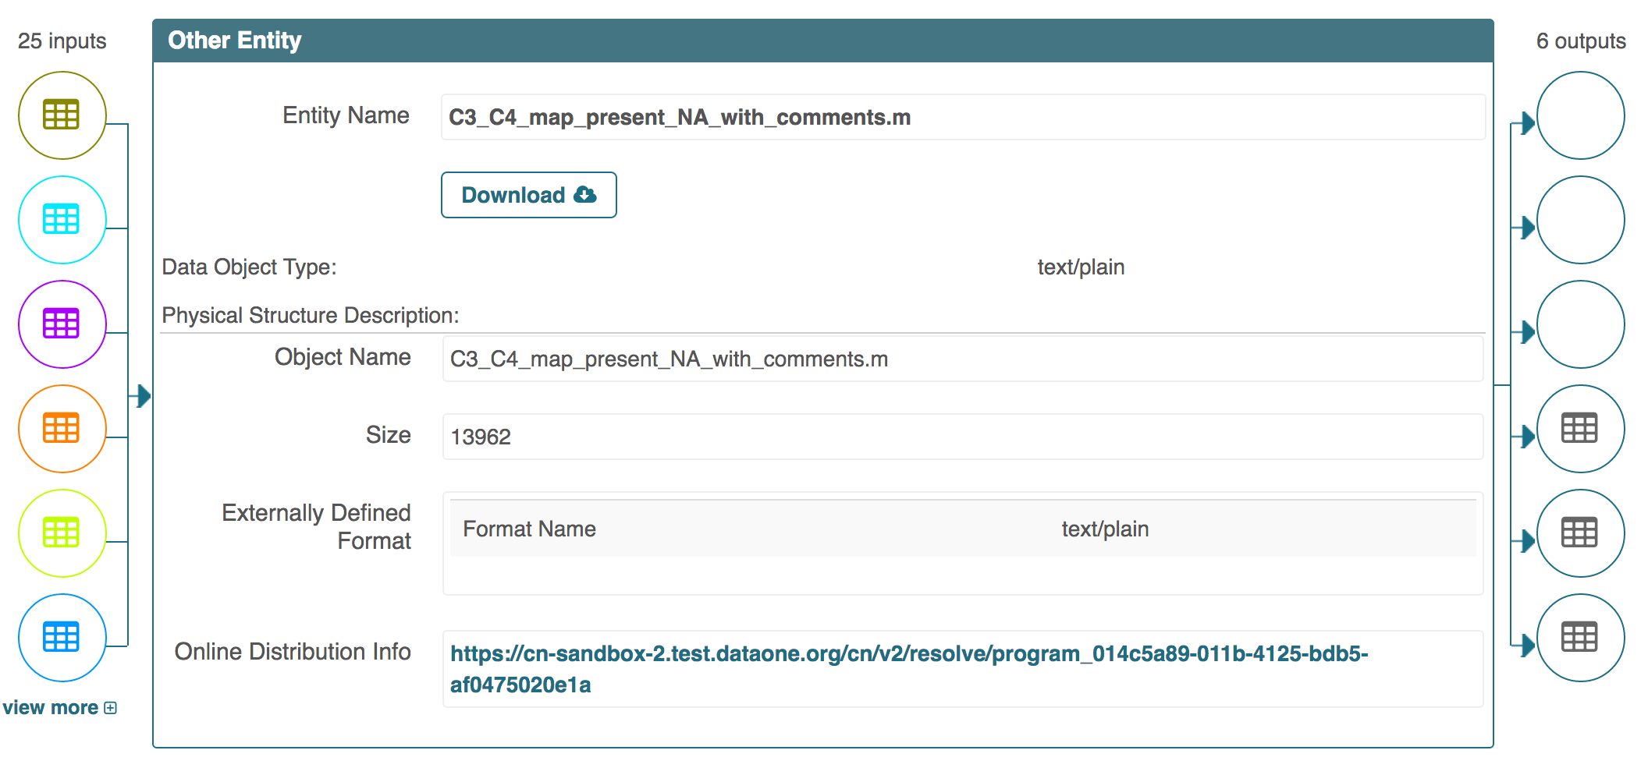
Notes:
Viewing the Wei soil processing workflow we see on the left that the Matlab script (C3_C4_map_present_with_comments.m) has 25 inputs. It also has 6 outputs on the right. The top three outputs are the YesWorkflow diagrams (dataflow, processflow, combined). The bottom three are the NetCDF data files that represent three different world map grids of percentage of grass types (C3 grass fraction, C4 grass fraction, and total grass fraction). The script can be downloaded with the Download button in the center. This can be accessed at https://search-sandbox-2.test.dataone.org/#view/metadata_e859d2dd-c5e6-4ec6-892f-1b00bb6f8f65.xml. Bertram, if you want to show the YesWorkflow diagram (combined) for this run showing how monthly air and precipitation values are used as the inputs, the combined diagram can be accessed from this page, or directly from https://cn-sandbox-2.test.dataone.org/cn/v2/resolve/d87e1a6a-1a78-4f96-bba8-cb74ac2b1efb

Slide 3
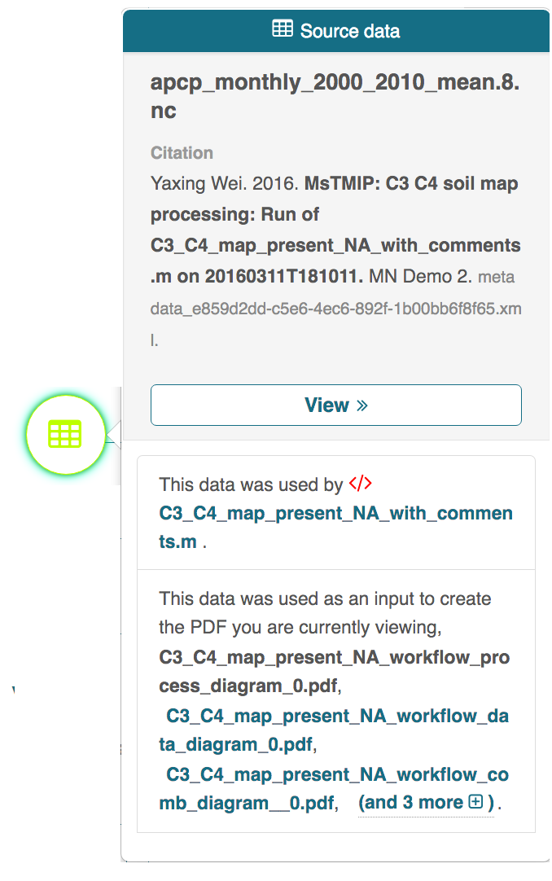
Notes:
Provenance details for any input or output in the provenance graph can be viewed by clicking on the icon. We provide human language descriptions of how data were used or generated via the script, and provide navigation.

Slide 4
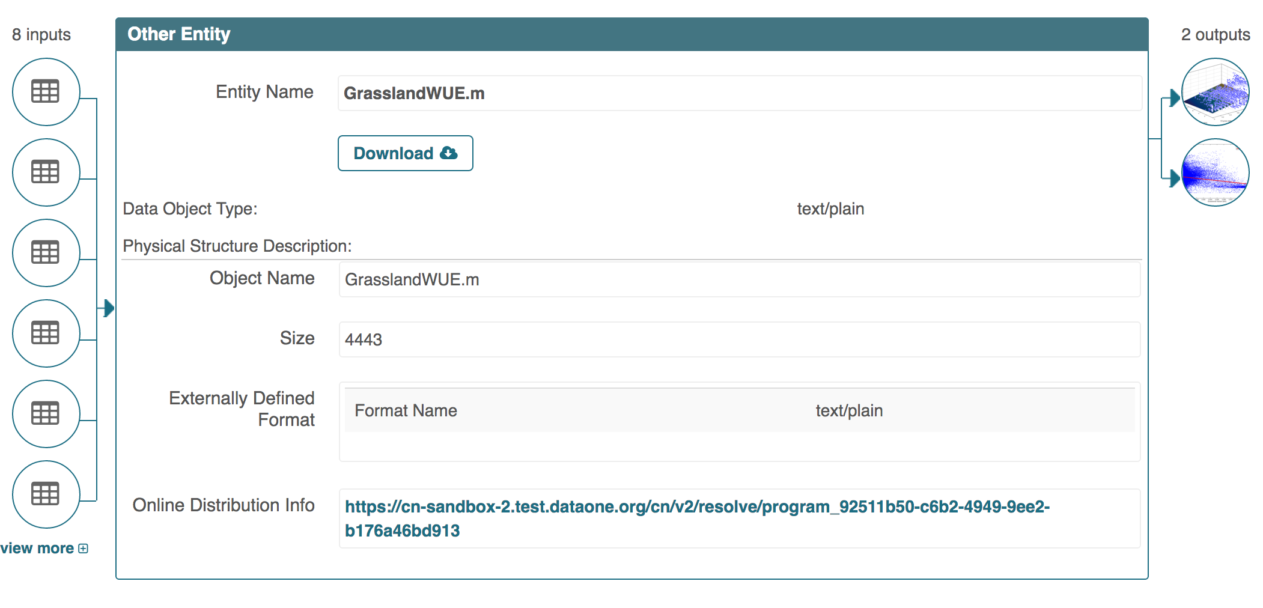
Notes:
Viewing the details of the Schwalm water use efficiency analysis script, we see that it takes 8 inputs, and produces 2 visualizations. By viewing the details for each input, we can see that some of them are the outputs produced by Yaxing Wei. The two outputs are viewable on this Data Package page (https://search-sandbox-2.test.dataone.org/#view/metadata_07277c1f-b2c2-467c-8aa2-792863524a21.xml ), or directly from https://cn-sandbox-2.test.dataone.org/cn/v2/resolve/66c8a315-ea56-4b72-bbd2-261f6777702f and https://cn-sandbox-2.test.dataone.org/cn/v2/resolve/3ecc1f59-eb7d-4a33-b7a4-bf6dc8560d54.

Slide 5
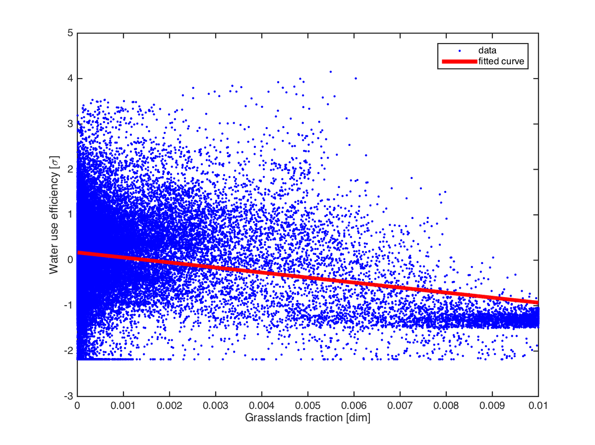
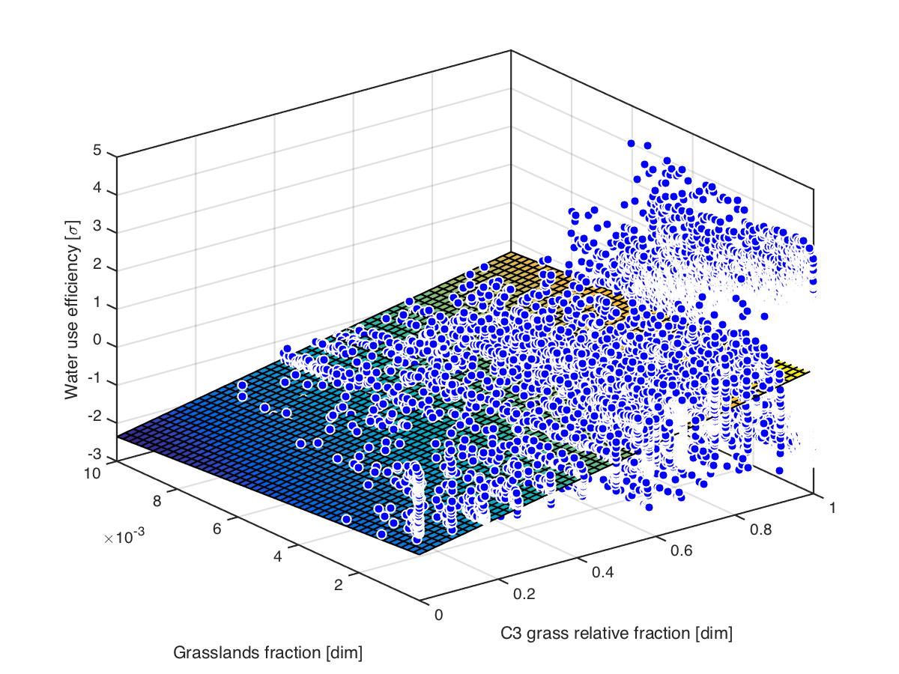
Notes:
The final two visualizations produced by Schwalm in the water use efficiency analysis.

