Slide 1

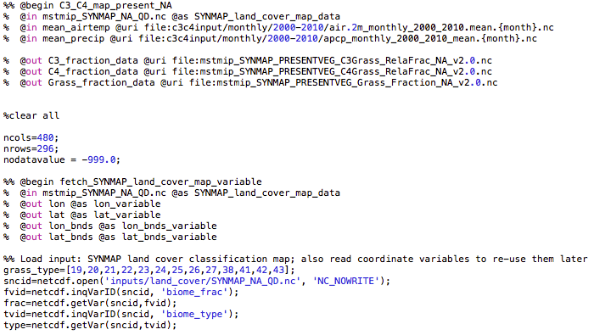
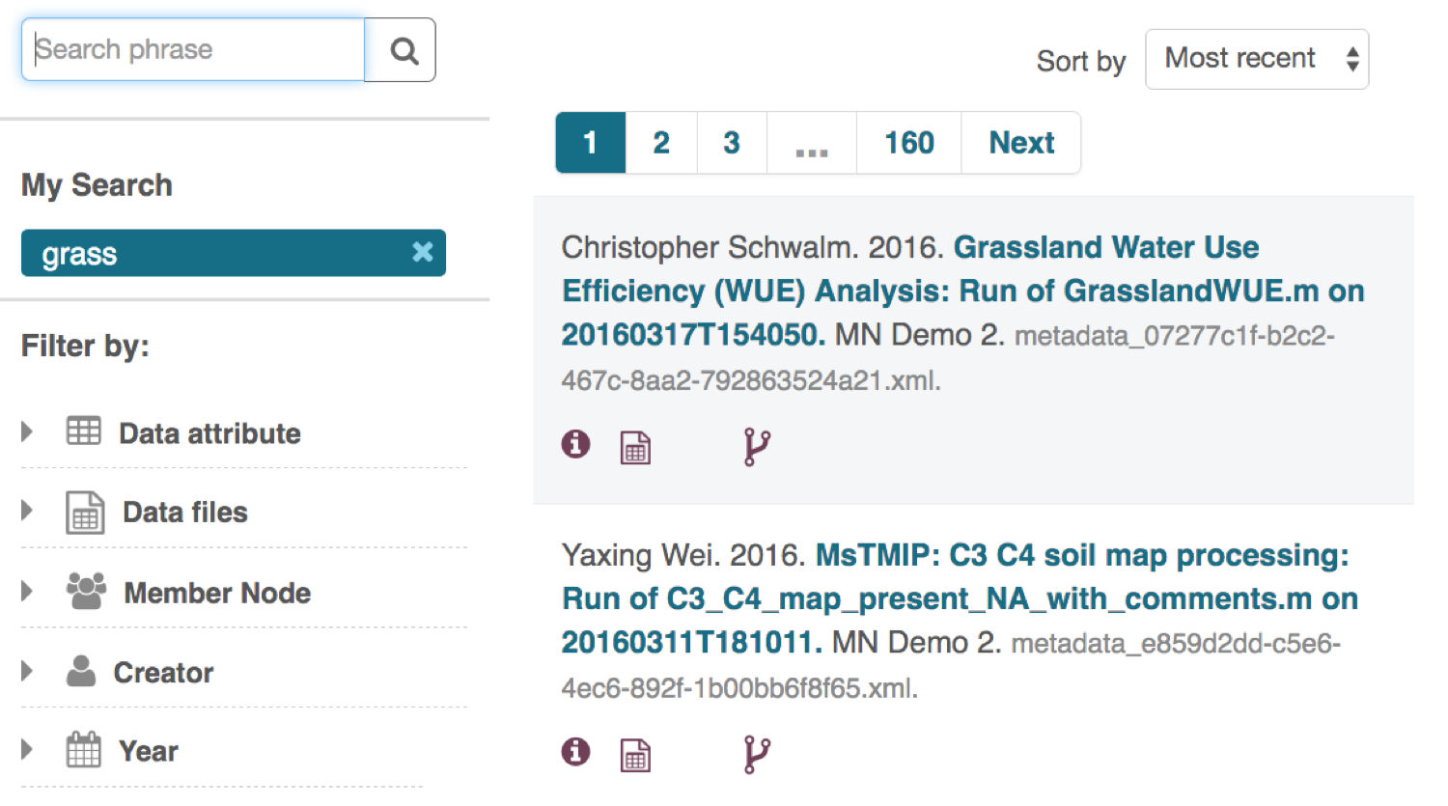
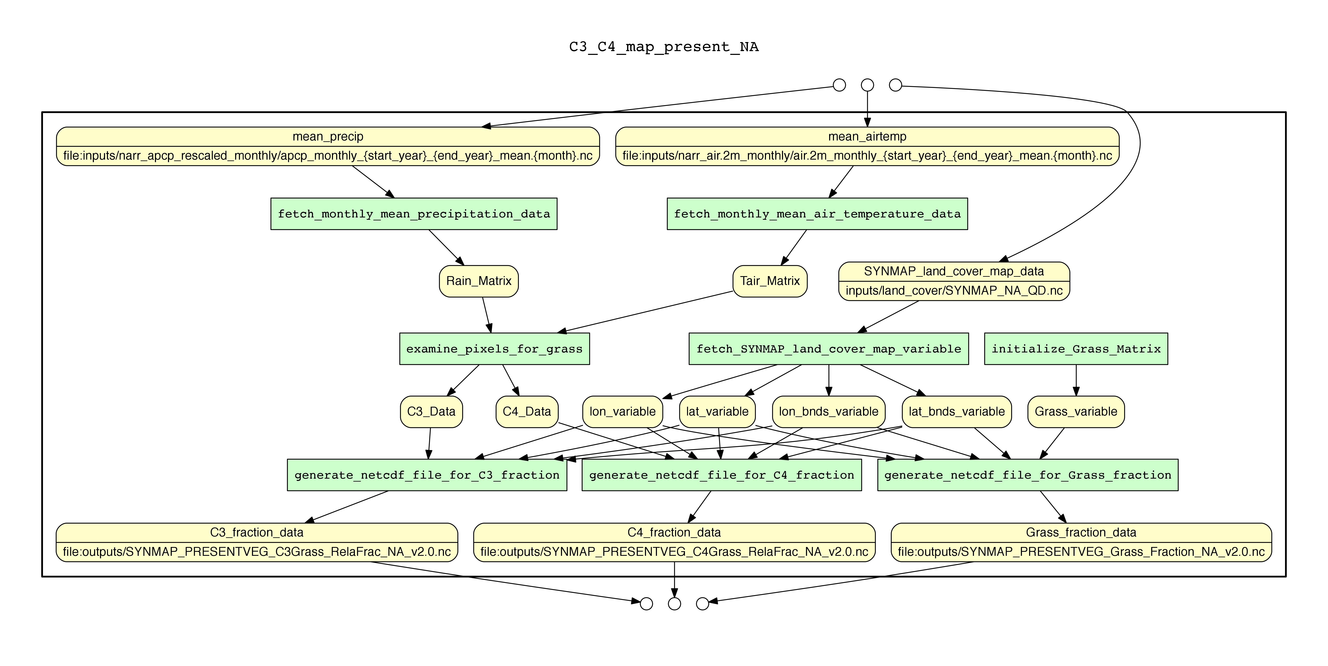
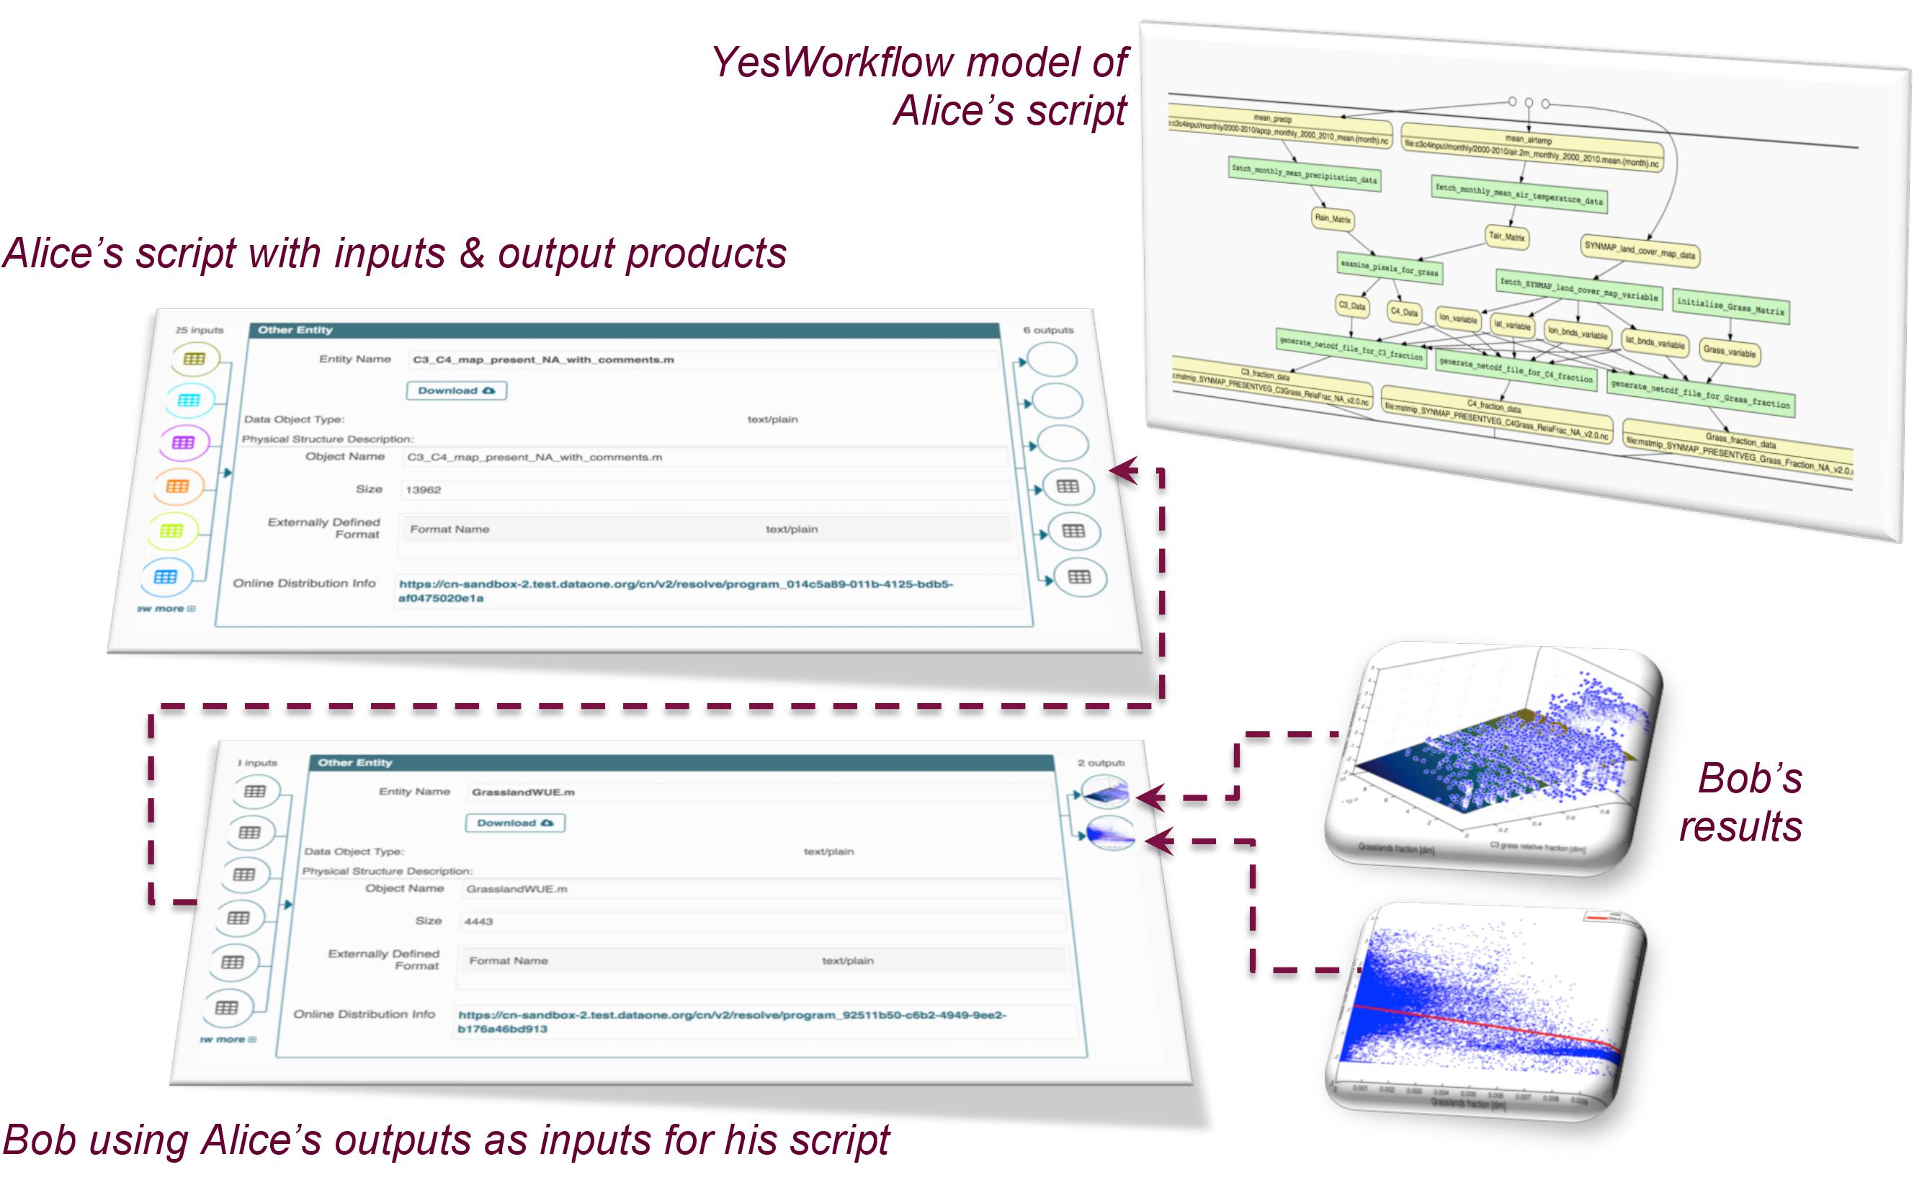






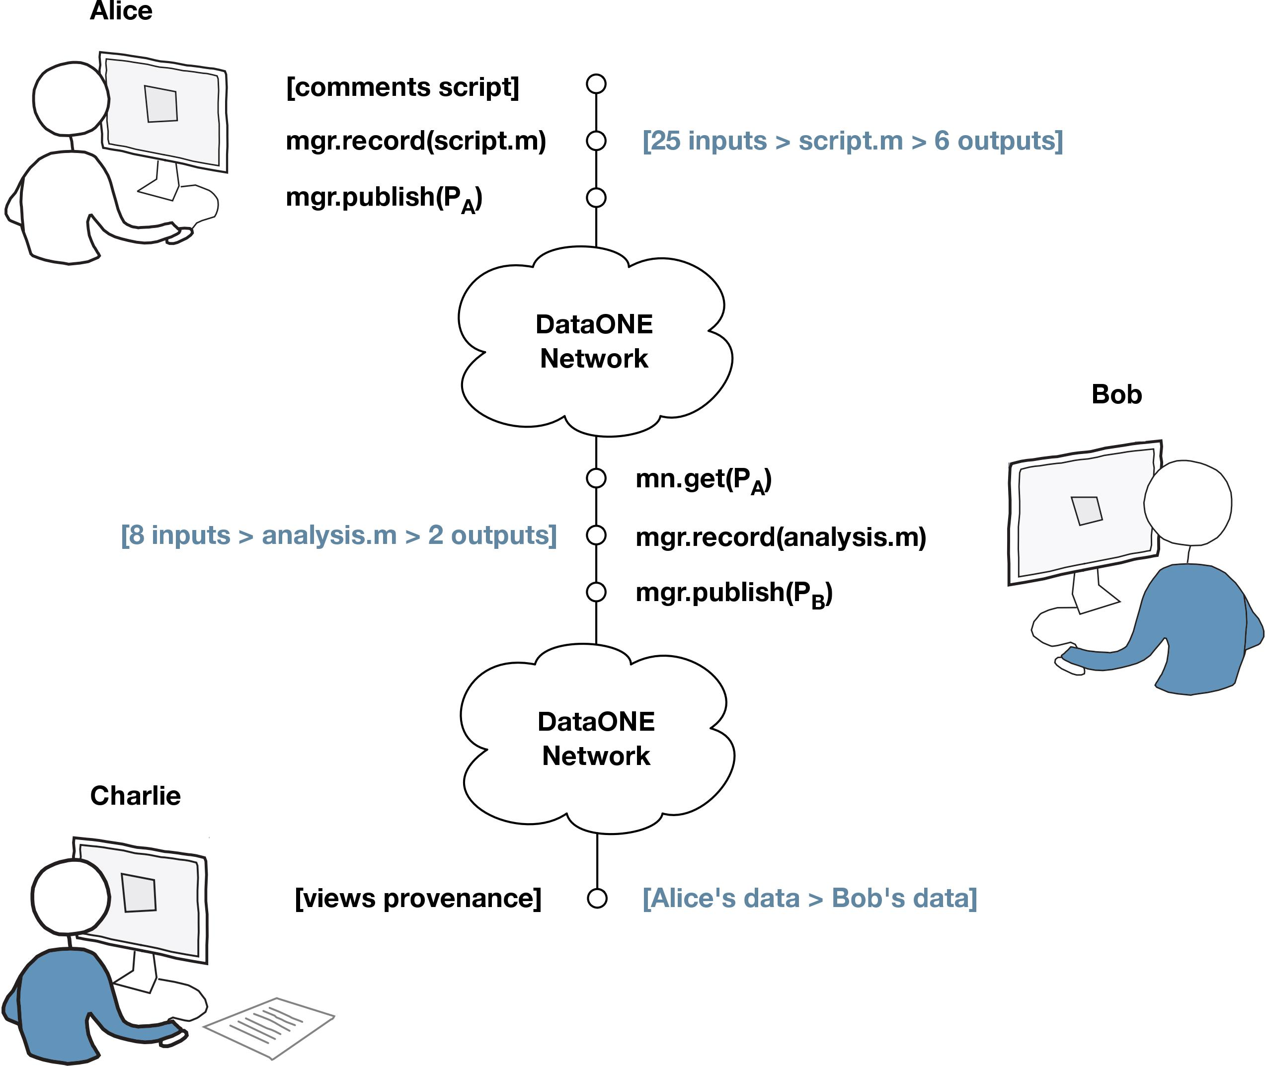
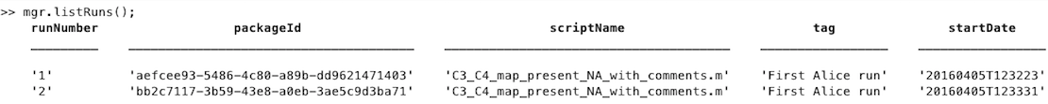
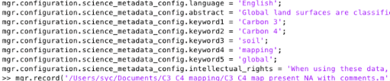

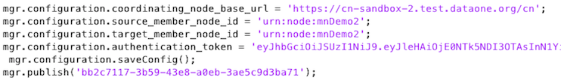
DataONE: A Data Federation with Provenance Support
Yang Cao¹, Christopher Jones², Víctor Cuevas-Vicenttín³, Matthew B. Jones², Bertram Ludäscher¹, Timothy McPhillips¹,
Paolo Missier⁴, Christopher Schwalm⁵, Peter Slaughter², Dave Vieglais⁶, Lauren Walker², Yaxing Wei⁷
¹University of Illinois, Urbana-Champaign, ²National Center for Ecological Analysis and Synthesis, UCSB, ³Universidad Popular Autónoma del Estado de Puebla, Mexico, ⁴School of Computing Science,
Newcastle University, UK, ⁵Woods Hole Research Center, Falmouth, MA, ⁶University of Kansas, Lawrence, ⁷Environmental Sciences Division, Oak Ridge National Lab, TN
Introduction
Scientific workflow provenance can help compuatinal scientists better understand and share their work with others while maintaining attribution. Prospective provenance describes the data transformation process or workflow; retrospective provenance describes the processing history and data derivations of a workflow.
DataONE (Data Observation Network for Earth) is a federated data network for Earth observational data. Its infrastructure consists of: Member Nodes, Coordinating Nodes, and an Investigator Toolkit. DataONE Search is a web application that lets users seamlessly and efficiently discover publicly accessible data packages within the DataONE federated network of Member Node repositories.
DataONE enables provenance-based browsing. We present provenance and search features with an example involving three scientists who interact through a Member Node. DataONE provenance systems enable reproducible research and facilitate proper attribution of scientific results transitively across generations of derived data products.
Alice’s Data Generation
DataONE Run Managers capture retrospective provenance from R and Matlab scripts, i.e., they:
• monitor file I/O events during a script’s execution
• determine provenance relationships between files and an execution
• allow users to search, archive, and publish provenance data package
YesWorkflow (YW) is a script annotation tool for prospective provenance, which:
  enables users to mark up scripts with YesWorkflow annotations to reveal the computational steps and dataflows hidden in the scripts
  provides query capabilities for the prospective and retrospective provenance of the scripts
“Alice” annotates her script using YW. After running it, result files, script, prospective provenance, and retrospective provenance, represented in the ProvONE provenance model, are bundled into an OAI-ORE compliant data package and uploaded to the DataONE network.
Bob’s Data Reuse
“Bob” discovers Alice’s package and uses her data in his own analysis. In order to find Alice’s published data package, Bob follows these steps:
Through a keyword search for “grass” data he finds Alice’s data package.
He uses the data-Ids of Alice’s outputs as input for his script, using MN.get(Id) for access.
He records retrospective script provenance using the MATLAB Run Manager.
He publishes a new data package with his results and their provenance.
Charlie’s Visual Data Navigation
Charlie also searches for “grass” data and finds Bob’s and Alice’s data packages along with their provenance information. He also notes that Bob’s inputs where obtained from Alice’s outputs.
Demo Site: http://dataoneorg.github.io/provweek2016-demo/
ProvONE provenance statements in the Alice’s data package
@prefix rdf: <http://www.w3.org/1999/02/22-rdf-syntax-ns#> .
@prefix ns1: <http://purl.dataone.org/provone/2015/01/15/ontology#> .
@prefix foaf: <http://xmlns.com/foaf/0.1/> .
@prefix owl: <http://www.w3.org/2002/07/owl#> .
@prefix dc: <http://purl.org/dc/elements/1.1/> .
@prefix ore: <http://www.openarchives.org/ore/terms/> .
@prefix dcterms: <http://purl.org/dc/terms/> .
@prefix ns2: <http://www.w3.org/ns/prov#> .
@prefix ns3: <http://purl.org/spar/cito/> .
<https://cn-sandbox-2.test.dataone.org/cn/v2/resolve/SYNMAP_PRESENTVEG_Grass_Fraction_NA_v2.0.nc>
ore:isAggregatedBy "https://cn-sandbox-2.test.dataone.org/cn/v1/resolve/resourceMap_e859d2dd-c5e6-4ec6-892f-1
b00bb6f8f65.rdf#aggregation" ;
ns2:wasDerivedFrom <https://cn-sandbox-2.test.dataone.org/cn/v2/resolve/air.2m_monthly_2000_2010_mean.1.nc> ;
a ns1:Data ;
a ore:AggregatedResource ;
ns2:wasGeneratedBy <https://cn-sandbox-2.test.dataone.org/cn/v2/resolve/execution_e859d2dd-c5e6-4ec6-892f-1
b00bb6f8f65> ;
ns3:isDocumentedBy <https://cn-sandbox-2.test.dataone.org/cn/v2/resolve/metadata_e859d2dd-c5e6-4ec6-892f-1
b00bb6f8f65.xml> ;
dcterms:identifier "SYNMAP_PRESENTVEG_Grass_Fraction_NA_v2.0.nc"ˆˆ<http://www.w3.org/2001/XMLSchema#string> .
Conclusions and Future Work
DataONE support for data discovery now includes provenance capabilities.
Future work includes:
(1) extensions to the Run Managers to support dependencies between multiple runs from one or more scripts by a single user (local operation);
(2) support for additional I/O functions; and
(3) finer grained provenance capture, e.g., via the noWorkflow tool (cf. “YesWorfklow & noWorkflow Demonstration, IPAW & TaPP 2016).
YesWorkflow annotations for prospective provenance
DataONE Search result for keyword “grass”. The fork icon indicate data packages having embedded provenance.
DataONE Provenance
Phase II Goal: Facilitate reproducible science
  track data derivation history
  track data inputs and outputs of analyses
  track analysis and model executions
  preserve and document software
New DataONE Provenance Tools
  provenance indexing and search
  web user interface for browsing provenance
  R tool for generating provenance
  Matlab tool for generating provenance
  Provenance Use Case
Acknowledgments. Supported by NSF awards ACI-1430508 and NSF ABI-1262458.
Create a runManager object
Call listRuns() function for provenance record display
Call record() function for retrospective provenance
Call publish() function for data sharing
Charlie’s view on the DataONE demo site: (1) A YesWorkflow model for Alice’ soil processing script; (2) Data lineage from Bob’s results back through his script to Alice’s data package; (3) Two visualizations produced by Bob’s water use efficiency analysis script.

