Slide 1
DMUX And its Applications
Presented by:
Hamza Mehmood
Jibran Naeem

Slide 2
Demultiplexer:
Demultiplexer means one to many. A demultiplexer is a circuit with one input and many output. By applying control signal, we can steer any input to the output.
A Demultiplexer is a combinational logic circuit that receives the information on a single input line and transmits the same information over one of ‘n’ possible output lines.

Slide 3
Demultiplexing:
Demultiplexing is the process of converting a signal containing multiple analog or digital signals backs into the original and separate signals.

Slide 4
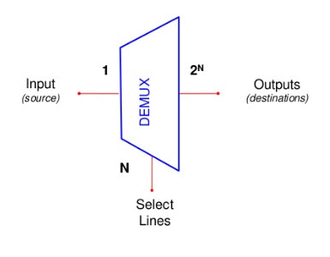
Cont.
The process of getting information from one input and transmitting the same over one of many outputs is called Demultiplexing.

Slide 5
Introduction:
The action or operation of a Demultiplexer is exactly the opposite to that of a Multiplexer. As an inverse to the MUX, Demux is a one-to-many circuit. With the use of a Demultiplexer, data from one input can be passed to one of the many output data lines.
Demultiplexers are mainly used in Boolean function generators and decoder circuits. Different input/output configuration demultiplexers are available in the form of single integrated circuits (ICs).
Also, there is a facility of cascading two or more DEMUX circuits, to generate multiple output demultiplexers.

Slide 6
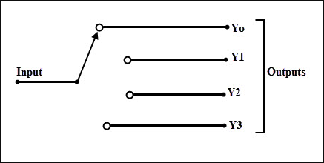
Selection lines:
In order to select a particular output, we have to use a set of Select Lines and the bit combinations of these select lines control the selection of specific output line to be connected to the input at a given instant. The below figure illustrates the basic idea of demultiplexer, in which the switching of the input to any one of the four outputs is possible at a given instant.

Slide 7
Construction:
It consists of 1 input line, ‘n’ output lines and ‘m’ select lines. In this, m select lines are required to produce 2^{m} possible output lines (consider 2^{m} = n). For example, a 1-to-4 demultiplexer requires 2 (2² = 4) select lines to control the 4 output lines.

Slide 8
Multiplexers VS. Demultiplexers:
If Multiplexers are called as Data Selectors, then Demultiplexers are called as Data Distributors, since they transmit the same data which is received at the input to different destinations.
Thus, a demultiplexer is a 1-to-N device, where as the multiplexer is an N-to-1 device.

Slide 9
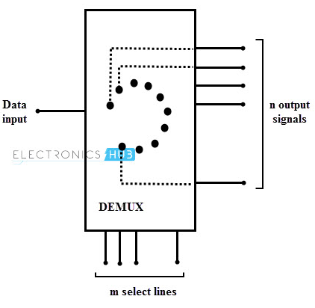
Block diagram of DeMux:

Slide 10
Cont…
There are several types of demultiplexers based on the output configurations such as 1:2, 1:4, 1:8 and 1:16.
These are available in different IC packages and some of the most commonly used demultiplexer ICs includes 74139 (dual 1:4 DEMUX), 74138 (1:8 DEMUX), 74237 (1:8 DEMUX with Address Latches), 74154 (1:16 DEMUX), 74159 (1:16 DEMUX open collector type), etc.
NOTE: The Demultiplexer ICs are also called as Decoder ICs. For example, 74159 is a 4-line to 16-line Decoder IC.

Slide 11
1-to-2 Demultiplexer:
A 1-to-2 demultiplexer consists of one input line, two output lines and one select line. The signal on the select line helps to switch the input to one of the two outputs. The figure below shows the block diagram of a 1-to-2 demultiplexer with additional enable input.

Slide 12
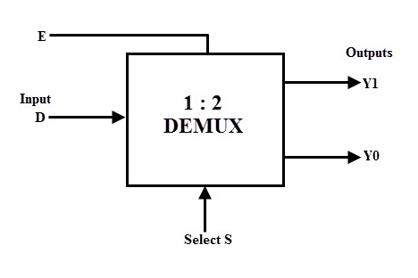
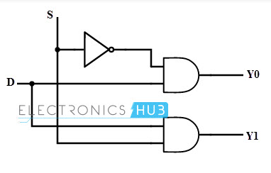
1*2 Demux:
S | D | Y1 | Y0
0 | 0 | 0 | 0
0 | 1 | 0 | 1
1 | 0 | 0 | 0
1 | 1 | 1 | 0

Slide 13
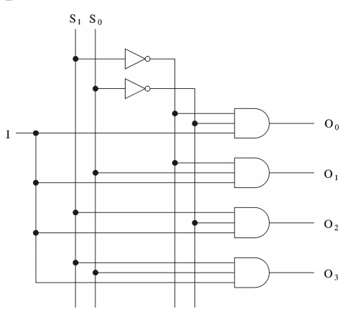
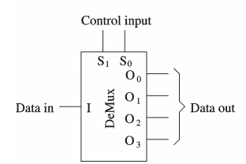
1*4 Demux:

Slide 14
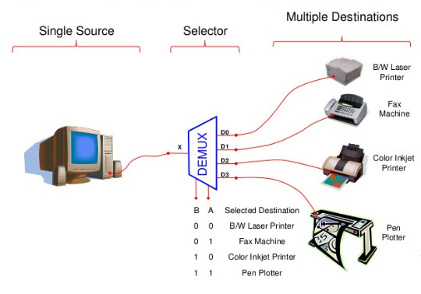
Applications of Demux:
A demultiplexer is used to connect a single source to multiple destination.

Slide 15
Communication System:
Communication system use multiplexer to carry multiple data like audio, video and other form of data using a single line for transmission.
This process make the transmission easier. The demultiplexer receive the output signals of the multiplexer and converts them back to the original form of the data at the receiving end. The multiplexer and demultiplexer work together to carry out the process of transmission and reception of data in communication system.

Slide 16
Conclusion:
A DEMULTIPLEXER (DEMUX) basically reverses the multiplexing function.
It takes data from one line and distributes them to a given number of output lines. For this reason, the demultiplexers is also known as a data distributor.
A multiplexer takes several inputs and transmits one of them to the output.
A demultiplexer (DEMUX) performs the reverse operation ; it takes a single input and distributes it over several outputs.

Slide 17
THANK YOU!!

