Slide 1
Object Oriented Programming Lecture # 9

Slide 2
Topics to be covered today
Inheritance (IS-A relationship)
Aggregation (HAS-A relationship)

Slide 3
Inheritance
One of the pillars of OPPs(Object Oriented programming system).
a mechanism in which one object acquires all the properties and behaviors of parent object
The idea behind inheritance in java is that you can create new classes that are built upon existing classes
When you inherit from an existing class, you can reuse methods and fields of parent class, and you can add new methods and fields also.
Inheritance represents the IS-A relationship known as parent-child relationship.

Slide 4
Why use inheritance in java
For Method Overriding
so runtime polymorphism can be achieved
For Code Reusability.

Slide 5
Terms used in Inheritance
Class
Sub Class/Child Class
Subclass is a class which inherits the other class. It is also called a derived class, extended class, or child class.
Super Class/Parent Class:
Superclass is the class from where a subclass inherits the features. It is also called a base class or a parent class.
Reusability:
a mechanism which facilitates to reuse the fields and methods of the existing class when create a new class.
Notes:
You can use the same fields and methods already defined in previous class.

Slide 6
Syntax of Java Inheritance
Class super {
…………
…………
}
class Sub extends Super {
……......
.…….....
}
extends is the keyword used to inherit the properties of a class
meaning of "extends" is to increase the functionality.

Slide 7
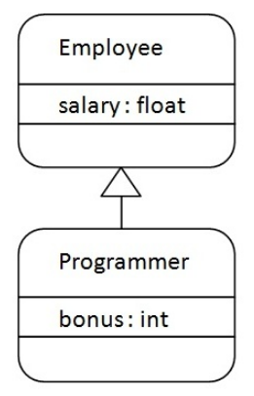
IS-A Relationship
Superclass
Subclass
Programmer IS-A Employee
instanceof Operator???

Slide 8
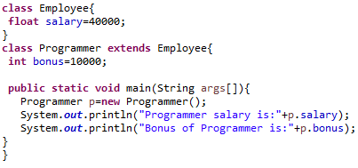
Example
Save as Programmer.java

Slide 9
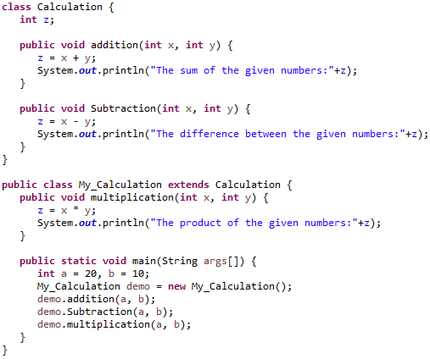
Example 2

Slide 10
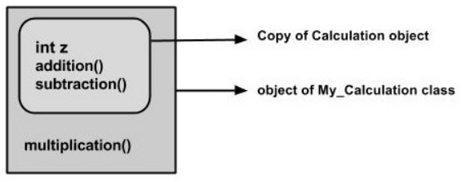
InnerView
when an object to My_Calculation class is created, a copy of the contents of the superclass is made within it. That is why, using the object of the subclass you can access the members of a superclass

Slide 11
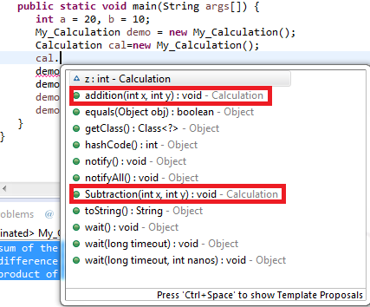
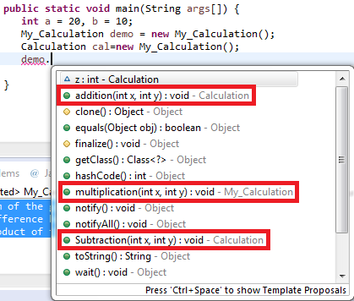
Superclass reference variable
The Superclass reference variable can hold the subclass object but using that variable you can access only the members of the superclass
So, it is recommended to always create reference variable to the subclass, to access members of both classes.

Slide 12
Note:
A subclass inherits all the members (fields, methods, and nested classes) from its superclass.
Constructors are not members, so they are not inherited by subclasses
The constructor of the superclass can be invoked from the subclass using super keyword.

Slide 13
The super keyword
similar to this keyword
a reference variable which is used to refer immediate parent class object
Usage: super can be used to
refer immediate parent class instance variable.
invoke immediate parent class method.
invoke immediate parent class constructor.

Slide 14
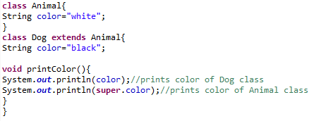

1) to refer immediate parent class instance variable.

Slide 15
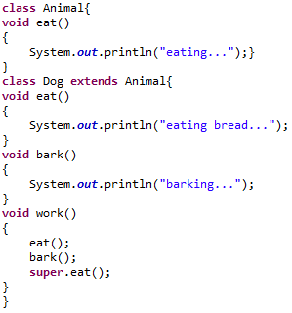

2) to invoke parent class method

Slide 16
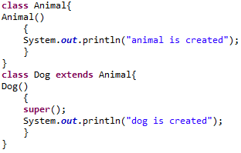

3) to invoke parent class constructor

Slide 17
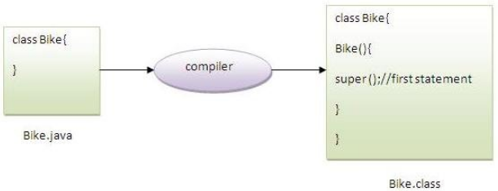
Note:
super() is added in each class constructor automatically by compiler if there is no super() or this().
default constructor is provided by compiler automatically if there is no constructor. But, it also adds super() as the first statement

Slide 18
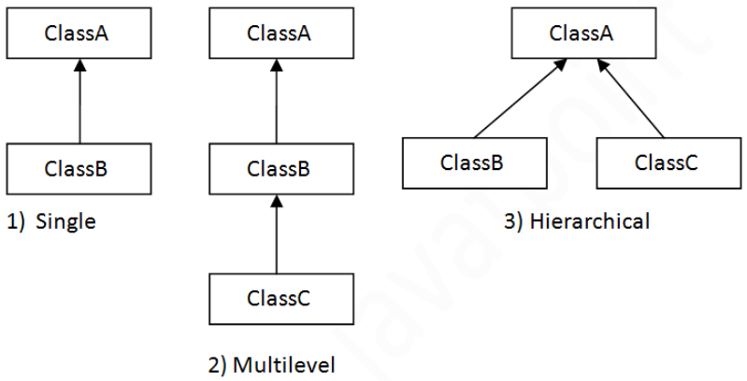
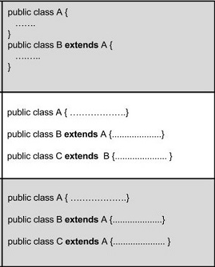
Types of inheritance in java
On the basis of class, there can be three types of inheritance in java: single, multilevel and hierarchical.

Slide 19
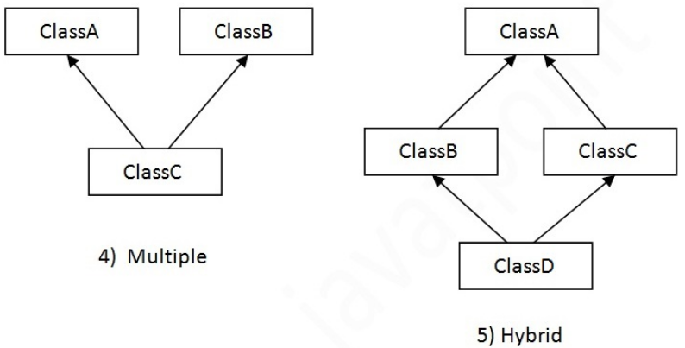
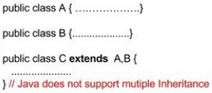
Multiple Inheritance
When a class extends multiple classes i.e. known as multiple inheritance
multiple and hybrid inheritance is supported through interface only

Slide 20
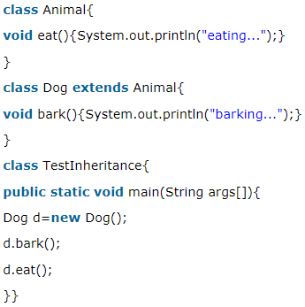
Single Inheritance Example
Notes:
File: TestInheritance.java

Slide 21
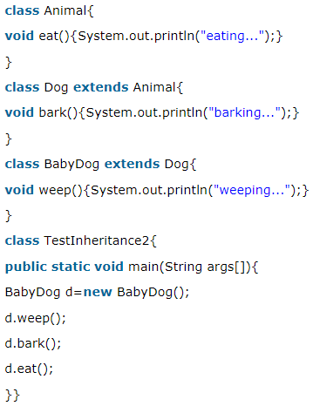
Multilevel Inheritance Example

Slide 22
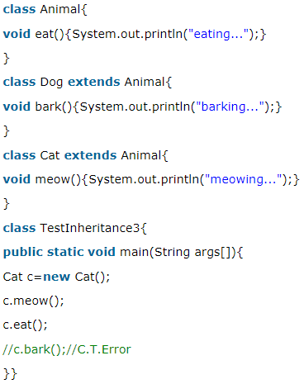
Hierarchical Inheritance Example

Slide 23
Q) Why multiple inheritance is not supported in java?

Slide 24
Why multiple inheritance is not supported in java?
To reduce the complexity and simplify the language, multiple inheritance is not supported in java.
Scenario:
Suppose there are three classes A, B and C.
The C class inherits A and B.
If A and B classes have same method and you call it from child class object, there will be ambiguity to call method of A or B class.
Since compile time errors are better than runtime errors, java renders compile time error if you inherit 2 classes whether methods are same or not

Slide 25
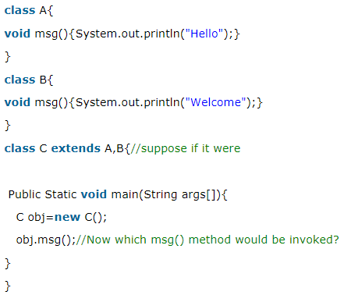
Example:

Slide 26
Aggregation in Java
HAS-A relationship
If a class has an entity reference, it is known as Aggregation
Why use Aggregation?
For Code Reusability.
Code reusability is also best achieved by aggregation when there is no is-a relationship.
Inheritance should be used only if the relationship is-a is maintained throughout the lifetime of the objects involved; otherwise, aggregation is the best choice

Slide 27
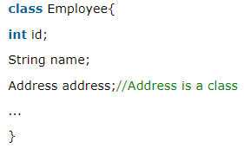
HAS-A relationship(Example)
Employee object contains many information such as id, name, email ID etc. It contains one more object named address, which contains its own information such as city, state, country, zipcode etc.
Employee has an entity reference address, so relationship is Employee HAS-A address

Slide 28
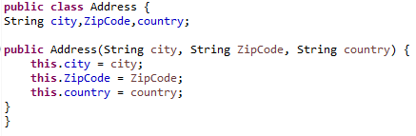
Example
Save as Address.java

Slide 29
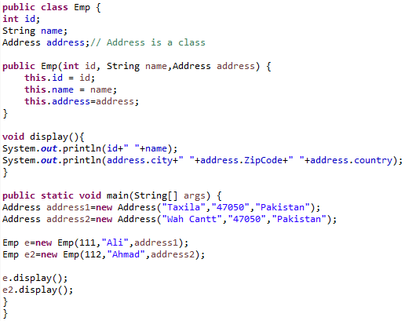
Employee Class (Emp.java)

Slide 30
Task
Question:
In inheritance, a subclass inherits all the members (fields, methods, and nested classes) from its superclass. Does it also inherit private members of superclass? What if some protected members are used in superclass?
Write a code to verify the response of members of both types.

Slide 31
Questions?

