Slide 1
Object Oriented Programming Lecture # 10

Slide 2
Topics To Be Covered Today
Polymorphism
Method Overloading
Method Overriding
Run-time polymorphism
Upcasting
Polymorphism in multilevel inheritance
Downcasting
Final keyword
Abstraction
Abstract Class
Abstract Method

Slide 3
Polymorphism
One task is performed in different ways. E.g: draw some shape, speak something etc.
A combination of inheritance and overriding
sub-classes retain flexibility to define their own methods, yet they still have to follow a consistent interface.
super-class defines common methods for sub-classes
sub-class provides specific implementations for some of the methods of the super-class
Achieved using:
Method overloading
Method overriding

Slide 4
Method overloading
If a class has multiple methods having same name but different in parameters.
Why overloading?
Suppose, you have to perform addition of the given numbers but there can be any number of arguments
Different methods for different number of parameter???
NO. it will be difficult to understand the behavior of the method because its name differs.
Perform method overloading to figure out the program quickly.
Advantage: increases the readability of the program.

Slide 5
ways to overload the method
There are two ways to overload the method in java
By changing number of parameters
By changing the data type

Slide 6
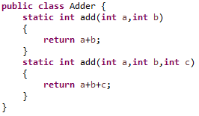
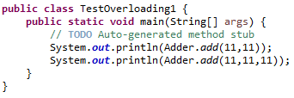
1) Method Overloading: changing no. of arguments

Slide 7
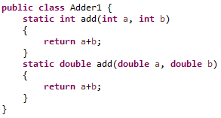
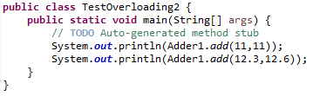
2) Method Overloading: changing data type of arguments

Slide 8
Rule
In java, Method Overloading is not possible by changing the return type of the method only.
Why???

Slide 9
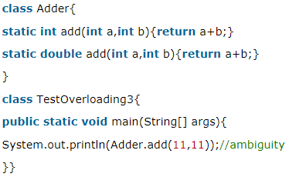
Example
how can java determine which sum() method should be called?
Notes:
Compile-time error: method add(int,int) is already defined in class Adder

Slide 10
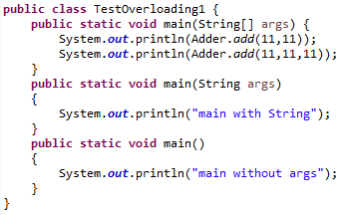
Q) Can we overload java main() method?
Yes, by method overloading. You can have any number of main methods in a class by method overloading.
But JVM calls main() method which receives string array as arguments only

Slide 11
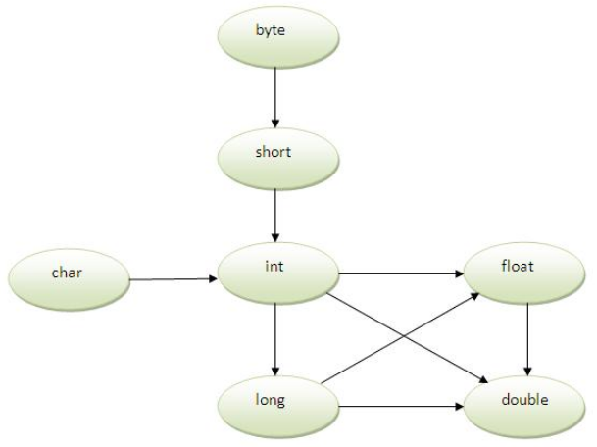
Method Overloading and Type Promotion
One type is promoted to another implicitly if no matching datatype is found.
Notes:
byte can be promoted to short, int, long, float or double.
The short datatype can be promoted to int,long,float or double.
The char datatype can be promoted to int,long,float or double and so on.

Slide 12
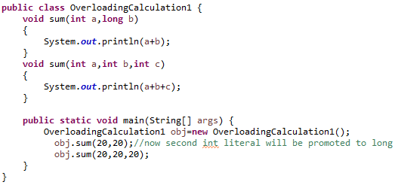
Example

Slide 13
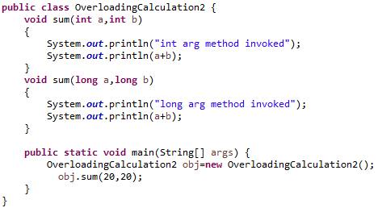
Method Overloading with Type Promotion if matching found
Which sum method will be called ???

Slide 14
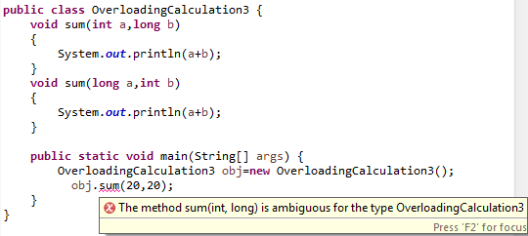
Method Overloading with Type Promotion in case of ambiguity
If there are no matching type arguments in the method, and each method promotes similar number of arguments, there will be ambiguity.

Slide 15
Rule:
“One type is not de-promoted implicitly.”
For example: double cannot be de-promoted to any type implicitly.

Slide 16
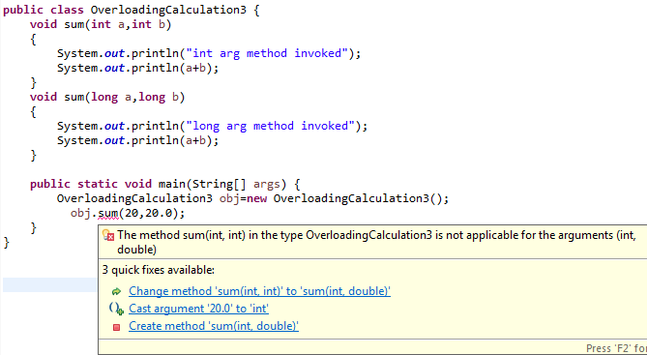
Example (Explicit De-promotion)
obj.sum(20,(int) 20.0);

Slide 17
Method Overriding
If subclass (child class) has the same method as declared in the parent class
if subclass provides the specific implementation of the method that has been provided by one of its parent class
Usage: Method overriding is used:
to provide specific implementation of a method that is already provided by its super class.
for runtime polymorphism

Slide 18
Rules for Java Method Overriding
method must have same name as in the parent class
method must have same parameter as in the parent class.
must be IS-A relationship (inheritance).

Slide 19
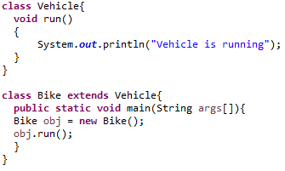
problem without method overriding
Problem is that I have to provide a specific implementation of run() method of Bike, use method overriding.

Slide 20
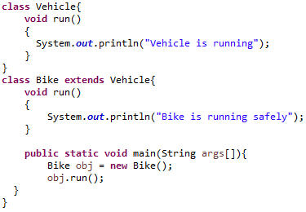
Example (method overriding)
Overriding:
The name and parameter of the method is same
there is IS-A relationship between the classes
Super keyword used to access super class method

Slide 21
Questions
Can we override static method?
No, static method cannot be overridden.
Why we cannot override static method?
because static method is bound with class whereas instance method is bound with object. Static belongs to class area and instance belongs to heap area.
Can we override java main method?
No, because main is a static method.

Slide 22
Overloading VS Overriding
used to increase the readability of the program.
performed within class.
parameters must be different.
Compile time polymorphism
Return type can be same or different
can't be performed by changing return type of the method only.
used to provide the specific implementation of the method that is already provided by its super class.
occurs in two classes that have IS-A (inheritance) relationship.
parameters must be same.
Run time polymorphism.
Return type must be same or covariant
Q) what is covariant return type?
Method Overloading
Method Overriding

Slide 23
Polymorphism in Java
polymorphism means many forms
derived from 2 greek words
poly and morphs. "poly" means many and "morphs" means forms
Two types of polymorphism in java
Compile time polymorphism
Static binding, Early binding and overloading as well.
Run-time polymorphism (Dynamic Method Dispatch)
Dynamic binding, Late binding and overriding as well.
we will focus on runtime polymorphism in java.
Notes:
https://freefeast.info/difference-between/difference-between-runtime-polymorphism-and-compile-time-polymorphism/
https://beginnersbook.com/2013/04/runtime-compile-time-polymorphism/

Slide 24
Runtime Polymorphism in Java
a process in which a call to an overridden method is resolved at runtime rather than compile-time.
an overridden method is called through the reference variable of a superclass
The determination of the method to be called is based on the object being referred to by the reference variable.
Upcasting ???

Slide 25
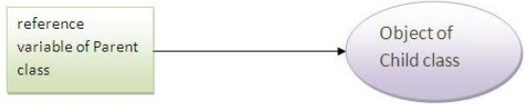
Upcasting
When reference variable of Parent class refers to the object of Child class, it is known as upcasting
class A {}
class B extends A{}
A a=new B(); // Upcasting

Slide 26
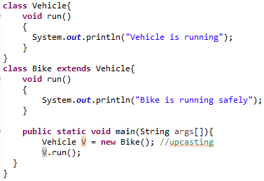
Example

Slide 27
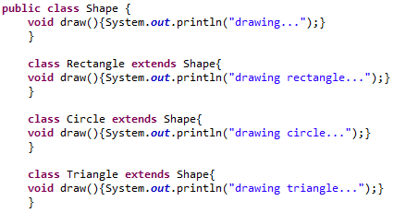
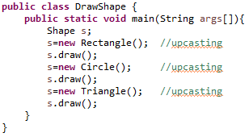
Java Runtime Polymorphism Example: Shape

Slide 28
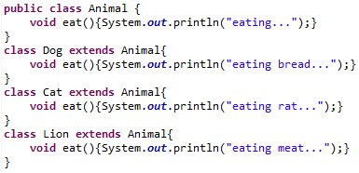
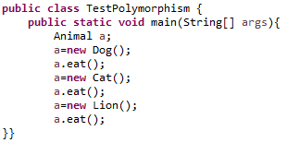
Another Example: Animal

Slide 29
Question
Can we perform Java Runtime Polymorphism with Data Member ?
Answer: NO
Runtime polymorphism can't be achieved by data members.
Why???
because Method is overridden not the data members

Slide 30
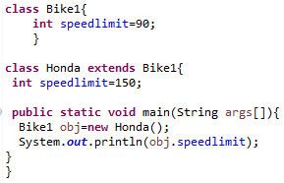
Example: Java Runtime Polymorphism with Data Member

Slide 31
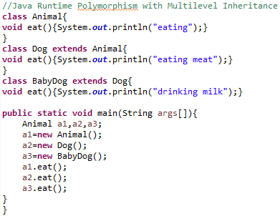
Java Runtime Polymorphism with Multilevel Inheritance

Slide 32
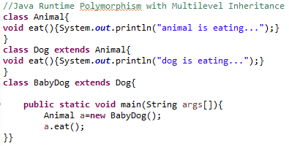
OUTPUT???
dog is eating...
Since, BabyDog is not overriding the eat() method, so eat() method of Dog class is invoked.

Slide 33
Downcasting
When Subclass type refers to the object of Parent class
Three possibilities of downcasting:
Perform it directly
Dog d=new Animal(); //Compilation error
perform it by typecasting
Dog d=(Dog)new Animal(); //Compiles successfully but ClassCastException is thrown at runtime
Downcasting is possible using instanceof operator

Slide 34

instanceof operator
used to test whether the object is an instance of the specified type (class or subclass or interface).

Slide 35
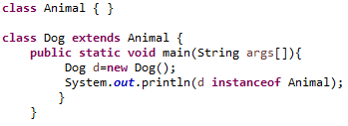
Object of subclass
An object of subclass type is also a type of parent class.
For example, if Dog extends Animal then object of Dog can be referred by either Dog or Animal class.

Slide 36
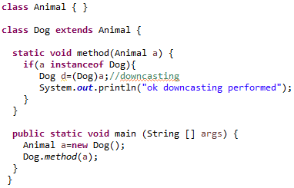
Downcasting with instanceof

Slide 37
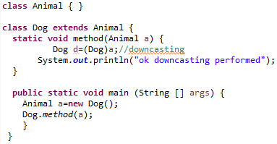
Downcasting without instanceof
Animal a=new Animal();
Dog.method(a);
//ClassCastException but not in case of instanceof

Slide 38
final keyword
The final keyword in java is used to restrict the user
Final can be:
Variable (stop value change)
blank or uninitialized final variable
final variable that have no value
can be initialized in the constructor only
can be static & initialized in the static block only.
Method (stop method overriding)
Class (stop Inheritance)

Slide 39
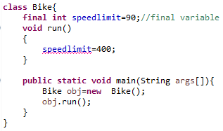


1) Java final variable
If you make any variable as final, you cannot change the value of final variable
It will be constant.
Notes:
Output:Compile Time Error
There is a final variable speedlimit, we are going to change the value of this variable, but It can't be changed because final variable once assigned a value can never be changed.

Slide 40
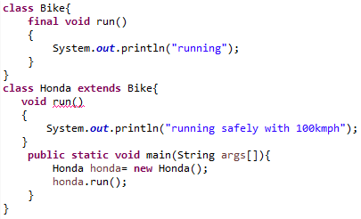

2) Java final method
If you make any method as final, you cannot override it.

Slide 41
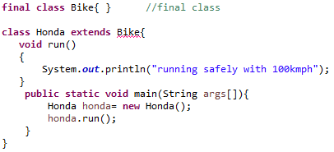


3) Java final class
If you make any class as final, you cannot extend it

Slide 42
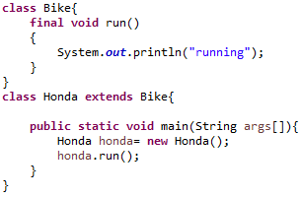
Q) Is final method inherited?
Yes, final method is inherited but you cannot override it.

Slide 43
Q) What is blank or uninitialized final variable?
A final variable that is not initialized at the time of declaration
Where It is useful ??
If you want to create a variable that is initialized at the time of creating object and once initialized may not be changed
For Example:
PAN number of an employee
class Student{
int id;
String name;
final String REG_NUMBER;
… ...
}
Notes:
Permanent Account Number is provided by Income tax department to every income tax payer.

Slide 44
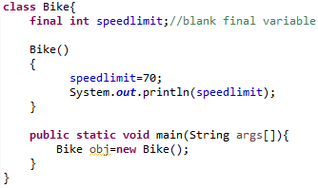
Q) Can we initialize blank final variable?
Yes, but only in constructor.

Slide 45
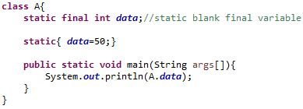
Q) What is static blank final variable? Where initialized?
A static final variable that is not initialized at the time of declaration
can be initialized only in static block.

Slide 46
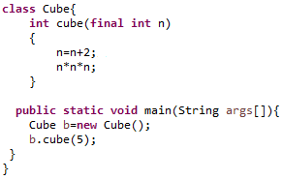
Q) What is final parameter?
If you declare any parameter as final, you cannot change the value of it.
//What if n=n+2 removed??
Notes:
Still Compilation error

Slide 47
Q) Can we declare a constructor final?
NO
Why?
Because constructor is never inherited.
Notes:
Constructor is like method, which is not inherited, so if a method is not inherited, its mean it cant be overidded, so no need to declare it as final

Slide 48
Abstraction
A process of hiding the implementation details and showing only functionality to the user.
it shows only important things to the user and hides the internal details
E.g. sending sms, you just type the text and send the message. You don't know the internal processing about the message delivery.
lets you focus on what the object does instead of how it does it.

Slide 49
Ways to achieve Abstraction
There are two ways to achieve abstraction in java
Abstract class (0 to 100%)
Interface (100%)

Slide 50
Abstract class
A class that is declared with abstract keyword
Abstract Class:
can have abstract and non-abstract methods (method with body).
if a class has at least one abstract method, then the class must be declared abstract.
cannot be instantiated.
needs to be extended and its method implemented.
abstract class A{}
Notes:
To use an abstract class, you have to inherit it from another class, provide implementations to the abstract methods in it.

Slide 51
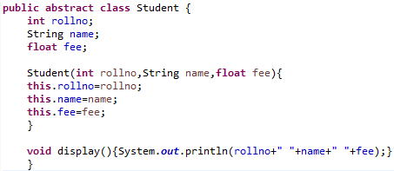
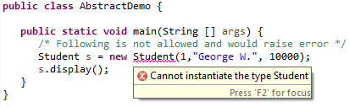
Example

Slide 52
Abstract Method
Inheritance allows a sub-class to override the methods of its super-class.
In fact, a super-class may altogether leave the implementation details of a method and declare such a method abstract:
abstract type name(parameter-list);
Two kinds of methods:
concrete – may be overridden by sub-classes
abstract – must be overridden by sub-classes
It is illegal to define abstract constructors or static methods.

Slide 53
Abstract Method
A method that is declared as abstract and does not have implementation is known as abstract method.
An abstract method
contains a method signature, but no method body.
Instead of curly braces, an abstract method will have a semi colon (;) at the end.
abstract void printStatus();//no body and abstract

Slide 54
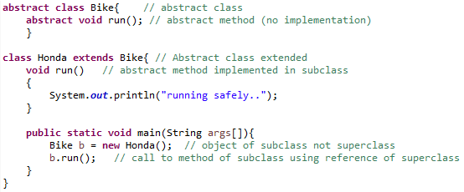
Example

Slide 55
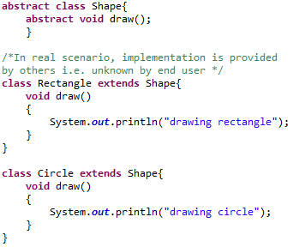

Another Example

Slide 56
Explanation
In this example:
Shape is the abstract class
Its implementation is provided by the Rectangle and Circle classes.
Mostly, we don't know about the implementation class (i.e. hidden to the end user) and object of the implementation class is provided by the factory method.
the method that returns the instance of the class
will learn about the factory method later.
if you create the instance of Rectangle class, draw() method of Rectangle class will be invoked.

Slide 57
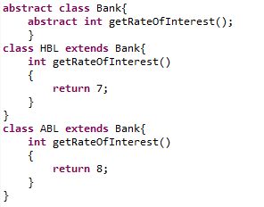
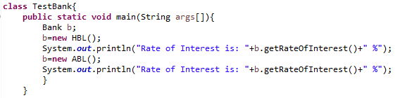
Real World Example (Bank)

Slide 58
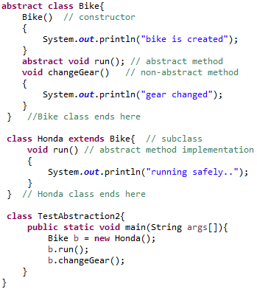
Abstract class having constructor, data member, methods etc.

Slide 59
Output??
class Bike {
abstract void run();
}
Rule:
If there is any abstract method in a class, that class must be abstract.

Slide 60
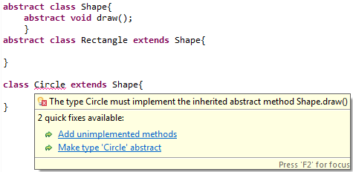
Rule:
If you are extending any abstract class that have abstract method, you must either provide the implementation of the method or make this class abstract.

Slide 61
Questions?

