Slide 1
Arrays ADT and
C++/java Implementation
Asim Rehan

Slide 2
Data Structures: Arrays(1)
An ordered set (sequence) with a fixed number of elements, all of the same type,
where the basic operation is
direct access to each element in the array so values can be retrieved from or stored in this element.

Slide 3
Data Structures: Arrays (2)
Properties:
  Ordered so there is a first element, a second one, etc.
  Fixed number of elements — fixed capacity
  Elements must be the same type (and size);
  ∴ use arrays only for homogeneous data sets.
  Direct access: Access an element by giving its location
    The time to access each element is the same for all elements, regardless of position – in contrast to sequential access (where to access an element, one must first access all those that precede it).

Slide 4
How well does C/C++ implement an array ADT?
    As an ADT In C++
ordered
fixed size
same type elements
direct access
indices numbered 0, 1, 2, . . ., CAPACITY - 1
CAPACITY specifies the capacity of the array
element_type is the type of elements
subscript operator []

Slide 5
Declaring arrays in C++
element_type array_name[CAPACITY];
where
element_type is any type
array_name is the name of the array — any valid identifier
CAPACITY (a positive integer constant) is the number of elements in the array
Can't input the capacity, Why?
The compiler reserves a block of “consecutive” memory locations, enough to hold CAPACITY values of type element_type.
score[0]
The elements (or positions) of the array are indexed 0, 1, 2, . . ., CAPACITY - 1.
score[1]
score[2]
score[3]
e.g., double score[100];
.
.
.
.
.
.
score[99]

Slide 6
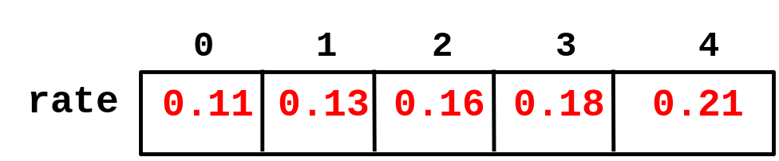
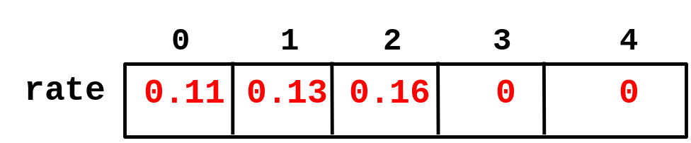
Array Initialization
In C++, arrays can be initialized when they are declared.
Numeric arrays:
element_type num_array[CAPACITY] = {list_of_initial_values};
Example:
double rate[5] = {0.11, 0.13, 0.16, 0.18, 0.21};
Note 1: If fewer values supplied than array's capacity, remaining elements assigned 0.
double rate[5] = {0.11, 0.13, 0.16};
Note 2: It is an error if more values are supplied than the declared size of the array.
How this error is handled, however, will vary from one compiler to another.

Slide 7
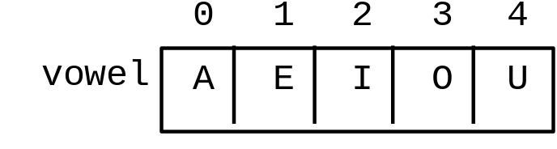
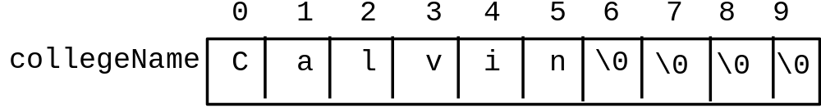
Character Arrays:
Character arrays may be initialized in the same manner as numeric arrays.
declares vowel to be an array of 5 characters and initializes it as follows:
char vowel[5] = {'A', 'E', 'I', 'O', 'U'};
Note 1: If fewer values are supplied than the declared size of the array,
the zeroes used to fill un-initialized elements are interpreted as the null character '\0' whose ASCII code is 0.
const int NAME_LENGTH = 10;
char collegeName[NAME_LENGTH]={'C', 'a', 'l', 'v', 'i', 'n'};

Slide 8
Addresses
When an array is declared, the address of the first byte (or word) in the block of memory associated with the array is called the base address of the array.
Each array reference must be translated into an offset from this base address.
For example, if each element of array score will be stored in 8 bytes and the base address of score is 0x1396. A statement such as
cout << score[3] << endl;
requires that array reference score[3]
be translated into a memory address:
score → 0x1396
[0]
[1]
[2]
0x1396 + 3 * sizeof (double)
= 0x1396 + 3 * 8
= 0x1396 + 0x18
= 0x13ae
score[3] →
0x13ae
[3]
.
.
.
.
.
.
[99]
The contents of the memory word with this address 0x13ae can then be retrieved and displayed.
An address translation like this is carried out each time an array element is accessed.

Slide 9
The value of array_name is actually the base address of array_name
array_name + index is the address of array_name[index].
An array reference array_name[index]
is equivalent to
*(array_name + index)
* is the dereferencing operator
*ref returns the contents of the memory location with address ref
    For example, the following statements of pseudocode are equivalent:
      print score[3]
print *(score + 3)
Why does an Array index start at zero (0)?

Slide 10
Pointers
What is a pointer?
How to access arrays using pointers?

Slide 11
Problems with Arrays
1. The capacity of Array can NOT change during program execution.
What is the problem?
Memory wastage
Out of range errors
2. Arrays are NOT self contained objects
What is the problem?
No way to find the last value stored.
Not a self contained object as per OOP principles.

Slide 12
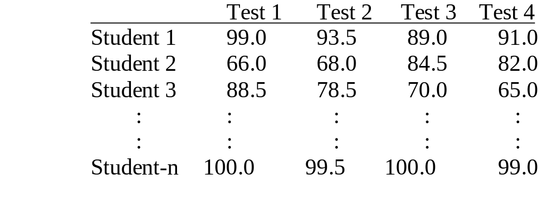
C++ Style Multidimensional Arrays
Most high level languages support arrays with more than one dimension.
2D arrays are useful when data has to be arranged in tabular form.
Higher dimensional arrays appropriate when several characteristics associated with data.
Example: A table of test scores for several different students on several different tests.
For storage and processing, use a two-dimensional array.

Slide 13
Declaring Two-Dimensional Arrays
Standard form of declaration:
element_type array_name[NUM_ROWS][NUM_COLUMNS];
[0] [1] [2] [3]
Example:
const int NUM_ROWS = 30,
NUM_COLUMNS = 4;
double scoresTable[NUM_ROWS][NUM_COLUMNS];
[0]
[1]
[2]
[3]
[29]
.
.
.
Initialization
♦ List the initial values in braces, row by row;
♦ May use internal braces for each row to improve readability.
Example:
double rates[][3] = {{0.50, 0.55, 0.53}, // first row
{0.63, 0.58, 0.55}}; // second row

Slide 14
Processing Two-Dimensional Arrays
♦ Remember: Rows (and) columns are numbered from zero!!
♦ Use doubly-indexed variables:
scoresTable[2][3] is the entry in row 3 and column 4
↑ ↑
 row index column index
Counting from 0
♦ Use nested loops to vary the two indices, most often in a row-wise manner.
♦ Dynamic two dimensional Arrays?

Slide 15
Higher-Dimensional Arrays
The methods for 2D arrays extend in the obvious way to 3D arrays.
Example: To store and process a table of test scores for several different
students on several different tests for several different semesters
const int SEMS = 10, STUDENTS = 30, TESTS = 4;
typedef double ThreeDimArray[SEMS][STUDENTS][TESTS];
ThreeDimArray gradeBook;
gradeBook[4][2][3]
is the score of 5th semester for student 3 on test 4
// number of semesters, students and tests all counted from zero!!

Slide 16
Arrays of Arrays
[0] [[1] [2] [3]
[0]
[1]
[2]
[3]
[29]
double scoresTable[30][4];
.
.
.
Declares scoresTable to be a one-dimensional array containing
30 elements, each of which is a one-dimensional array of 4 real numbers; that is,
scoresTable is a one-dimensional array of rows , each of which has 4
real values. We could declare it as
[0]
[1]
[2]
[3]
[29]
[0] [[1] [2] [3]
typedef double RowOfTable[4];
RowOfTable scoresTable[30];
.
.
.

Slide 17
In any case:
scoresTable[i] is the i-th row of the table
scoresTable[i][j] should be thought of as (scoresTable[i])[j]
that is, as finding the j-th element of scoresTable[i].
Address Translation:
The array-of-arrays structure of multidimensional arrays explains
address translation.
Suppose the base address of scoresTable is 0x12348:
[0]
[1]
[9]
[10]
scoresTable[10][3]
.
scoresTable[10]
→
0x12348 + 10*(sizeof RowOfTable)
.
.
.
.
.
= 0x12348 + 10 * (4 * 8)
scoresTable[10][3]
.
[3]
→
.
base(scoresTable[10]) + 3*(sizeof double)
.
= 0x12348 + 10 * (4 * 8) + 3 * 8
= 0x124a0
In general, an n-dimensional array can be viewed (recursively) as a
one-dimensional array whose elements are (n - 1)-dimensional arrays.

Slide 18
Implementing Multidimensional Arrays
More complicated than one dimensional arrays.
Memory is organized as a sequence of memory locations, and is thus 1D
How to use a 1D structure to store a MD structure?
A B C D
E F G H
I J K L
A character requires a single byte
Compiler instructed to reserve 12 consecutive bytes
Two ways to store consecutively i.e. rowwise and columnwise.

Slide 19
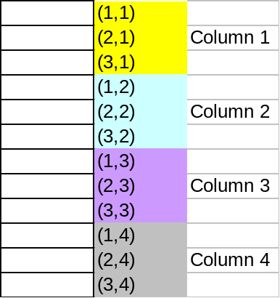
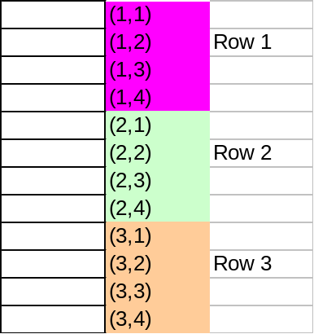
Two Dimensional Arrays in Memory
Two ways to be represented in memory
  Column by column → column majored
  Row by row → row majored
Representation depends upon the Programming language used

Slide 20
Analysis of Arrays
How to insert an item?
  How many steps in terms of N (number of elements in array)?
    N steps at maximum (move items to insert at given location)
How to delete an item?
  How many steps in terms of N (number of elements in array)?
    N steps at maximum (move items back to take place of deleted item)

Slide 21
java
java arrays are objects that are dynamically created.
In a true 2D array, all the elements of the array occupy a continuous block of memory, but that's not true in Java.
2D array is really an array of pointers, where each pointer can refer to a one-dimensional array.

Slide 22
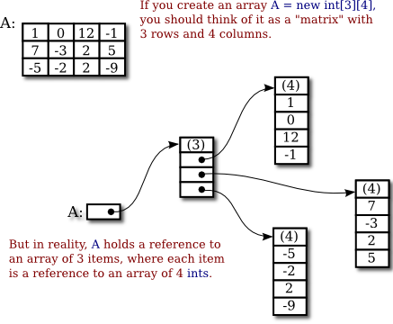

Slide 23
class MultidimensionalArray {
public static void main(String[] args) {
int[][] a = { {1, 2, 3}, {4, 5, 6, 9}, {7}, }; System.out.println("Length of row 1: " + a[0].length);
System.out.println("Length of row 2: " + a[1].length);
System.out.println("Length of row 3: " + a[2].length);
}
}

Slide 24
Analysis of Arrays
How to search an item?
  Linear Search
  Binary Search

Slide 25
Questions?

