Slide 1
Stacks
Asim Rehan
NUML

Slide 2
Stacks
“A Stack is a special kind of list in which all insertions and deletions take place at one end, called the Top”
Other Names
Pushdown List
Last In First Out (LIFO)

Slide 3

Stacks (examples)
Books on a floor
Dishes on a shelf

Slide 4
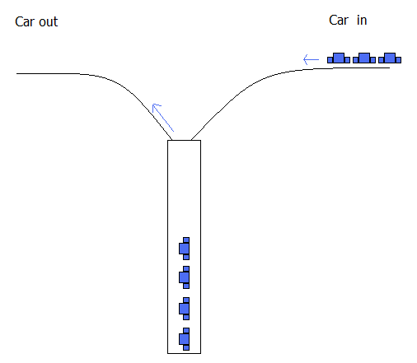
Stacks (examples)
Is there an appropriate data type to model this parking lot???

Slide 5
Use of Stack in Function calls
Whenever a function begins execution, an activation record is created to store the current environment for that function
Current environment includes the
  values of its parameters,
  contents of registers,
  the function’s return value,
  local variables
  address of the instruction to which execution is to return when the function finishes execution (If execution is interrupted by a call to another function)

Slide 6
Use of Stack in Function calls
Functions may call other functions and thus interrupt their own execution, some data structure must be used to store these activation records so they can be recovered and the system can be reset when a function resumes execution
It is the fact that the last function interrupted is the first one reactivated
A stack is the appropriate structure, and since it is manipulated during execution, it is called the run-time stack

Slide 7
Consider the following program
int main(){
int a=3;
f1(a); // statement A
cout << endl;
}
void f1(int x){
cout << f2(x+1); // statement B
}
int f2(int p){
int q=f3(p/2); // statement C
return 2*q;
}
int f3(int n){
return n*n+1;
}

Slide 8
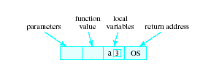
Run-time Stack
OS denotes that when execution of main() is completed, it returns to the operating system

Slide 9
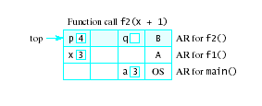
Use of Run-time Stack
When a function is called …
Copy of activation record pushed onto run-time stack
Arguments copied into parameter spaces
Control transferred to starting address of body of function

Slide 10
Stacks (examples)
In general
  A Stack is a special kind of list in which all insertions and deletions take place at one end, called the Top
  Last In First Out (LIFO)

Slide 11
Common Operations on Stacks
MAKENULL(S): Make Stack S be an empty stack.
TOP(S): Return the element at the top of stack S.
POP(S): Remove the top element of the stack.
PUSH(S,x): Insert the element x at the top of the stack.
EMPTY(S): Return true if S is an empty stack; return false otherwise.

Slide 12
Static and Dynamic Stacks
There are two kinds of stack data structure -
  a) static, i.e. they have a fixed size, and are implemented as arrays.
  b) dynamic, i.e. they grow in size as needed, and implemented as linked lists

Slide 13
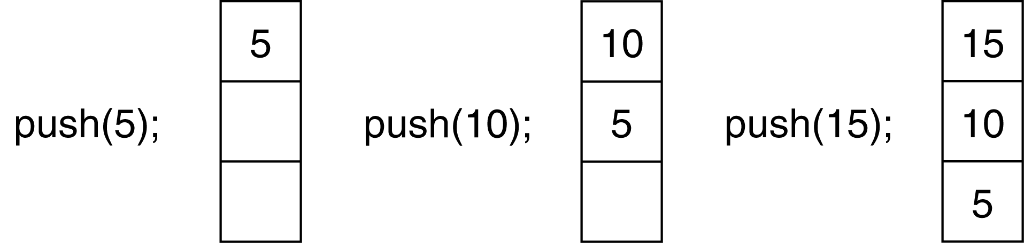
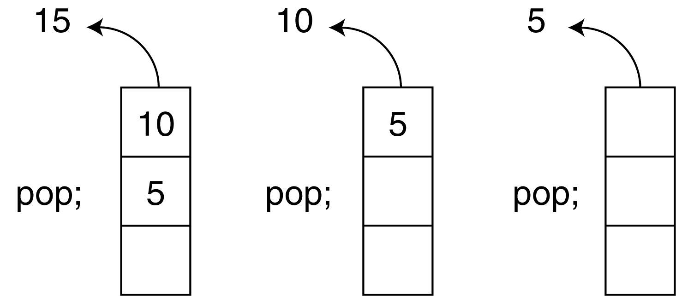
Push and Pop operations of Stack

Slide 14
An Array Implementation of Stacks
First Implementation
Elements are stored in contiguous cells of an array.
New elements can be inserted to the top of the list.
top
First Element
Second Element
List
Last Element
Empty
maxlength

Slide 15
An Array Implementation of Stacks
1
2
3
2
1
2
1
1
Problem with this implementation
Every PUSH and POP requires moving the entire array up and down.

Slide 16
An Array Implementation of Stacks
Since, in a stack the insertion and deletion take place only at the top, so…
A better Implementation:
Anchor the bottom of the stack at the bottom of the array
Let the stack grow towards the top of the array
Top indicates the current position of the first stack element.

Slide 17
An Array Implementation of Stacks
A better Implementation:
top
1
2
First Element
Second Element
.
.
maxlength
Last Element

Slide 18
A Stack Class
#ifndef INTSTACK_H
#define INTSTACK_H
class IntStack
{
private:
int *stackArray;
int stackSize;
int top;
public:
IntStack(int);
void push(int);
void pop(int &);
bool isFull(void);
bool isEmpty(void);
};
#endif

Slide 19
Implementation
//*******************
// Constructor *
//*******************
IntStack::IntStack(int size)
{
stackArray = new int[size];
stackSize = size;
top = -1;
}

Slide 20
Push
// Member function push pushes the argument onto
// the stack
void IntStack::push(int num)
{
if (isFull())
cout << "The stack is full.\n";
else
{
top++;
stackArray[top] = num;
}
}

Slide 21
// Member function pop pops the value at the top
// of the stack off, and copies it into the variable
// passed as an argument.
void IntStack::pop(int &num)
{
if (isEmpty())
cout << "The stack is empty.\n";
else
{
num = stackArray[top];
top--;
}
}

Slide 22
//***************************************************
// Member function isFull returns true if the stack *
// is full, or false otherwise. *
//***************************************************
bool IntStack::isFull(void)
{
bool status;
if (top == stackSize - 1)
status = true;
else
status = false;
return status;
// return (top == stackSize-1);
}

Slide 23
//**********************************************
// Member funciton isEmpty returns true if the //stack *
// is empty, or false otherwise.*
//***********************************************
bool IntStack::isEmpty(void)
{
bool status;
if (top == -1)
status = true;
else
status = false;
return status;
// return (top == -1);
}

Slide 24
// This program demonstrates the IntStack class.
#include <iostream.h>
#include "intstack.h“
void main(void)
{
IntStack stack(5);
int catchVar;
cout << "Pushing 5\n";
stack.push(5);
cout << "Pushing 10\n";
stack.push(10);
cout << "Pushing 15\n";
stack.push(15);
cout << "Pushing 20\n";
stack.push(20);
cout << "Pushing 25\n";
stack.push(25);

Slide 25
cout << "Popping...\n";
stack.pop(catchVar);
cout << catchVar << endl;
stack.pop(catchVar);
cout << catchVar << endl;
stack.pop(catchVar);
cout << catchVar << endl;
stack.pop(catchVar);
cout << catchVar << endl;
stack.pop(catchVar);
cout << catchVar << endl;
}

Slide 26
Program Output
Pushing 5
Pushing 10
Pushing 15
Pushing 20
Pushing 25
Popping...
25
20
15
10
5
Note the sequence !

Slide 27
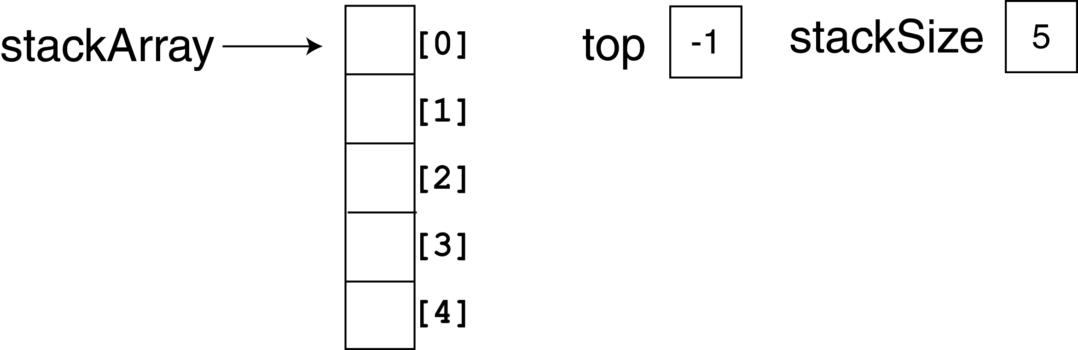
About Program 1
In the program, the constructor is called with the argument 5. This sets up the member variables as shown in Figure 1. Since top is set to –1, the stack is empty

Slide 28
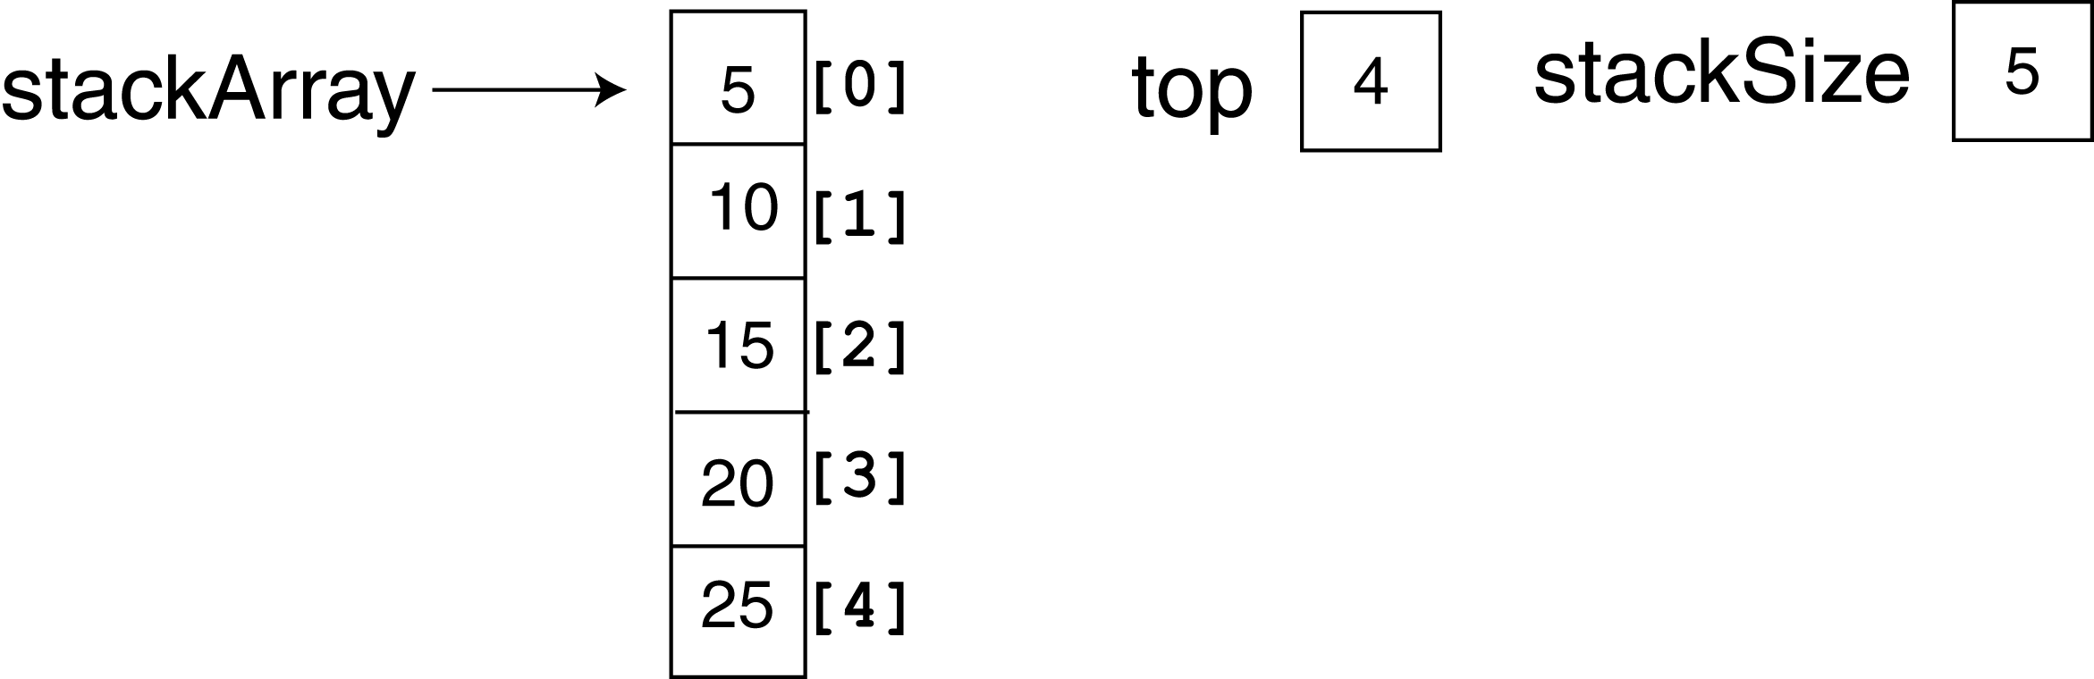
Figure below shows the state of the member variables after all five calls to the push function. Now the top of the stack is at element 4, and the stack is full.

Slide 29
Notice that the pop function uses a reference
parameter, num.
The value that is popped off the stack is copied into
num so it can be used later in the program.

Slide 30
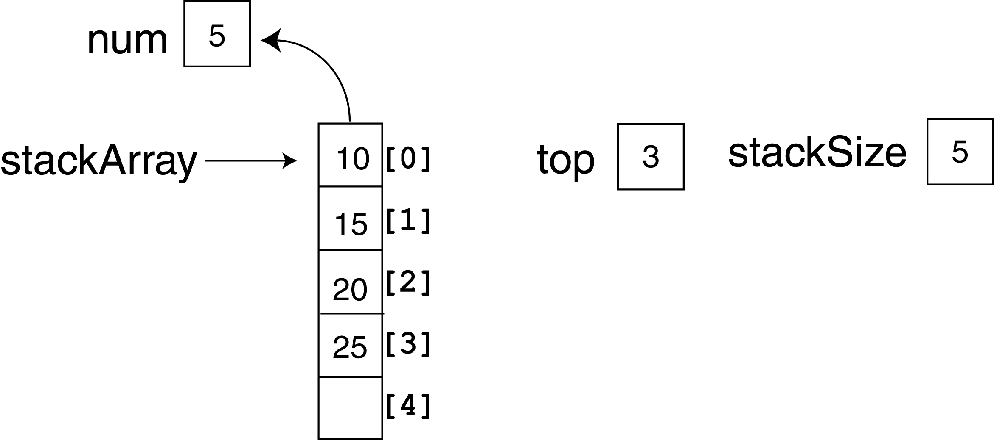
Figure depicts the state of the class members, and the num parameter, just after the first value is popped off the stack.

Slide 31
Stack Templates
The stack class so far work with integers only. A stack template can be used to work with any data type.

Slide 32
A Linked-List Implementation of Stacks
Stack can expand or shrink with each PUSH or POP operation.
PUSH and POP operate only on the header cell and the first cell on the list.
.
Top
x
y
z

Slide 33
Linked List Implementation of Stack
class Stack
{
struct node
{
int data;
node *next;
}*top;
public:
void Push(int newelement);
void Pop(int &);
bool IsEmpty();
};

Slide 34
void Stack::Push(int newelement)
{
node *newptr;
newptr=new node;
newptr->data=newelement;
newptr->next=top;
top=newptr;
}
void Stack:Pop(int& returnvalue)
{
if (IsEmpty()) { cout<<“underflow error”; return;}
tempptr=top;
returnvalue=top->data;
top=top->next;
delete tempptr;
}

Slide 35
void Stack::IsEmpty()
{
if (top==NULL) return true;
else return false;
}

Slide 36
Program 3
// This program demonstrates the dynamic stack
// class DynIntClass.
#include <iostream.h>
#include "dynintstack.h“
void main(void)
{
DynIntStack stack;
int catchVar;
cout << "Pushing 5\n";
stack.push(5);
cout << "Pushing 10\n";
stack.push(10);
cout << "Pushing 15\n";
stack.push(15);

Slide 37
cout << "Popping...\n";
stack.pop(catchVar);
cout << catchVar << endl;
stack.pop(catchVar);
cout << catchVar << endl;
stack.pop(catchVar);
cout << catchVar << endl;
cout << "\nAttempting to pop again... ";
stack.pop(catchVar);
}
Program Output
Pushing 5
Pushing 10
Pushing 15
Popping...
15
10
5
Attempting to pop again... The stack is empty.

