Slide 1
Trees
Asim Rehan
NUML

Slide 2
Trees
Non Linear Data Structure
Hierarchical data structure
Definition:
“Tree is a non-linear data structure which organizes data in hierarchical structure and this is a recursive definition”.
“Tree data structure is a collection of data (Node) which is organized in hierarchical structure recursively”
Examples:
  TOC in a book have a shallow tree structure
  A family tree
  Xml
  File System
Notes:
In linear data structure data is organized in sequential order (like one after the other) and in non-linear data structure data is organized in random order.
Pstree, facebook, databases, decision trees.

Slide 3
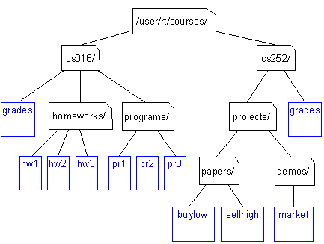
Unix / Windows file structure

Slide 4
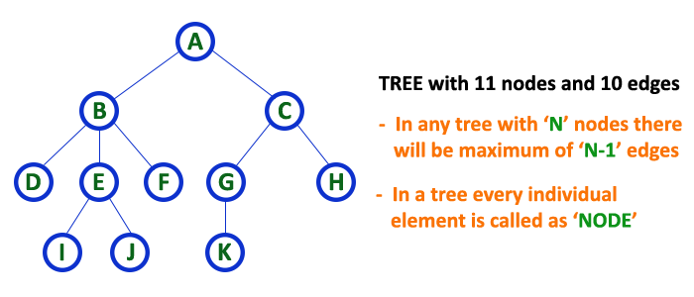
Trees: Basic terminology[1]
Hierarchical data structure
Each position in the tree is called a node
The “top” of the tree is called the root
Edge is the connecting link between the two nodes.
Notes:
Every tree must have a root node. We can say that the root node is the origin of the tree data structure.

Slide 5
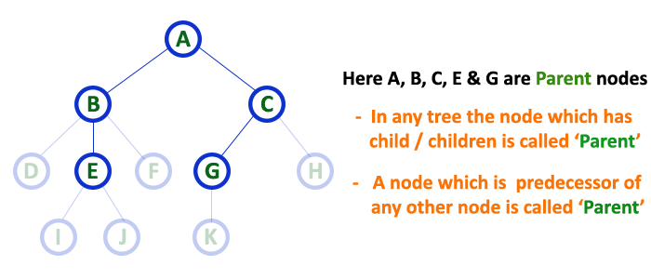
Parent: In a tree data structure, the node which is a predecessor of any node is called as PARENT NODE.
Child: In a tree data structure, the node which is descendant of any node is called as CHILD Node.
Leaf: In a tree data structure, the node which does not have a child is called as LEAF Node.

Slide 6
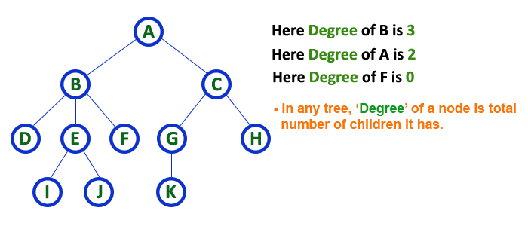
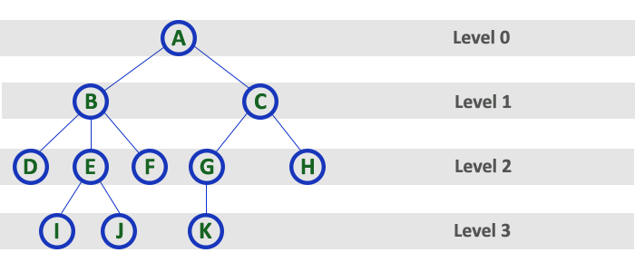
Degree: In a tree data structure, the total number of children of a node is called as DEGREE of that Node.
Level: in a tree each step from top to bottom is called as a Level and the Level count starts with '0' and incremented by one at each level (Step).
Notes:
In simple words, the Degree of a node is total number of children it has. The highest degree of a node among all the nodes in a tree is called as 'Degree of Tree

Slide 7
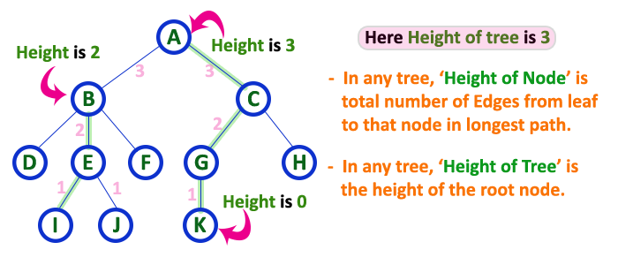
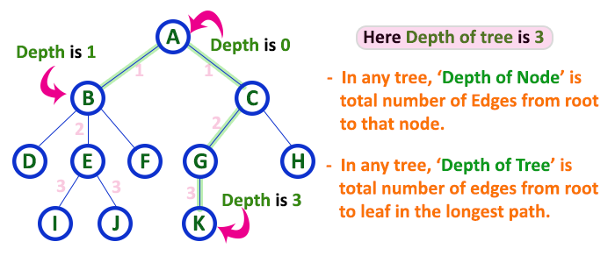
Height: In a tree data structure, the total number of edges from leaf node to a particular node in the longest path is called as HEIGHT of that Node.
Depth: In a tree data structure, the total number of edges from root node to a particular node is called as DEPTH of that Node.

Slide 8
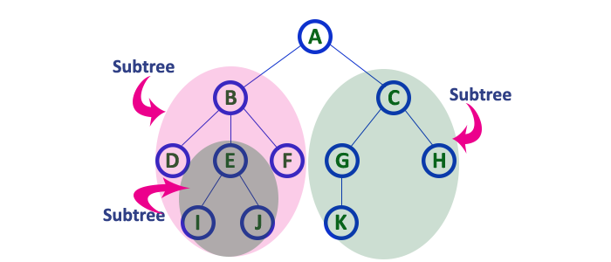
Sub Tree: In a tree data structure, each child from a node forms a subtree recursively. Every child node will form a subtree on its parent node.
Notes:
Tree is a recursive data structure because it is make of small but same data structure.

Slide 9
BINARY TREES

Slide 10
Binary Trees
A commonly used type of tree is a binary tree
Each node has at most two (bi) children
The “tree” is a conceptual structure
The data can be stored either in
  a dynamic linked tree structure, or
  in contiguous memory cells (array) according to a set pattern;
In other words, implementation can be pointer-based or array-based

Slide 11
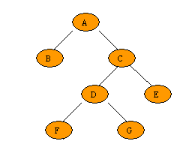
Binary Trees -Types
A Strictly binary tree / 2-tree / Full Binary Tree : Is a tree in which every node other than the leaves has two children. Or, perhaps more clearly, every node in a binary tree has exactly (strictly) 0 or 2 children.

Slide 12
Binary Trees -Types
A Complete binary tree is a binary tree in which each node must have 2 children and all terminal must be at same level. Complete binary tree is also called as Perfect Binary Tree
  Example?
  A family tree?
Notes:
Complete binary tree is also called as Perfect Binary Tree

