Slide 1
AVL Trees Georgy Adelson-Velsky and Landis' tree
NUML

Slide 2
AVL Tree: Balance Factor
The height of the left subtree minus the height of the right subtree of a node is called its balance factor. For an AVL tree, the balance factor of all nodes is always -1, 0 or 1.
The height of an empty tree is defined to be -1.

Slide 3
Node Height and Balance Factor
height of node = h
balance factor = h_{left} - h_{right}
empty height = -1
Tree A (AVL)
Tree B (AVL)
6
height=2 BF=1-0=1
6
1
0
4
9
4
9
0
0
1
5
-1
-1
1
5
8
-1
-1
-1
-1
-1
-1
-1
-1
-1
-1
-1

Slide 4
AVL Trees: Updates
Given an AVL tree, if insertions or deletions are performed, the AVL tree may not remain height balanced.

Slide 5
Node Heights after Insert 7
height of node = h
balance factor = h_{left} - h_{right}
empty height = -1
Tree A (AVL)
Tree B (not AVL)
3
balance factor
1-(-1) = 2
6
6
2
4
9
4
9
1
-1
1
5
7
1
5
8
0
7

Slide 6
AVL Tree Transformations
To maintain the height balanced property of the AVL tree after insertion or deletion, it is necessary to perform a transformation on the tree so that
1) in-order traversal of the transformed tree is the same as for the original tree (i.e., the new tree remains a binary search tree).
2) the tree after transformation is height balanced.

Slide 7
Insert and Rotation in AVL Trees
Insert operation may cause balance factor to become 2 or –2 for some node
Observations:
only nodes on the path from insertion point to root node have possibly changed in height
Follow the path up to the root, find the first node (i.e., deepest) whose new balance violates the AVL condition. Call this node ‘a’
If a new balance factor (the difference h_{left} - h_{right}) is 2 or –2, adjust tree by rotation around the node

Slide 8
Single Rotation in an AVL Tree
2
2
6
6
1
2
1
1
4
9
4
8
0
0
1
0
0
0
0
1
5
8
1
5
7
9
0
7

Slide 9
Left Rotation (LL) in an AVL Tree
b becomes the new root.
a takes ownership of b's left child as its right child, or in this case, null.
b takes ownership of a as its left child.
a
b
b
a
c
c

Slide 10
Right Rotation (RR) in an AVL Tree
b becomes the new root.
c takes ownership of b's right child, as its left child, or in this case, null.
b takes ownership of c, as it's right child.
c
b
b
a
c
a

Slide 11
Single Rotation may be Insufficient
a
c
a
Left
Right
c
c
a
b
b
b
c becomes the new root.
a takes ownership of c's left child as its right child, in this case, b.
c takes ownership of a as its left child.
a becomes the new root.
c takes ownership of a's right child as its left child, b.
a takes ownership of c as its right child.

Slide 12
Left-Right Rotation (LR) or "Double left"
a
a
b
Left
c
b
a
c
Right
b
c
perform a right rotation on the right subtree.
b becomes the new root.
a takes ownership of b's left child as its right child, in this case null.
b takes ownership of a as its left child.

Slide 13
Right-Left Rotation (RL) or "Double right"
c
c
b
Right
a
b
Left
a
c
b
a
perform a left rotation on the left subtree.
b becomes the new root.
c takes ownership of b's right child as its left child, in this case null.
b takes ownership of c as its right child.

Slide 14
Insert and Rotation in AVL Trees
Insert operation may cause balance factor to become 2 or –2 for some node
only nodes on the path from insertion point to root node have possibly changed in height
Follow the path up to the root, find the first node (i.e., deepest) whose new balance violates the AVL condition. Call this node a
If a new balance factor (the difference h_{left}-h_{right}) is 2 or –2, adjust tree by rotation around the node

Slide 15
How and when to rotate?
Let the node that needs rebalancing be a.
In general, violation may occur when an insertion into
There are 4 cases:
Outside Cases (require single rotation) :
1. Insertion into left subtree of left child of a (RR).
2. Insertion into right subtree of right child of a (LL).
Inside Cases (require double rotation) :
3. Insertion into right subtree of left child of a (RL).
4. Insertion into left subtree of right child of a (LR).

Slide 16
How and when to rotate?
IF tree is right heavy
{
IF tree's right subtree is left heavy
{
Perform Double Left rotation
}
ELSE {
Perform Single Left rotation
}
}
…
…
ELSE IF tree is left heavy
{
IF tree's left subtree is right heavy
{
Perform Double Right rotation
}
ELSE {
Perform Single Right rotation
}
}

Slide 17
Example: 3 2 1 4 5 6 7
construct binary search tree without height balanced restriction
depth of tree = 4

Slide 18
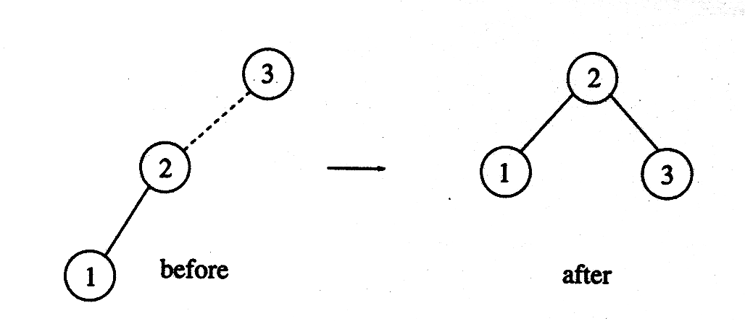
AVL Trees: Single Rotation
Construct AVL tree (height balanced)

Slide 19
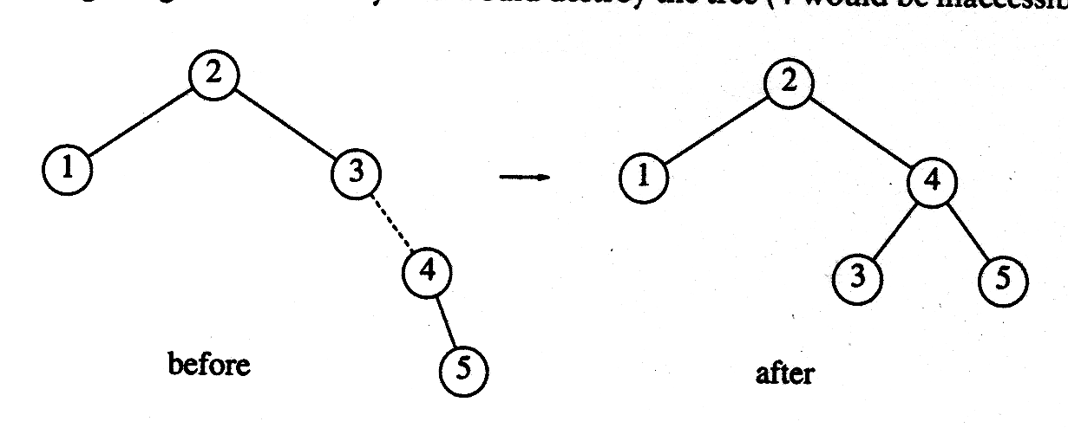
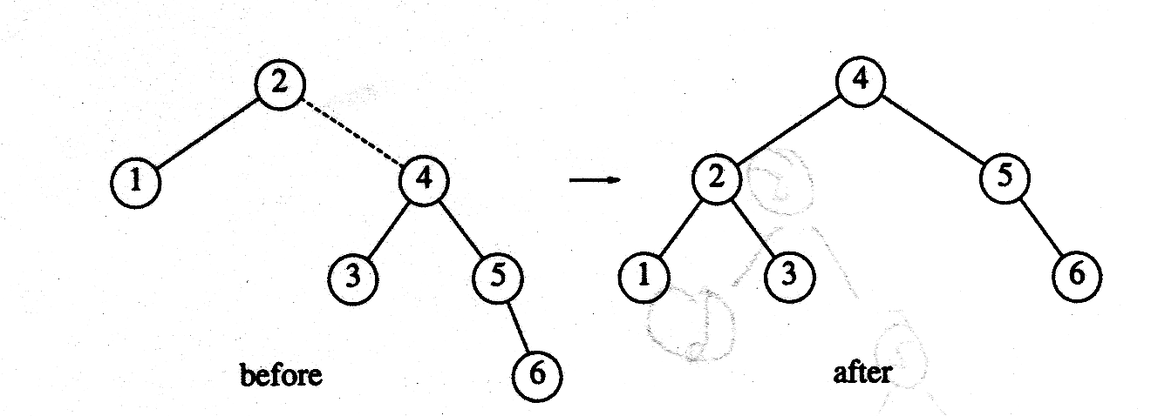
AVL Trees: Single Rotation
Insert 4, 5
Insert 6

Slide 20
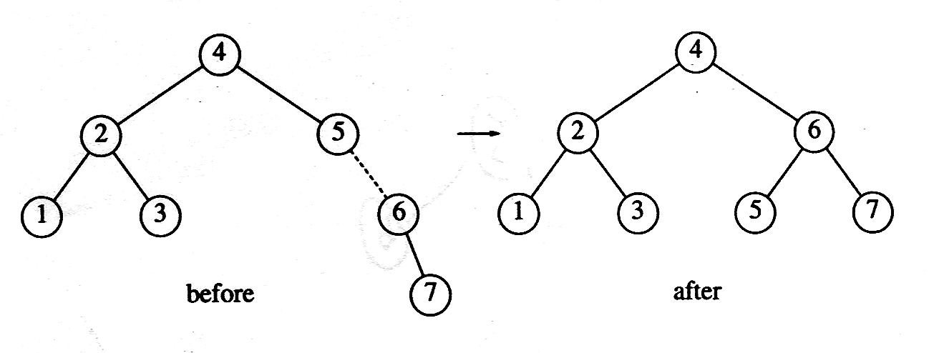
AVL Trees: Single Rotation
Insert 7

Slide 21
So far so good, what about inserting the following numbers
16, 15, 14, 13, 12, 11, 10, 8

