Slide 1
Rockbuster Strategic Insights
Prepared by Joseph Adamski

Slide 2
Executive Summary
Rockbuster's customer base is strongest in India, China, and the United States.
The most common film rating is PG-13, and average rental rate is $2.98.
Five top-paying customers brought in over $995 total revenue.
Strategic marketing in these regions could improve engagement and profits.

Slide 3
Film Data Summary (Task 3.6)
Average Rental Rate: $2.98
Average Replacement Cost: $19.98
Average Film Length: 115 minutes
Most Common Film Rating: PG-13

Slide 4
Customer Data Summary (Task 3.6)
Active Customers: 584
Inactive Customers: 15
Modal Store: Store 1
Customers are spread globally, with concentrations in several countries.

Slide 5
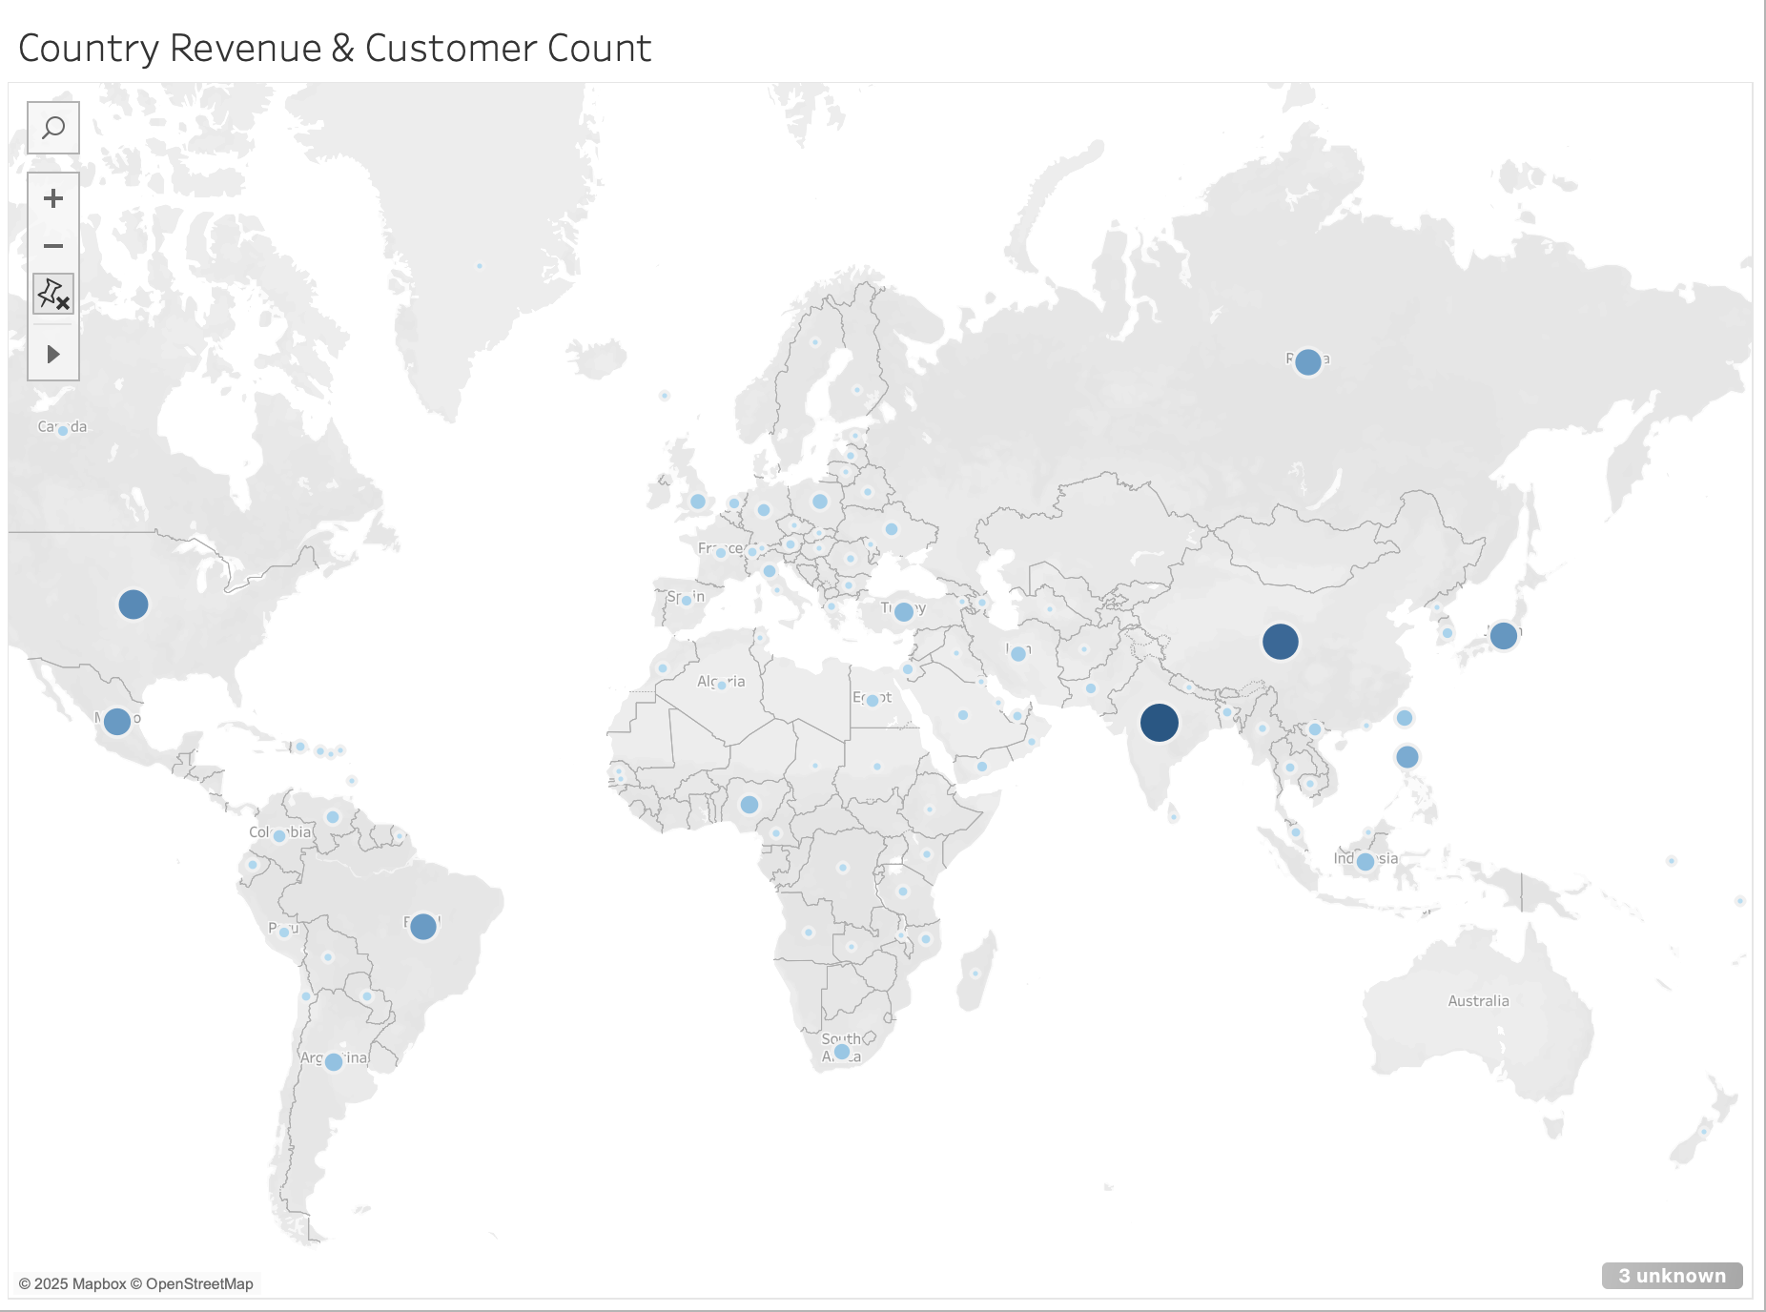
Map – Country Revenue & Customer Count

Slide 6
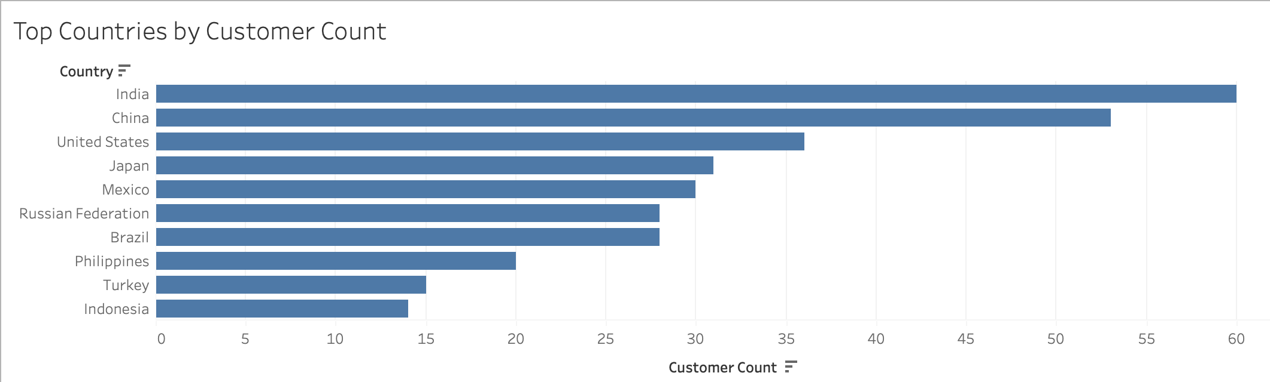
Top Countries by Customer Count

Slide 7
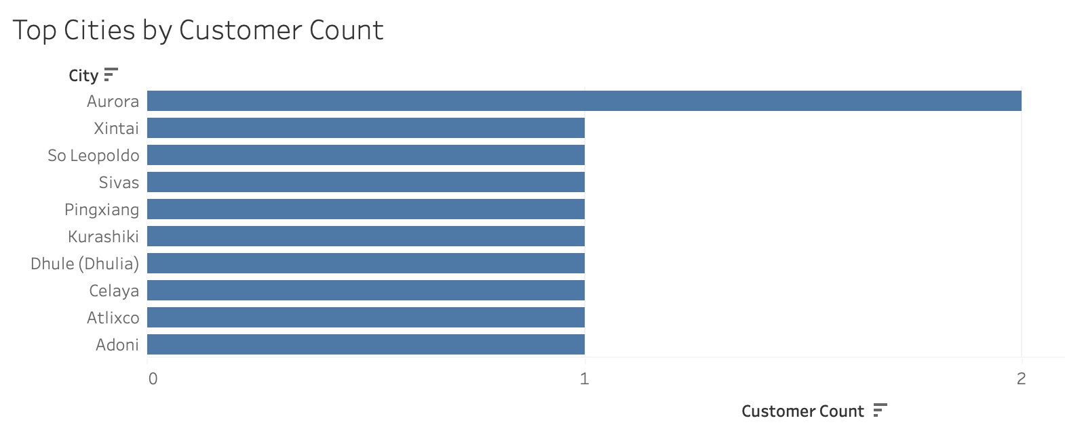
Top Cities by Customer Count

Slide 8
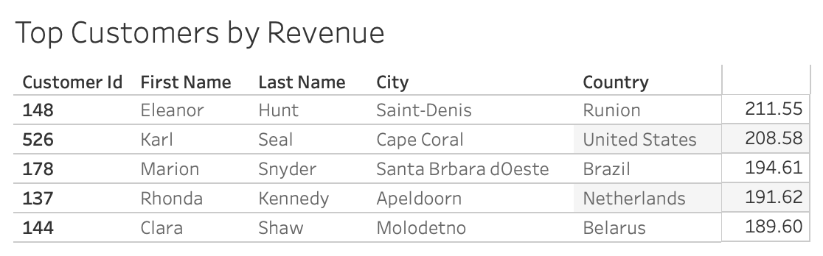
Top Customers by Revenue

Slide 9
Interactive Tableau Dashboard
https://public.tableau.com/app/profile/joseph.adamski/viz/3_10_tableau/Dashboard1?publish=yes

Slide 10
Business Recommendations
Focus marketing campaigns on top three countries: India, China, and the US.
Continue curating and promoting PG-13 films to align with viewer trends.
Create loyalty programs targeting high-revenue customers.
Explore growth opportunities in smaller cities with consistent engagement.

