Slide 1

Sheikh Samsuzzhan Alam Data Scientist ISRT, Batch 15

Slide 2
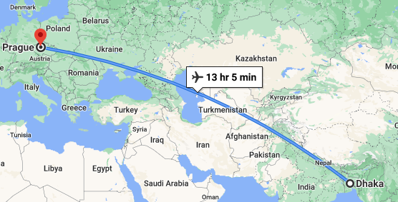
35° C → 5° C
Prague, Czech Republic

Slide 3
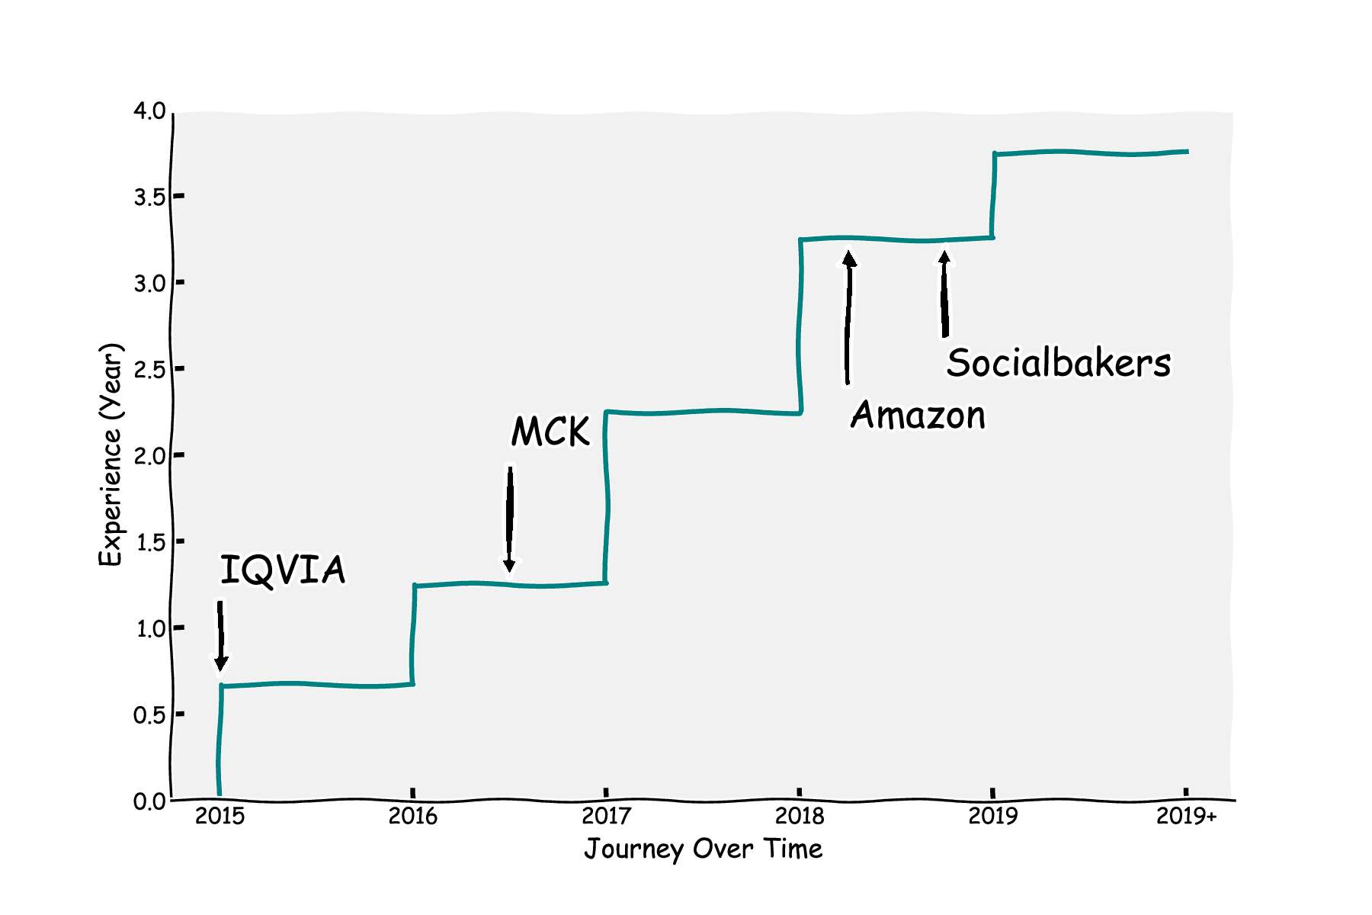





Data Science Dev.

Slide 4

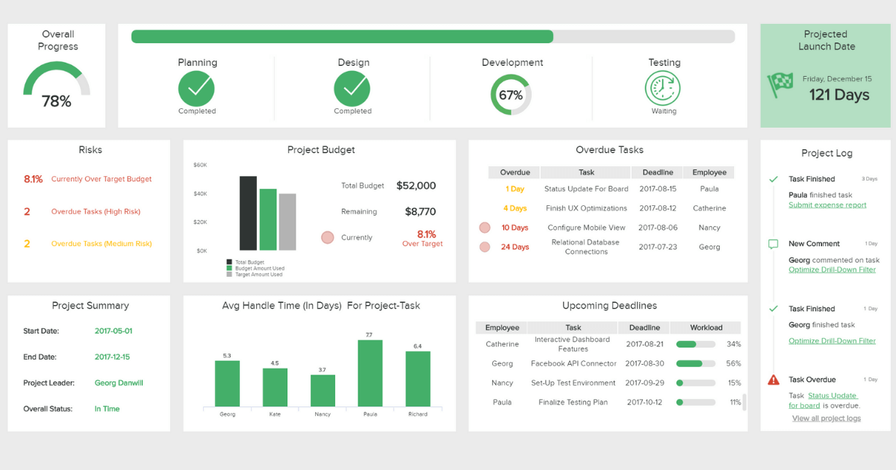
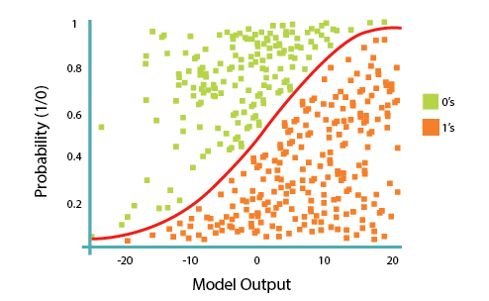
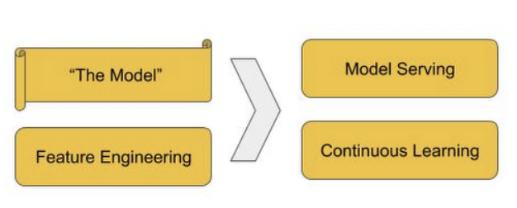





Data Team in Tech.
Head of Data and AI
Data Engineer
Data Analyst
Data Scientist
ML Engineer
AWS Cloud

Slide 5











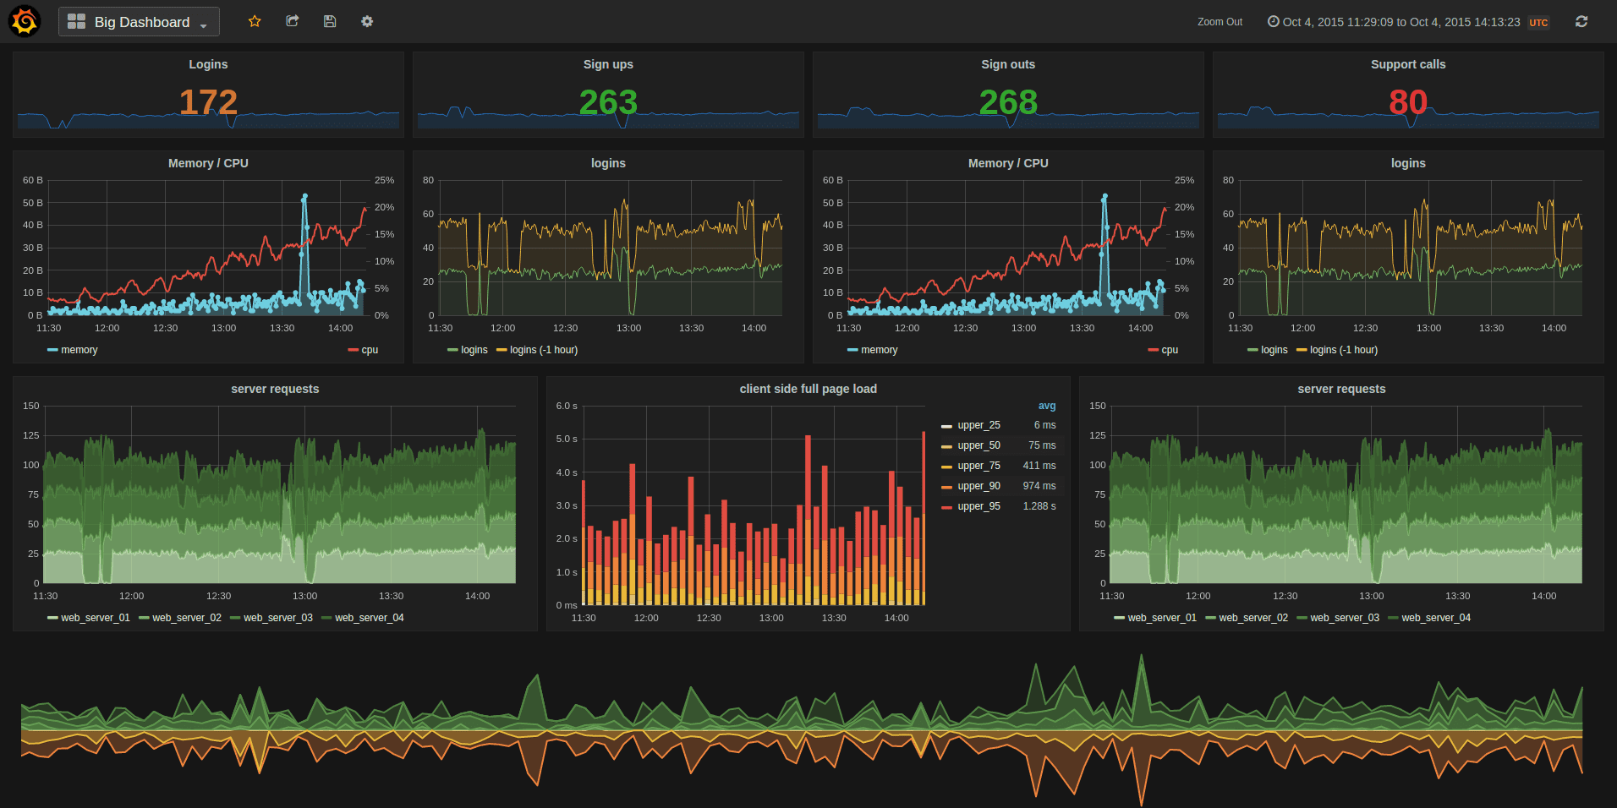

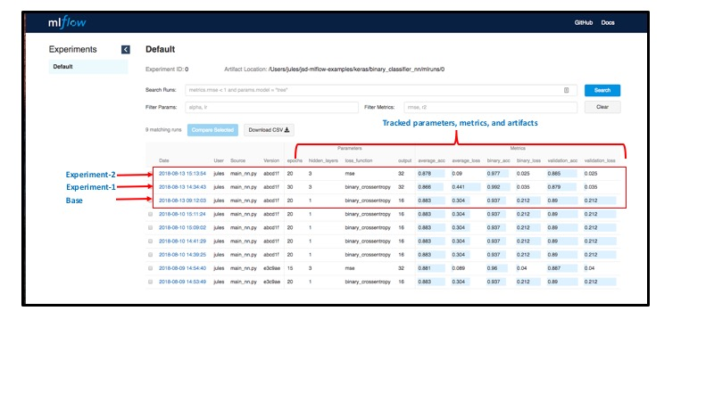


Language, Tools & Frameworks
Data Engineer
Data Analyst
Data Scientist
ML Engineer
***Where is Statistics?

Slide 6
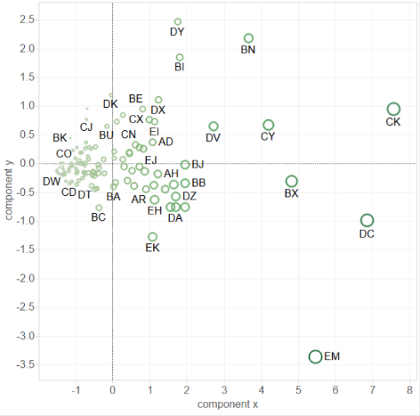
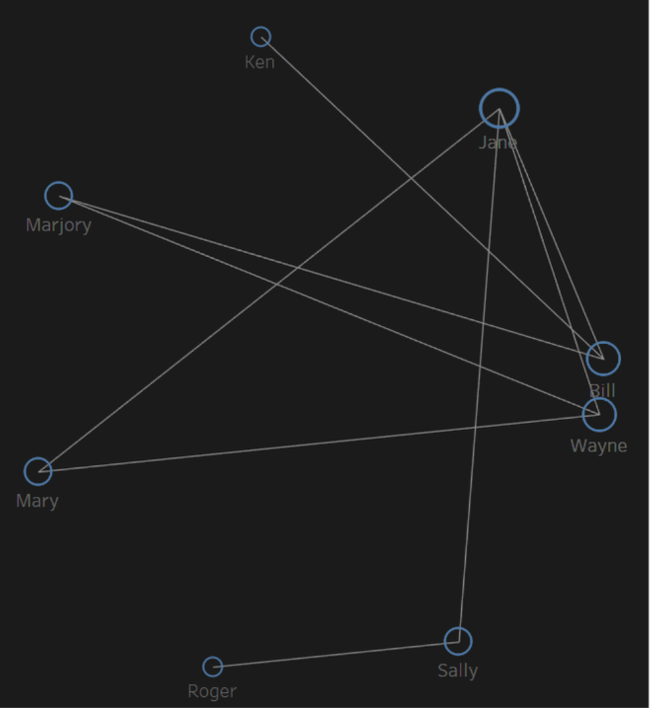
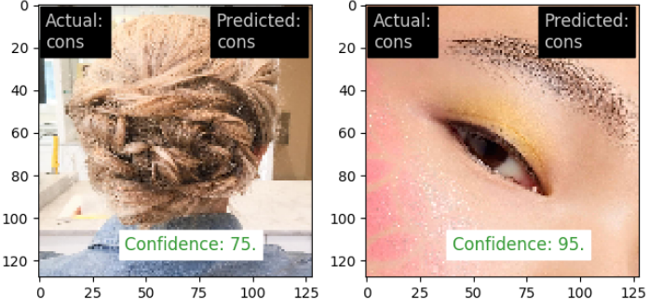
Industrial Projects

Slide 7
McKinsey: Time & Expense

Slide 8
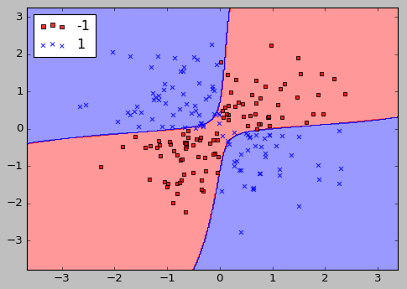
Socialbakers: Consumer Identification with Computer Vision

Slide 9


Things I could have done better during my study!

Slide 10

New Language on the Rise !

Slide 11
Demo !
An End to End Data Science Product
Code Repo: https://github.com/DataPsycho/isrt-ds-intro-2021

Slide 12

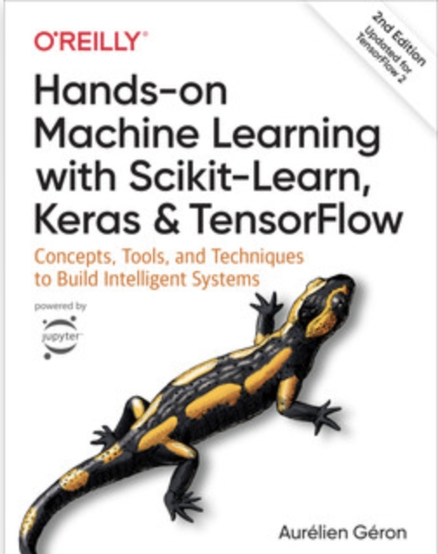
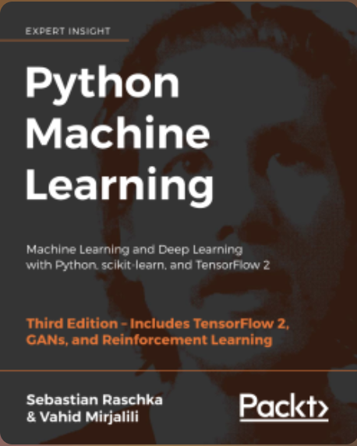
Becoming a Data Scientist: First Steps
Object Oriented Programing
Data Structures
Design pattern
Decorators
Class, Module, Packaging
Statistics and Visualization
Beginner Friendly, Hands On Exercise
Neural Network
Decision Support System
Application
Statistics and Visualization
Algorithms: Supervised and Un-Supervised
Neural Network
Advance Programming
Application

Slide 13


Q & A?
www.linkedin.com/in/sheikh-samsuzzhan-alam-7b5560a7
@MrDataPsycho

